Slide 1
Faculty Performance Evaluations
Dean Training
Tuesday, February 23rd 2021

Slide 2
Agenda
Introductions - Vanessa
Workflow Overview – Vanessa
Accessing the OnBase Workflow - Ted
Demo & Practice
Dean Workflow Queues – Ted
Evaluation Review Queue Demo
Evaluation Signature Queue Demo
Retrieving Final Evaluations – Vanessa & Ted
Additional Information – Melanie
Questions - Vanessa

Slide 3
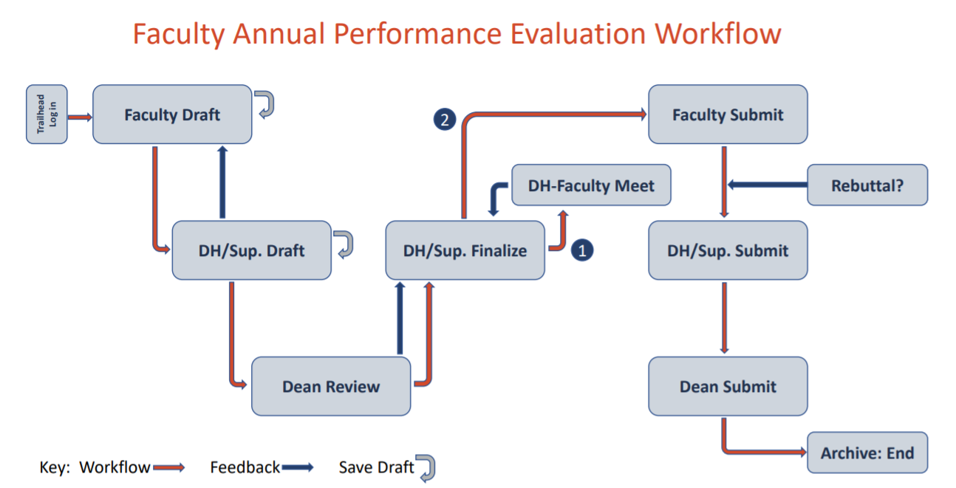
Workflow Overview
Deans have access to 2 Workflow Queues:

Slide 4
Workflow Overview: Initial Review
Evaluation Review Queue
“AA1: Dean Evaluation Review Queue”
Beginning of the process
Review Faculty evaluations following assessment by Department Heads
View-only access (feedback is shared outside of workflow)
Available action:
Route back to Department Head

Slide 5
Workflow Overview: Sign
Evaluation Signature Queue
“AA1: Dean Evaluation Signature Queue”
End of the process
Final review of evaluation signed by Faculty and Department Head
Evaluation may contain modifications from last review (including rebuttal statement if applicable)
Available action:
Sign and route evaluation to the Academic Affairs

Slide 6
Demo & Practice
Demo
Accessing the OnBase Workflow
Dean Workflow Queues
Evaluation Review Queue
Evaluation Signature Queue

Slide 7
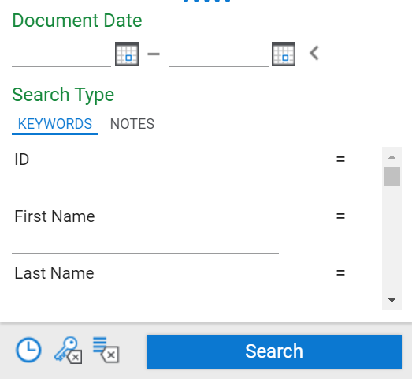
Retrieving Final Evaluations
Using Document Retrieval in OnBase
1. Using the waffle menu at the top left-hand corner of your screen, click Document Retrieval
2. Under the Document Type Group Academic Affairs, select the AA-Faculty Evaluations Document Type.
3. Enter search criteria using various keywords (i.e. name, department, supervisor, etc.) and click Search.

Slide 8
Demo & Practice
Document Retrieval

Slide 9
Additional Information
Dean feedback (given outside of workflow)
Editing privileges of submitted evaluations
Evaluation Review Queue – View only
Evaluation Signature Queue – View only
Review of feedback since go-live (i.e. FDR verbiage, library faculty, character limit increases)

Slide 10
Questions?

Slide 11
Faculty Performance Evaluations
Thank you!
https://www.mines.edu/academic-affairs/faculty-evaluation-resources/

