Slide 1
Faculty Workshop: Promotion and Tenure
Understanding the Process, Your Role In It, and Ensuring you have a Clear and Compelling Dossier
Hosted by: Rick Holz, Provost
University P&T Committee 2021-22: Chair, Amy Landis, Sumit Agarwal, Kip Findley, Doug Nychka, Piret Plink-Bjorklund, Manika Prasad, Ryan Richards
Last updated 4/4/2022

Slide 2
Intended Audience and Workshop Agenda
Workshop targeted to faculty who will applying for promotion & tenure
Agenda:
Promotion and Tenure Process Overview
Role of Departmental Promotion and Tenure Committee, DH, External letters
Promotion and Tenure Requirements
Research
Teaching
Service
UP&T Recommendations & Advice
Q&A

Slide 3
Ground Rules - RESPECT
Rule of three – 3 people speak before you
Expect to learn something about yourself & others
Speak clearly
Participate honestly & openly
Engage by listening and speaking
Concise – keep your comments succinct
Turn off your devices, put them all away!

Slide 4
Promotion and Tenure Process Overview*
August
DH Solicits External Reviews^
September
Department P&T Reviewsº
Candidate Submits Dossier (changing soon to July)
October
November
DH Reviewsº
Candidate Submits Addendum
Dean Reviews
December
University P&T Reviewsº
DH Shares Reviews with Candidate
January
Provost Reviews
February
Candidate May Submit ”Error in Fact”
March
Recommendations Submitted to President
April
* Defined in Section 8, Faculty Handbook
^ External letters of recommendation not disclosed to candidate
º Internal letters of recommendation available for candidate review
BoT Reviews & Approves
May

Slide 5
Role of the Departmental Committee
Defined in Section 8.1.3, Faculty Handbook
The Departmental Promotion and Tenure Committee reviews the promotion and/or tenure application taking into account the standards and practices of the Candidate’s discipline … and:
in relation to guidelines and criteria established by the institution, evaluate the Candidate's research contributions, teaching effectiveness, and service to both internal and external communities; and
make a written recommendation to the Department Head regarding the Candidate's progress toward, or suitability for promotion and/or tenure.
The Departmental Promotion and Tenure Committee shall determine the process followed in producing this recommendation.

Slide 6
Departmental Committee Operational Requirements and Recommendations
Committee Composition
By common practice, the Department Head appoints Chair and charges the Committee
All eligible faculty are required to participate except:
those on leave (i.e., medical, unpaid, or administrative), and
those on sabbatical (not required but may choose to participate)
Faculty eligibility is defined in Faculty Handbook (8.1.3, 8.2.2) and the Procedures Manual (6.1)
No department heads, no emeritus faculty, no transitional faculty

Slide 7
Departmental Committee Operational Requirements and Recommendations
Operations (Procedures Manual 6.1)
Committees may choose their own process procedures (e.g., when to meet, how to manage review of dossiers, voting, etc.)
Faculty with COIs should recuse themselves from discussion and voting of individual dossiers. Faculty with COI should disclose this to the Chair
With the exception of COIs, all faculty are expected to render an opinion on all candidates (no abstentions)
Only vote tally reported in recommendation letter(s).

Slide 8
Departmental Committee Operational Requirements and Recommendations
Departmental Committees must produce at least one formal recommendation letter for each candidate. This letter must:
Define the outcome of committee deliberations and document the vote tally supporting this outcome
Address if and then how the candidate meets the requirements for promotion and/or tenure as defined in the Handbook and Procedures Manual
Provide overall context of the standards commonly applied for promotion and/or tenure in the discipline
In the case of a split vote, an additional letter summarizing the dissenting view must also be produced and submitted to the DH

Slide 9
Departmental Committee Operational Considerations
Committee Meeting Notes, Drafts and Emails: May be subject to disclosure in response to public records requests or discovery requests in litigation. Recommend developing committee protocol for record retention after recommendation voted on and finalized in written form.
Confidentiality and Disclosures: Candidate is given Department and DH recommendations and has the opportunity to respond to correct factual errors. May seek additional information through post-review appeal process; however, no external letters or identities of external reviewers are provided to the candidate.

Slide 10
Promotion Requirements
Minimum qualifications of each faculty rank are defined in the Faculty Handbook, Section 4.1, 4.4 and 4.5
Additional considerations are defined in the Faculty Handbook, Sections 8.1.7 and 8.2.1. For T/TT faculty, the criteria are summarized as follows:
“Promotion in rank at Mines for tenured and tenure-track faculty is based on the quality of a faculty member's overall performance in teaching, scholarship, and service, and the likelihood of continued growth in their accomplishments and their professional reputations nationally and internationally.”
Notes:
While Teaching faculty criteria are more clearly defined, promotion criteria as defined in the Handbook are vague. (marked for deletion by Anne)

Slide 11
Tenure Requirements
Criteria for tenure are set forth in the Faculty Handbook, Section 8.1.2:
The factors that shall be considered by Mines in making a tenure decision shall include, but not be limited to, the following:
the Candidate's academic degree and other professional attainments;
the quality and trajectory of the Candidate's performance in teaching, scholarship and service;
the likelihood that the Candidate will continue to produce at or above his or her current level and continue to grow professionally;
the Candidate's progress toward establishment of a national and international professional recognition;
the Candidate's potential for achievement of greater professional recognition; and
the compatibility of the Candidate's academic expertise with the long-term, programmatic goals and requirements of Mines.

Slide 12
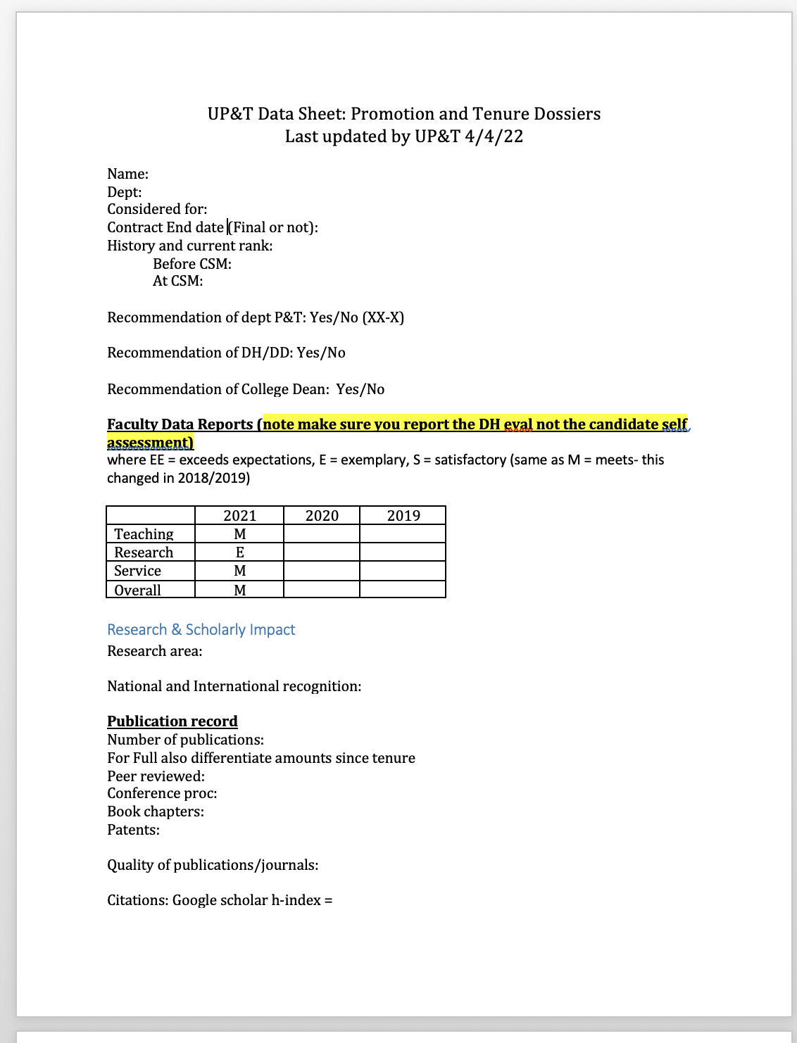
UP&T starts by filling out a data sheet
Make sure that your dossier is clear and makes it easy to find this info!
Ensure that the Table of Contents is bookmarked &/or easy to jump to sections by clicking on the TOC titles
Contract End date
FDRs
https://www.mines.edu/academic-affairs/faculty-resources/

Slide 13
Cultivating External Letter Writers
External evaluators are incredibly important for commenting on 2,3,4&5 of handbook section 8.1.2
Have 10 in mind – develop professional relationships; they cite you, you cite them invite them for talks in your dept (understand the expectations for your field)
Candidate recommends half of letters requested, DH/dept P&T committee recommends other half
WHO? Full professors, recognized experts in the field!
What about experts outside of academia?
International letter writers
Consider at least one for assistant, 2-3 for associate to full
What are COIs?

Slide 14
Definition of Activities Relevant to the Criteria: Faculty Senate Guidance
Section 6.5 – Academic Affairs Procedures Manual
Constructed by a faculty committee charged by the Faculty Senate with results endorsed by the Senate and Academic Affairs administration
Provides guidance to candidates as to how they should document, and to committees as to how they should review and evaluate attainment of broader institutional expectations for promotion and tenure
Every member of a Departmental Committee should read this document prior to reviewing candidate dossiers.

Slide 15
Scholarly impact (Research) Asst Prof: based on trajectory, Assoc: should be established
Publications, how many? how high impact?
Clearly state author order convention for your field and the type of publications that are important.
How many publications do you have as lead PI? With your students?
How many citations? H-index
External funding to support research? How many? How much $? How prestigious?
Can your level of funding support a research program in your department?
Is the research sustainable?
Who was PI? What was your role? How many students matriculated?
If not awarded, how strong was the effort? What were the ratings? How is this going to improve?
Presentations and international reputation?
Have there been invited presentations? Keynotes?
Has the PI and students presented at national and international conferences?
Is there a clear international reputation established? By editorship? Invited participation in conferences? **especially important for promotion to Full**
Impact and activity NOT Associated with your PhD advisor or postdoc advisors are most important.
Clearly state which pubs & grants are at Mines and independent of previous advisors
Help connect these dots in the research statement

Slide 16
Teaching (from the procedures manual)
“Examples of successful teaching for those promoted to Associate Professor with tenure may include:
Dedicated, high-quality student instruction at the undergraduate and graduate levels as demonstrated by the following: student evaluations, teaching portfolio that includes examples of teaching methods and/or effectiveness, teaching statements, and teaching awards.
Designing or leading of classroom activities that enhance the educational experience or that are important to the teaching mission, including leading undergraduate and graduate independent studies, advising senior design teams, teaching field session, etc.
Development and implementation of highly effective or innovative teaching methods and incorporation of feedback from formalized assessments, where appropriate.
Development of teaching infrastructure. …”

Slide 17
Teaching continued
We look at teaching scores, but we recognize that they are well-documented to be biased instruments, so we look for other evidence of effective teaching
Clearly present info in the data sheet:
how many classes per year, how many students in classes? Give info in comparison to dept expectations
Is the applicant clearly trying to improve teaching trajectory?
Has the applicant created new courses or content that are key to campus?
What evidence-based best practice pedagogical approaches are being used?

Slide 18
Teaching continued
UP&T recommendations:
To establish trajectory: it is really helpful to teach the same class multiple years in a row! You may have to advocate for this with your DH!
Have a professional or well-known educator observe your class
Document how you use lessons learned from observations, workshops to improve your teaching
Give class EXAMPLES in the dossier (e.g. before & after, plus results)
Clearly describe the pedagogy & evidence-based best practices that you use in your classrooms

Slide 19
Service
Divided into i) within department, ii) university and iii) broader community
Departmental committees are usually standard: seminar, graduate affairs, undergraduate affairs, faculty searches.
University committees are also standard: research, undergraduate and graduate affairs, P&T, library, etc.
Broader service is typically two components: Outreach to community (K-12, etc.), also service to professional society (in a context that promotes research)
UP&T Recommendations:
For the most part, people within Mines know which committees are light work and which are extensive work.
However, it is always best practice to clearly document major leadership roles (esp for Assoc to Full) and major service efforts.
Comment on the time commitment and your role
Notes:
You will not make tenure on service ALONE

Slide 20
Other tips & considerations from UP&T
Get mentors! And sponsors!
At least one mentor within your department. Not your DH. But meet with your DH at least once a semester.
One outside your department at Mines
Consider one outside Mines
Craft your dossier WITH your mentors!
Make sure that the info in the data sheet is clear in your dossier.
The dossier should speak for itself (important data should not be hunted for!)
Ensure that your credit is clearly stated (on pubs, grants).
Ensure that you separate work with previous advisors from independent work.
Don’t misrepresent or mislead
Per Handbook, we look for evidence of positive trajectory

Slide 21
University P&T Summary
If you know the criteria and prepare it’s really not bad – We all want you to be successful!
Understand who is doing the assessment including external letters (usually 5-10)
From this day forward keep your CV updated every time you do something that counts and start your P&T dossier as soon as you get the job
Know your strengths and shortcomings and address them head on. Do things to document that you’re working on any shortcomings (e.g. writing workshop, teaching workshop)

Slide 22
We want you to be successful!!
Reach out if you have questions, need advice or mentorship!
Recent UP&T committee members: Elizabeth Davis, Lawrence Weincke, Andy Herring, Dinesh Mehta, David Wu

