Slide 1
FY2022 Budget
Board of Trustees
May 18, 2021

Slide 2
Agenda
Overview of FY22 Budget and its components
Consideration for Approval:
3.0% increase for resident/non-resident residential tuition rates
3.0% increase for online tuition rates
3.0% increase to administrative and academic faculty salaries
Increases to room and board rates
Decrease to mandatory fees
Changes in other fees and charges
Operating Budget: Revenue, Expense and Net

Slide 3
Overview
Tuition revenue up due to larger incoming class and 3% rate increase. Net tuition revenue is softening due to focus on cost of education
Housing projecting occupancy to improve but not return to pre-pandemic levels – occupancy budget at 82%
State Funding 14.3% increase as state economy improves
Endowment spending stable due to strong CY20 investment performance and continued gifts
Research Funding continues to grow
Increased costs to fund online delivery, operational mandates and strategic initiatives

Slide 4
FY2022 Proposed Budget

Slide 5
Operating Revenue

Slide 6
Fall 2021 Preliminary Enrollment – May 1 Commit Date
First-Year Admissions Statistics
Applications | 10,606 | 12,648 | 11,749 | 12,032 | 12,020
Admits | 5,909 | 6,218 | 6,234 | 6,591 | 6,837
Admit % | 55.7% | 49.2% | 53.1% | 54.8% | 56.9%
Enrolled | 1,139 | 1,199 | 1,282 | 1,172 | 1,534*
Yield % | 19.3% | 19.3% | 20.6% | 17.8% | 22.4%*
* * Fall 2021 is Intends to Enroll - Reflective of deposits as of 5/11/21

Slide 7
Tuition Rates
Recommending a 3% increase for resident, non-resident and online
Resident $17,160
Non-Resident $38,460
Preliminary Tuition Changes: Colorado Peer Comparison
 | CO Mesa | CSU | Ft. Lewis | MSU | CU Boulder | UNC | Western
% Change in Tuition | + 3% | + 3%* | No Change | No Change | + 3%* | + 7% | No Change
* Students will see a 0% increase in 2021-2022 with HEERF funding support. The 3% increase will take effect the following academic year.

Slide 8
State / Federal Stimulus Funding
State Funding to Mines
Federal Stimulus Funding
Act | Fund | FY20 | FY21 | FY22
CARES | HEERF I (student) | $1.7
 | HEERF I (Institutional) | $1.7
 | Through State Alloc. |  | $13.4
CRRSA | HEERF II (student) |  | $1.7
 | HEERF II (Institutional) |  | $3.2
ARPA | HEERF III (student) |  |  | $4.4
 | HEERF III (Institutional) |  |  | $4.4
 | Total | $3.4 | $18.3 | $8.8

Slide 9
Other Revenue
$0.5M increase in Indirect Cost revenue from research grants see following page for research information
$2.6M increase in housing and dining revenue from higher occupancy and rates
$1.0M increase in Continuing Education projected revenue
$4.4M of one-time funding from HEERF III

Slide 10
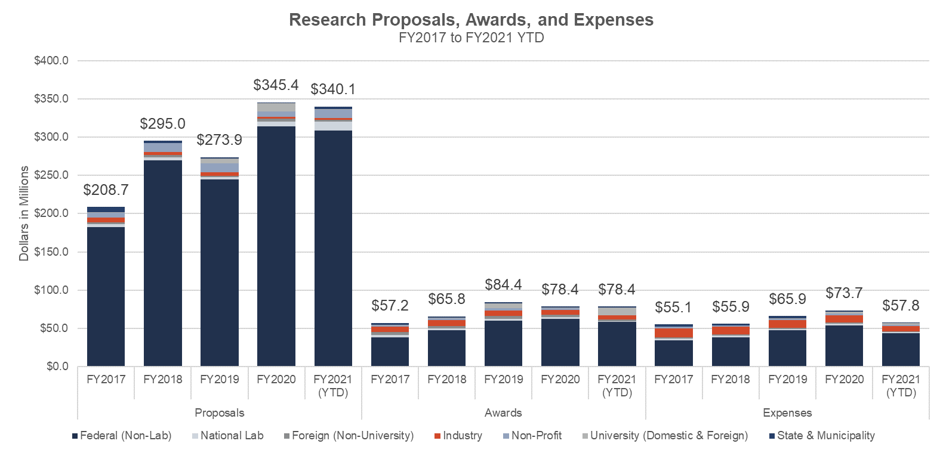
Research

Slide 11
FY2022 Revenue Overview

Slide 12
Financial Aid and Net Tuition

Slide 13
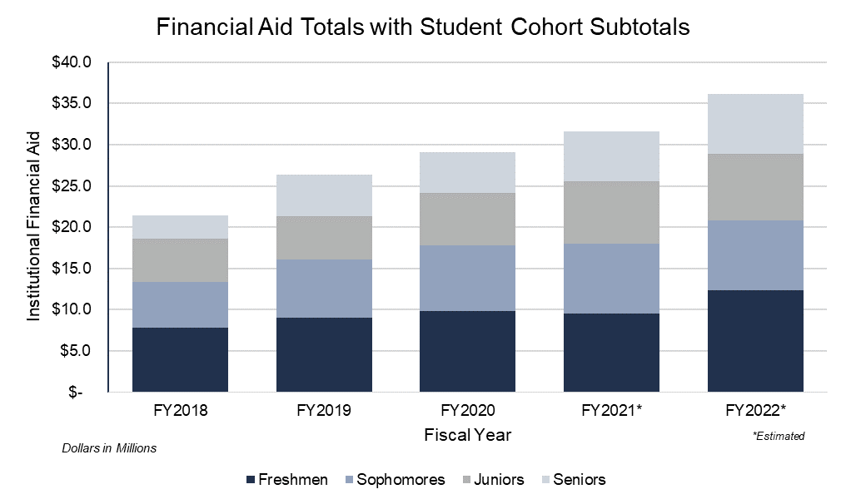
Growth in Financial Aid

Slide 14
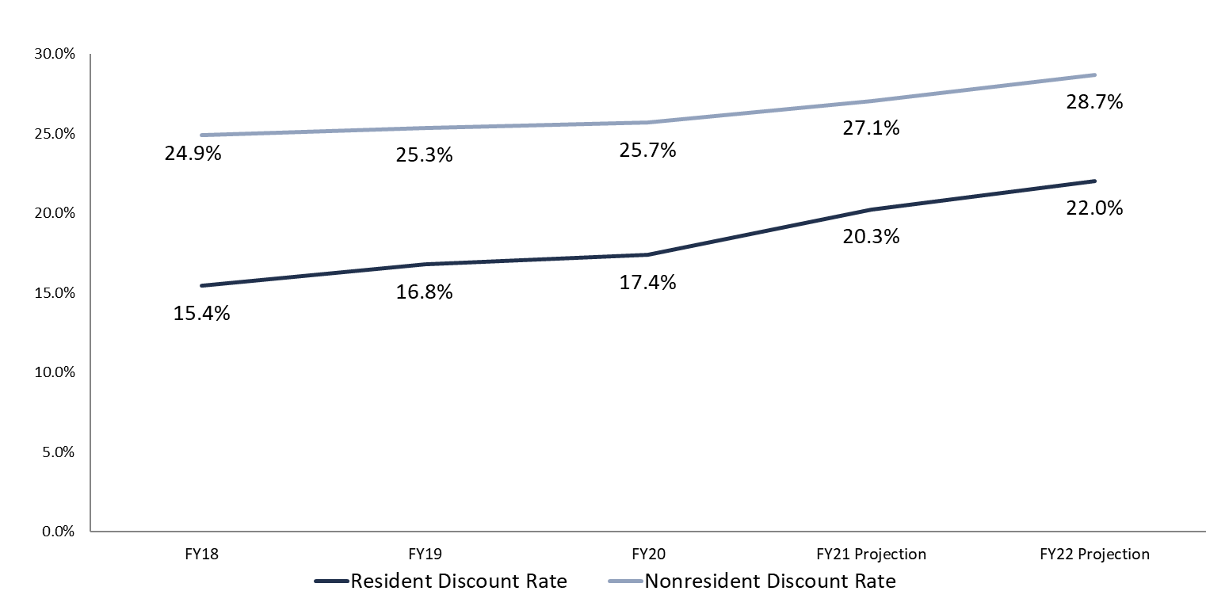
Tuition Discount Rate Trend
Discount rate includes all undergraduate institutional financial aid divided by undergraduate gross tuition.

Slide 15
Fees, Charges and Cost of Attendance

Slide 16
Proposed Mandatory Fees
(per semester)
Notes:
Colorado Peers:

Slide 17
Proposed Room and Board Rates

Slide 18
Proposed Other Fees and Charges (see attached complete package)
New Fee:
Undergraduate application fee is $25/application
Other Fees and Charges Changes:
Student Health Insurance Plan rates are back to AY2020 levels (~6% increase).

Slide 19
Cost of Attendance

Slide 20
Operating Expenses

Slide 21
FY2022 Added Expenses in thousands

Slide 22
FY2022 Expense Overview

Slide 23
FY2022 Proposed Budget

Slide 24
Resolution Slide
Pursuant to authority conferred by §23-41-104(1), C.R.S. (2012) and as required by §23-5-119.5(1), C.R.S. (2012), the Board of Trustees has the responsibility and authority for the financial management of the School including the setting of tuition and fees and the approval of the budget.
Be it resolved that the Finance and Audit Committee has reviewed the proposed budget for the Fiscal Year 2022 and recommends to the Board of Trustees the Fiscal Year 2022 budget consisting of:
  Total operating revenue of $253.3m
  Total operating expenses of $250.8m
  3.0% increase for resident and nonresident residential undergraduate and graduate tuition rates;
  3.0% increase for online tuition rates;
  3.0% increase to administrative and academic faculty salaries;
  Increases to room and board rates;
  Decrease to mandatory fees; and
  Changes in other fees and charges

Slide 25
Appendix

Slide 26
Resident Tuition – National Comparison
ROI
SmartAsset: #1 Best Value Colleges in Colorado (#8 nationally)
PayScale: #7 in ROI and #14 in Alumni Earnings
Wall Street Journal: #1 for Public Schools in the West with highest salaries 10 years out
Mines Career Center Annual Report-Outcomes & Salary Survey 2018-2019 Avg. Salary Offers (11/28/19):
  Employed or in graduate school:
    BS- 95%; MS- 97%; PhD-97%
  Average salary offers:
    BS- $69,375; MS- $86,280; PhD-$82,375
AY2021 Peer Published Tuition for Undergraduate Students
Peer Institutions | Public Institutions |  |  |  |  | Private Institutions
 | CSU | CU Boulder-Engineering | Georgia Tech | UC Berkeley | Mines | Carnegie Mellon | Rensselaer Polytechnic | Worcester Polytechnic | Rice
Resident Tuition (15 hrs) | $ 12,260 | $ 14,184 | $ 10,258 | $ 14,312 | $ 16,650 | $ 57,560 | $ 55,600 | $ 53,100 | $ 50,310
Non Resident Tuition (15 hrs) | $ 31,712 | $ 39,638 | $ 31,370 | $ 44,066 | $ 37,350 | $ 57,560 | $ 55,600 | $ 53,100 | $ 50,310

Slide 27
Continue to Focus on Cost of Education
  Direct costs to students
    Tuition rate
      No Resident rate increase FY20+21
      No Non-Resident rate increase FY21
    Fees
      Moderated for FY21 and FY22 decline
    Financial aid
      $1m allocated for COVID FY21 support
      $500k allocated in Spring 2021 semester
      $2.7m FY21 federal support
      Increased support for Women, Under- Represented Minority and Need-Based
  Indirect costs
    Cost-cutting measures FY21 and FY22
    Administrative efficiencies
      Processes
      Space
  Net Tuition rate (avg) decreases
    Resident has dropped since 2018
    Non-resident has dropped since 2019

Slide 28
Online Financial Model

Slide 29
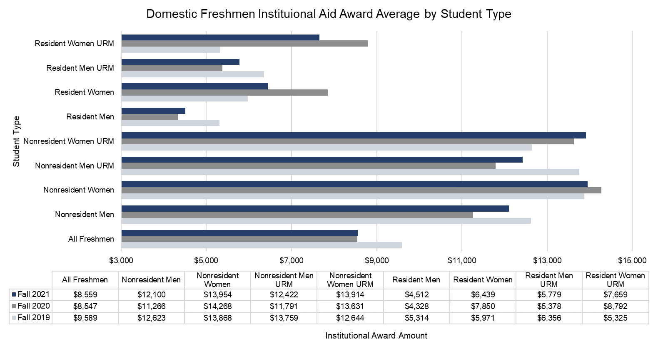
Average Freshmen Financial Aid Awards
Notes:
Averages for students receiving a financial aid award.
Fall 2019 and Fall 2020 are as of census.
Fall 2021 is intent-to-enroll students.
URM equals “underrepresented minority.”

Slide 30
Tuition Rates Adjusted for Discounting
Increasing discounting has led to a flattening of net tuition rates
Enrollment
2,801
2,728
2,809
2,812
2,905
2,978
3,028
Enrollment
1,807
1,884
1,985
2,142
2,250
2,238
2,274
Note: Average net tuition rate considers institutional financial aid only.

Slide 31
FTE Changes - General Fund and UDAux

Slide 32
FTE Changes - Foundation and DesAux

Slide 33
2021-2022 Proposed Tuition Rates Per Credit Hour
Undergraduate Rates Increase 3%
Undergraduate Resident
  2020-2021: $555
  2021-2022: $572
Undergraduate Nonresident
  2020-2021: $1,245
  2021-2022: $1,282
Graduate Rates Increase 3%
Graduate Resident
  2020-2021: $925
  2021-2022: $953
Graduate Nonresident
  2020-2021: $2,075
  2021-2022: $2,137
Online
  2020-2021: $999
  2021-2022: $1,029

Slide 34
Proposed Parking Rates
Student General
  2020-2021: $330/year
  2021-2022: $395/year
Student Commuter
  2020-2021: $130/year
  2021-2022: $225/year
Student Freshman Waiver (previously Freshman Lottery)
  2020-2021: $300/year
  2021-2022: $510/year
Employee Reserved
  2020-2021: $497/year
  2021-2022: $525/year
Employee Blue
  2020-2021: $330/year
  2021-2022: $395/year
Employee Commuter
  2020-2021: $130/year
  2021-2022: $225/year
Employee Garage
  2020-2021: $800/year
  2021-2022: $525/year

Slide 35
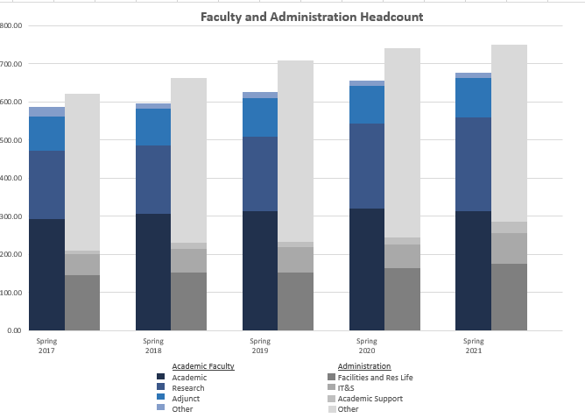
FTE Trend – Function View

Slide 36
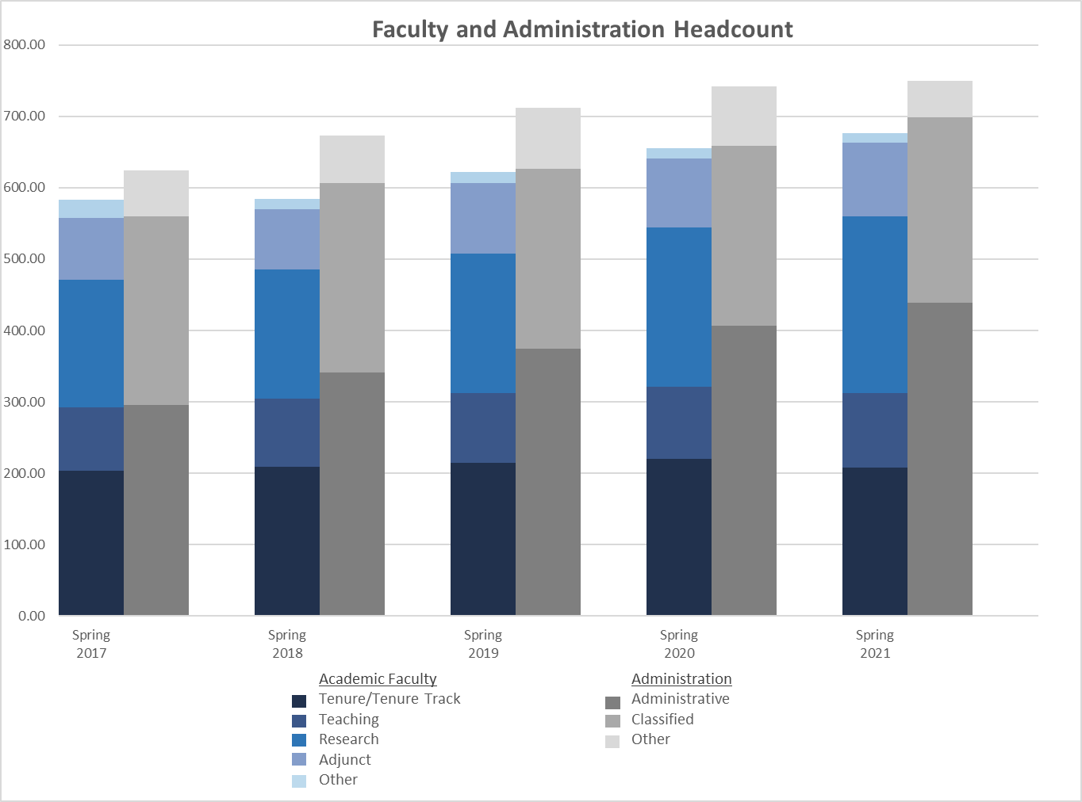
FTE Trend – Employee Classification View

Slide 37
Financial Aid Totals by Year and Cohort

Slide 38
Scholarship by Recruitment Purpose

Slide 39
FY2022 All Funds Budget - Revenues

Slide 40
FY2022 All Funds Budget – Expenses and Net Activity

Slide 41

CSM Foundation Budget – Draft Proposal Informational

