Slide 1
FY2025 Budget
Board of Trustees
May 3, 2024

Slide 2
Next Year's Outlook

Slide 3
Fiscal Year 2025 Highlights
Increase in expenses continue to outpace revenue
Continued Inflationary pressures
  Healthcare significant impact
Focus on building reserves
Complete E&I programming
Unknown impact on fall enrollment
  FAFSA delays
  Changes to PELL
Continued focus on growing non-thesis based masters

Slide 4
Projected Increase in Revenue $26.1M
Tuition: +$17.5M
  Increased enrollment (forecasted enrollment slide) and tuition rate (3%) increases
Auxiliaries: +$3.3M
  Housing (see rate table) and dining (+6%) rates based on construction costs, housing market comparison, and contractual commitments
State Support: +$3.5M; 10.5% increase, recently increased in the long bill by the Joint Budget Committee
  Additive amount is included in reserves
Indirect Cost Recoveries: +$1.0M
Other Income: +$0.8M

Slide 5
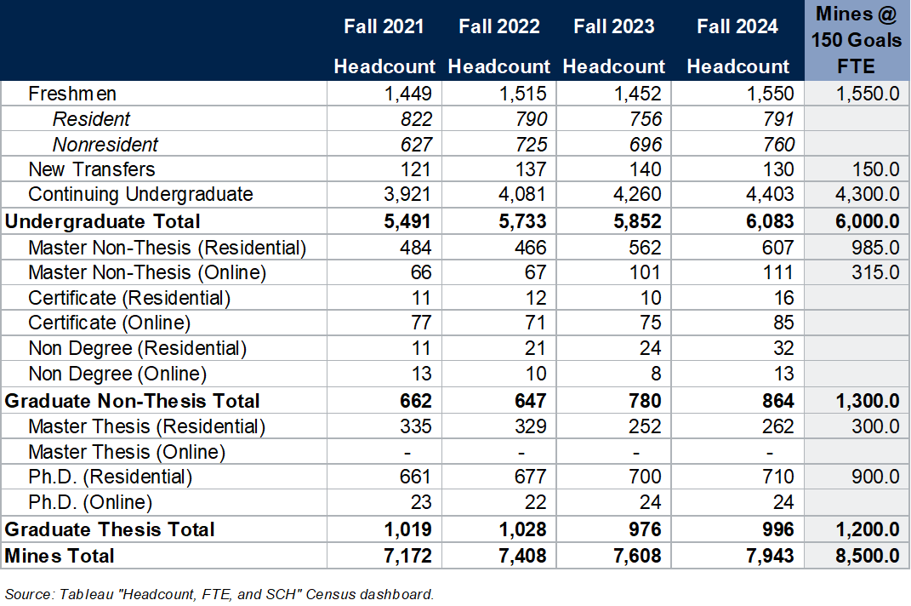
Anticipated Fall 2024 Enrollments
Notes:
-Online students are primary program students paying an Online tuition rate.
-Online Total End-of-Term Headcount: Fall 2021 = 204, Fall 2022 = 183, Fall 2023 = 208
-Mines @ 150 UG Goals Adjusted December 2023 by Mines Executive Team

Slide 6
FY2025 Tuition, Fees, and Charges

Slide 7
Next Year’s Rate Increases
Tuition: 3.0% based on the State Budget cap
Mandatory student fees: 6.7%
Housing: 3.0% except in the renovated Mines Park apartments​
Dining: 6.0% (rising food costs)
Cost of Attendance
  Undergraduate residents: 4.1%
  Nonresidents: 3.8%
  See Appendix for all other rate increases

Slide 8
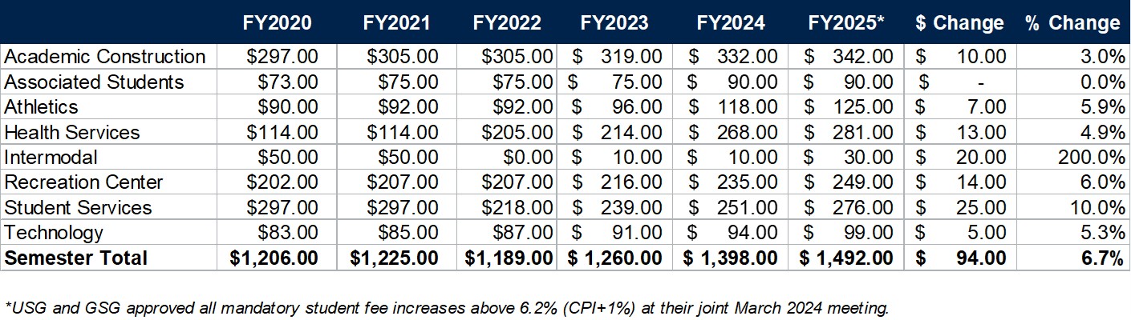
Proposed Mandatory Student Fees

Slide 9
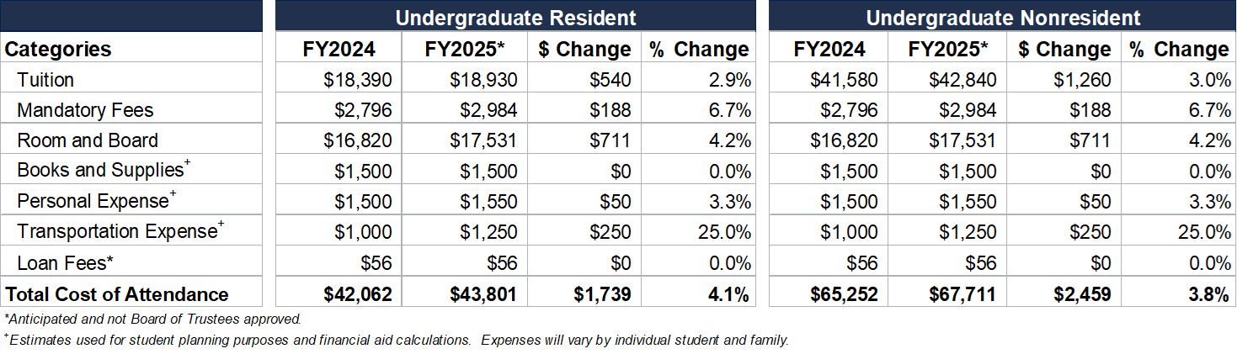
Proposed Cost of Attendance

Slide 10
Investments

Slide 11
FY2025 Expense Unknowns
Colorado Promise – If mandated (FY26?), we will likely need to expand financial aid to include a “promise” program similar to other CO state institutions
Dining – The cost of food continues to impact the dining contract with Sodexo FY25 - amount not solidified yet
Pell – The new FAFSA rollout delay, along with new calculation approach for need is presenting issues in understanding the full fall 2024 financial aid picture at this time
Enrollment – In addition to the FAFSA rollout issues, there is a ripple impact on student decisions as all higher education is seeing a timeline shift in the undergraduate cycle

Slide 12
Proposed Budget Investments
General Fund
Category | Continuing | Temporary | Total | % | FTE
Mandatory | $6,618,108 | $(585,649) | $5,934,292 | 32.5%
Employee Support | 3,163,282 | 13,000 | 3,176,282 | 17.1%
System and Infrastructure | 1,388,239 | 40,625 | 1,428,864 | 7.7% | 1.325
Enrollment | 3,089,765 | (800,000) | 2,289,765 | 12.3% | 1.000
Investment in Faculty | 3,921,550 | 2,357,492 | 6,368,787 | 33.8% | 8.000
E&I | 760,408 |  | 760,408 | 4.1% | 1.000
Other | (352,893) | (1,035,027) | (1,387,920) | (7.5%)
Total | $18,588,459 | $(9,559) | $18,570,900 | 100.0% | 11.325

Slide 13
Proposed Budget Investments
Auxiliary
Undesignated Auxiliaries
Category | Continuing | Temporary | Total | FTE
Mandatory* | $5,990,776 |  | $5,990,776
Employee Support | 160,023 |  | 160,023
Enrollment | 231,880 |  | 231,880 | 3.000
Systems and Infrastructure | 154,332 | 84,375 | 238,707 | 1.675
CPES | 352,893 |  | 352,893
Total | $6,889,904 | $84,375 | $6,974,279 | 4.675

Slide 14
FY2025 Budget

Slide 15
FY2025 Proposed Budget: General Fund
Notes:
On-top adjustment of $2.3M from Institutional Support to Academic Support (IT Changes) to reflect anticipated future program codes adjustments based on FY2024 Q1 changes.
“FY2024 Budget” is BOT approved June 2023.
“Adjustments” are prior year Q4, Banner-to-WD adjustments, FY2024 beginning clean-up, Q1, Q2, Q3
“FY2024 Forecast” is budget as of March 31, 2024 (Q3)
“Adjustments” are potential FY2024 Q4, FY2025 beginning clean-up, and new FY2025 budget adjustments
“FY2025 Proposed Budget” is proposed BOT budget for May 2024 vote

Slide 16
FY2025 Proposed Budget: Auxiliaries
Notes:
“FY2024 Budget” is BOT approved June 2023.
“Adjustments” are prior year Q4, Banner-to-WD adjustments, FY2024 beginning clean-up, Q1, Q2, Q3
“FY2024 Forecast” is budget as of March 31, 2024 (Q3)
“Adjustments” are potential FY2024 Q4, FY2025 beginning clean-up, and new FY2025 budget adjustments
“FY2025 Proposed Budget” is proposed BOT budget for May 2024 vote

Slide 17
Resolution on the FY2025 Budget

Slide 18
Resolution
Pursuant to authority conferred by §23-41-104(1), C.R.S. (2012) and as required by §23-5-119.5(1), C.R.S. (2012), the Board of Trustees has the responsibility and authority for the financial management of the School including the setting of tuition and fees and the approval of the budget.
Be it resolved that the Finance and Audit Committee has reviewed the proposed budget for the Fiscal Year 2025 and recommends to the Board of Trustees the Fiscal Year 2025 budget consisting of:
  Total GF operating revenue of $280.84M;
  Total GF operating expenses of $276.73M;
  Total Aux operating revenue of $41.48M;
  Total Aux operating expenses of $47.98M;
  2.9% increase for undergraduate resident rate;
  3.0% increase for undergraduate nonresident, graduate, faculty-led, and online tuition rates;
  Increases to room and board rates averaging 4.6%;
  Increases to mandatory fees averaging 6.7%; and
  Changes in other fees and charges

Slide 19
Appendix

Slide 20
Summary of Unrestricted Net Assets
($ in millions) | FY18 | FY19 | FY20 | FY21 | FY22 | FY23
Undesignated – Short Term | $24.5 | $28.7 | $41.1 | $55.9 | $43.3 | $32.0
Undesignated – Long Term | 17.7 | 17.1 | 16.3 | 20.9 | 18.1 | 17.8
Total Undesignated | $42.2 | $45.8 | $57.4 | $76.7 | $61.4 | $49.8
Designated | 71.5 | 67.6 | 78.4 | 85.9 | 101.3 | 87.2
Total | $113.7 | $113.4 | $135.8 | $162.6 | $162.7 | $137.0
Designated Reserves | FY22 | FY23
Academic / Research | $43.6 | $43.8
Start Up, Research Dev, Roll Forward | 30.5 | 33.0
Research Equipment | 1.4 | 1.0
Gifts | 2.5 | 2.4
Other (CGS, Ext. Lab Sales, NU Agreement, Research Cost Share) | 9.3 | 7.4
Student | $24.2 | $14.9
Student Fees / Health Insurance / Orgs. | 13.5 | 10.9
Senate Bill 003 / Financial Aid | 10.6 | 3.7
Other | 0.2 | 0.4
Risk Management | $1.6 | $1.6
Other Designated | $0.7 | $0.4
Total (excluding Capital Projects) | $70.1 | $60.9
Current Capital Projects | 31.2 | 27.0
Total Designated Reserves | $101.3 | $87.2
Spent $4M of Acad Constr. Fee on Classroom Building
Spent $5M of SB003 Fund on Classroom Building

Slide 21
Debt Outstanding by Purpose
General Fund Debt
($145M, 20%)
Total Debt = $725M*
As of 4/1/2024. Includes capital lease for 1750 Jackson which had a value of $42.0M as of 6/30/2023.
Notes:
Student Services includes Student Center, Wellness Center, Rec Center, Welcome Center
Campus Infrastructure includes GRL, Green Center Roof, Operations Center, Chiller, Generator, ECEC, Utilities, Jones Road, Ford
Academic/Lab includes Labriola, Beck, Classroom Building, McNeil Hall, Marquez Wing, Brown Hall

Slide 22
Inflation Compared to Student Costs

Slide 23
Proposed Tuition Rates

Slide 24
Proposed Housing Rates
Note: Mines Park rates reflect current, newly renovated inventory.
Notes:
Mines Park increases related to plan increases for remodeled apartments.
According to Axios Denver March 2024 (https://www.axios.com/local/denver/2024/03/07/golden-colorado-median-apartment-rent), median rentals for 1 bedroom apartments:
•Golden $1900
•Denver $1810
•Boulder $1810
•Broomfield $1720
•Centennial $1700
•Westminster $1700
•Arvada $1400
•Lakewood $1490

Slide 25
Proposed Dining Rates
Notes:
Sodexo cost increase is 6%.

Slide 26
Proposed Parking Rates

Slide 27
Other Proposed Fee Increases

Slide 28
Other Proposed Fee Increases

