Slide 1
HCDS Adaptive Shooting Project
By: Jen Broderick, Brennon Saucier, Wills Booth, Griffin Stanton, and Ryan Meraux
Notes:
Brennon - Hello, my name is Brennon Saucier and Today I will be giving you a short introduction to the Adaptive Shooting Project. Members include myself, Jennifer Broderick, Wills Booth, Griffin Stanton, and Ryan Meraux.

Slide 2
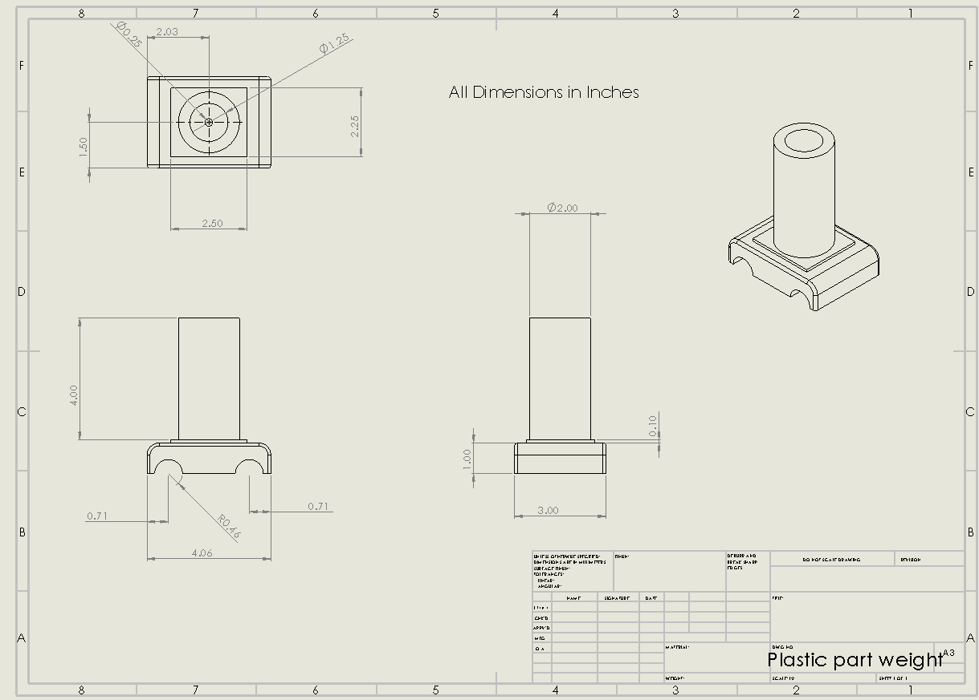
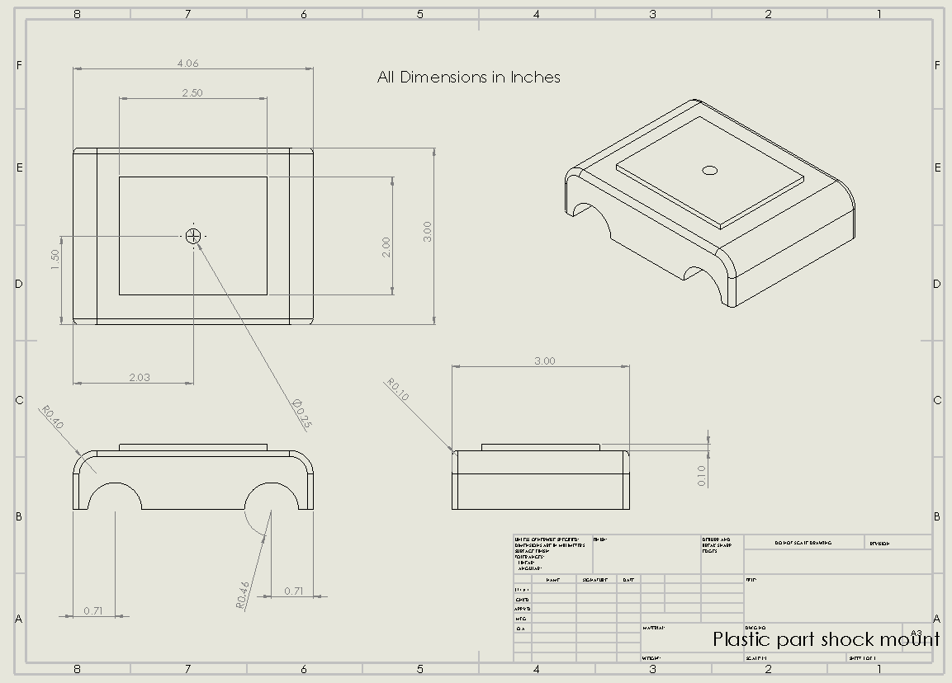
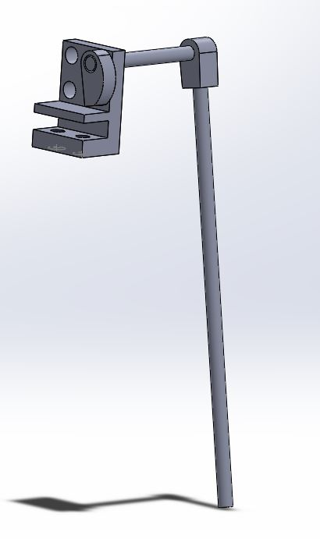
Design
Ballast Mount
Shock Mount
Trigger
These are the final pieces being manufactured and need to be completed, once completed, assembly should be quite easy
Notes:
Brennon - Our design was quite simple to be honest, we started out with a Caldwell Base and manipulated it to achieve our needs. We only had to design a few parts including a trigger system and a ballast system. The ballast and shock mounted parts are 3D printed while the trigger system was made in the machine shop.

Slide 3
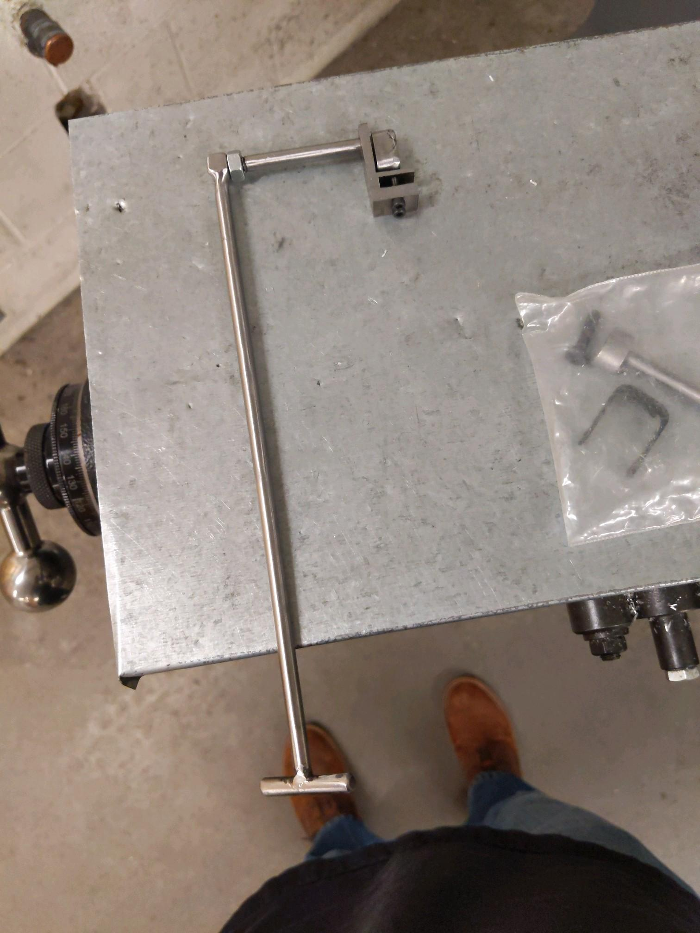
Manufacturing
3D Printing
Top shock mount
Ballast mount for weight system
PETG filament
Welding
Lower shock mount
Trigger mechanism
TIG welder
Machining
Lower shock mount
Trigger mechanism
Manual mill and lathe
Water jet
Notes:
Griffin-3d Printing: PETG, Machining/Welding: manual mills, lathes, tig welding, low carbon steel

Slide 4
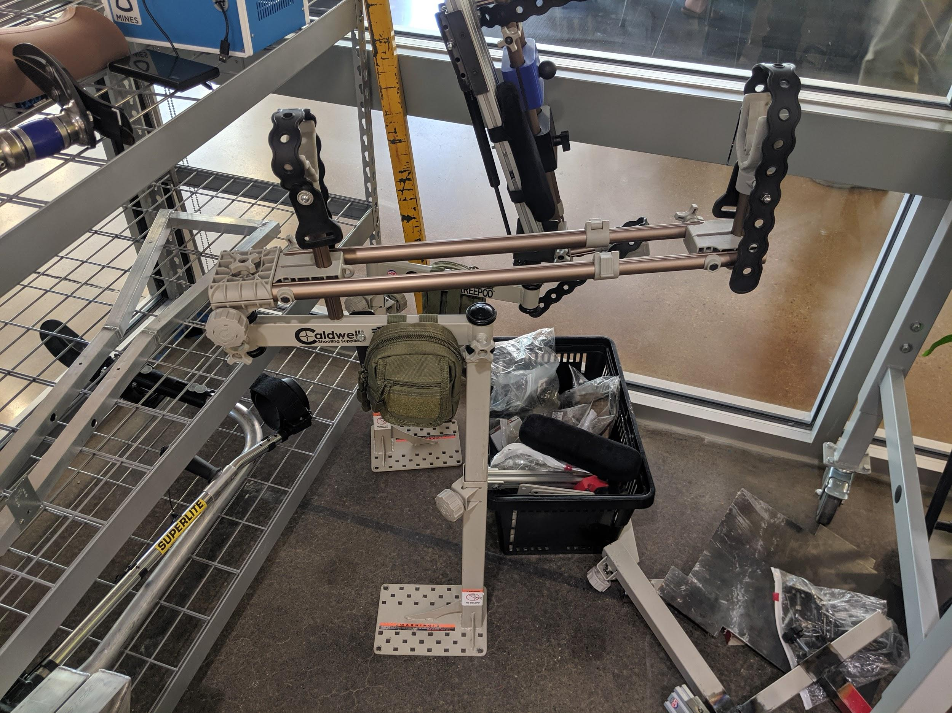
Assembly
Base: Caldwell
Shotgun Mount: Caldwell with adjusted pivot point for usability
Shock Mount: Machined and 3D printed part bolted onto the Caldwell
Trigger: Machined cam, trigger guard mount, and lever arm
Ballast: 3D printed mount bolted onto the Caldwell
Notes:
Wills - Our products assembly is actually quite simple, and can be done in the field with the tools provided. An allen key set, and a few small wrenches are provided in a pouch attached to the apparatus. Most parts are easily removed by unscrewing the hardware, or using the pressure knobs on the caldwell itself.

Slide 5
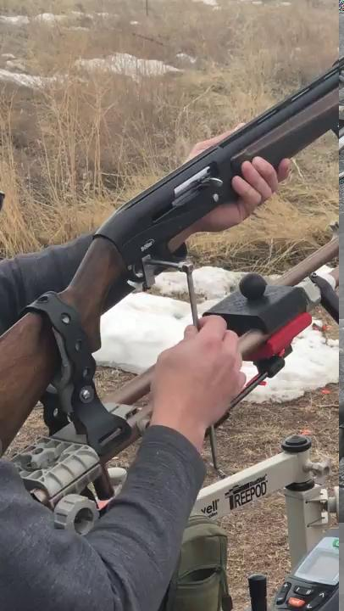
Testing
Items that need future testing:
Plastidip on trigger
New gas springs
Ballast
Notes:
Ryan - During our tenure with the product, we had multiple opportunities to be able to test it with the help of stakeholders. For our final round of testing, we need to test the plastidip on the trigger to ensure a tougher grip, our new shock mounts to better counter the weight of the gun, and the ballast system to help fine tune and improve usability with any shotgun, despite the differences in weight.

Slide 6
Documentation
User Manual: Mostly finished, just needs a few more pictures here and there
Build Instructions: Needs pictures and hardware specifications
Notes:
Jen - Our user manual is coming along nicely, Unfortunately due to COVID-19, we have been unable to gather the needed documentation of the final product. Once we are able to access our product, the user manual will be completed in no time.

Slide 7
Budget
Company | Name | Part Number | Cost
Caldwell | DeadShot TreePod | 484148 | $160.00
Home Depot | VELCRO Brand 12 ft. x ¾ in. One-Wrap Strap | 90340 | $9.27
Manufactured | Top Joint | N/A | Free*
McMaster-Carr | Gas Spring | 4138T56 | $18.94
Dick’s Sporting Goods | Lacrosse Ball | 17DSGUNNNLXBLL201LXT | $3.99
Amazon | Bike Grip | N/A | $9.99
Amazon | Weights | N/A | $34.44
Manufactured | 3D Prints | N/A | Free*
Manufactured | Base | N/A | Free*
Home Depot | ProGrip Better Than Bungee 6 ft. 100 lbs. Break Strength Particle Rope Lock Paracord | 055160 | $4.45
Home Depot | Hardware | Assorted | $10.00
Total | - | - | $251.08**
* Not all parts will be free for every party. These parts were provided to us, or were left over from the previous group.
**Price is liable to change.
Notes:
Jen - Our budget can be seen here in our last slide. We worked hard to drive down the costs on our product, however due to the supplies that were available to us, we are not able to give an exact budget. Metal pieces, and 3D printing prices may vary. In the future, we may be able to drive down costs even more with bulk orders, as well as unifying the hardware.

