Slide 1
Faculty Climate Survey 2016: results for Electrical Engineering faculty
Wednesday, December 14, 2016

Slide 2
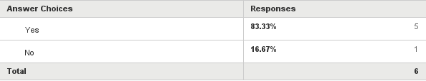
Q1: The Senate will protect your confidentiality. Only aggregate data will be shared and we will not disclose information in a format that compromises your identity. Only a small subcommittee of three has access to the raw data. It is helpful to be able to share anonymous written comments. May we do so?
Answered: 6 Skipped: 0

Slide 3
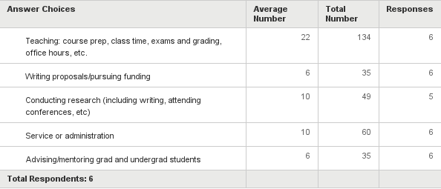
Q2: As you think about how you spent your time during the last academic year, about how many hours PER WEEK did you spend on each of the following activities?:
Answered: 6 Skipped: 0

Slide 4
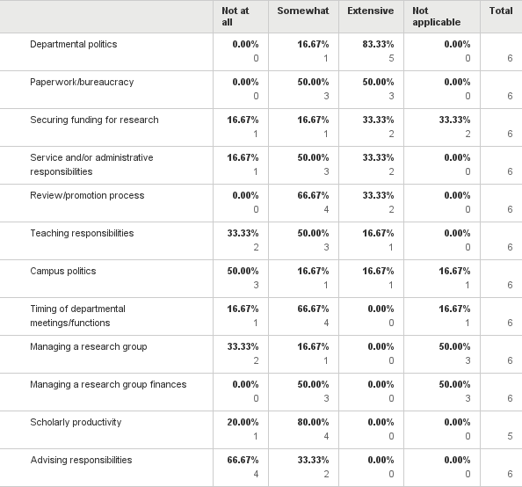
Q3: Please indicate the extent to which each of the following aspects of work has been a source of STRESS for you over the past twelve months:
Answered: 6 Skipped: 0

Slide 5
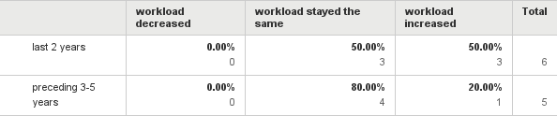
Q4: Has your total workload changed over the last five years and two years, if at all?
Answered: 6 Skipped: 0

Slide 6
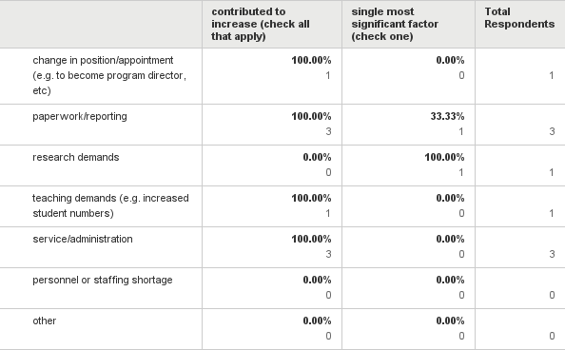
Q5: If your workload has increased, indicate which of the factors below has contributed significantly, and single out the most significant one:
Answered: 3 Skipped: 3

Slide 7
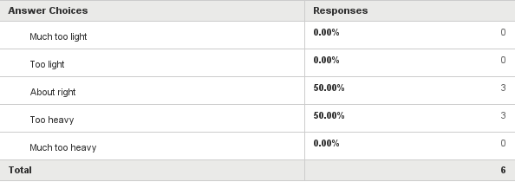
Q6: Overall, how would you rate the reasonableness of your workload?
Answered: 6 Skipped: 0

Slide 8
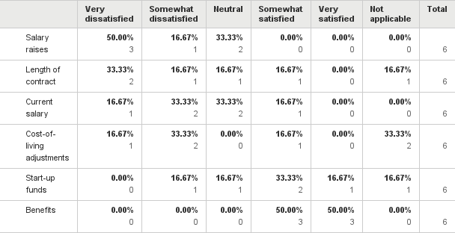
Q8: Specify the degree to which you are satisfied with each of the following, related to compensation:
Answered: 6 Skipped: 0

Slide 9
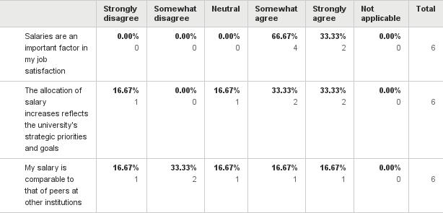
Q9: Please indicate your agreement or disagreement with the following statements:
Answered: 6 Skipped: 0

Slide 10
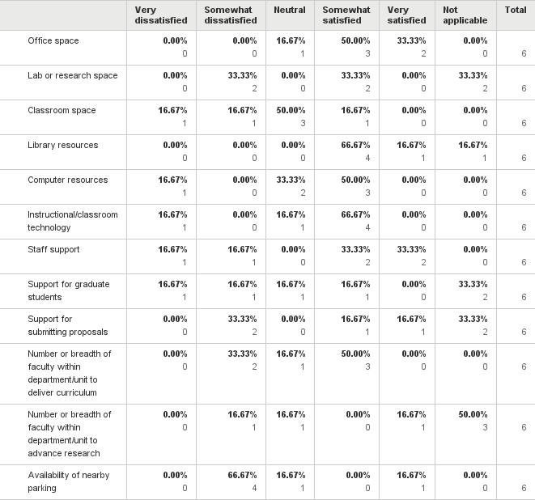
Q10: Specify the degree to which you are satisfied with each of the following, related to resources:
Answered: 6 Skipped: 0

Slide 11
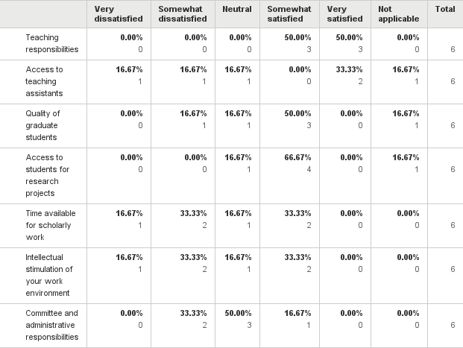
Q11: Specify the degree to which you are satisfied with each of the following, related to job responsibilities:
Answered: 6 Skipped: 0

Slide 12
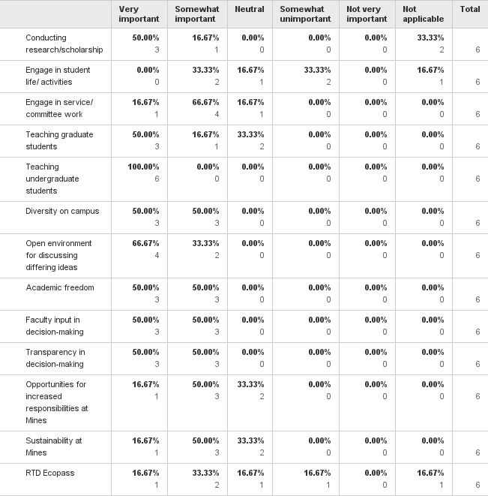
Q12: How important are the following to you?:
Answered: 6 Skipped: 0

Slide 13
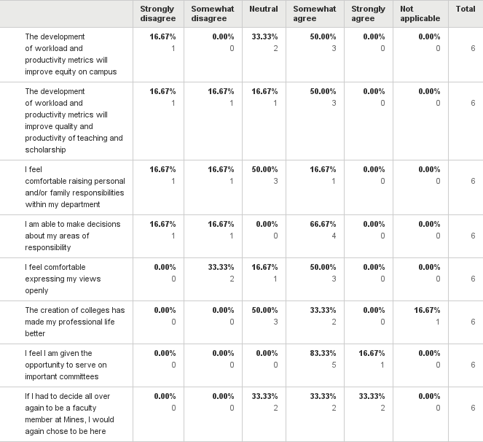
Q14: Please indicate your agreement or disagreement with the following statements:
Answered: 6 Skipped: 0

Slide 14
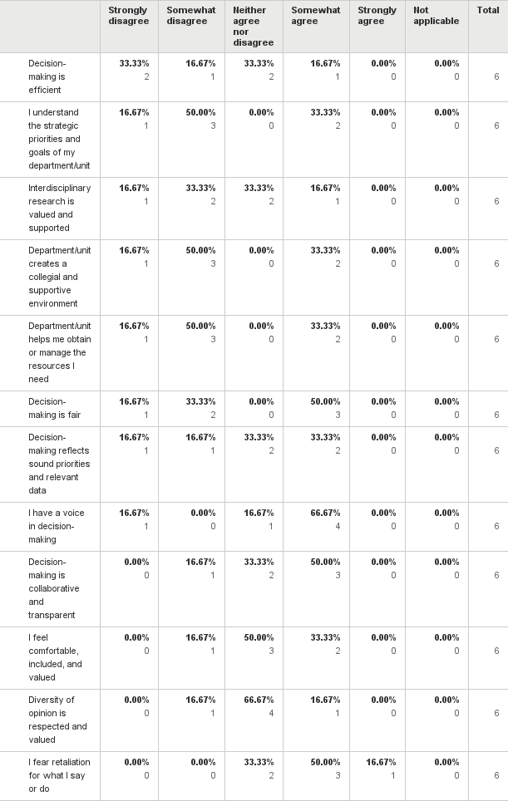
Q15: With respect to your DEPARTMENT/UNIT, indicate your agreement or disagreement with the following statements:
Answered: 6 Skipped: 0

Slide 15
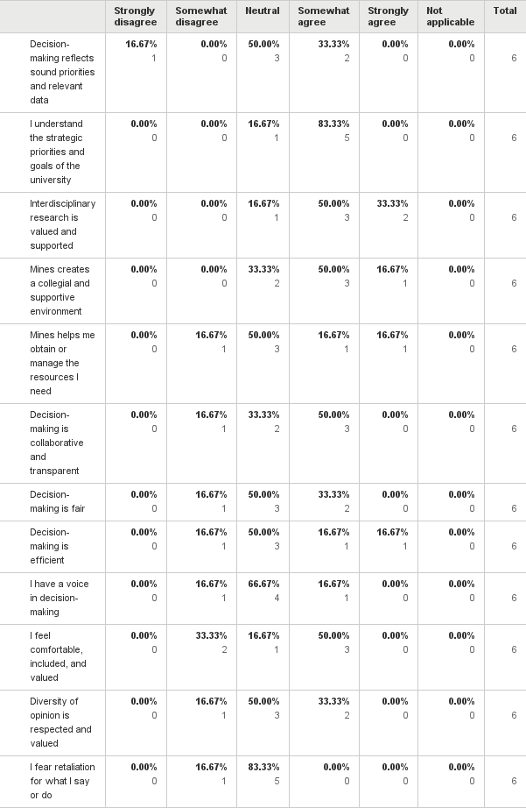
Q16: With respect to Mines, indicate your agreement or disagreement with the following statements:
Answered: 6 Skipped: 0

Slide 16
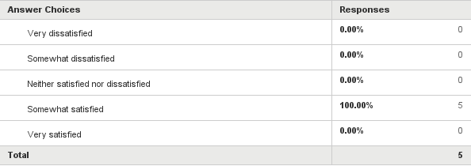
Q17: Overall, how satisfied are you with the current college structure?
Answered: 5 Skipped: 1

Slide 17
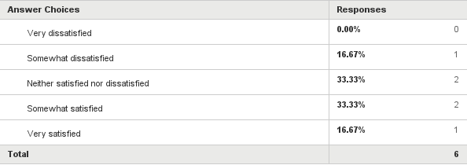
Q18: Overall, how satisfied are you being a faculty member at Mines?
Answered: 6 Skipped: 0

Slide 18
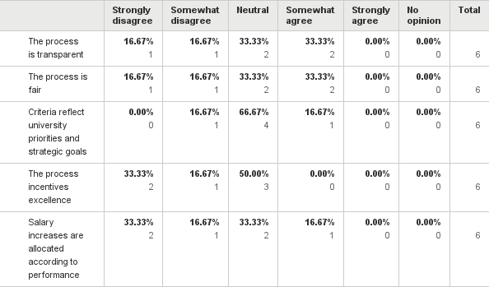
Q19: With respect to the annual faculty review process, indicate your agreement or disagreement with the following statements:
Answered: 6 Skipped: 0

Slide 19
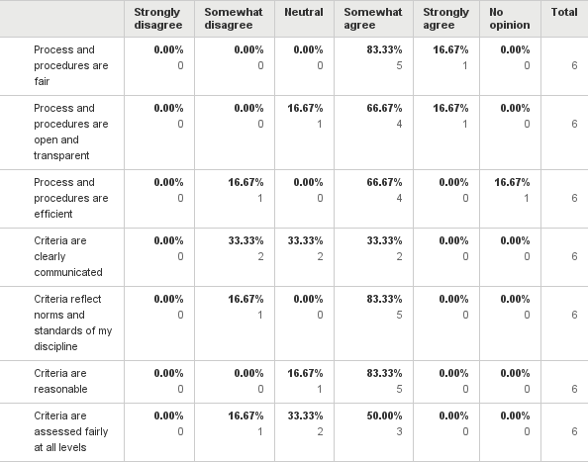
Q20: With respect to PROMOTION AND/OR TENURE FOR YOUR RANK, indicate your agreement or disagreement with the following statements:
Answered: 6 Skipped: 0

Slide 20
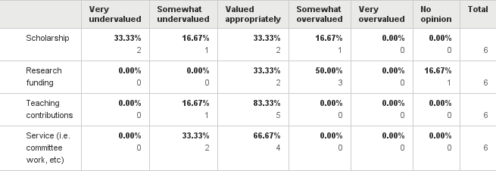
Q21: How appropriately are these items valued in the PROMOTION AND/OR TENURE PROCESS FOR YOUR RANK?
Answered: 6 Skipped: 0

Slide 21
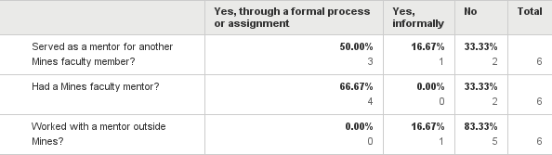
Q22: While at Mines, have you:
Answered: 6 Skipped: 0

Slide 22
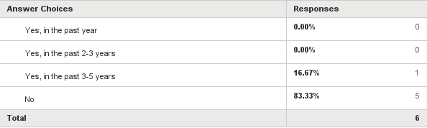
Q24: Have you applied for a job at another university recently?
Answered: 6 Skipped: 0

Slide 23
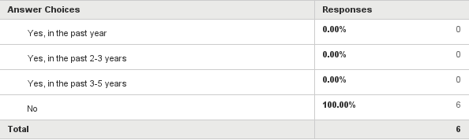
Q25: Have you applied for a job outside academia recently?
Answered: 6 Skipped: 0

Slide 24
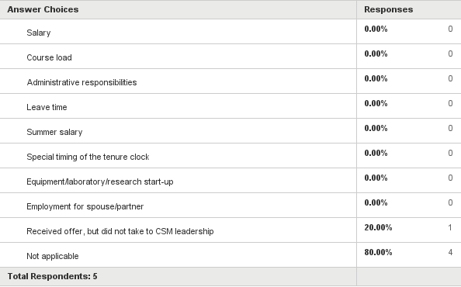
Q26: During the last five years, did you receive an outside job offer that you shared with Mines leadership and that resulted in adjustments to any of the following? (check all that apply)
Answered: 5 Skipped: 1

Slide 25
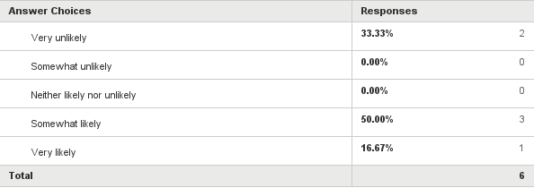
Q27: In the next three years, how likely are you to leave (or try to leave) Mines?
Answered: 6 Skipped: 0

Slide 26
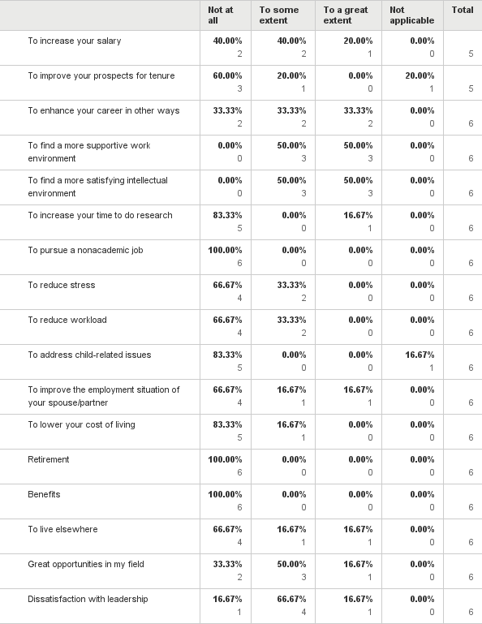
Q28: To what extent, if at all, have you considered the following reasons to leave?
Answered: 6 Skipped: 0

Slide 27
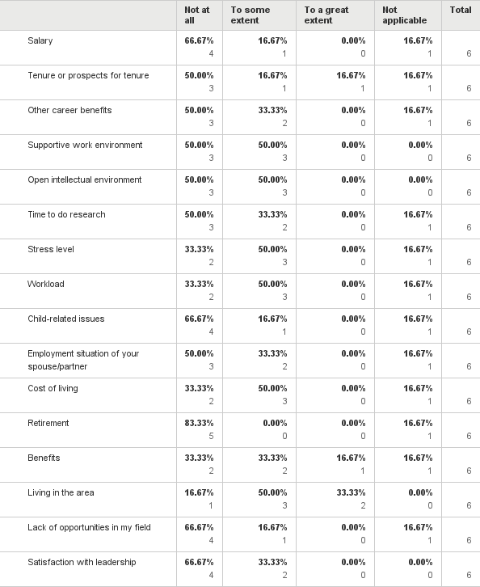
Q29: To what extent, if at all, have the following reasons encouraged you to stay at Mines?
Answered: 6 Skipped: 0

