Slide 1
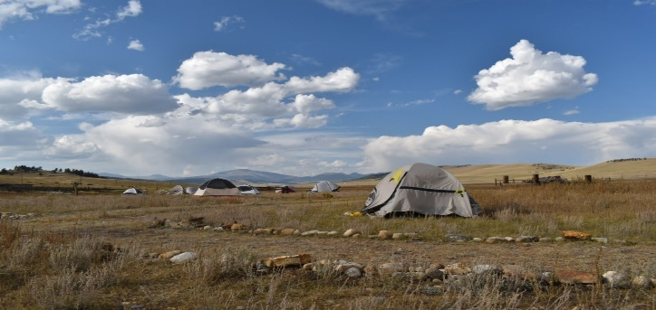
The Environmental Leadership Lab is an overnight camping experience at the Rocky Mountain Land Library in Fairplay, CO. This event provides students with an opportunity to build community and develop their leadership skills in a collaborative outdoor setting through team events and experiential workshops lead by Mines faculty.
The inaugural ELL event took place in September, 2021. Students involved in the event commented on its value in fostering community and advancing leadership skills:
“I came away from ELL with a new perspective on how humans and the environment intersect, as well as a feeling of strength and resilience from the community that I gained.”-Stephanie Caulk, Civil Engineering, Class of 2022
“I did not really know how to get involved in environmental activities on campus but now I have a community that will help me get involved. Could not have asked for a more amazing weekend.” -- Hunter Adam, Computer Science, Class of 2024
“The whole ELL made me experience nature like I’d never before and that’s something I’ll forever remember.” -- Praise Olusoji, Quantitative Bioscience and Engineering, Class of 2024.
After completing the ELL, students join the Environmental Scholars Program, which is a student-led initiative designed to expand environmental initiatives at Mines and form a network that connects students, faculty, and alumni with a shared interest in environmental sustainability
For more information please contact project lead Shannon Mancus at shannonmancus@mines.edu or Joe Horan at jwhoran@mines.edu

