Slide 1

Sustainable Energy @ Mines
New Significant Student Experience
Paulo Tabares (ME)
Leslie Light (EDS)
Tim Ohno (Physics)
Shiling Pei (CEE)
Susan Reynolds (CEE)
Salman Mohagheghi (EE)
This Photo by Unknown Author is licensed under CC BY-NC-ND

Slide 2
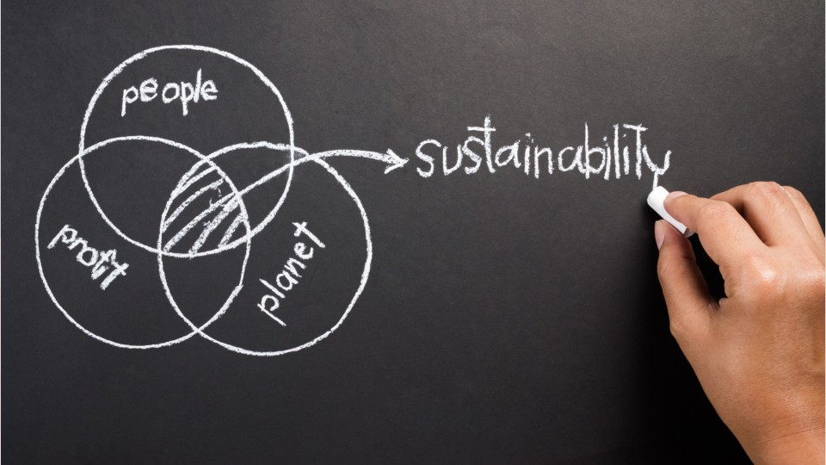
Why?
Students are requesting
Sustainable related energy courses
  Solar, wind, hands-on experiences
Central location of sustainable energy activities at Mines
Certificate or stamp in their transcript and added to their resume
Busy student schedule and high credit degrees require a flexible distinction path that values holistic learning:
  Learning also happens outside of classrooms
  Diverse options to meet our diverse students needs
  Flexible opportunities
  Value students leadership and self-driven efforts
This Photo by Unknown Author is licensed under CC BY

Slide 3
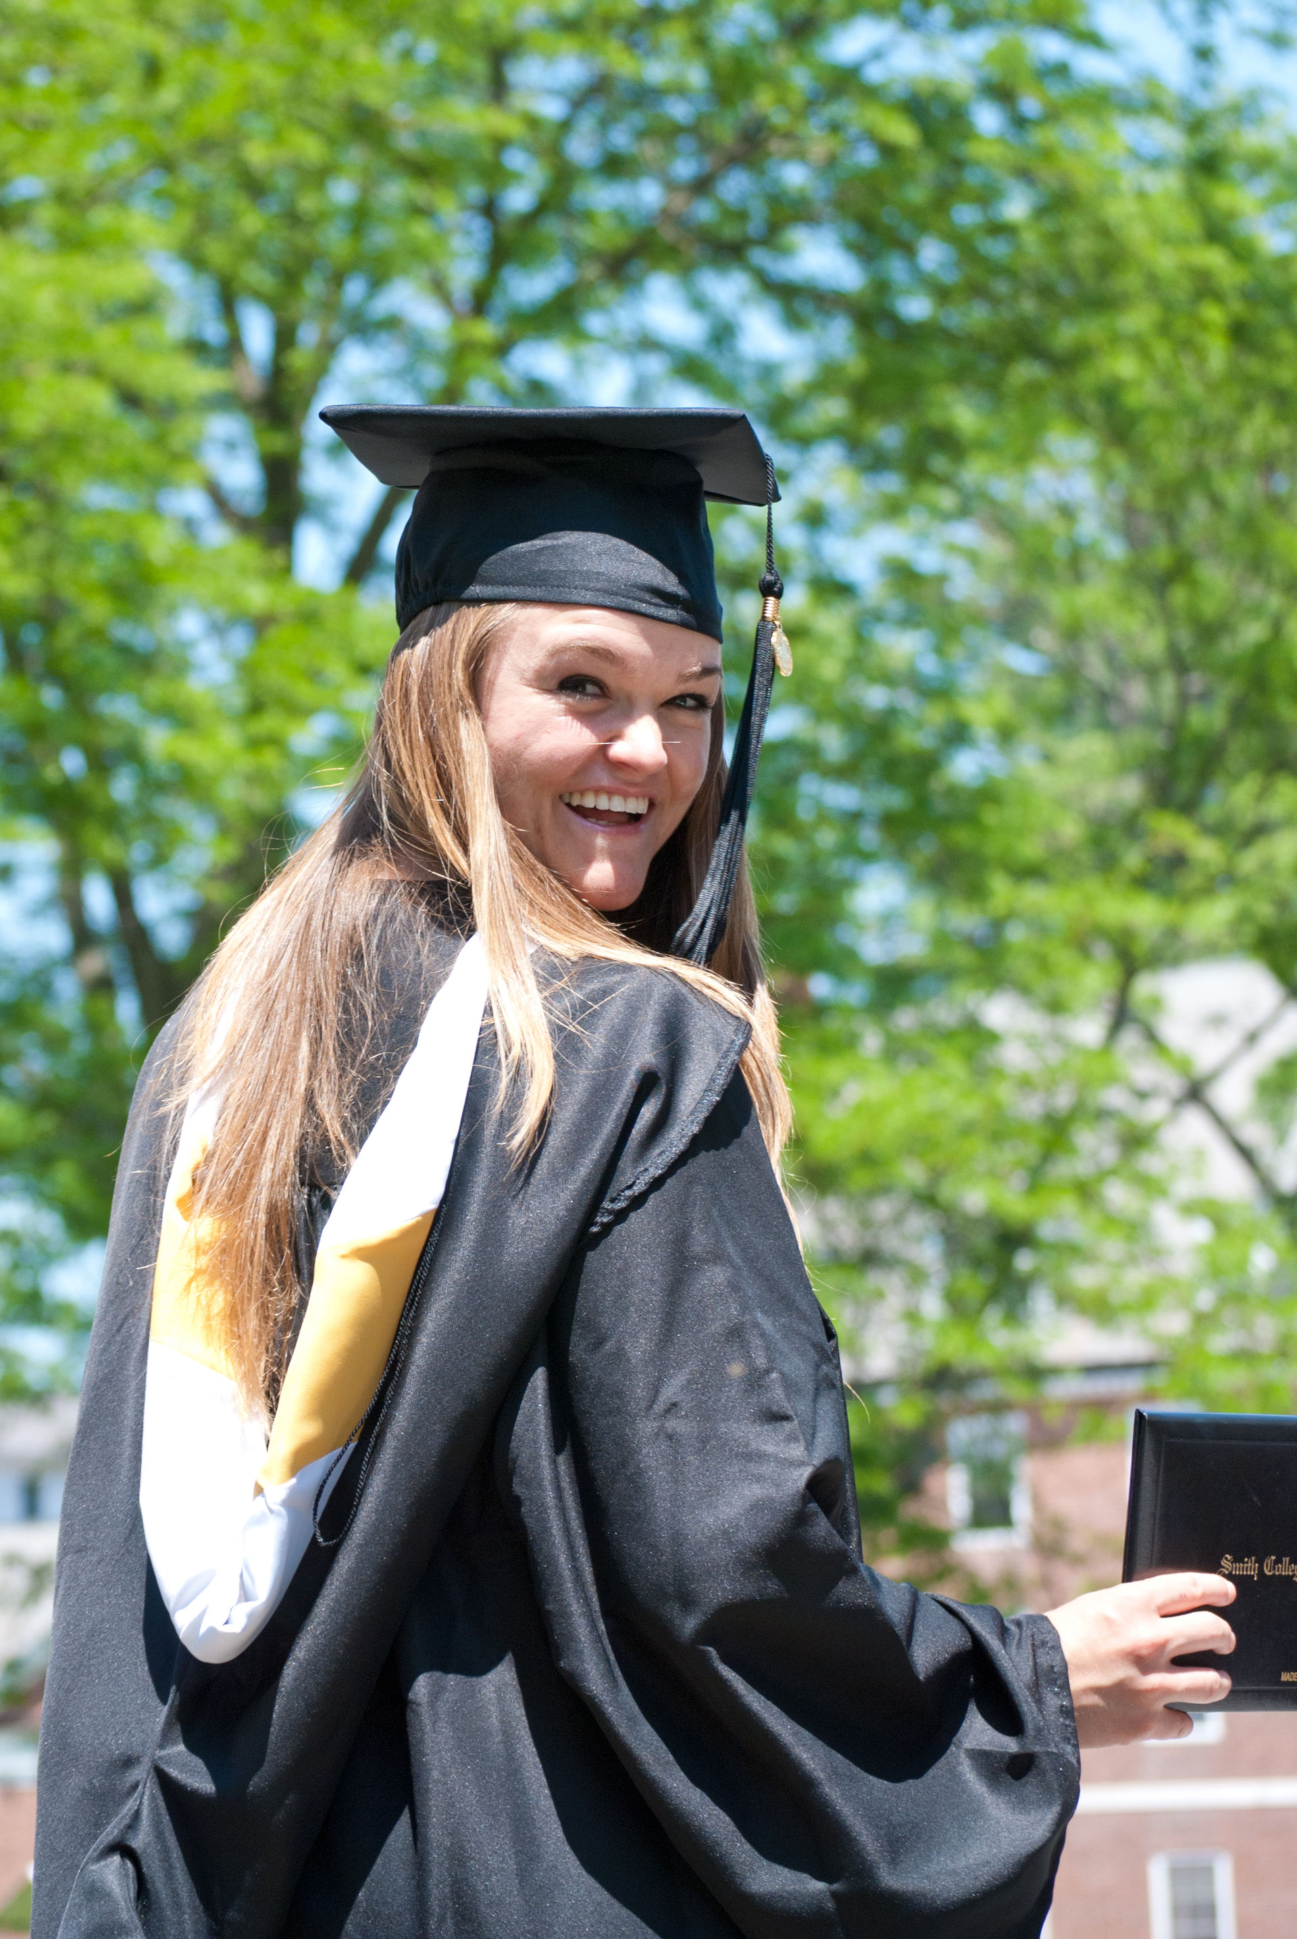
Sustainable Energy @ Mines: Objective
Recognize students’ sustainable energy-related engagement on campus with a graduation distinction
Low credit requirement to support our community of students from different majors who are in various ways focused on learning about and shifting the landscape on sustainable energy.
This honor has minimum qualifications and point system (60 points) based on three categories:
  LEARN
  APPLY
  BUILD COMMUNITY
This Photo by Unknown Author is licensed under CC BY-SA

Slide 4
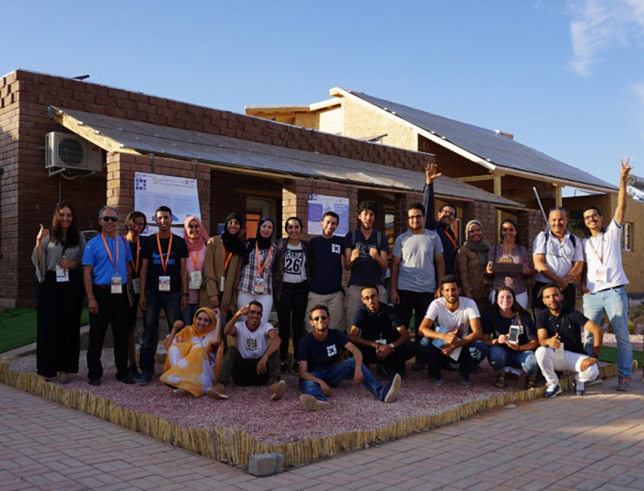
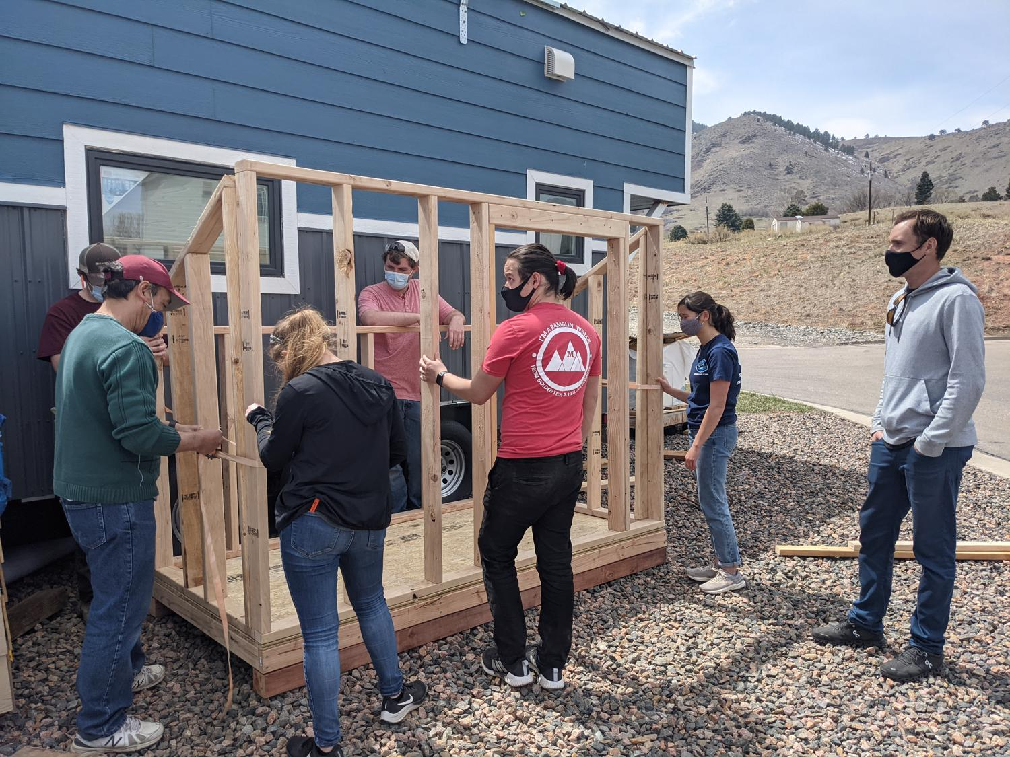
Sustainable Energy @ Mines
LEARN (minimum of two)
Mines course pertaining to sustainable energy (3.33 points per credit hour)
Attend relevant lectures or webinars (1 point each, up to 10 points)
APPLY (minimum of one)
Sustainable energy-related internship or research internship (10 points/summer/semester)
Social/community engagement (such as training sessions, or community development projects) (describe commitment and propose)
Solar Decathlon or energy work on Tiny House (5-10 points/semester)
Industrial Assessment Center Certificate (20 points)
Present research results at external conference or publish journal paper (10 points each)
Present research results at Graduate Research and Discovery Symposium (GRADS) or Undergraduate Research Symposium (5 points each)
BUILD COMMNUNITY (minimum of one)
Executive officer of an active energy-related student club (5 points/semester)
Host an energy-related social networking event not sponsored by student club (5 points each)
Attend a related social networking event (1 point each, up to10 points max). (Includes ASHRAE, ASME club meetings, EEC, etc, requiring active participation)
Attend Environmental Leadership Lab (5 points)

Slide 5
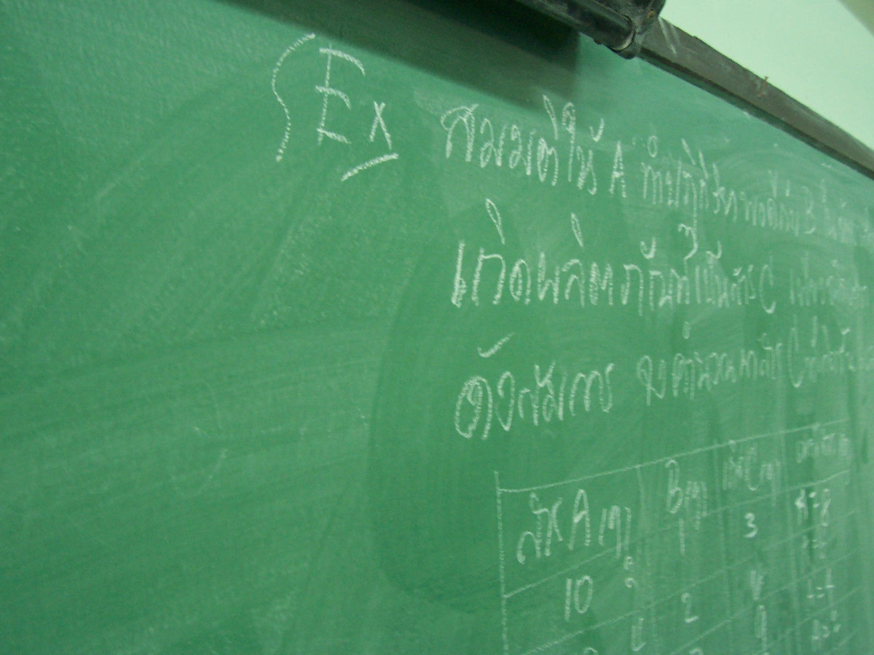
Sustainable Energy @ Mines
Mines courses pertaining to sustainable energy:
CEEN477 Sustainable Engineering Design
CEEN501 Life Cycle Assessment
CEEN576 Pollution Prevention: Fundamentals and Practice
CEEN360 Introduction to Construction Engineering
EDNS491/492 Smart/Sustainable Environmental Design Studio (SEDS)
EENG390 Energy, Electricity, Renewable Engineering & Electric Power Grid
EENG475 Interconnection of Renewable Energy, Integrated Power Electronics, Power Systems, and Power Quality
EENG481 Analysis and Design of Advanced Energy Systems
EENG589 Design and Control of Wind Energy Systems
ENGY200 Introduction to Energy
ENGY320 Introduction to Renewable Energy
ENGY350 Geothermal Energy
HASS464 Environmental Law and Sustainability
HASS490 Energy and Society
HASS491 Energy Politics or HASS492 Energy & Security Policy
MEGN469/569 Fuel Cell Science and Technology
MEGN467/567 Principles of Building Science
PHGN419 Principles of Solar Energy Systems
This Photo by Unknown Author is licensed under CC BY-SA

Slide 6
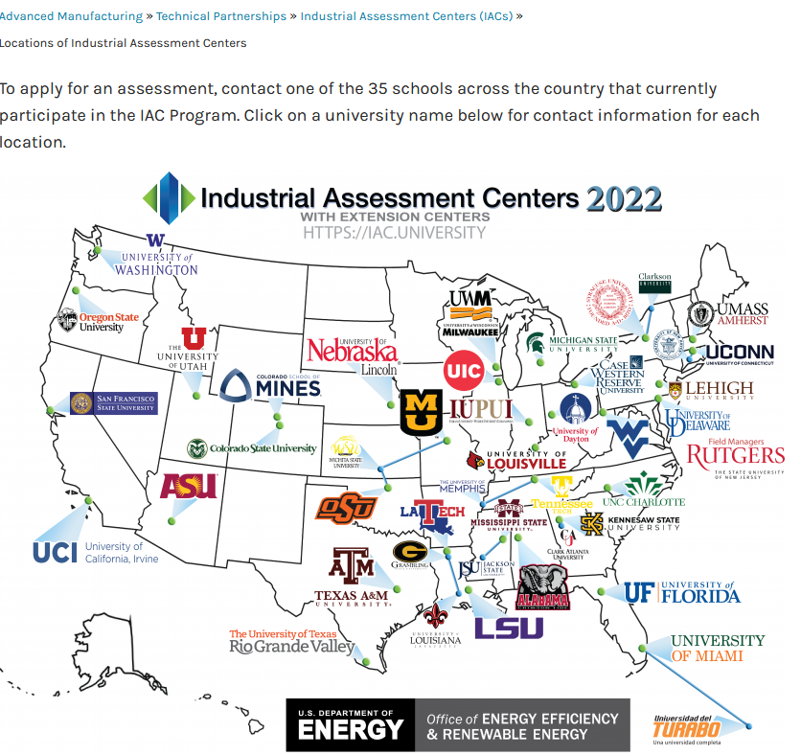
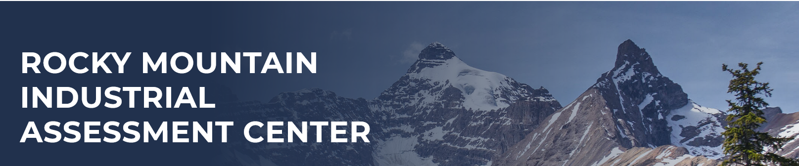
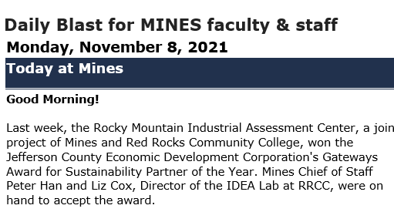
Work done so far?
Successfully developed a $2.2 million DOE Grant:
  Rocky Mountain Industrial Assessment Center
Developed SE@M idea and point systems and reviewed current courses available
Engaged with students
  Surveyed more than 200 students
  Hosted about 30-40 students to get additional feedback
Met and got feedback from multiple senior faculty and school administrators
Submitted Tech fee
Ready to launch!!!

