Slide 1
Mines Online Status Update
Sam Spiegel, Assistant V.P. Online Education

Slide 2
Mines’ Mission: the core = educating
Colorado School of Mines is a modern learning center that is one of the country’s oldest and most distinctive STEM universities—a place where curious, ambitious and dedicated students work closely with professors, researchers, and industry professionals to engineer solutions to the world’s most pressing challenges. At the heart of Mines’ mission is providing rigorous and high-quality learning opportunities and programs focused on STEM fields around Earth, Energy & Environment- regardless of modality.

Slide 3
Online teaching and learning is a modality that allows:
Greater ACCESS
FLEXIBILITY in location and time
Rich ENGAGING experiences
Integration of SUPPORTS & SCAFFOLDS
Supporting learners ACROSS THEIR CAREERS
Opportunities for NEW PARTNERSHIPS
MODERN approaches
Extended CAREER-LONG LEARNING
Notes:
Access regardless of geographical locations (some technical limitations)
Flexibility in when (during day/week) learning occurs
Engaging learning opportunities
Utilization of modern approaches to teaching and learning
Providing additional supports (scaffolds) for students
Can reach diverse learners including those with disabilities, working professionals, etc.

Slide 4
MINES Online Teaching & Learning
Is NOT the same as remote courses
nor correspondence or self-study courses.

Slide 5
Online Teaching & Learning at Mines
The Mines online experience is much the same as you would find in our face-to-face classrooms where students interact with
world-class faculty,
colleagues,
researchers,
Alumni, and
industry professionals.

Slide 6
Mines Online Focus
Mines Online’s primary focus is at the Graduate, Professional, and Executive education levels.
In addition, we will develop strategically targeted courses to support our Undergraduate residential population.

Slide 7
Road to where we are today

Slide 9
Timeline Highlights
In 2017, Mines conducted extensive research into online programming:
Explored partnering with Online Program Management (OPM) companies
Interviewed online leaders across ten other universities
Conducted internet and literature search to better understand current trends, issues, and best practices others have utilized
Organized a large faculty committee to develop Standards for Mines Online courses
Organized campus-wide “team online” to guide the establishment of a strong foundation to support online teaching and learning
Accredited to offer multiple online courses and 1 program 12/06/2018.
Began offering first fully-online graduate level program (Space Resources) in Spring 2019.
HLC provided full accreditation in Summer 2020, allowing multiple programs to be offered

Slide 10
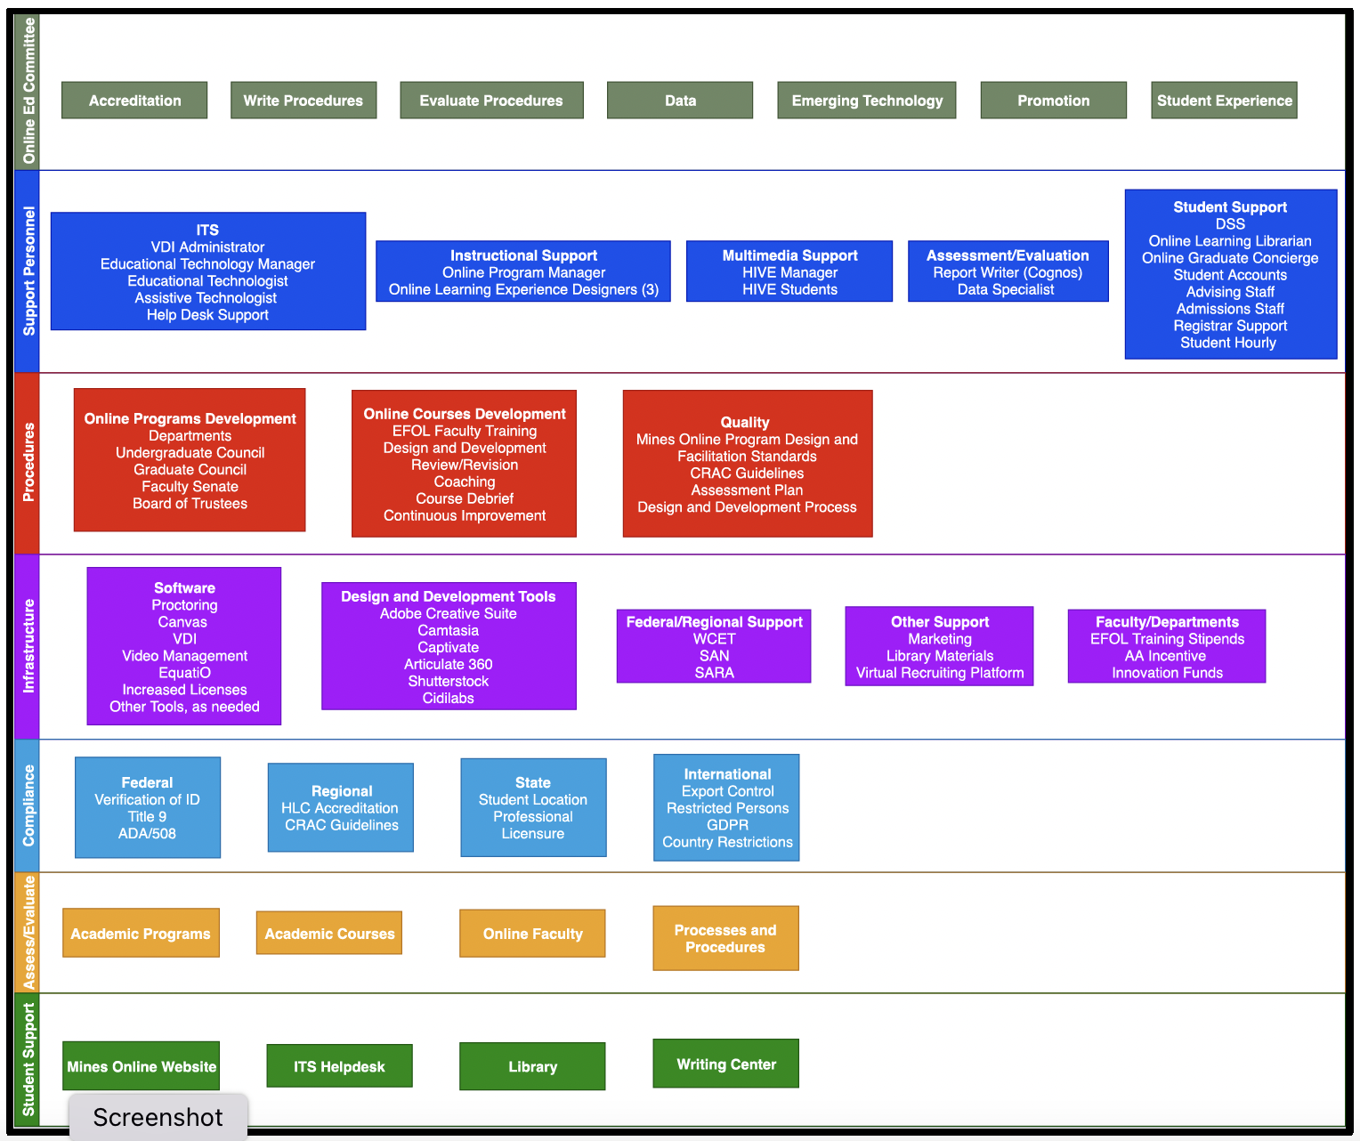
Mines Online and Infrastructure Organized to support online teaching and learning (2018 version)

Slide 11
Launching & Developing Online Programs and Courses

Slide 12
Online Approval Processes
Online follows the same processes as residential with a few exceptions:
Early market study and review by Mines Online to help refine and target portfolio and resources
Provost and VP for Global Initiatives review proposals
Once approved, there are defined and required development and teaching processes

Slide 13
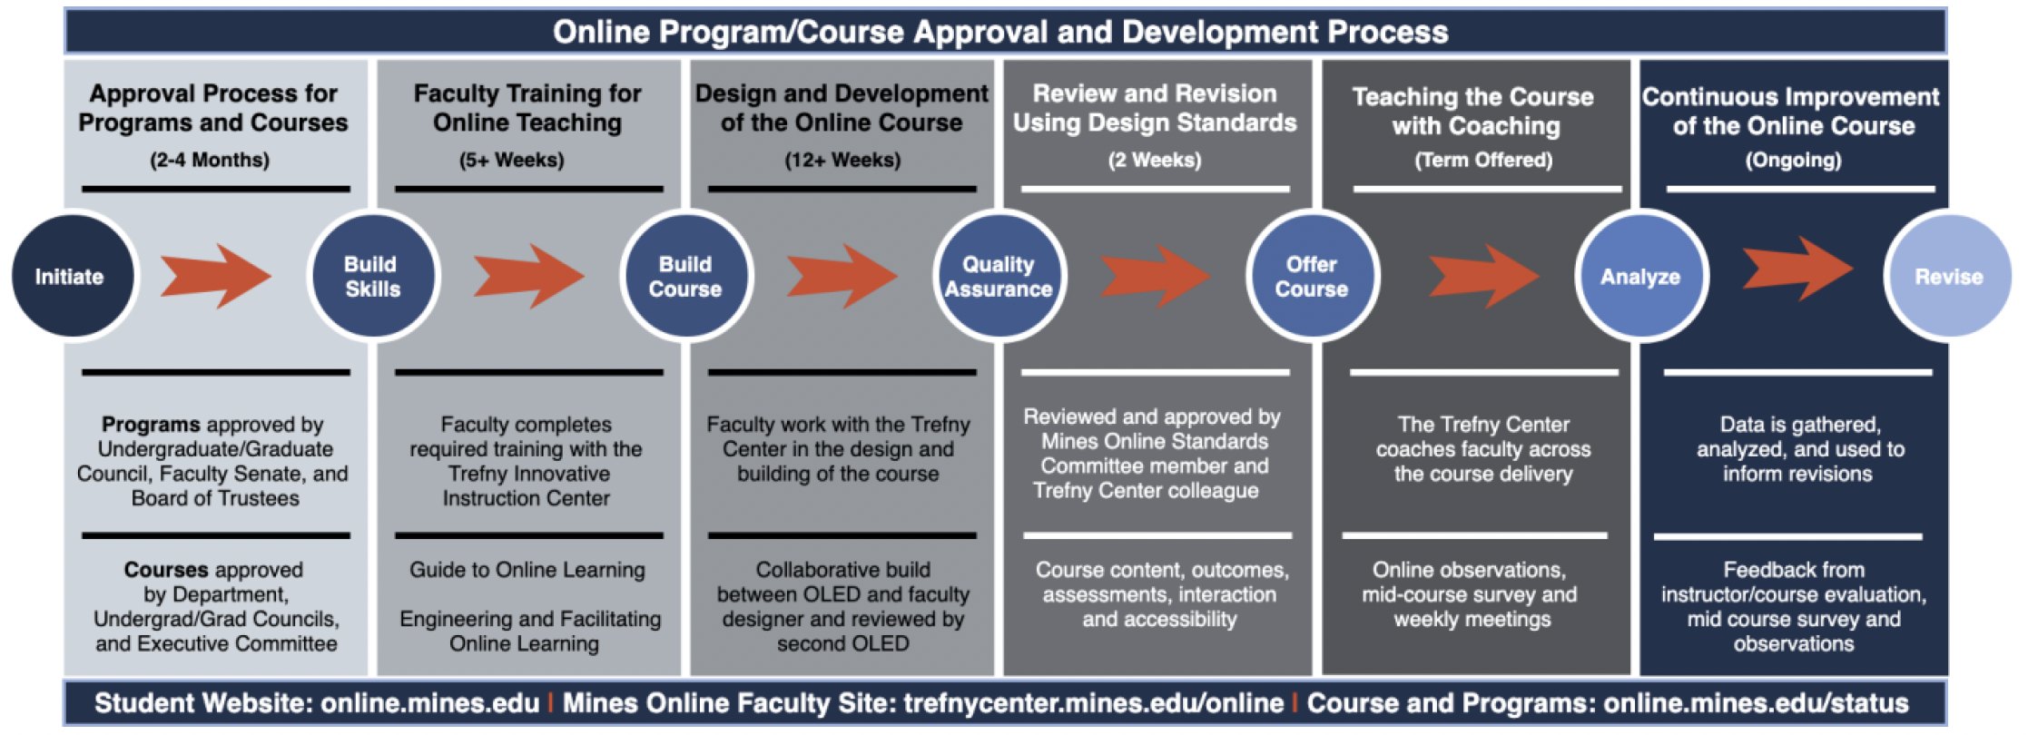
A new flow chart with step-by-step guidance and projected funding will be shared next month.

Slide 14
Development timeline
Most Universities suggest that faculty plan on about 8 hours for each hour of course time – so most courses should plan on about 384 hours of development/prep time.
We have a collaborative design process (faculty builder and OLED- plus support team) that takes most faculty about 140 hours of development time (~14 weeks @ ~10 hrs./week)
Vast majority of faculty complete their build in about 14 weeks and then are reviewed against Mines Online Course Design Standards by another faculty member and a Mines Online member.

Slide 15
Mines Online by the Numbers

Slide 16
Mines Online by the Numbers
Target Goals:
Steady state of ~ 900 fully-online graduate students enrolled in online degree programs.
That goal may be adjusted to account for # fully-online students enrolled in online credit-bearing courses.
Continuing education experiences – goal not established yet.
UG level- goal is to support more flexibility and tackle bottle-neck courses issues.
Fully Online Programs :
Launched: 22 degrees (1 PhD; 2 MS; 19 Cert.**)
Launched: 9 CPES short courses
In Development: 2 MS & 6 Cert.
Courses:
122 built and passed Standards
33 Proposed courses delayed in development
~ 9 courses started but not completed
4 courses mostly built – did not pass standards

Slide 17
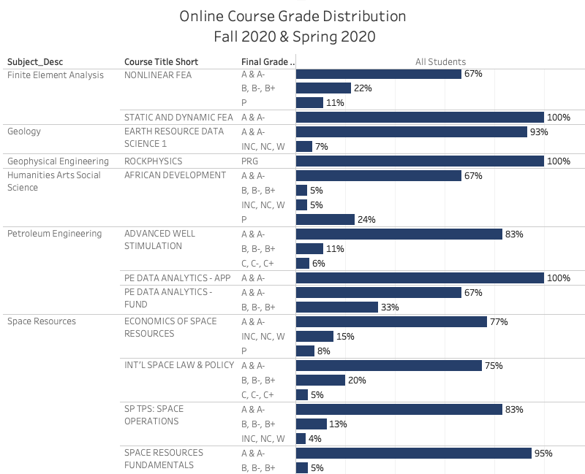
Mines’ online students are performing at comparable levels with our residential population
(based on grade distributions, retention, and student feedback)

Slide 18
Online degrees Awarded 2019-2021

Slide 19
Mines Online by the Numbers Fall 2021 Enrollment in all Online Courses (as of 08/09/2021)
1052 Students in total
(may include some double counting)
570 Students in Grad Courses
(500+ level)
(includes residential and fully online students; may include some double counting)
482 Students in UG Courses
(100-499 level)
(includes residential and fully online students; may include some double counting)
** For ”target goal” numbers, we are refining what counts, but our current number is 210 students enrolled in online programs for Fall ’21.

Slide 20
Mines Portfolio and future directions

Slide 21
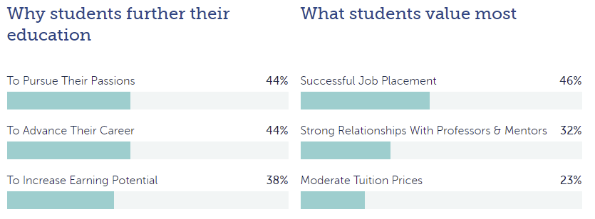
Student Expectations for Online
Source: https://eab.com/insights/blogs/adult-learner/graduate-student-recruitment-strategy/

Slide 22
Mines Online Portfolio- designed to:
Meet rapidly changing needs of industry, STEM fields, students, & faculty
Provide continuity of learning across a persons’ professional career, including Mines’ alumni and new professional populations around the world
Establish opportunities for new partnerships and reaching new student populations
Remain competitive and modern
Providing unique, interactive and engaging, supportive online learning experiences

Slide 23
Through Mines Online, students may want to:
brush up on a specific skill or content area;
learn a new approach or new technology (new to them or the field);
develop a more comprehensive understanding and skill set in a field (certificate, Masters, PhD);
explore a specific subject just because they are curious about it; or
engage with others in a specific field.

Slide 24
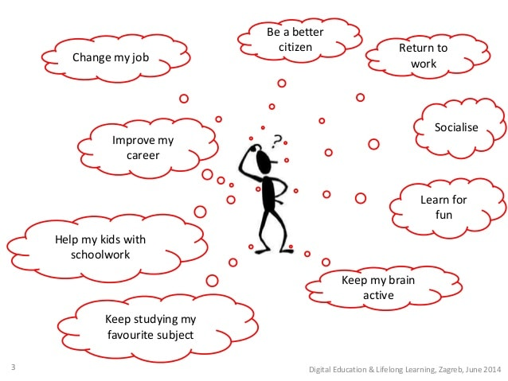
Our goal is to develop a rich portfolio of learning opportunities to support ongoing needs and life-long learning for all Orediggers - through their careers and beyond

Slide 25
Q&A Discussion
What questions do you have?
For more information or additional questions,
reach out to Sam Spiegel (sspiegel@mines.edu)

