Slide 1
Office for Entrepreneurship & Innovation http://innovation.mines.edu
Werner G Kuhr, Director
Sid Saleh, Associate Director (Academics); Bud Rockhill (Interim Director, Beck Venture Center)
Jennifer Crawford, Asst. Director (Communications)
March 8, 2022

Slide 2
Are Mines Graduates Entrepreneurial?
A recent search on Linked-In found:
Title Keyword | # Mines Alumni
CTO (Chief Technical Officer) | 72
Founder | 512
CEO (Chief Executive Officer) | 476
President | 2,059
Roughly 11% of our 30,000 alumni!

Slide 3
Center for Entrepreneurship: Mission and Vision
VISION
Integrate an entrepreneurial and innovative solution-oriented mindset in all academic departments at the Colorado School of Mines, where entrepreneurs are seamlessly connected with the infrastructure, resources, and funding they need to achieve their goal.
MISSION
One, to educate all our students in modern entrepreneurial thinking, and
Two, to provide the opportunity for our students, faculty and alumni to explore the commercialization of their science and technology ideas.

Slide 4
Entrepreneurship Process at Mines
Business Venture Creation Framework
Goal: Increase the conversion of Mines Earth/Energy/Environment concepts, ideation, innovations, etc. to profitable, sustainable business ventures
EDS / McNeil E&I Center
Business Analytics / ETM MS
Education
R&D /
Innovation
Problem Definition
Solution Prototyping
Market Validation
Product Development
Commercial-ization
Scale
Growth/ Exit
Business Model Development
Funding: PreSeed, Seed, Early Stage, Later Stage, etc.
McNeil Center for E&I: Students, faculty, alumni
(McNeil Hall, Labriola InnoHub, Nickoloff Fellows)
Business Incubator (Beck Venture Center)
Alumni Mentors and Companies
Business Accelerator (Beck Venture Center)
Office of Research and Tech Transfer

Slide 5
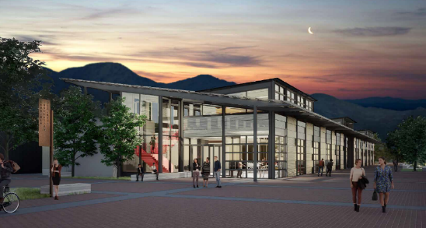
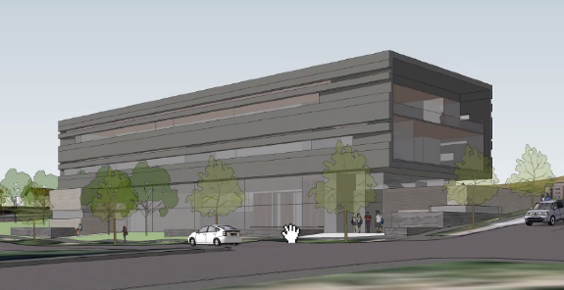
Mines E&I Ecosystems
Problem Definition
Solution Iteration
Initial Learning Experiences
Startup Concept Development
Programs
Cornerstone & Capstone classes
EBGN 360 Intro to Entrepreneurship
EBGN 498 Change the World
EBGN 598 Innovate X Courses & Studio
University Innovation Fellows
Mentor training and engagement
Resources
Nickoloff Entrepreneurial Faculty Fellows
Kern Engineering Entrepreneurial Network
Humanitarian Engineering
Social Entrepreneurship
NAE Grand Challenges Scholars
Maker Spaces
Library Tools Checkout
Startup Workshops
Programs
EBGN Entrepreneurship Certificate
ETM MS Degree
Lean Canvas Workshop Series
Mentors and EiRs
Resources
Mines Innovation Fund
Maker Spaces / InnoHub / BVC
Library Tools Checkout
Nickoloff E&I Faculty Fellows
On-line training workshops
Collaborative Opportunities
Alumni companies & startups
Student Clubs (UIFs, Evolve, Maker Society, Robotics)
Engineering Design & Society programs
Advanced Manufacturing Certificate
Academic Depts & Library
NREL, DoD/NSIN, DHS, FEMA, CISA, CO-OEM
Global partners (UAE, Oman)
Funding and Growth
Stakeholder Engagement
Pitch Competitions
Innovate X Demo Day
Innovate FEMA Hackathon
Advanced Manufacturing Challenge
Emergency Management (EMx) Challenge
Data Analytics Hackathons
Wright Outdoor Challenge
Henderson (Freeport McMoRan) & Newmont Mining Challenges
360 Demo Day
Energy Venture Investment Conference
External Challenges
Inclusive Community Spaces
Startup Launch
McNeil Hall
Innovation classes
Labriola InnoHub
Cornerstone and Capstone programs
Makerspaces & faculty mentors
Beck Venture Center
Business incubator (students & faculty)
Co-working space (alumni & community)
Innovation corporate partners
Startup Development Services
NSF I-Corp Hub (w/USC, UCLA, CU Boulder)
Mines Foundation Venture Fund
RTT – Technology Transfer (MATTI) support
E&I Alumni Interest Group
Mentor Programs (future EiRs)

Slide 6
Buildings
McNeil Innovation Classroom Space
State of the art innovation classrooms
Labriola Innovation Complex
30,000 sq.ft. Innovation workspace with multiple makerspaces, co-working space and office space
Beck Venture Center
34,000 sq.ft. business incubator and accelerator
  Event space, co-working and private office spaces

Slide 7
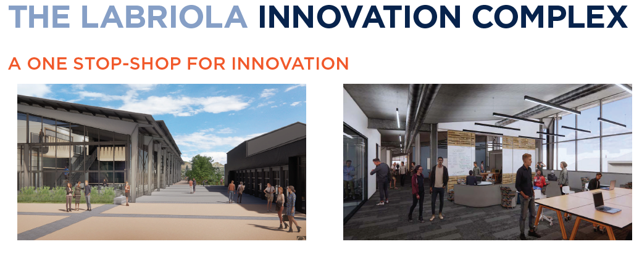
McNeil Center for E&I – Donors and New Facilities
Thanks to our founding donors!
  Charles “Charlie” McNeil ’71 and his wife, Judy McNeil, made a generous gift to endow entrepreneurship and innovation programming and established McNeil Hall, a teaching laboratory for E&I, where all Cornerstone classes are now taught.
  Thomas Nickoloff’83 funded and helped create a E&I Faculty Fellows program to establish an active, collaborative network of colleagues who are informed and enthusiastic about integrating an entrepreneurial mindset into their teaching and research.
  Frank ’52 and Mary Labriola, who donated toward the construction and development of the Labriola Innovation Complex, a hub for student-led collaborations. The facility will contain makerspaces and mentor offices for Cornerstone and Capstone programs, as well as student clubs and competition teams, such as SAE Formula One car, ASCE concrete canoe, SpaceX Hyperloop sled and more!
  Mike and Kelly Beck made a generous gift to be used to attract and match other investments in the new Venture Center. This will provide Mines student, faculty, and alumni entrepreneurs with the space, knowledge, mentoring support, and connections to other entrepreneurs and investors necessary to build sustainable and successful commercial entities.
THE BECK VENTURE CENTER:
EDUCATE • CONNECT • LAUNCH

Slide 8
Academic programs with expanded entrepreneurial content – 2020/2021 (Dr. Sid Saleh, Associate Director)
Current and Planned Academic Programs
  Engineering Design, Society: Contributed E&I modules and co-created EDNS 151 Design I Innov8x Edition.
  Formalized Innov8x, piloted Innov8x Studio and currently launching Innov8x Study Abroad with Honors.
  Innov8x Studio allows Mines startups to test and de-risk their innovations in context.
  Integrating entrepreneurship broadly: Innov8x now fulfills requirements for these MS degrees:
    Data Sciences, Advanced Manufacturing, Humanitarian Engineering, Supply Chain, and Space Resources.
  Created the Nickoloff Faculty Fellows Boot Camp and trained 11 faculty who delivered E&I outcomes.
  Working with EB to create a course sequence and standalone entrepreneurship minor.
  Creating Startup Your Career workshop with the Career Center.
  Shared Instrumentation Facility: developing a subscription-based model to grow revenue.
Partnership Development – External
  Innov8x: DoD, DHS (1st nationwide course), FEMA, UAE, City of Golden, and others.
  VF Corp: ran a series of three flash challenges this semester.
  Allegion: expand enrollment in product management certificate, online leadership 1-credit courses.
  MI3: commercialize Backsweep – a product developed by Daniel Croce in Petroleum Engineering.
  S3Key: commercialize IP developed by Dejun Yang.
  Expanding Innov8x online enrollment through partnerships with UAE universities.

Slide 9
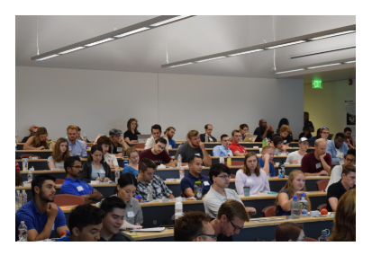
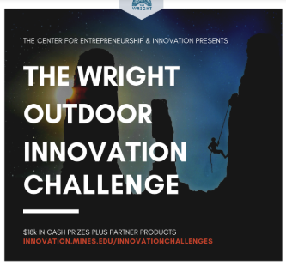
Innovation Competitions and Hackathons
2019/2020
Henderson Sustainability Challenge – two seasons (2018 and 2019)
  Sponsored by Freeport/McMoRan and Mining Department
  Started Saturday, Aug 25, 2019, last Demo Day was Friday, Dec 7, 2019
  Over 100 students started in ~20 teams, extensive mentoring and interaction with community, final 5 teams pitched for $50K in cash prizes
NREL Solar Hackathon (2018) and Data Analytics Hackathon (2019)
  NREL hackathon on Nov 10, 2018 hosted by Mines; Data Analytics Hackathon in Oct 2019
  Roughly 50 students at each event
  Mines teams placed 1st and 3rd at NREL; all Mines teams in Data Analytics Hackathon
The Wright Outdoor Adventure Challenge (2019)
  Sponsored by VentureWell, kickoff was Jan 12, 2019
  Almost 100 students, 20 teams focused on developing solutions to problems posed by 10 companies who presented and pitched
  Demo Day is Monday April 29, 2019 at 5PM (Marquez 126)
Advanced Manufacturing Innovation Challenge (2019)
  Co-sponsored by Space Resources and Advanced Manufacturing Programs, run by Craig Brice and Jennifer Blacklock
  Roughly 80 students from Mines
  Judges from Lockheed Martin, Ball Aerospace and Griffin Systems on Dec 5, 2019
Future Cities Competition – hosted on Jan 18, 2020 (2nd Annual at Mines)
  Regional Competition was hosted on campus at Mines. This event encourages over 200 students in 6th, 7th and 8th grades to imagine, research, design, and build cities of the future that showcase their solution to a citywide sustainability issue. Theme this year was water conservation.

Slide 10
Existing Programs in E&I at Mines
"Energy Venture Investment Summit" launched with new partner Enercom, Inc.
  Two day virtual event featuring startups in the energy transition held on Feb 10-11, 2021
      25 startups, including 2 Mines student teams and 8 alumni startups
      450 pre-registered attendees in energy companies, investors and VCs, viewed over 1,000 hours of live presentations
      John Bradford gave keynote address on Mines Global Energy Futures Initiative
  Planning live event at Mines in February next year (Green Center, ~1,000 participants expected)
Interim Beck Venture Center
  Interim Director hired
    Bud Rockhill (Managing Partner, Traxion, Golden), has worked with Mines for ~4 years training teams at Innovation Challenges
  Interim Space at 1600 Jackson defined and ready to go
    Space for ~12 Mines teams
    E&I office will be moved to 1600 Jackson until Labriola InnoHub complete (summer, 2022)
    Strong interest by VC groups to partner with Mines to develop accelerator and investment fund
McNeil Center: Launched InnovateX, grad level innovation course
  Follows format of Innovate EMx (with FEMA) and Hacking for Defense (with DoD)
  New sponsor – UAE Ministry of Possibilities, who funded development of course by Prof. Sid Saleh
  Leads to new "InnovateX Lab", a six week startup boot camp to be held this summer at Mines (or virtually)

Slide 11

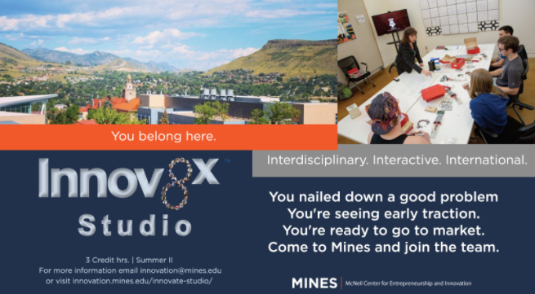
Entrepreneurial Programs: Innovate X: Past, Present & Future
Spring 18
Spring 19
Fall 20
Spring 21
Summer 21
1st H4D Course
Innovate Defense | H4D
Innovate EMx Course
Course
Studio
1 team = 3-5 students
Plus 1-3 mentors
4
5
6
8
Teams
Teams
Teams
Teams
2
2
2
Startups
Startups
Teams
?
1
Deployment
H4D is Hacking for Defense, a DoD program administered by National Innovation Security Network (NSIN)
Innovate EMx was sponsored by FEMA, and will later include addn’l divisions of Homeland Security
UAE Ministry of Possibilities is sponsoring development of “Innovate Public Service”

Slide 12
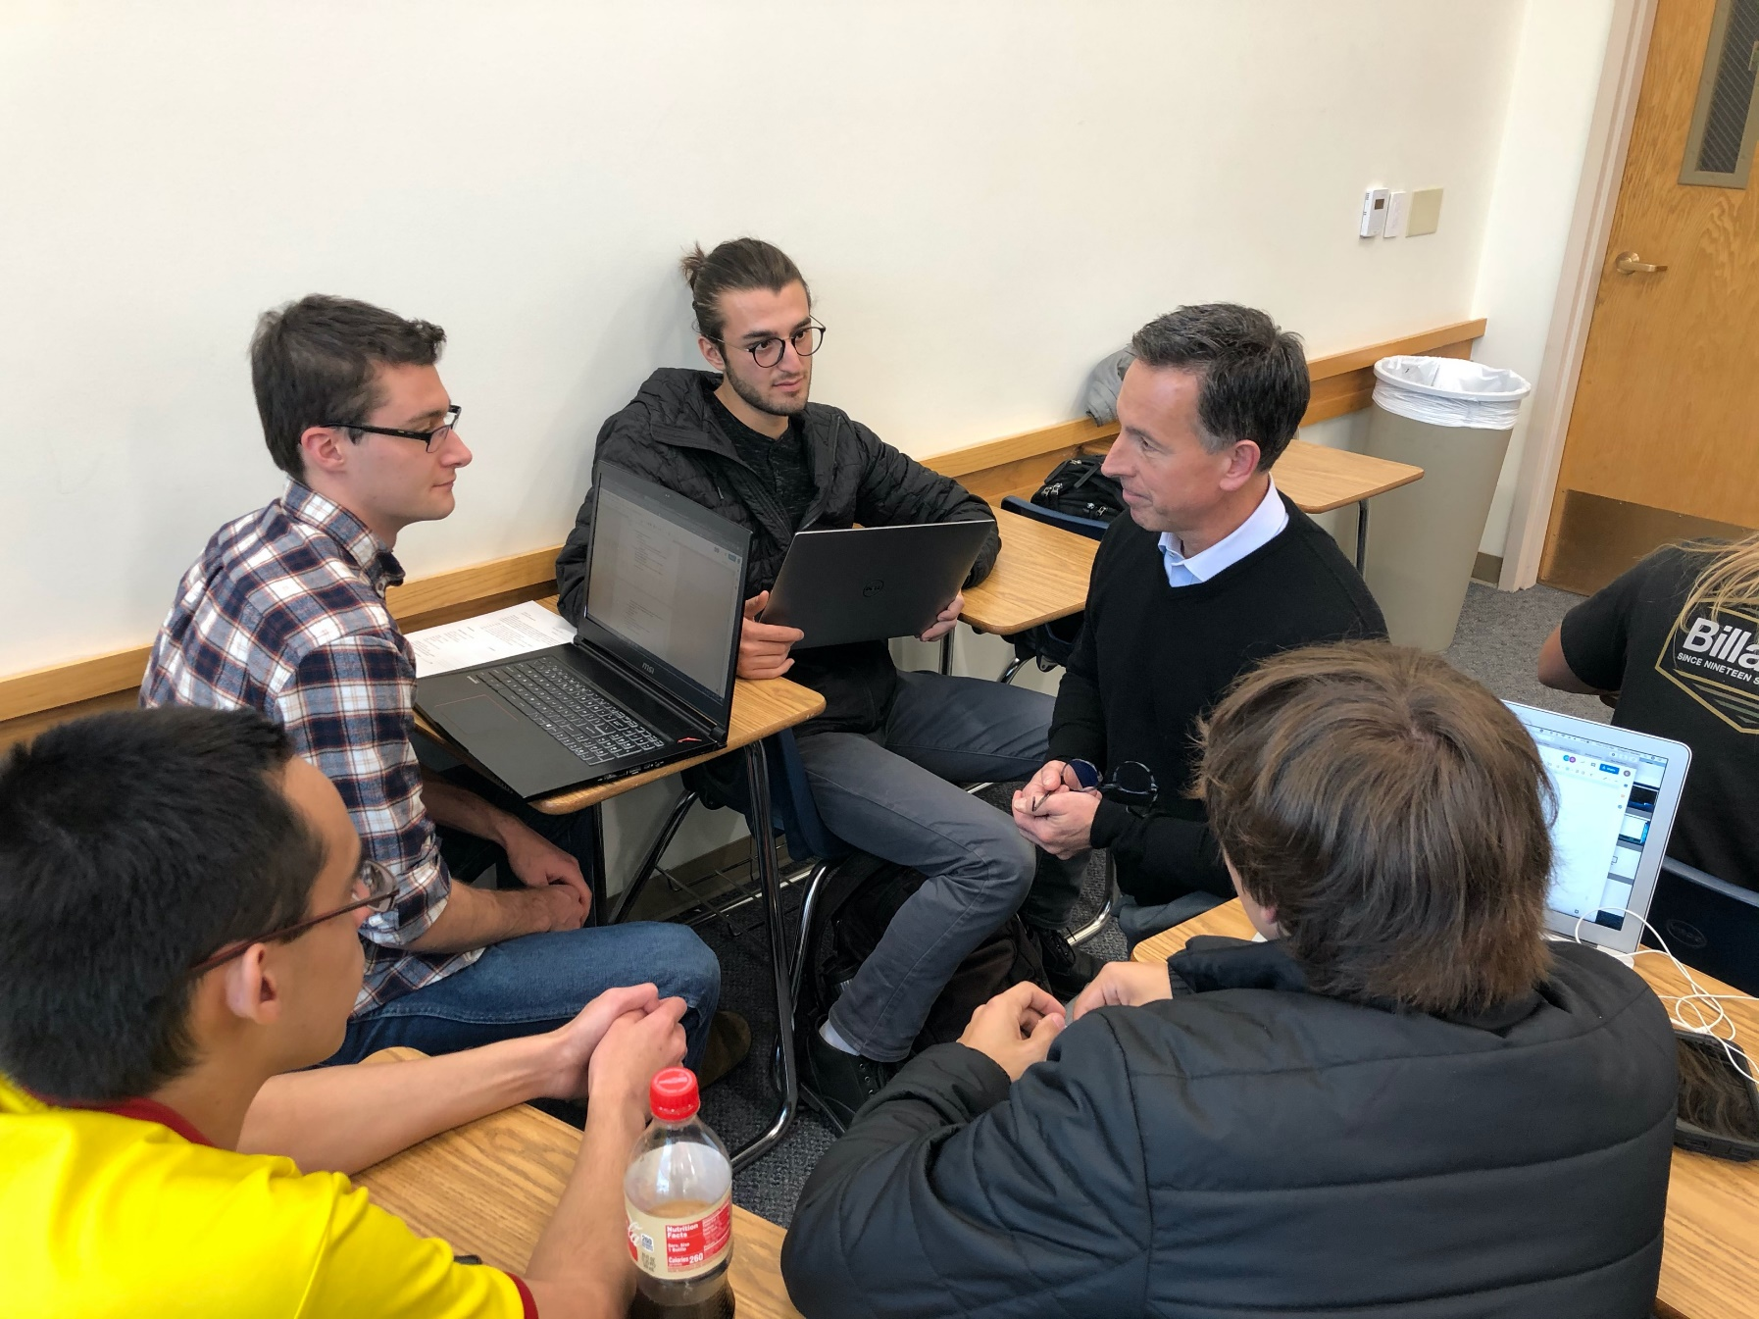
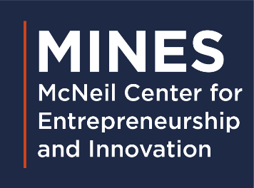
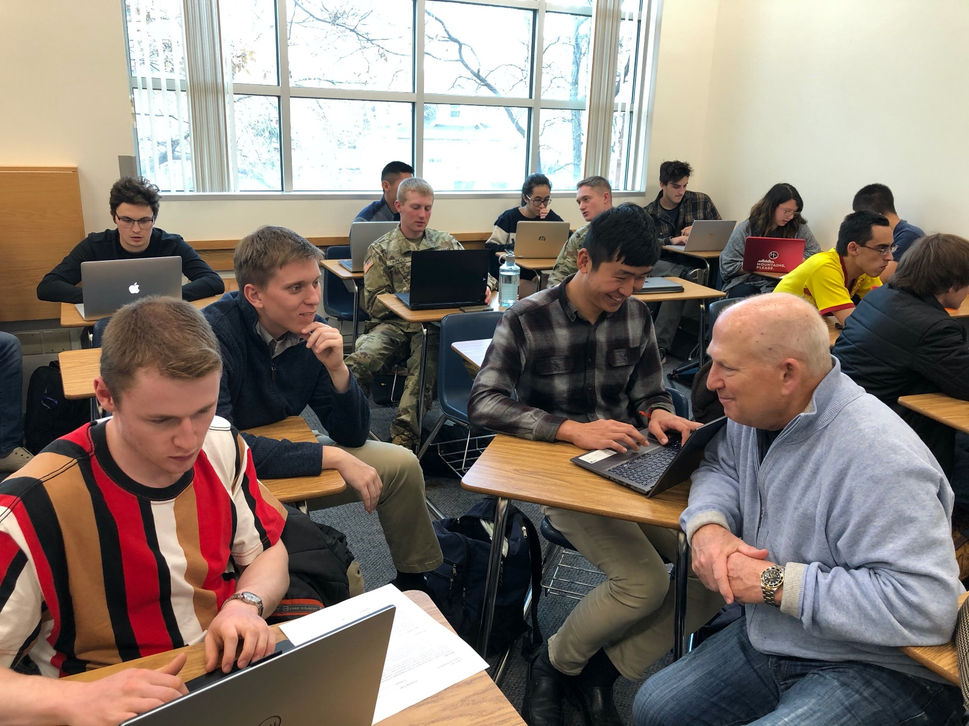
Mentor: Todd McLean, President, BOK Financial Insurance
Mentor: Rodney Marcy, Former VP, Covidien, Serial Entrepreneur

Slide 13
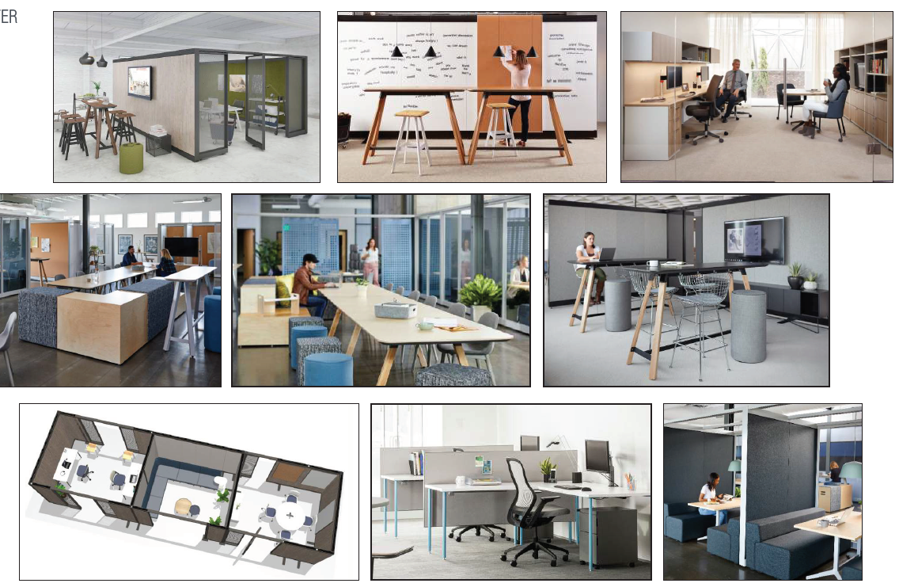
Beck Venture Center – Purpose and Function
Key Facilities and Programs
  Co-working Space for Mines and Community
  Business office space for Mines Startups
  Seed and Venture Funds for Start-ups
  Corporate Sponsors & Angel investors
  Alumni collaboration & sponsor co-location
Entrepreneurs in Residence (mentors)
Continuing Ed & on-line resources
Business resources and consultants
IP licensing and translational support (w/TT)
Competitions and hackathons
Meetups and networking events
Layout and Design

Slide 14
Beck Venture Center Programs
Founder Membership (Individuals)
  Co-working open office space
  On-line educational resources
  On-line and in-person workshops to support new ventures
  Innov8x competitions and sponsored events
  Mentorship
  Networking opportunities with mentors, startups and sponsors
  Opportunities for internships and employment
  Eligibility for pretotype development funding
Venture Membership (Teams)
  Co-working open office space and shared private workspace
  Prototyping space (Innov8^{x} Lab)
  Advanced on-line educational resources
  Advanced workshops and access to accelerator programs
  Eligibility for BVC Innovation grants
  Eligibility for access to BVC equity funding (companies only)
  Introduction to established companies / technology licensing
Professional Partners membership (Companies)
  Reserved office space
  Participation as mentors
  Increase awareness among students for potential recruiting
  Ability to submit projects for innovation competitions and courses
  Access to Career Center for job postings and internships
  Access to review early stage concepts
  Access to review university license portfolio
Funding Opportunities – Eligibility Based on Membership Level
  BVC Innovation Grant (Seed funding to develop an idea or prototype)
  Innov8x Grant (Seed funding to work in the Innov8x Lab)
  BVC Startup Accelerator Grant (Seed funding from Mines Foundation & CO OEDIT to pursue commercialization)
  Proof of Concept Grant (Funding for faculty/staff to develop a research idea for commercialization)
  Proof of Concept 2 Grant (Funding to explore commercialization opportunities for POC projects)
  Nickoloff Faculty Fellowships (Funding to develop entrepreneurial mindset in faculty)
  Mines Venture Fund 1 (Future Equity-based funding for new startups; late 2022)
  Introductions to Affiliated Accelerators and Venture Funds

Slide 15
New Partners in Entrepreneurship and Innovation
West Gate at Mines
  The U.S. Department of Energy (DOE) launched the latest expansion of its Lab-Embedded Entrepreneurship Program to accelerate the commercialization of clean energy technologies. Hosted by the National Renewable Energy Laboratory (NREL), with support from the Colorado School of Mines, where Innovators will reside.
  Through West Gate, up to five innovators will be selected via a competitive process and will each receive:
    Two-year paid fellowships: Each fellowship provides an annual stipend of $100,000 with healthcare and relocation benefits for qualifying candidates.
    National laboratory access and research funding: Participants will gain unparalleled access to NREL’s facilities, equipment, and expertise, as well as receive $175,000 of research and development funding to foster research collaboration.
    Business mentors, entrepreneurial training, and networking: Fellows will have access to experienced business mentorship, entrepreneurial training programs, and exclusive networking opportunities. These programs will expose fellows to a wide range of leaders from academia, industry, government, and finance that can serve as advisors and partners.
I-CORPS@MINES (NSF WESTERN I-CORPS HUB)
  The Colorado School of Mines is a proud affiliate of the Western Innovation Corps Hub, one of only five National Science Foundation Innovation Corps (I-Corps) National Hubs, in a partnership between UCLA, USC, and CU Boulder. Our collaboration extends to Caltech, UC Riverside, University of Utah, and University of New Mexico.
  Team Application eligibility
    You are eligible for $50,000 to conduct customer discovery while participating in an immersive entrepreneurial experience. The success rate for I-Corps teams applying for SBIR grants is roughly 50%, or at least 3 times higher than without this training. This funding comes directly to you as a university principal investigator.

Slide 16
Opportunities to engage Partners in E&I at Mines
External sponsorship of entrepreneurial activities in translational research
  (Named) Translational E&I Faculty Fellows –
    Support faculty that receive Proof of Concept funding to take either NSF I-Corps or E&I Faculty Boot Camp (e.g., Nickoloff E&I Fellows Program)
  (Named) Translational Innovation Faculty Chairs – associated with commercial / industrial funding and endowments
    Chairs would be 0.5 FTE in E&I, and receive funds for grad students and postdocs to pursue translation opportunities
  (Named) Academic Entrepreneurial Faculty Chairs – associated with private endowments focused on issues/program areas
    Chairs would be 0.5 FTE in E&I, and receive funds for grad students and postdocs to pursue educational and academic initiatives
  (Named) Accelerator, Innovation Competitions, Start-up Competitions and follow-on start-ups
    Perfect for collaboration & sponsor co-location
    Corporate sponsors & angel investors involvement in challenges
    Corporate Seed and Venture Fund offices located on site

