Slide 1
ITS Information & Technology Services
September 20, 2021
Josh Lawrence - An Introduction to Navigating ITS
Martin Heck – New Xerox printers
Rachel Battista – Workday transition
Jackie Twehues – Cognos/AFBR reports and Workday changes

Slide 2
Agenda
How to get what you need from ITS
Top issues
How does ITS communicate?

Slide 3
Introduction Josh Lawrence jtlawrence@mines.edu
Senior Manager of User Experience and Support Services
25 years IT experience, 20+ years in higher education
Bachelor’s in Mechanical Engineering
Masters in Information Management

Slide 4
Getting help
“Did you submit a ticket?”
Start with TDX at helpcenter.mines.edu
Priority matters – impact
Keywords in ticket subject: URGENT, emergency
Use the Knowledge base – it’s really good!

Slide 6
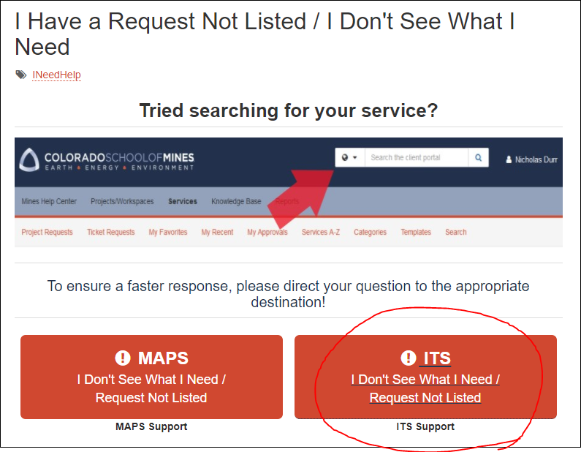
Shortcut for creating a ticket “I don’t know”
Enter “I don’t know” in the helpcenter.mines.edu search box.
Opens a generic form that allows you to enter a description of the issue.
NOTE: Avoid this approach for high impact issues

Slide 7
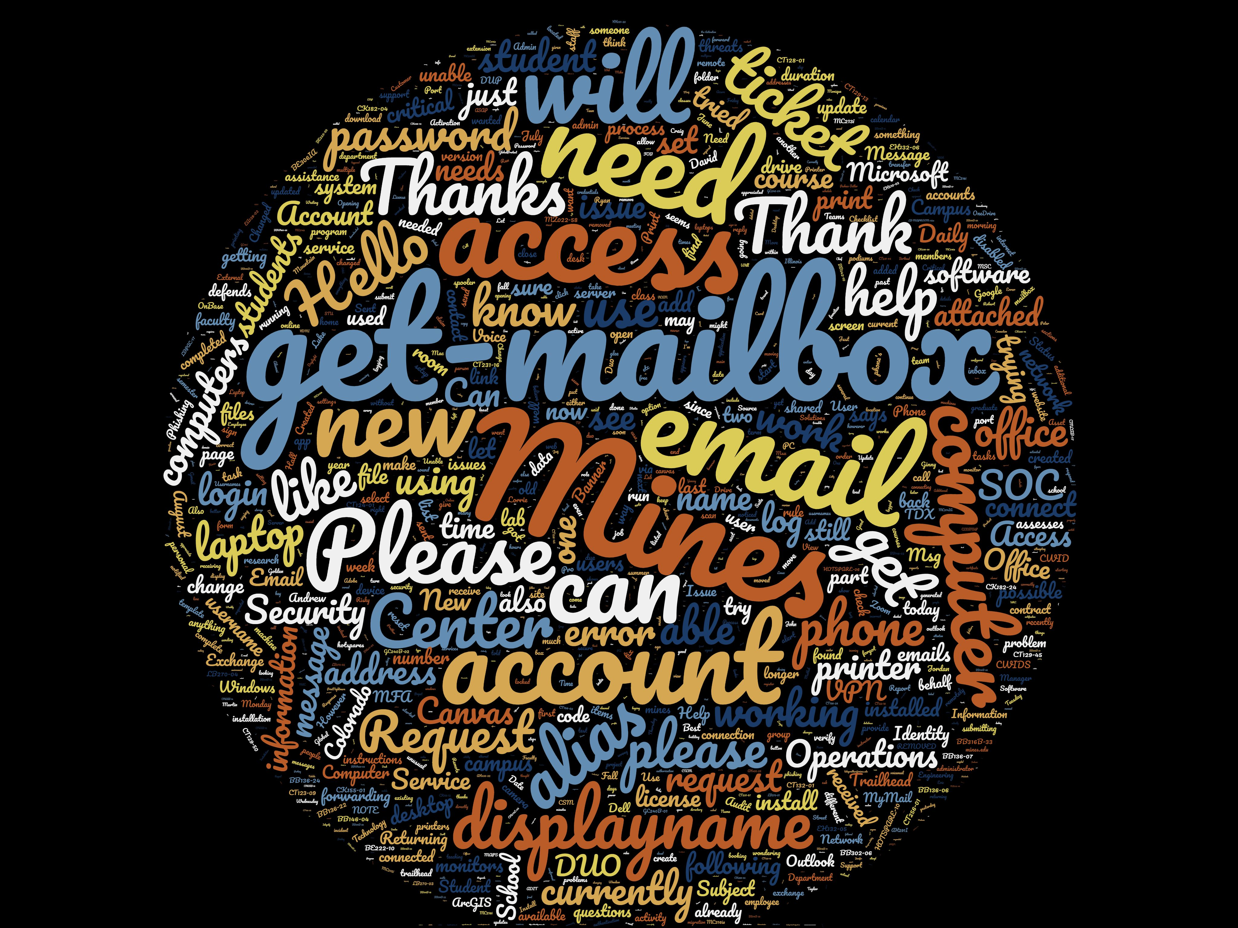
Word Cloud Last 90 Days

Slide 8
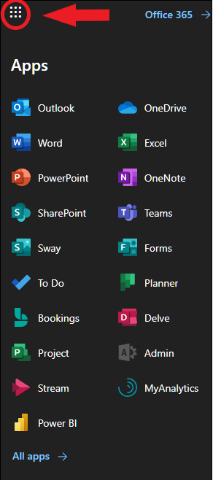
Top ITS Support Topics
Email – workaround:
https://outlook.office.com
Other O365 apps
Other top topics:
Printing
Request to install software
Operating System issues and hardware

Slide 9
Top ITS Support Topics
Security
Phishing is the #1 attack vector, leading to malware payloads
Phish button in Outlook

Slide 10
How ITS communicates
Pay close attention to announcements from ITS
Daily Blast
Direct email
Be quick to ask clarifying questions
*New – Monthly Administrative Professionals meeting!
Other sources of information
https://its.mines.edu
Active and planned outages
News
https://helpcenter.mines.edu

Slide 11
Takeaways | Josh Lawrence jtlawrence@mines.edu (303) 384-2485
Set impact when creating tickets
Use descriptive keywords when needed in the subject line to help us prioritize
Use https://outlook.office.com and the other O365 apps
Watch Daily Blast and email for IT-related announcements
Josh Lawrence
jtlawrence@mines.edu
(303)384-2485

Slide 12
Questions?

Slide 13
Thank you!

