Slide 1
Mines Copy & Print Services, Fall 2021
Martin Heck
Sr. Windows System Administrator
Infrastructure Solutions group
Information and Technology Solutions (ITS)

Slide 2
ITS and Partners Providing Services
ITS Manages:
OreCopy Xerox Copier Fleet
Integration, Authentication, and Billing
Legacy Konica Copier Fleet
Integration, Authentication, and Billing
OrePrint stations – all supplies including paper
Computer Commons Printing Resources:
Poster Printing
Special Printing Requests
https://helpcenter.mines.edu/TDClient/1946/Portal/KB/ArticleDet?ID=134818

Slide 3
ITS and Partners Providing Services
Partners Provide:
Xerox:
Toner, Maintenance & Repairs for Xerox fleet
Lewan Tag with 1-888 number on each unit
Konica:
Toner, Maintenance & Repairs for Konica fleet
Konica Tag with 1-888 number on each unit
Note: Xerox & Konica do NOT provide paper.
AlphaGraphics & FedEx:
High volume print jobs
Special requests (large scale binding, special papers, etc.)
Other communications & media needs – Banners, posters, fliers
Design Work
https://helpcenter.mines.edu/TDClient/1946/Portal/KB/ArticleDet?ID=134818

Slide 4
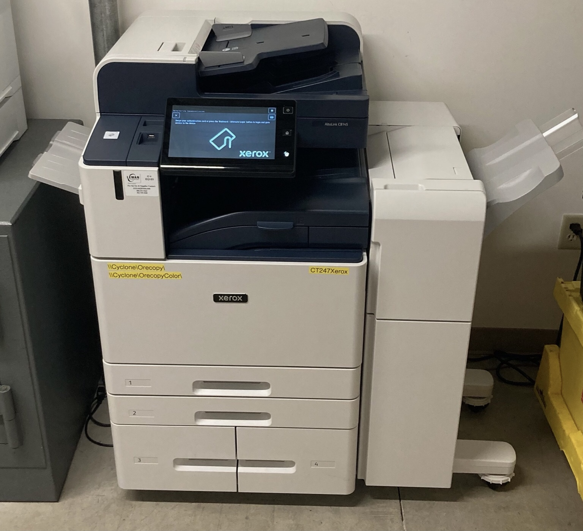
OreCopy
Being deployed as we speak
52 units across campus
As of Friday, 25 are deployed
Another handful of Konica’s will be replaced over the course of the next 18 months as leases expire
Xerox MFP’s, with “Follow Me” or “Find Me” printing, available across campus

Slide 5
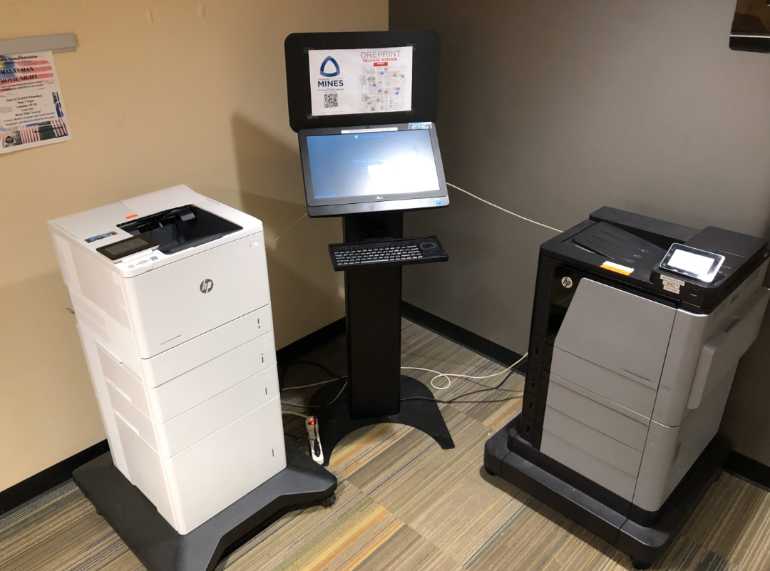
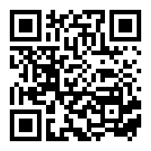
OrePrint
18 units across campus
Students get a per-semester Tech Fee allocation of printing
https://its.mines.edu/oreprint-information/
HP LaserJets & MFP’s, with “Follow Me” or “Find Me” printing, available across campus

Slide 6
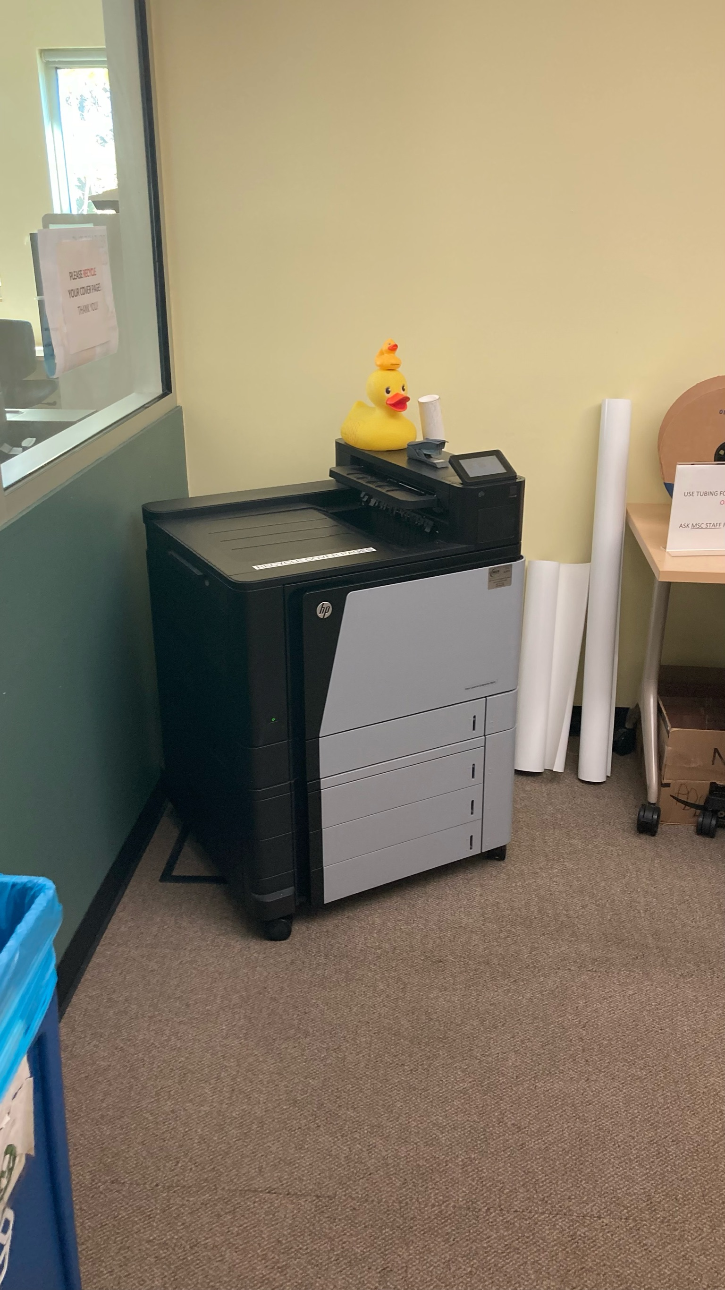
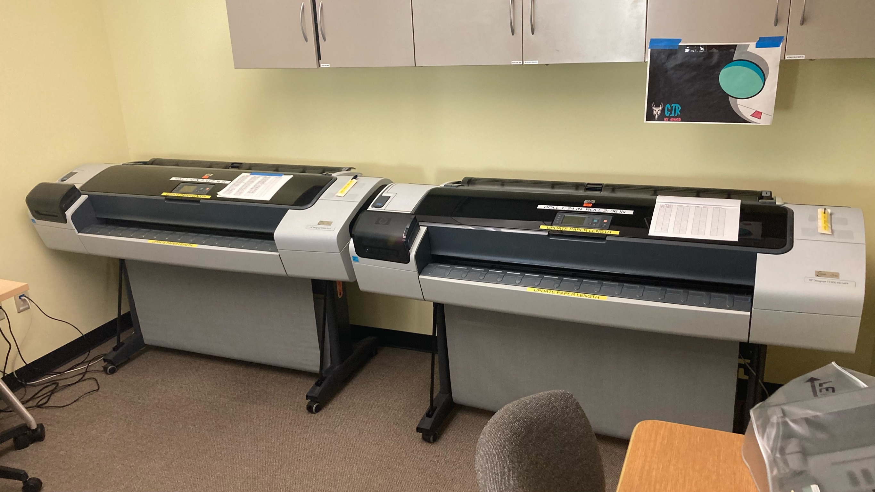
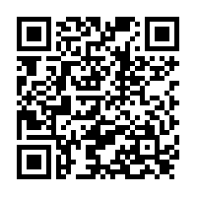
Computer Commons Resources
Large Format Printing
11x17 Printing
Special Papers upon request
https://helpcenter.mines.edu/TDClient/
1946/Portal/Requests/ServiceDet?ID=30965

Slide 7
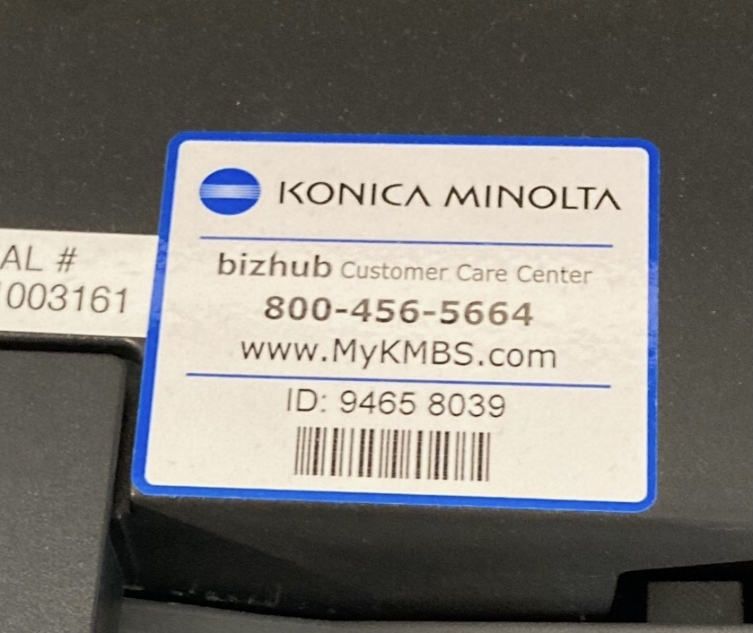
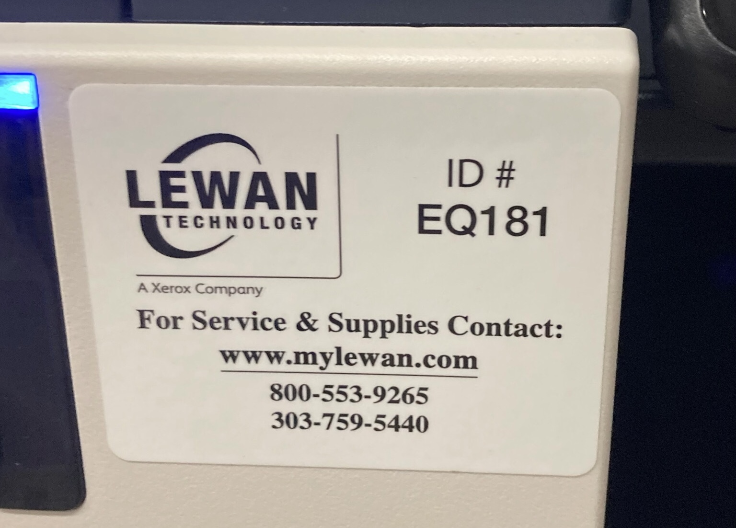
Partner Services
Xerox
Konica

Slide 8
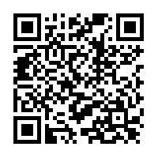
Partner Services
AlphaGraphics
Email Order Form
Price List To be Included
FedEx
Online Ordering Available
Price List To Be Included

