Slide 1
Participation Stipends – Accounts Payable

Slide 2
Introduction
Michael Dunn, Assistant Controller (Interim AP Supervisor Duties)
mdunn1@mines.edu
Ariel Pacheco, Accounts Payable Specialist
ArielPacheco@mines.edu

Slide 3
Overview
Introduction
Form
Funding and Approval
Participant Setup
Process
What Accounts Payable Needs
Questions

Slide 4
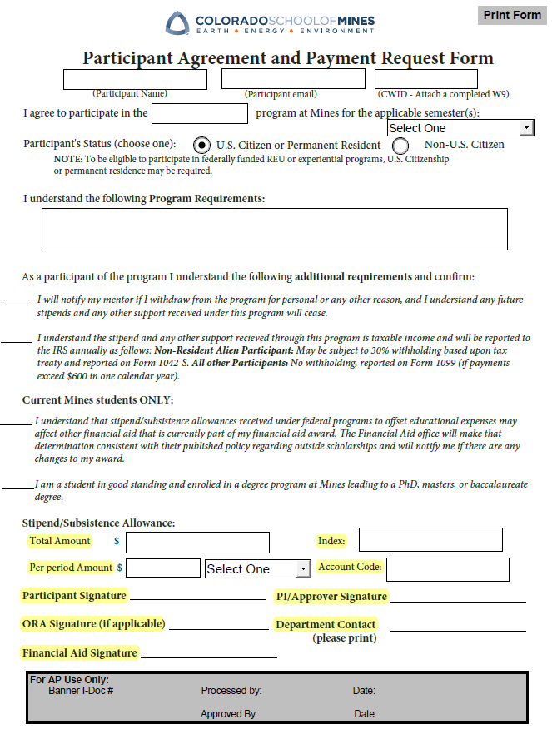
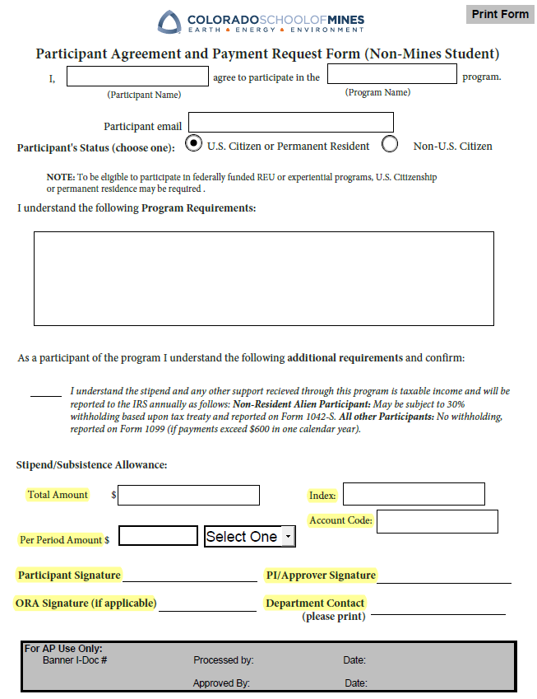
Form

Slide 5
Funding & Approval
If Grant Funded – We need ORA approval on the PAPRF form BEFORE payments can be made to participants
If Participant is a Mines Student, Student Financial Aid must also review and approve
PI must review and approve
Participant signs after all these approvals are complete

Slide 6
Payment Setup – W-9 (W-8 International)
Only required for Non-Mines Students
https://helpcenter.mines.edu/TDClient/2657/maps/Requests/ServiceDet?ID=49768#postSubmission
This is how we establish their CWID in order to pay them!
They must have a CWID to get paid!!

Slide 7
Payment Setup Continued
If the Non-Mines Participant prefers to be paid via Direct Deposit, this setup takes approximately 3-5 Business Days
It also requires one of the following to be submitted in addition to the standard information to establish a CWID
Bank Letter from the Participant’s Bank
Voided Check
Bank Statement Copy
We need to verify Account Number, Routing Number, and other institutional information

Slide 8
Payment Setup Continued
Check Runs are on Tuesdays and Fridays for Accounts Payable
Typically, Participants are paid on the Friday Check Runs
Recurring PI/Requestor approval needed by COB Wednesday
This approval is made in the TDNext Ticket

Slide 9
Process
Submit Completed PAPRF Form (Slide 4) for each participant as an attachment in TDNext ticket
1 Ticket for each participant
Assuming participant is setup for Direct Deposit or Check – this is what we need to process the first payment

Slide 10
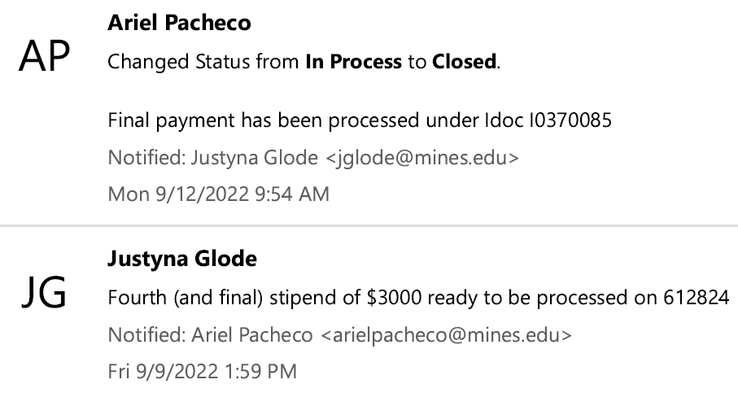
Process - Continued
Subsequent Payments
Requestor/PI needs to update ticket that subsequent payment is approved
Also, let Accounts Payable know if Participant has dropped or if payment should be delayed

Slide 11
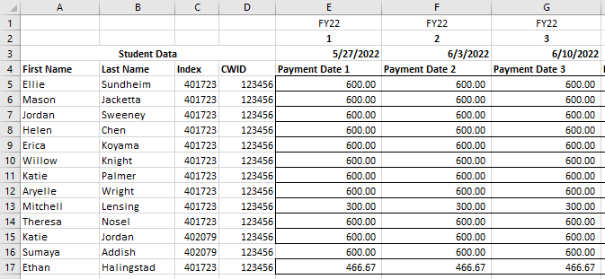
Insurance for PI/Requestor (AP Needs)
Template Available Upon Request

Slide 12
Questions?

