Slide 1
Procurement & Contracting
We assist students, staff and faculty with purchasing and contract needs to help you achieve your goals while maintaining compliance with Mines policies and procedures as well as all local, state and federal laws and regulations.
Mitigate risk and maintain funding
1

Slide 2
Connect with Us
Procurement@mines.edu
Teams – Message or call
https://www.mines.edu/procurement/

Slide 3
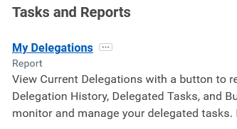
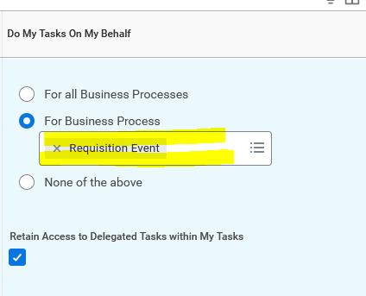
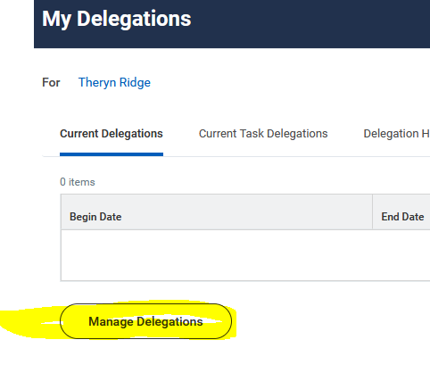
Procurement | Workday Delegations
If a fund manager has delegated you as proxy approver on a worktag, ensure that this delegation is set up correctly in workday. Otherwise, requisitions will not process correctly.

Slide 4
Procurement | Steps when purchasing
What is the cost?
What am I buying?
Is a vendor coming to campus?
$5,000+ Requires a purchase order
$10,000+ Requires competition
$50,000+ Over 5 years requires a solicitation
Equipment? Operations approval may be required
Software or digital service? IT Approval is required
Foreign items? Import broker needed
Logo? PO is required
Furniture? Furniture approval is required
4

Slide 5
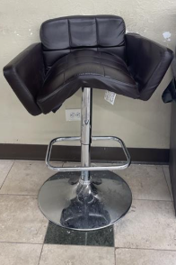
All furniture purchases must be done by ODC.
Buildings have approved furniture standards and themes to ensure:
Aesthetic environment
Consistency
Longevity and durability
Warranty
Safety
5

Slide 6
https://www.mines.edu/procurement/purchasing/
6

Slide 7
https://www.mines.edu/procurement/purchasing/
7

Slide 8
Procurement | Steps when purchasing
What is the cost?
What am I buying?
Is a vendor coming to campus?
$5,000+ Requires a purchase order
$10,000+ Requires competition
$50,000+ Over 5 years requires a solicitation
Equipment? Operations approval is required
Software or digital service? IT Approval is required
Foreign items? Import broker needed
Logo? PO is required
Furniture? Furniture approval is required
All on-campus services require the vendor to have commercial insurance and provide a COI regardless of cost.
8

Slide 9
Procurement | Steps when purchasing
Is there a contract?
When do I need this good/service?
Agreement for:
Hotel room block
Banquet
Performance
Donation
Software
Revenue
Food truck
Quote requiring signature before order
Any contract, quote or other written documents where the vendor requires signature must be reviewed and approved by Procurement and Contracting regardless of cost or no cost.
Ensure adequate time is allowed.
9

Slide 10
Timeline | Time Required
Regular PO | 4 - 7 days
Equipment/Logo PO | 5 - 7 days
Hotel/Event Contract | 14 days prior to hold date expiration
Software Contract | 14 – 90 days
Expo/Booth Rental at Conference | 30 days prior to hold date expiration (Send as soon as possible. Very difficult)
Equipment purchase ($50k+) | 30 days
Other Goods/Services ($50k+) | 90 – 120 days
Software Systems or Custom Services | 18 – 24 months
Vendoring | 7 – 20 days from supplier submission date
#1 Request we get far too late…
10

Slide 11
Purchases being made using grant funds.
Having sponsor provided funds makes procurement more difficult, lengthy and risky.
We can have funding revoked if we do not follow federal procurement guidelines.
Having grant funds does not exempt purchases from the Procurement process.
#1 Request we get far too late…
11

Slide 12
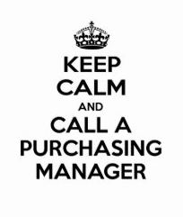
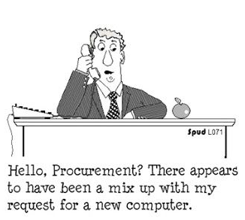
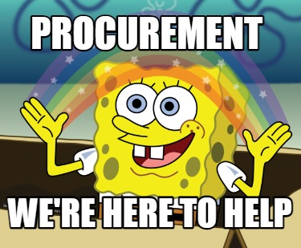
Questions?

