Slide 1
Fall Kick Off Student Orientation
Being an Oredigger means taking care of each other and being a positive community member.
Mines Public Safety
Community Standards
Office for Institutional Equity
SHAPE (Sexual Harassment and Assault Advocacy, Prevention, and Education)
Notes:
Welcome to new graduate student orientation.

Slide 2
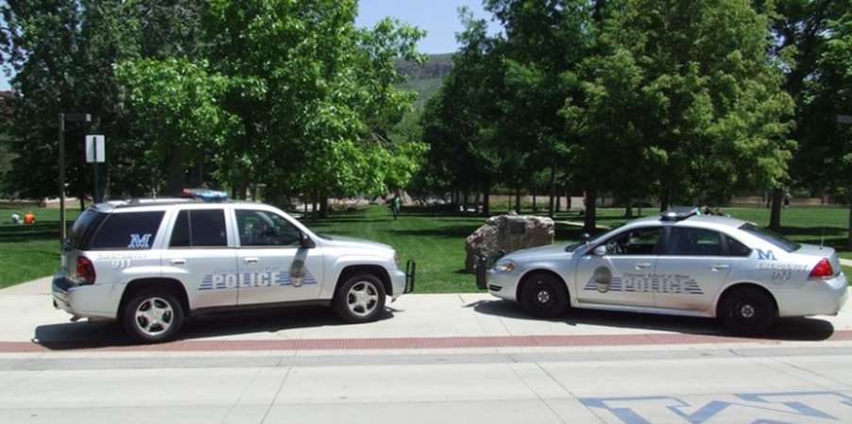
Mines Police Department - Campus Safety
Dustin Olson, Chief of Police
Dave Cillessen, Commander and Assistant Director

Slide 3
Sam Ralston (she/hers), Director of Community Standards
Kimberly Myers (she/hers), Assistant Director of Community Standards
Dr. Derek Morgan, (he/him), Dean of Students
and…
Notes:
Our office assists students, staff, and faculty understand policies and procedures as they relate to Conduct and Academic Integrity at Mines. The mission of our conduct process is intended to be an educational and restorative experience fostering student growth and development through intentional conversation and reflection. Students will work to understand the impact of their actions, and when possible, reduce or repair harm through educational outcomes. Staff will treat students with care and respect through equitable procedures, while balancing needs of the Mines community. The conduct process is not meant to be punitive; rather it exists to protect the interests of the community and to support behavior that reflects the values of Colorado School of Mines. The first step in understanding Community at Mines is reading more about our policies and procedures.

Slide 4
What We’ll Cover
What it means to be a Mines community member
Student Code of Conduct
Academic Integrity
Amnesty Policy
Notes:
Values = integrity, respect, community, social justice, responsibility
Our code is an outline of what we expect and don’t expect to see from students to uphold a safe and healthy community. Beyond that, we also expect you to care for one another .

Slide 5
Being an Oredigger means
we watch out for each other.
Recognize that the situation is harmful, or that someone needs help or support.
Step-in in a way that feels comfortable to you.
Ask others to help.
Notes:
Part of being an oredigger is respecting each other and being an active bystander. We watch out for each other by recognizing when some needs our help and support, by stepping in in ways that are safe, comfortable, and true to your personality, and by asking others to join in helping.

Slide 6
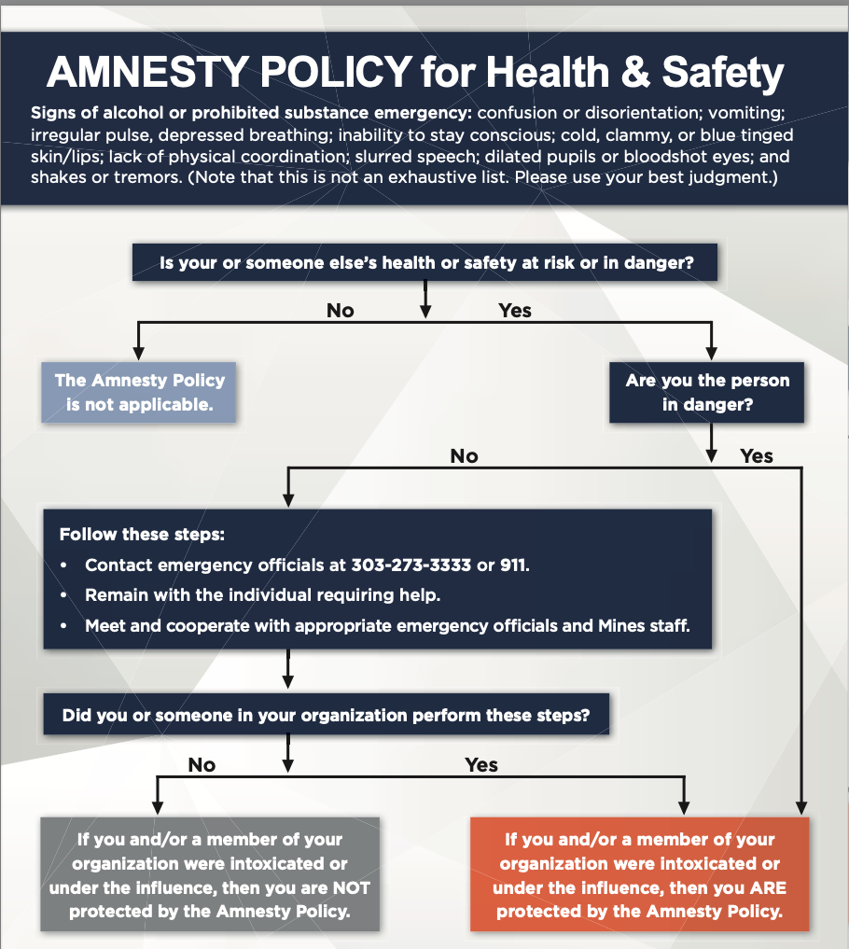
Notes:
Mines' Amnesty Policy allows amnesty or forgiveness from violating school policy against using alcohol or prohibited substances for individuals who seeks help on behalf of themselves or another person during a medical emergency or dangerous situation.

Slide 7
Office for Institutional Equity
Carole Goddard, Director, OIE & Title IX Coordinator Kristin Moulton, Assistant Director, OIE
Tammy Curry, Administrative Assistant, OIE
Notes:
Kristin
Welcome to new student orientation! I’m Kristin Moulton the Assistant Director in the Office for Institutional Equity. Carole Goodard is your Title IX Coordinator and the Director of OIE. Also, in my office is; Tammy Curry who is the program Director. You can contact any three of us with questions or concerns.

Slide 8
What We’ll Cover
Mines Policies on Sexual Misconduct, Discrimination and Retaliation
Reporting Options
Supportive Measure and Resources
Notes:
Kristin
Today I am going to share Mines policies on Sexual Misconduct, Discrimination and Retaliation. We will go over some reporting options, and available supportive measures and resources.
We recognize this topic can be difficult so please take care of yourself today as needed. Feel free to take breaks as needed on your own time. We are sharing this information with you, so you are aware of your rights and expectations as a Mines student, and so you are aware of options and resources available to you.

Slide 9
The Office of Institutional Equity utilizes fair and unbiased processes for addressing reports of discrimination and harassment. We manage:
Complaints and Investigations
Supportive measures, and
Resolution options
for complaints alleging
Bias
Discrimination
Harassment
Sexual misconduct, and
Retaliation
on the basis of a protected class for employees and students. OIE is active in education and training for employees and students and also manages Clery compliance.
Notes:
What do we do in OIE?
The office of institutional equity utilizes fair and unbiased processes for addressing reports of discrimination and harassment. We manage complaints and investigations, supportive measures, and resolution options for complaints alleging bias, discrimination, harassment, sexual misconduct, and retaliation; on the basis of protected class for employees and students. Our office also manages prevention education and training for employees and students, and compliance with the Clery.

Slide 10
Student Code of Conduct at Mines
Notes:
Kristin
Our office operates under one combined policy and that is the policy Prohibiting Sexual Misconduct, Discrimination, and Retaliation. I am going to break this policy down a little and discuss each section.

Slide 11
Notes:
Breaking this policy down and starting with sexual misconduct….Instead of legal definitions of each I put some examples of actions that would fall under sexual misconduct on the right hand side. These behaviors are prohibited under Mines policy and are also illegal.

Slide 12
Discrimination
Discriminatory Harassment occurs in an environment wherein an unwelcome behavior based on a protected class is so severe, pervasive, or objectively offensive that it unreasonably deprives, interferes, or limits a person’s participation or access to university programs or activities
Protected Classes: race, color, religion or creed, sex (including pregnant and parenting status, sexual orientation, gender identity, and gender expression), marital status, ethnicity, national origin, age, disability, genetic information, ancestry, and veteran status or military service.
Notes:
Kristin
Discriminatory Harassment occurs in an environment wherein an unwelcome behavior based on a protected class is so severe, pervasive, or objectively offensive that it unreasonably deprives, interferes, or limits a person’s participation or access to university programs or activities
Those Protected Classes include race, color, religion or creed, sex (including pregnant and parenting status, sexual orientation, gender identity, and gender expression), marital status, ethnicity, national origin, age, disability, genetic information, ancestry, and veteran status or military service.

Slide 13
Retaliation
Retaliation means any negative or adverse action against an individual for reporting an allegation of Sexual Misconduct or Discrimination or for cooperating or participating in an investigation
Notes:
Kristin
The last part of our main policy is retaliation…Retaliation means any negative or adverse actions against an individual for reporting an allegation of sexual misconduct or discrimination or for cooperating or participating in an investigation. I heard one of the main barriers for not reporting incidents is a fear of retaliation, so I wanted to show that we do have policies protecting a person (complainants and witnesses from retaliation

Slide 14
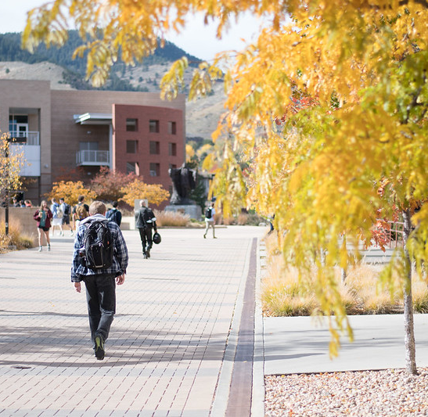
Reporting Options
Notes:
Kristin
Next we are going to talk about reporting options

Slide 15
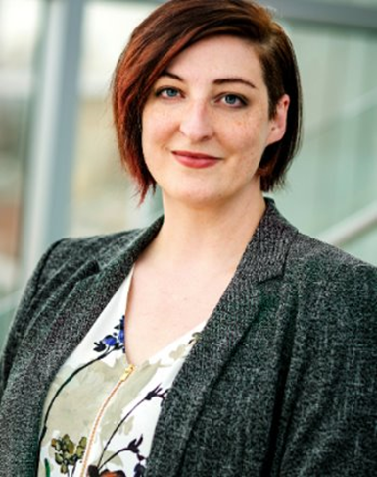
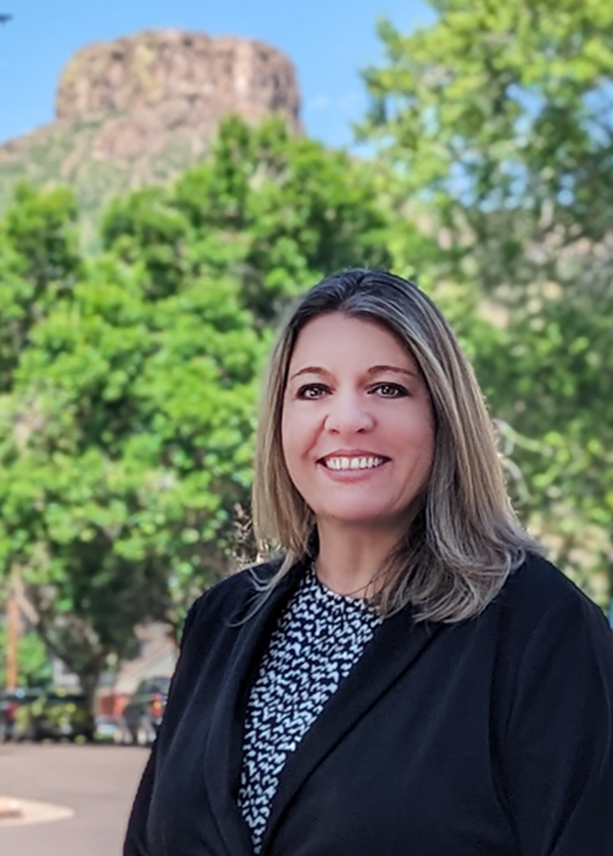
Reporting Options for Sexual Misconduct, Discrimination and Retaliation
Email: OIE@mines.edu
Phone: 303.273.3260
Mail or Walk-ins: 1706 Illinois St.
Online: https://www.mines.edu/institutional-equity-title-ix/
Carole Goddard (she/her) Kristin Moulton (she/her)
Note: Anyone who serves as a mandatory reporter must report to Carole or Kristin either using the online reporting form or directly via email, phone, or in person
Notes:
Kristin
You can report any concerns of discrimination, harassment, or Sexual misconduct to me or Carole. You can reach us by email at oie@mines.edu, by phone, by mail, or by walking into the OIE office located at 1706 Illinois Street. We are the cottage between the WISEM office and the Honors House. You can also report online. Links to our online reporting form are on the Office for Institutional website.

Slide 16
What happens after an incident is reported?
Carole or Kristin will reach out to the impacted individual(s) and offer to meet and provide resources, support measures, and complaint options.
It is up to the impacted individual(s) to decide if they meet with us. They can always choose to do so later.
Notes:
Kristin
After an incident is reported, Carole or I will reach out to the impacted individual or individuals and offer to meet and provide resources, support measures, and complaint options. It is up to the impacted individual(s) to decide if they want to meet with us. If they decline meeting initially, they can always choose to do so later.

Slide 17
Choices
You have choices about how to move forward:
Report for the record only (we keep all reports in our records to monitor campus activity and patterns);
Supportive Measures only (e.g.change to housing, excused absence);
Informal Resolution (e.g. mediation, agreements, etc.)
Formal Resolution (investigation, cross examination, hearing)
Notes:
Kristin
Mines has several options for how to resolve complaints of discrimination and sexual misconduct. Complainants may choose no action or take use of supportive measures only. We also have informal resolution options, in addition to the formal grievance process. Complainants have the agency to decide how they want to proceed.

Slide 18
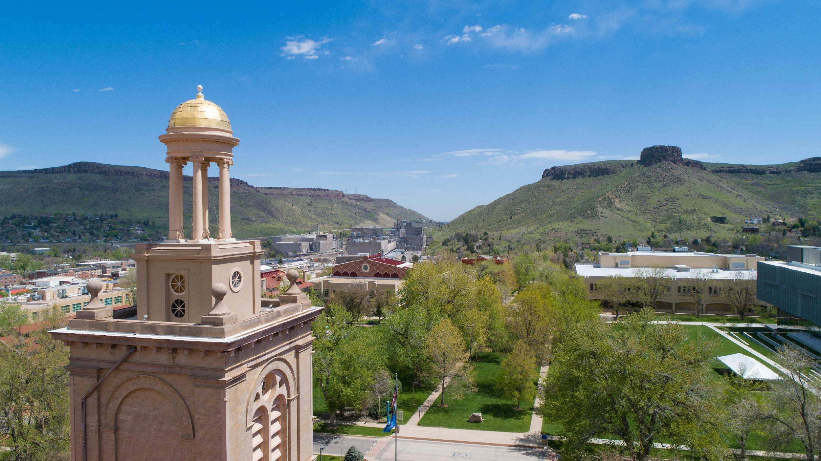
Notes:
Transition slide

Slide 19
Sexual Harassment and Assault Advocacy,
Prevention, & Education
Sareen Lambright Dale, Associate Director, and Confidential Resource Advocate
Notes:
Good morning, Orediggers! I’m Sareen Lambright Dale, (she, her), and I serve as the associate director for Sexual Harassment and Assault Advocacy, Prevention and Education. Many students are affected by these things while in college so it’s important that we work to change that and to support students affected.. The SHAPE provides education to the Mines community with the goal of fostering a safe, inclusive and accessible campus environment. We provide a range of educational programming for undergraduate students, designed to build awareness and skills for reducing, recognizing, preventing, and responding to problematic behaviors, and creating a healthy and supportive campus community.

Slide 20
What we’re talking about
Resources
Bystander Intervention: Helping when someone needs help
Consent
Ongoing prevention training for Orediggers
Notes:
For the new couple minutes we’re going to talk about Resources, Bystander Intervention basics, Consent, and ongoing prevention professional development for orediggers

Slide 21
Resources
Notes:
Next we are going to talk about confidential resources and non-confidential and reporting resources

Slide 22
RESOURCES
Resources can be found on the Resource Tab on the OIE Webpage
CONFIDENTIAL RESOURCES
The Mines Counseling Center
Student Health
St. Anthony Hospital
Porchlight Family Justice Center
SHAPE (Sareen Lambright Dale and Dr. Jen Davis)
NON-CONFIDENTIAL & REPORTING RESOURCES
Office for Institutional Equity (Kristin & Carole)
Dean of Students Office/Community Standards
Human Resources
Public Safety – Mines Police
Student Outreach and Support
MINES ONLINE RESOURCES
AcademicLiveCare
Mines.ThrivingCampus.com
Ulifeline.org/Mines
You.Mines.Edu
Notes:
If someone needs help, there are a lot of options at Mines and in the Community. Confidential Resources include Mines Counseling Center for short-term counseling and groups, Student Health for non-emergency health care, St. Anthony Hospital level 1 trauma center and forensic nurse program, Porchlight, a one-stop help center for victims of crime, and SHAPE - confidential support and referrals for survivors and their support systems affected by sexual assault and harassment, dating and domestic violence, and stalking. Our non-confidential and reporting resources in cluding the Office for Institutional Equity, the Dean of Students Office, Public Safety, and Student Outreach and Support. Online You@Mines is an excellent and customizatible resources for all types of things for college students.

Slide 23
Being an Oredigger means
we watch out for each other.
Recognize that the situation is harmful, or that someone needs help or support.
Step-in in a way that feels comfortable to you.
Ask others to help.
Notes:
Part of being an oredigger is respecting each other and being an active bystander. We watch out for each other by recognizing when some needs our help and support, by stepping in in ways that are safe, comfortable, and true to your personality, and by asking others to join in helping.

Slide 24
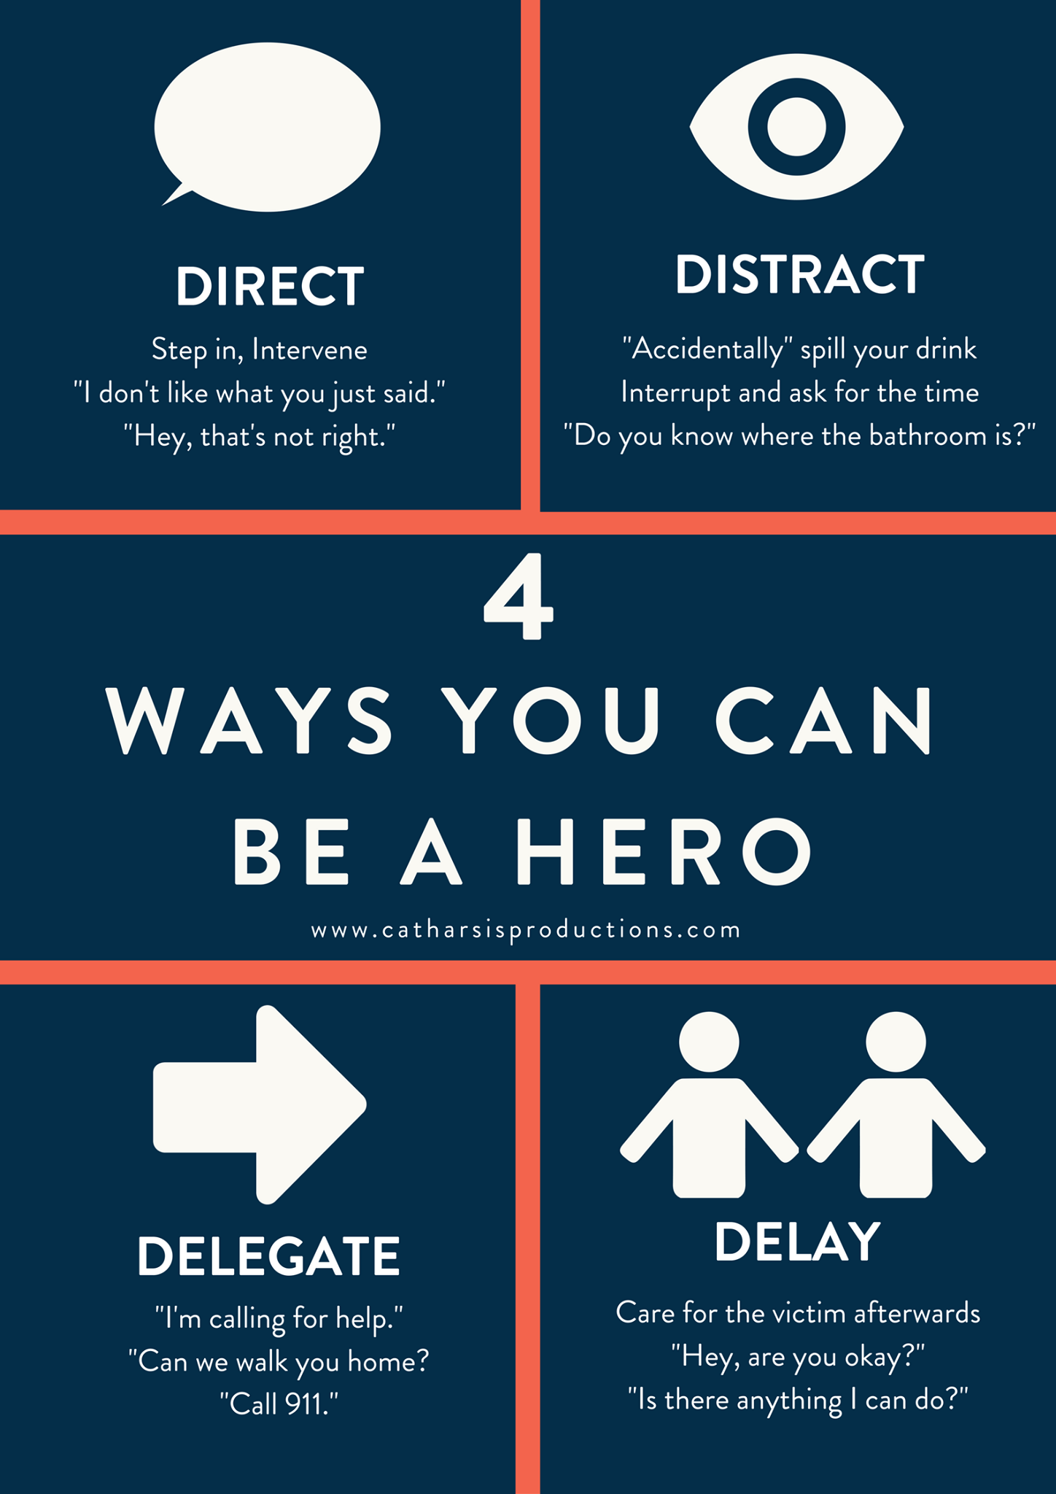
🡨 Active Bystander Options
Notes:
Stepping in when someone needs help, makes you a hero of that story. You might directly ask if someone needs help, you might delegate by asking someone with more information to help, you might create a distraction that interrupts what ever negative behavior was about to happen, or you my delay and check in on someone affected afterwards to see if they are okay. These strategies also work well together so you might use a combination depending on the context of the situation. Whatever active bystander strategy you go with, know that people will respect you for it, and will feel seen and supported.

Slide 25
Learn about consent in two minutes
https://youtu.be/laMtr-rUEmY
Notes:
Let’s learn about consent from this 2 minute campus clarity video

Slide 26
Consent at Mines
Affirmative, knowing, mutual, unambiguous, ongoing, and voluntary agreement through word or action to engage in specific sexual activity throughout a sexual encounter.
Consent cannot be inferred by a current or previous relationship.
Consent can be withdrawn at any time.
Consent cannot be obtained by fear, threat, Coercion, intimidation, and/or Force or from someone who is Incapacitated.
Notes:
Consent is important for establishing respect and boundaries in all relationships. Mines definition of consent is: Affirmative, knowing, mutual, unambiguous, ongoing, and voluntary agreement through word or action to engage in specific sexual activity throughout a sexual encounter.
Consent cannot be inferred by a current or previous relationship. Consent can be withdrawn at any time. Consent cannot be obtained by fear, threat, Coercion, intimidation, and/or Force or from someone who is Incapacitated.

Slide 27
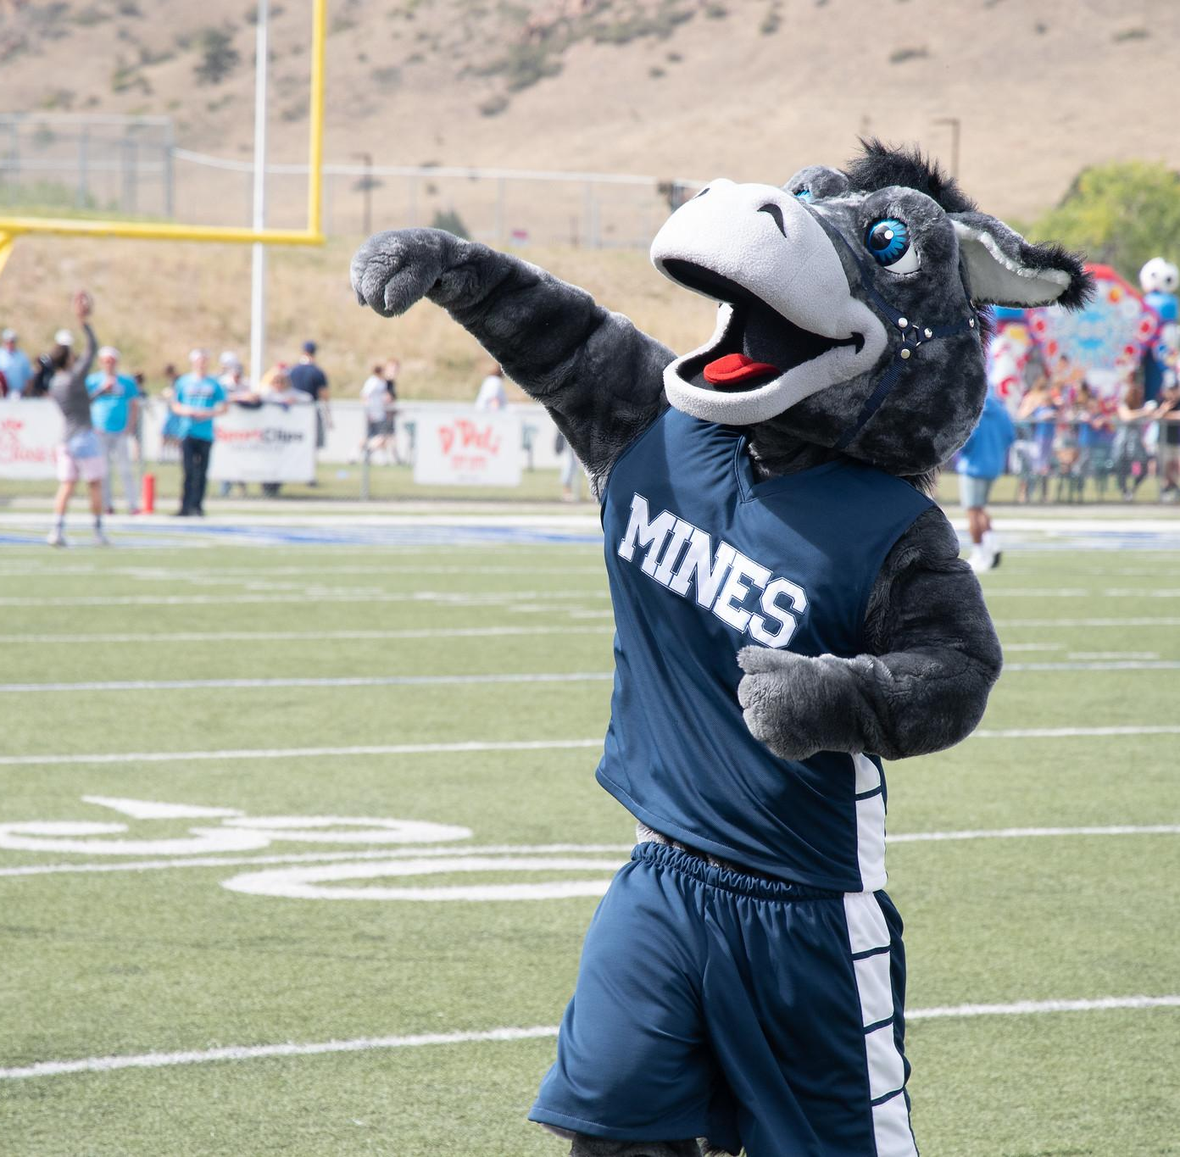
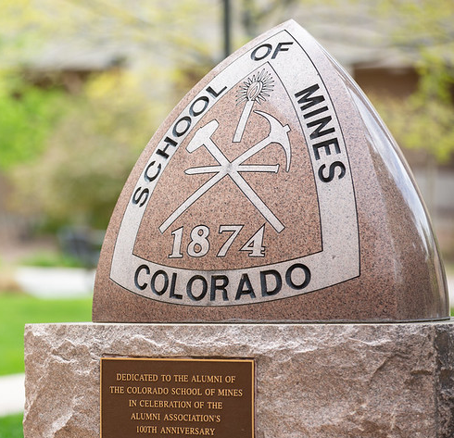
Ongoing Doses of Prevention Training for Orediggers
Sexual Assault Prevention for Undergraduates
Title IX Essentials for International Students
AlcoholEdu
CSM101!
Notes:
sToday is the start of ongoing prevention education for orediggers. Everyone has been assigned a couple courses, Thank you to the 30% of students who have already completed them! Additionally you’ll learn more insights into bystander intervention in CSM101.

Slide 28
Contact
Sareen Lambright Dale slambrightdale@mines.edu SHAPE Office Associate Director, and Confidential Resource Advocate
General Inbox confidentialresource@mines.edu
Notes:
Thank you for your time. You can follow up with us at our general inbox: confidentialresource@mines.edu, or directly via our Mines email addresses. Have a wonderful semester, and GO OREDIGGERS!

