Slide 1
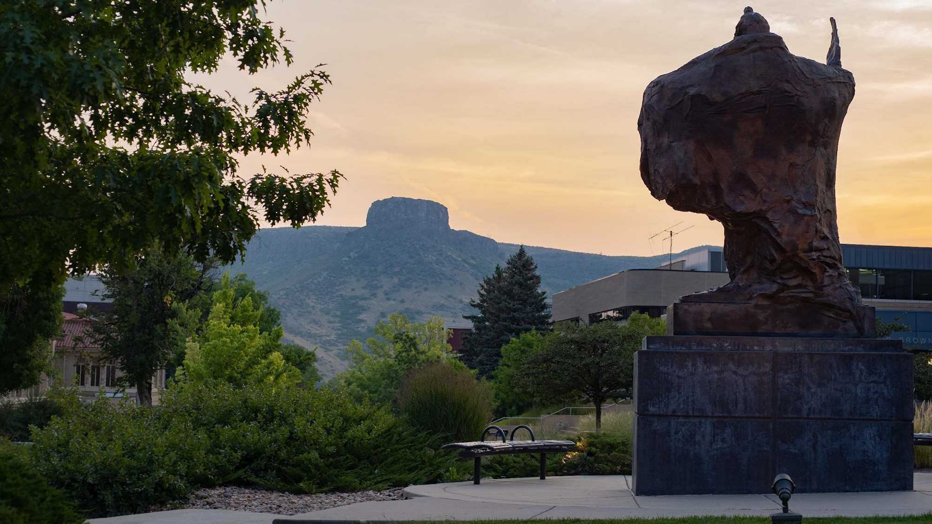
Clery Act Training
For Campus Security Authorities (CSA’s)
Presented by your Clery Management Team and the Office for Institutional Equity
1
Notes:
Welcome to the Colorado School of Mine’s online Clery Act training for Campus Security Authorities or (CSAs). This course will introduce the Jeanne Clery Disclosure of Campus Security Policy and the Campus Crime Statistics Act, commonly known as the Clery Act.

Slide 2
Content Warning
Please Note: This training contains information on sensitive topics.
2
Notes:
Please note that this training contains information on sensitive topics, such as definitions and scenarios involving crimes of violence, including sexual assault, hate crimes, and relationship violence. Please reach out to your campus’ confidential resources if you need support resources.

Slide 3
Purpose and Benefits of this Training
Provide a safe and secure environment
Alert other about potential dangers
Help others make informed decisions
Ensure compliance
Assist Mines with alerting the community of possible concerns
Notes:
First I would like to thank you in advance for participating in this course. By understanding and adhering to the Clery Act requirements, you help the university provide many benefits to the campus community. Including:
•Helping to provide a safe and secure learning and working environment
• Alerting students and others about potential dangers on campus
•Helping current and prospective students and employees make informed decisions when choosing a campus
• Ensuring compliance with legal and policy requirements; and lastly,
• Assisting the university with tracking crimes and alerting the public to possible safety concerns

Slide 4
Why am I taking this training?
The Colorado School of Mines takes seriously its duty to train and educate all Campus Security Authorities (CSA’s) on their reporting obligations.
Per Clery mandates, all campuses must identify and train CSA’s
You have been identified as a Mine’s CSA and are in the process of fulfilling your obligation to receive the necessary Clery Act training.
Notes:
You may be asking yourself why you are taking this training. The Colorado School of Mines takes seriously its duty to train and educate all CSA’s on their reporting obligations. Higher Education Institutions must identify and train all CSAs. If you are taking this course, you have been identified as a CSA and are in the process of fulfilling your obligation to receive the necessary Clery Act training.

Slide 5
Objectives
1
Clery Act
Identify and Adhere to
Clery Act Requirements
2
Responsibilities
Recognize and fulfill your responsibilities as a CSA
3
Reporting
Properly engage with reporting parties & report all Clery crimes
4
Resources
Understand Timely Warnings and ASR Requirements
Locate campus specific resources
5
Notes:
By the end of this course, you should be able to:
Identify and adhere to Clery Act requirements
Recognize and fulfill your responsibilities as a campus security authority
Properly engage with reporting parties to report all Clery crimes and;
You will also be able to locate relevant campus resources, such as reporting procedures for your location.

Slide 6
Let's Understand the History and Importance of the Clery Act.
Watch the following introductory video about Jeanne Clery.
Notes:
To help you understand the purpose and importance of the Clery Act, let’s consider its history. In 1986, Jeanne Clery was raped and murdered in her dorm room at Lehigh University in eastern Pennsylvania. It was one of 38 violent crimes that occurred at Lehigh within a three-year span. Jeanne Clery’s parents argued that, had they known of the crimes at Lehigh, Jeanne would not have attended the university. The Clery Act was enacted in 1990, in Jeanne’s memory, to help ensure transparency in campus crime reporting and safety policies allowing current and prospective students and employees to make informed decisions about where to study and work. Play the imbedded video to hear from the Clery family.

Slide 7
What are the requirements of the Clery Act?
Under the Clery Act, any postsecondary institution that participates in federal student financial assistance programs are required by law to:
Advise students and employees of Clery crimes and issue timely safety warnings and emergency notifications for crimes that pose a serious or continuous threat to the campus community.
Issue an annual security report that discloses campus crime statistics to current and prospective students, employees, and the U.S. Department of Education.
Make available its campus security policies.
Maintain a public, daily log of reported crimes.
Notes:
Under the Clery Act, any postsecondary institution that participates in federal student financial assistance programs are required by law to:
advise students and employees of Clery crimes and issue timely safety warnings and emergency notifications for crimes that pose a serious or continuous threat to the campus community.
issue an annual security report that discloses campus crime statistics to current and prospective students, employees and the U.S. Department of Education
make available its campus security policies and
maintain a public, daily log of reported crimes.

Slide 8
Why is the Clery Act relevant to you?
Individuals in certain positions throughout campus are designated as Campus Security Authorities (CSAs) and they are required to promptly report Clery crimes of which they are aware so that the incidents can be included in campus crime reports in accordance with the Clery Act. CSAs also help promote campus safety because timely reports allow campus police to issue alerts when others on campus may be in danger.
What is the purpose of the CSA?
The Clery Act was enacted to increase the accountability and transparency of Institutions of Higher Education in meeting certain responsibilities regarding the safety and security of students on their campuses.
The intent of including non-law enforcement personnel in the role of CSA is to acknowledge that some community members, particularly students, may be hesitant about reporting crimes to the police; however, they may be more inclined to report incidents to other campus-affiliated individuals.
Notes:
Why is the Clery Act relevant to you?
Individuals in certain positions throughout campus are designated as Campus Security Authorities (CSAs) and they are required to promptly report Clery crimes of which they are aware so that the incidents can be included in campus crime reports in accordance with the Clery Act. CSAs also help promote campus safety because timely reports allow campus police to issue alerts when others on campus may be in danger.
What is the purpose of the CSA?
The Clery Act was enacted to increase the accountability and transparency of Institutions of Higher Education in meeting certain responsibilities regarding the safety and security of students on their campuses.
The intent of including non-law enforcement personnel in the role of CSA is to acknowledge that some community members, particularly students, may be hesitant about reporting crimes to the police; however, they may be more inclined to report incidents to other campus-affiliated individuals.

Slide 9
Failure to Comply has Consequences
You are an essential part in compliance!
Notes:
University policy requires that campuses and personnel adhere to the Clery Act. You will learn about
your responsibilities under the Clery Act later in this course. For now, it is important to know that
failure to comply with the Clery Act could result in monetary penalties for the university and
disciplinary action for the CSA. A campus violating the Clery Act can be fined by the U.S. Department of
Education for each violation. Other potential consequences include having Title 4 funding limited and
receiving negative media attention.

Slide 10
Who is a CSA?
I’m a CSA!
Someone who works as part of campus police or campus security.
Someone who has responsibility for campus security. Examples include:
Special event staff
Parking enforcement
Hired security officers
Any University official with "significant responsibility for student campus activities." These activities include student housing, student discipline, and campus judicial proceedings. Some examples include:
Dean of Students
Peer Mentors
Housing and residence life staff
Directors of Greek life
Residential life staff (including front desk staff)
Director of athletics
Team coaches
Student discipline officials, student judicial affairs officials, student conduct, VP of Student Affairs
Employees who oversee student centers and campus buildings
Officials who oversee student extracurricular activities
Faculty advisors to student groups/organizations
10
Notes:
Lets review Who is a CSA? The categories include;
Someone who works as part of campus police or campus security.
Someone who has responsibility for campus security. Examples include:
Special event staff
Parking enforcement
Hired security officers
Any University official with "significant responsibility for student campus activities." These activities include student housing, student discipline and campus judicial proceedings. Examples include:
Dean of Students
Peer Mentors
Housing and residence life staff
Directors of Greek life
Residential life staff (including resident assistants)
Director of athletics
Team coaches
Student discipline officials, student judicial affairs officials, student conduct, VP of Student Affairs
Officials who oversee a student center
Officials who oversee student extracurricular activities
Faculty advisors to student groups/organizations

Slide 11
What to do if you are a CSA:
The function of a campus security authority is to report qualifying crimes to the proper Mines offices which include; Mines Police, OIE, or to the CSA online reporting form; www.mines.edu/clery-act/.
CSAs are responsible for reporting allegations of Clery Act crimes that are reported to them in their capacity as a CSA. This means that CSAs are not responsible for investigating or reporting incidents that they overhear students talking about in a hallway conversation; that a classmate or student mentions during an in-class discussion; that a victim mentions during a speech, workshop, or any other form of group presentation; or that the CSA otherwise learns about in an indirect manner.
11
Notes:
The function of a campus security authority is to report qualifying crimes to the proper Mines offices which include; Mines Police, OIE, or to the CSA online reporting form. CSAs are responsible for reporting allegations of Clery Act crimes that are reported to them in their capacity as a CSA. This means that CSAs are not responsible for investigating or reporting incidents that they overhear students talking about in a hallway conversation; that a classmate or student mentions during an in-class discussion; that a victim mentions during a speech, workshop, or any other form of group presentation; or that the CSA otherwise learns about in an indirect manner.

Slide 12
What Crimes do I Need to Report?
Reportable Clery Crimes
As a CSA you must report the following Clery Crimes!:
Murder
Non-Negligent Manslaughter
Manslaughter by negligence
Rape
Fondling
Incest
Statutory Rape
Robbery
Aggravated Assault
Burglary
Motor Vehicle Theft
Arson
Hate Crimes
Dating Violence
Domestic Violence
Stalking
Criminal arrests for liquor, drug, and weapons law violations
Disciplinary referrals for liquor, drug, and weapons law violations that would otherwise qualify as a crime
14
Notes:
Reportable Clery Crimes. The Clery Act requires colleges and universities to report statistics for the
following crime categories: murder/non-negligent manslaughter; manslaughter by negligence; rape;
fondling; incest; statutory rape; robbery; aggravated assault; burglary; motor vehicle theft; and arson.
We must also report Hate crimes, which include all criminal offenses previously listed, plus larceny,
theft, simple assault, intimidation, or destruction, damage, or vandalism of property that was motivated
by the bias of the perpetrator; Violence Against Women Act (VAWA) offenses, which include dating
violence, domestic violence, and stalking; Arrests for liquor, drug, and weapons law violations; and
Referrals for disciplinary action for liquor, drug, and weapons law violations for those affiliated with
the university that would otherwise qualify as a crime

Slide 13
Responsibility to Report
Let's Talk Geography
Only report crimes that occur with in these geographic locations
On-Campus Buildings and Property
Clery
Geography
Public Property Immediately Adjacent to Campus
Non-Campus Property
Residence Halls
Note: When in doubt…just report.
Notes:
Lets discuss Clery geography. Only qualifying crimes that occur within a certain geographic location need to be reported to the Mines Clery office. It is important to recognize Clery geography, which includes on-campus buildings or property, including student residence halls, public property immediately adjacent to the main campus (sidewalks, alleys, parks), and non-campus property, like the Edgar Mine. If you are unsure if the report qualifies under Clery geography requirements…just report the incident. The Clery team will screen each complaint to ensure it qualifies. Detailed definitions of these locations are located on the Clery website if you would like to review them further.
Note Insert Slide Layers: Hover over each of the geography locations for additional definitions and information of each.
On Campus Buildings and Property
On-campus is defined as:
• (i) Any building or property owned or controlled by an institution within the same
reasonably contiguous geographic area and used by the institution in direct support of,
or in a manner related to, the institution’s educational purposes, including residence
halls; and
• (ii) any building or property that is within or reasonably contiguous to the area
identified in paragraph (i) of this definition, that is owned by the institution but
controlled by another person, is frequently used by students, and supports
institutional purposes (such as a food or other retail vendor
Public Property Immediately Adjacent to Campus
Public property is defined as “all public property, including thoroughfares, streets, sidewalks, and parking facilities, that are within the campus, or immediately adjacent to and accessible from the campus.”
Non-campus Property
Non-campus building or property is defined as:
• any building or property owned or controlled by a student organization officially recognized by the institution; or
• any building or property owned or controlled by an institution that is used in direct support of, or in relation to, the institution’s educational purposes, is frequently used by students, and is not within the same reasonably contiguous geographic area of the institution.
Residence Halls
All residence halls on campus

Slide 14
What to Report?
What happened?
Let’s discuss the reporting process in further detail. Remember, CSAs are required to report all crimes covered by the Clery Act. First, collect basic facts about the alleged crime, including - what occurred, and where and when it allegedly occurred.
11
Notes:
What to report in further detail. Remember, CSAs are required to report all crimes covered by the
Clery Act. First, collect basic facts about the alleged crime, including - what occurred, and where and
when it allegedly occurred. Submit that information to Mines police or on the online CSA form
located on the OIE/Clery Website.

Slide 15
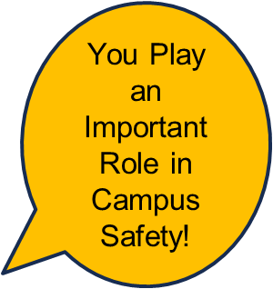
Reporting Responsibilities
DO
Document basic facts
Record what you witness or what you are told
Follow Mines procedures to report immediately
Refer reporting party to campus resources
Call 911 or Mines police if necessary
Do Not
Do not investigate crimes
Do not interrogate the reporting party or try to contact involved parties
Do not wait to report
Notes:
When it comes to reporting an incident, you play an important role in campus safety. In summary, you should:
• Document facts like what, where, and when.
Record what you witness or what you are told
• Follow Mines procedures to submit the report as soon as practicably possible
• If appropriate, offer the reporting party referrals to campus resources
• If you know of a Clery crime that could be a serious or ongoing threat, call 9-1-1 or campus police immediately;
Here are some Items Not to Do:
•Non-police CSAs, and CSAs who are not Title IX investigators, should not investigate crimes
• Do not interrogate the reporting party or try to contact any involved parties
• Lastly, do not wait to report. If you are unsure whether a crime is covered under the Clery Act, report it anyway. Let Mines Clery Act Coordinators or the campus police department make that determination.

Slide 16
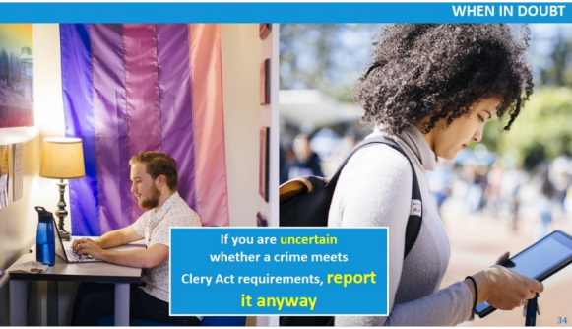
When in Doubt…Report.
In your role as a CSA, your primary responsibility is to report alleged crimes that are
reported to you or that you witness.
11
Notes:
When in doubt in your role as a CSA or unsure about jurisdictional details, report. Your primary
responsibility is to report alleged crimes that are reported to you or that you witness. If you are
uncertain if a crime meets the Clery Act requirements, such as the definition of a Clery Crime or Clery
Geography, just report. As a CSA, you are not required to make determinations for Clery
classifications or Clery geography. Simply report all relevant information (being as detailed as
possible) pursuant to Mines procedures. Your Clery Act Compliance Team in conjunction with the
Mines Police Department, will determine if it meets the Clery Act definitions if needed.

Slide 17
Timely Warnings and Emergency Notifications
You Play an Important Role in Campus Safety!
Timely Warnings
Timely Warning notifications are design to alert the Mines Community about Clery crimes
Reported to Mines Police or CSA’s
Represent a serious or ongoing threat
Emergency Notifications
Emergency Notifications are sent upon confirmation of a significant emergency or dangerous situation.
Immediate threat to health or safety or campus community
Notes:
An important Clery Act requirement involves campuses issuing timely warnings and emergency notifications, sometimes referred to as campus safety alerts.
A timely warning is a notification to alert the campus community about Clery crimes occurring within Clery geography, that are:
1.Reported to campus police or a campus security authority; and
2.Considered by the campus to represent a serious or ongoing threat to the campus community.
Emergency notifications are required to provide an immediate notification to the campus community upon confirmation of a significant emergency or dangerous situation occurring on, or around, campus that involves an immediate threat to the health or safety of students or employees.
As a CSA, you are essential to the timely warning and emergency notification process. Please report quickly and immediately so a Timely Warning or an Emergency Notification can be sent to the Mines Community if needed.

Slide 18
Daily Crime Log
Quick Facts
Clery requires campuses with a police or security department to maintain a daily crime log to record all alleged criminal incidents that are reported to campus police.
Colorado School of Mines maintains the daily crime log at the Mines Police Department. It is posted outside the office door located at 1310 Maple St, Golden, CO 80401.
1. Nature of the crime
2. Date and time the incident occurred
The log contains four major categories of information.
3. General Location
4. Disposition, if known
18
Notes:
Next we will discuss Daily Crime Logs
Clery requires campuses with a police or security department to maintain a daily crime log to record all alleged criminal incidents that are reported to campus police.. The log contains four major categories of information which include; the nature of the crime, the date and time the incident occurred, a general location where the incident took place, and the disposition, if known. The Colorado School of Mines maintains its daily crime log at the Mines Police Department office. It is posted outside the office door located at 1310 Maple St, Golden, CO 80401. This log is available for any student, staff member or member of the public to review.

Slide 19
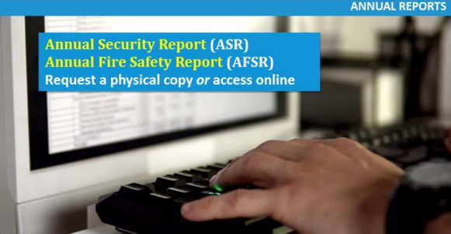
Annual Reports (ASR, ASFR)
Quick Facts
Shows 3 yrs of Data
Distributed Annually
Publicly Available
Notes:
Annual Reports, Per Clery Act Requirements
Mines must publish and provide notice of the availability of the Annual Security Report (ASR) and the Annual Fire Safety Report (AFSR) by October 1st every year. The ASR and AFSR are provided to all current and prospective university students and employees. The report will contain the last three years of data. The reports are publicly available. You may view them online or receive a physical copy by request.

Slide 20
Let’ s practice what we have learned with some scenarios!
Notes:
Let’ s practice what we have learned with some scenarios!

Slide 21
Scenario #1
Clery Act Scenarios
What Do You Think?
Jay is participating in a swim conditioning class. They tell their swim instructor, Ted, that they think they are being followed by a person they met while working at a local off campus restaurant. The person began showing up at the restaurant and will not leave them alone. They also noticed the person following them on campus and they fear for their safety. They do not know whether the person is a university affiliate.
Is this Clery reportable? Select “yes” or “no”
Yes,
Ted should report this as staking occurring on on-campus property
No,
This is not a Clery crime. Plus, it started off campus
Instructions: Hover your mouse over each answer to find the answer and additional feedback.
11
Notes:
Scenario #1
What Do You Think?
Jay is participating in a swim conditioning class. They tell their swim instructor, Ted, that they think they
are being followed by a person they met while working at a local off campus restaurant. The person
began showing up at the restaurant and will not leave them alone. They also noticed the person
following them on campus and they fear for their safety. They do not know whether the person is a
university affiliate.
Is this Clery reportable? Select “yes” or “no”
Slide Layers Insert : Hover over each answer to find the answer and feedback
Yes is Correct! This incident should be reported. Remember, for Clery purposes, it is important to
consider the crime and geography.
Stalking is a Clery crime. Although the incident began off campus, it continues on-campus, within Clery
geography. Note that it does not matter that the person may or may not be a UC affiliate, nor does it
matter whether Jay is a student, staff, or faculty member.
No is Incorrect. Remember, for Clery purposes, it is important to consider the crime and the geography.
Part of the issue has occurred on campus.
on campus.

Slide 22
Scenario #2
Clery Act Scenarios
What Do You Think?
Based on what you learned so far, which of the following incidents do you think should be reported under the Clery Act? Choose any that apply?
A. A robbery that occurs in alley adjacent to a Mines lecture hall.
B. A student reports that someone grabbed and squeezed their buttocks as they walked by them in the campus dining hall.
C. A student reported that they were shoved during a verbal argument in their dorm recreation area
D. Both A and B
Instructions: Hover your mouse over each answer to find the answer and additional feedback.
11
Notes:
Scenario #2?
Based on what you learned so far, which of the following incident do you think should be reported
under the Clery Act? Choose any that apply?
Slide Layers Insert : Hover over each answer to find the answer and feedback
D is the correct answer. Both A and B are Correct.
Correct. Robbery is a Clery crime. The CSA must report this incident because it occurred on public property adjacent to the campus (Clery geography), but this may not be the only answer.
Correct. Fondling is a Clery crime. The CSA must report this incident, which occurred on campus (Clery geography), but this may not be the only answer
Is Incorrect. Assault is not a Clery reportable crime. However, please note that aggravated assault is a Clery reportable crime.
Is Correct. Both Robbery and Fondling are Clery reportable crime when they occur in Clery geography.

Slide 23
Scenario #3
Clery Act Scenarios
What Do You Think?
When reporting an alleged crime or incident what should you do? Select all that apply.
A. Make judgements. Record personal opinions.
B. Record when and where the alleged crime occurred.
C. Record what occurred, in as much detail as possible.
D. Investigate the crime or incident to make sure you should report it.
E. Follow campus procedures to make a report.
Instructions: Hover your mouse over each answer to find the answer and additional feedback.
11
Notes:
Scenario #3
When reporting an alleged crime or incident what should you do? Select all that apply.
Slide Layers Insert : Hover over each answer to find the answer and feedback
Incorrect. Do not make judgments or include opinions. Only record what you see or are told.
Correct. To the extent possible, record when and where the crime or incident occurred.
Correct. To the extent possible, record what the crime or incident entailed. That is, what specifically occurred, its nature, and a detailed description of the incident.
Incorrect. Unless you are a Title IX investigator or police officer, you are likely not an investigator. Do NOT interrogate the reporting party or try to contact any involved parties. Only record what you see or are told.
Correct. Follow your campus procedures to report the incident. Make an online report on the Clery website or to the Mines Police Department.

Slide 24
Scenario #4
Clery Act Scenarios
What Do You Think?
Rachael is a Resident Advisor. They are in their room watching TV when a student knocks on their door. The student is very upset. They tell Rachael that they just returned from a party in an on-campus student housing facility. They think that they may have been sexually assaulted, but they are not sure. They do not want Rachael to tell anyone. Which of the following steps should Rachael NOT take?
1
2
Tell the student she will not report the incident, per their request.
Refer the student to campus resources for additional support (SHAPE, Mines Health Center, Counseling Office)
3
4
Follow campus procedures to report under the Clery Act
Report the information to the Title IX Office
Instructions: Hover your mouse over each answer to find the answer and additional feedback.
11
Notes:
Scenario #4
Rachael is a Resident Advisor. They are in their room watching TV when a student knocks on their door. The student is very upset. They
tell Rachael that they just returned from a party in an on-campus student housing facility. They think that they may have been sexually
assaulted, but they are not sure. They do not want Rachael to tell anyone. Which of the following steps should Rachael NOT take?
Slide Layers Insert : Hover over each answer to find the answer and feedback
1. Correct. This is the one item Rachel should not do. This incident may involve rape or fondling which are both Clery crimes that occurred in an on-campus student housing facility, which is Clery geography. It is important that Rachel reports the incident per Mines policy.
2 Incorrect: it is important that Rachel provide the student with contact information for campus departments for additional support; the
student Health center, SHAPE and the counseling Department are all great resources for the student.
3. Incorrect. This incident must be reported as a CSA crime and to the Title IX office.
4. Incorrect. This incident also falls under Title IX and must be reported.

Slide 25
Reminders and Summary
Clery Act Scenarios
11
Notes:
Reminders and Summary
In summary, you can help the university provide a safe and secure learning and working environment.
Remember to: Identify and adhere to Clery Act requirements; Recognize and fulfill your
responsibilities as a CSA; Properly engage with reporting parties and report all Clery crimes; and
know where to Locate your campus resources

Slide 26
CSA Assessment
Instructions: Answer the following 8 questions using the information you just leaned. All questions are multiple choice.
You must have an 80% to pass the assessment.
After this training is you would like more information or additional resources, please visit the Office for Institutional Equity Clery page at: https://www.mines.edu/clery-act/
26
Notes:
Instructions: Answer the following 8 questions using the information you just leaned. All questions are multiple choice. You must have an 80% to pass the assessment.
After this training is you would like more information or additional resources, please visit: https://www.mines.edu/clery-act/

Slide 27
Assessment
Question #1. Choose only one answer.
1. Which U.S. Department investigates Clery violations?
a. Department of Health and Human Services
b. Department of Justice
c. Department of State
d. Department of Education
27
Notes:
1. Which U.S. Department investigates Clery violations?
“D” is the correct answer The Department of Education enforces the Clery Act, so it evaluates the merit of Clery Act complaints and suspected violations. If DOE confirms a violation occurred, it launches a program review, which is a full investigation of Clery Act violations by the school

Slide 28
Assessment
Question #2. Choose only one answer.
1. The Clery Act is…
a. A victims’ right law
b. A campus crime reporting law
c. A copyright law
d. A campus privacy law
28
Notes:
1. The Clery Act is…
“B” is the correct answer
The Clery Act requires that schools participating in federal student aid funding notify the campus when a crime has been reported.

Slide 29
Assessment
Question #3. Choose only one answer.
2. What item does the Clery Act NOT require?
a. A daily crime log
b. regular police searches of campus housing
c. timely notification of campus emergencies
d. an annual security report
29
Notes:
2. What item does the Clery Act NOT require?
“B” is the correct answer
The Clery Act does not require or suggest that routine police searches be conducted.

Slide 30
Assessment
Question #4. Choose only one answer.
The Clery Act requires a daily crime log with all the crimes that happen on campus, emergency alerts, and an annual report listing all the crimes (and more) for that year.
4. How many years of crimes does the annual report require?
a. One
b. Two
c. Three
d. Four
30
Notes:
The Clery Act requires a daily crime log with all the crimes that happen on campus, emergency alerts, and an annual report listing all the crimes (and more) for that year.
4. How many years of crimes does the annual report require?
“C” is the correct answer The report has to detail every single Clery crime reported for the past three years — which makes it easy to compare how crime has changed from one year to the next.

Slide 31
Assessment
Question #5. Choose only one answer.
2. What crime should you NOT report as part of your Clery reporting obligations?
a. Robbery
b. DUI – Driving Under the Influence
c. Sexual Assault
d. Arson
31
Notes:
2. What crime should you NOT report as part of your Clery reporting obligations?
“B” is the correct answer
DUI does not need to be reported to Clery, but should be reported to Mines Police as needed for safety issues.

Slide 32
Assessment
Question #6. Choose only one answer.
2. True or False.
Hate Crimes are a reportable Crime under Clery.
a. True
b. False
32
Notes:
2. True or False.
Hate Crimes are a reportable Crime under Clery.
“A” is the correct answer
True. All Hate Crimes including crimes associated with; Larceny-Theft, Simple Assault, Intimidation, and Destruction of Property should all be reported.

Slide 33
Assessment
Question #7. Choose only one answer.
2. Who from the list below is NOT a Campus Security Authority (CSA).
a. Resident Assistants
b. Peer Mentors
c. Any University official with significant responsibility for student campus activities.
d. A faculty member who does not advise a student group
33
Notes:
2. Who from the list below is NOT a Campus Security Authority (CSA).
“D” is the correct answer
Faculty who do not have significant responsibility outside the classroom, or with student campus activities, are not CSA’s.

Slide 34
Assessment
Question #8. Choose only one answer.
2. What should you NOT do as a CSA?
a. Report in a timely manner
b. Understand your reporting options
c. List the date, time, and location of the incident in your report
d. Investigate and confront involved parties
34
Notes:
2. What should you NOT do as a CSA?
“D” is the correct answer
Do not confront parties or attempt to investigate. This could put you at risk.

Slide 35
Congratulations on finishing CSA Training!
If you would like more information or additional resources, please visit the Office for Institutional Equity Clery page at: https://www.mines.edu/clery-act/
35
Notes:
Congratulations on finishing CSA Training!
If you would like more information or additional resources, please visit the Office for Institutional Equity, Clery webpage. The website is listed here. Thank you and have a safe semester.

Slide 36
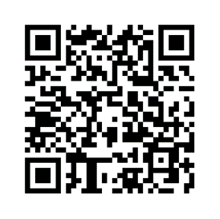
TRAINING VERIFICATION FORM
Thanks for attending Office for Institutional Equity training. Please fill out the form below to verify your successful completion of OIE training.
https://www.mines.edu/institutional-equity-title-ix/training_attendance
Make sure you get credit!

