Slide 1
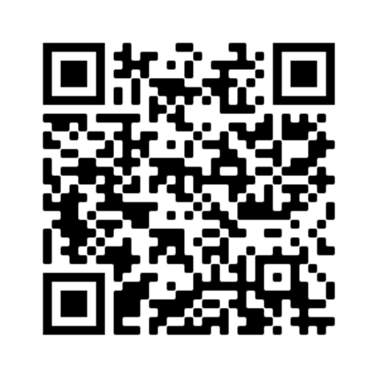
Attendance Form
Before the workshop begins, please fill out the
attendance form
https://www.mines.edu/diversity/workshop_attendance/

Slide 2
Facilitator Notes:
HIDE at least 2 data slides that are not relevant to your audience before you give the presentation!
DECIDE if you want to do the names activity first or the discussion activity first. The ppt is set up for the names first
Review the presenter notes to help with facts and figures
You only have one breakout: 4 minutes ~3 people per room/group
If you are a peer educator, please show slide 9, the Betsy’s Friends slide

Slide 3
Background for Presenters Only
FitzGerald et al. (2019) conducted a systematic review of peer-reviewed studies (2005-2015) that tested interventions designed to reduce implicit bias:
-Findings suggest that procedures that “associated sets of concepts, invoked goals or motivations, or taxed people’s mental resources produced the largest positive changes in implicit bias.”
-Authors identified “intentional strategies to overcome biases, evaluative conditioning, identifying the self with the outgroup, and exposure to counterstereotypical exemplars” as categories in need of further research.
-See Notes for FitzGerald et al. link.
Notes:
FitzGerald, C., Martin, A., Berner, D., & Hurst, S. (2019). Interventions designed to reduce implicit prejudices and implicit stereotypes in real world contexts: A systematic review. BMC Psychology, 7(1). https://doi.org/10.1186/s40359-019-0299-7

Slide 4
Workshop Structure & outline
PRE workshop: Survey
Objectives of the workshop & Why we are here (to recruit & retain top talent), why DI&A
DI&A overview
Community guidelines
Definitions
Overview of Research
Activity- how do stats apply to me?
Where does IB come from
Photos activity?
We can unlearn this
Explore how IB applies to us/what are our biases specificallly wrt mines & stem
Activity?
The continuum that Kelsi & Emma made
Strategies to mitigate
Make more tangible strategies like in the microaggressions workshop
Activity? (have several activities based on the type of participant)
Reiterate that there is hope, it takes work, but we can change, if we learned it we can unlearn it
Other DI&A workshops/Survey
Learning Outcomes
LO: participants will have been exposed to the research on implicit bias
LO: Participants will Recognize IB and its validity
LO: Participants will Internally acknowledge own biases
LO: and identify ways to counteract/mitigate these biases

Slide 5
Understanding Unconscious Bias
Thank you for being here!

Slide 6
Participation guidelines
Participate Rule of 3
Be open, honest, respectful, candid and collaborative
Be respectful of everyone’s identities and acknowledge how they impact our experiences
Acknowledge we are all taught misinformation about our own group and about members of other groups
Take risks. Comfort is overrated. Dare to engage yourself.
Be open to discomfort to learn new things
Use ‘I’ statements to describe an experience
Note: Like most employees, facilitator is a mandatory reporter. Title IX updated Mines reporting requirements Spring 2023 to include reports of discriminatory harassment
Notes:
Welcome everyone into our virtual room
Take a moment to be fully present
Lots of distractions
Put them away and bring our whole selves to these workshops
And be fully engaged.
Let’s start by taking a deep breath to come into this moment.
(count to 10 and take 1-2 deep breaths)
In these sessions, we want to set out some community guidelines:
Together we will strive to create a safe and welcoming space where we can explore DI&A concepts without fear of embarrassment or shame.
Encourage openness
Engagement and
Participation in our activities
Be aware of and open to everyone’s identities.
Treat each other with dignity
Think about our own experiences during these discussions – acknowledge that our individual experiences inform our perspectives.
We’re all taught the same misinformation and so we’ll want to acknowledge that when we dive into difficult topics.
These conversations can be hard and triggering…
But it’s important for us to go outside of our normal comfort zones to expand our bubbles
If we all commit to this, then we can all learn without shame and judgement,
Which will establish our virtual community as a safe space where all perspectives are heard and respected.
We can also look at this as having an approach using a “beginner’s mind” –
where we come with curiosity and openness as if we’re learning something for the very first time.
Have self-compassion as we learn difficult topics that may cause discomfort.
Ask hard questions! That’s why we’re here!
Feel free to participate via the chat box!
Lastly, we want you to contribute to these guidelines as they are for this group.
In the chat box, I invite you to type out any additional guidelines that may be missing or
that would create a safe space for us to explore these sensitive topics.
Note on Title IX mandatory reporting: quickly remind the audience that you are a mandatory reporter, and must report incidents of discriminatory harassment. This could include stories of harassment shared in this workshop
For your FYI: the policy used to just be reporting for sexual misconduct.
Pause for contributions in the chat and any questions

Slide 7
Learning Objectives of the Workshop
LO: Learn about the research on unconscious bias
LO: Recognize IB and its validity
LO: Internally acknowledge our own biases
LO: Identify and practice ways to counteract/mitigate these biases

Slide 8
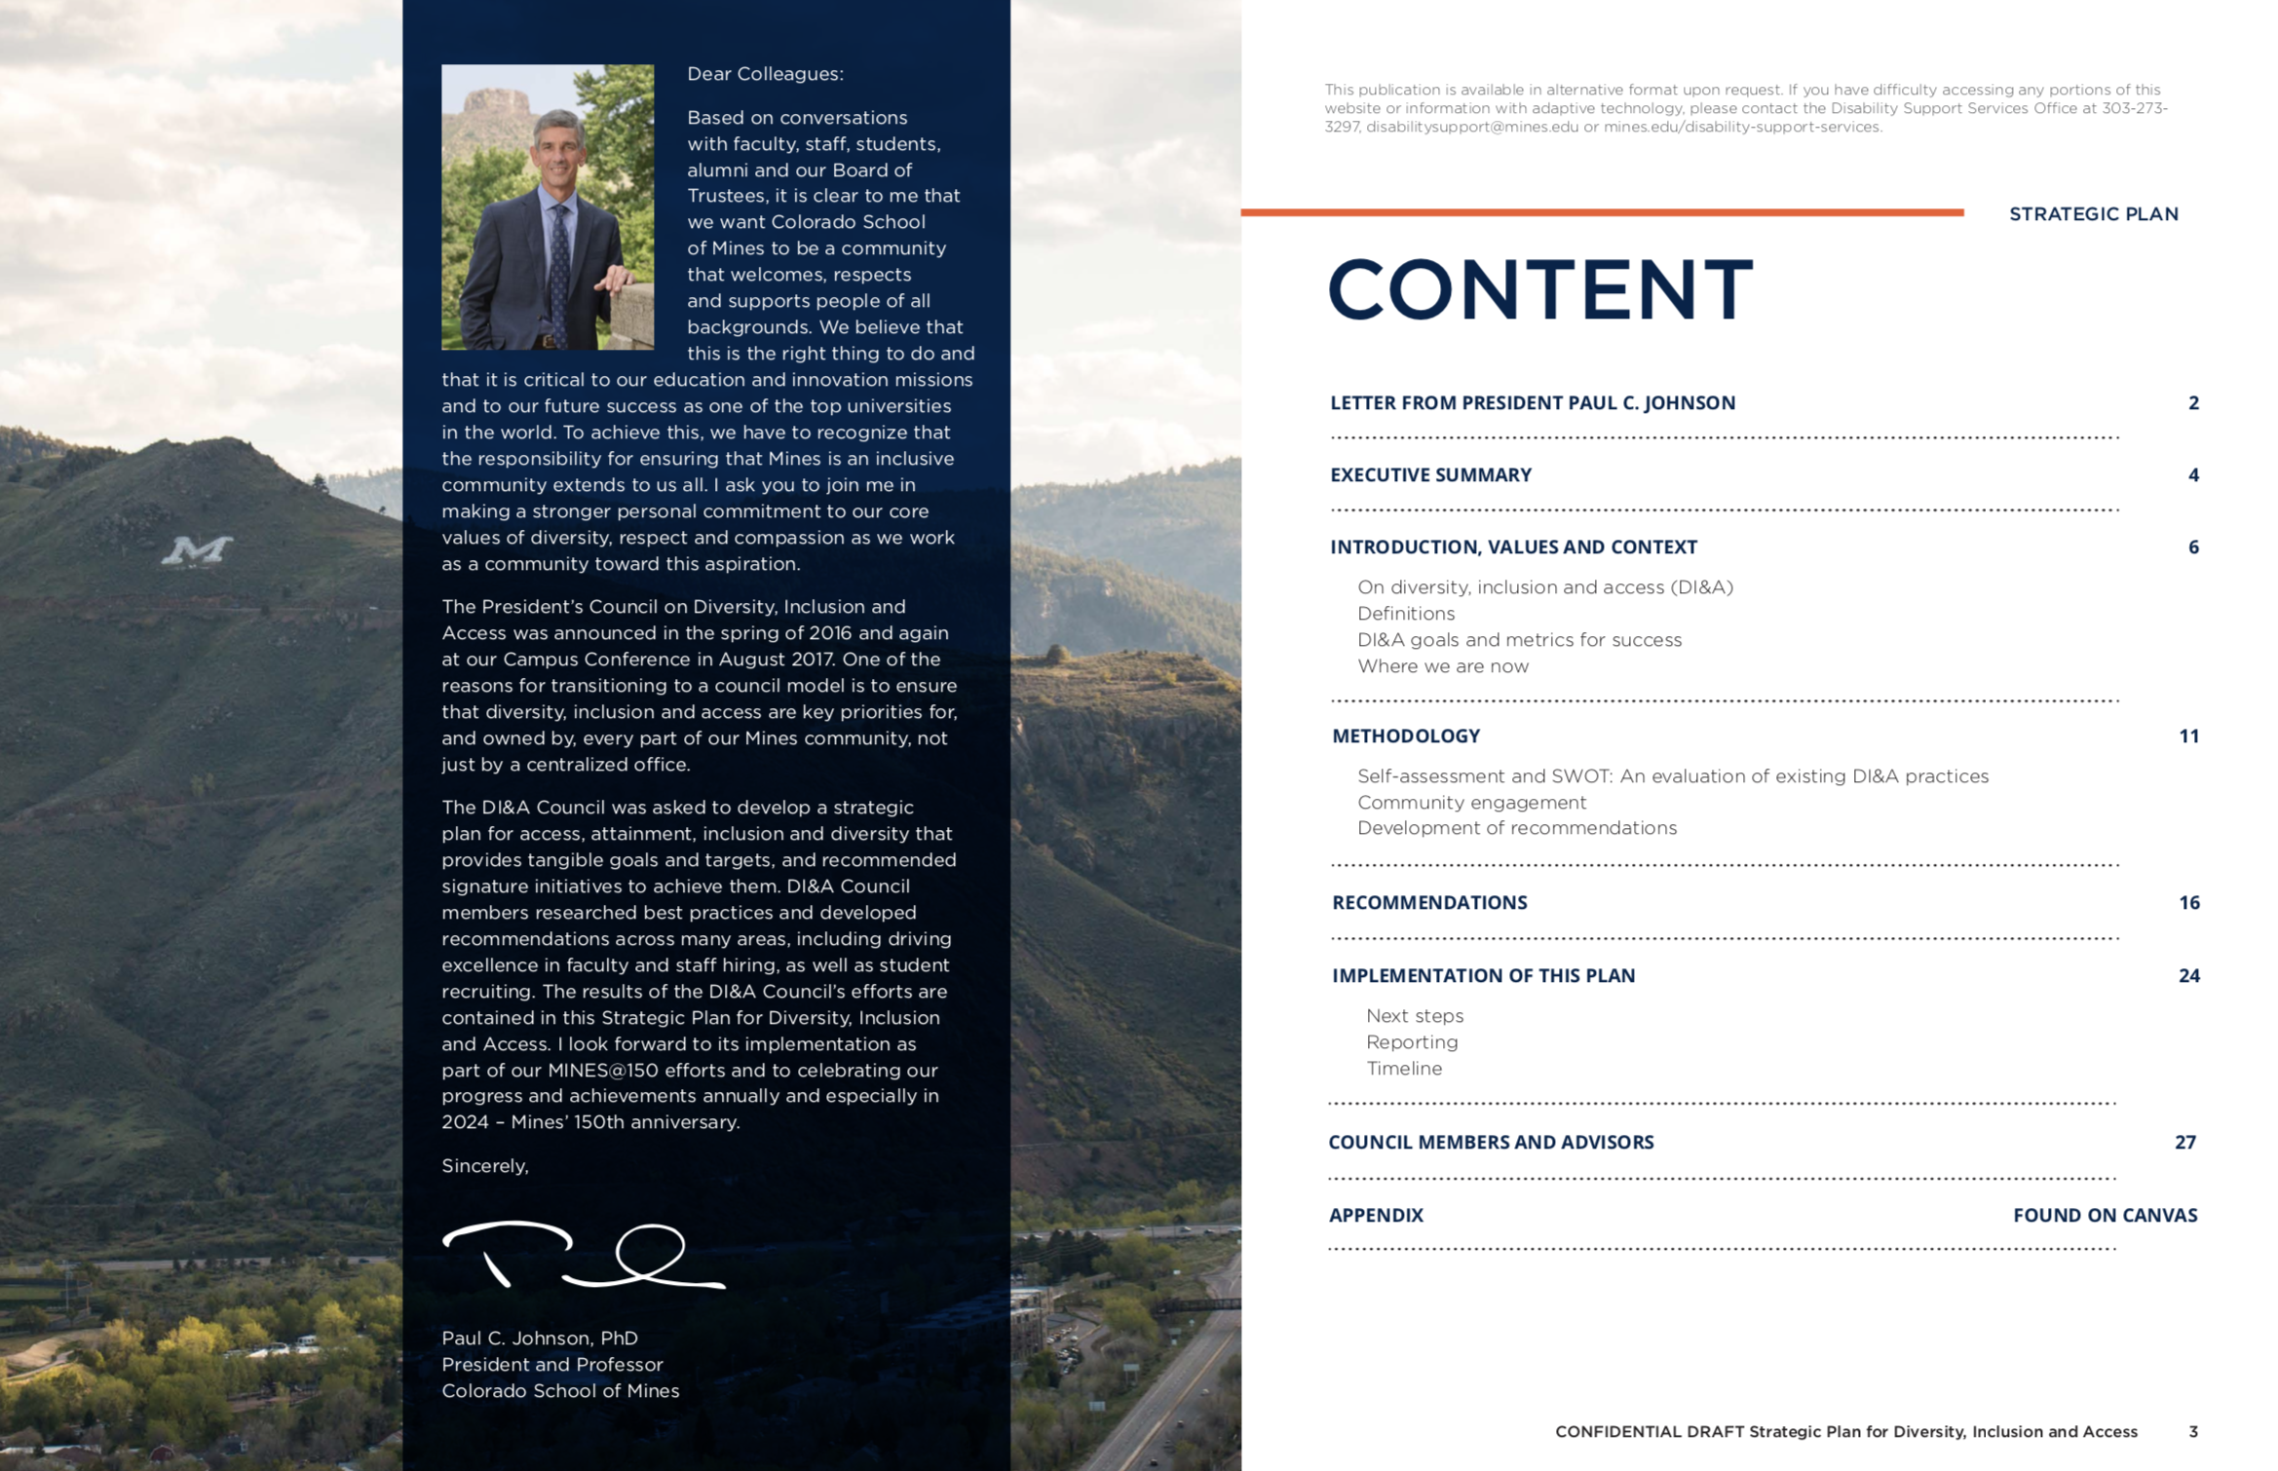
Our Strategic Plan and Commitment Diversity, Inclusion & Access
Goals
Attract, retain, graduate and promote students, faculty & staff
Cultivate an inclusive campus culture
Inspire shared responsibility for DI&A
Notes:
Key highlights:
SP published in February 2019 – goals for MINES@150 in 2024
Has 7 priority focus areas
24 strategic, measurable, achievable, realistic and timely (SMART) recommendations within those priority focus areas
Available on DI&A website

Slide 9
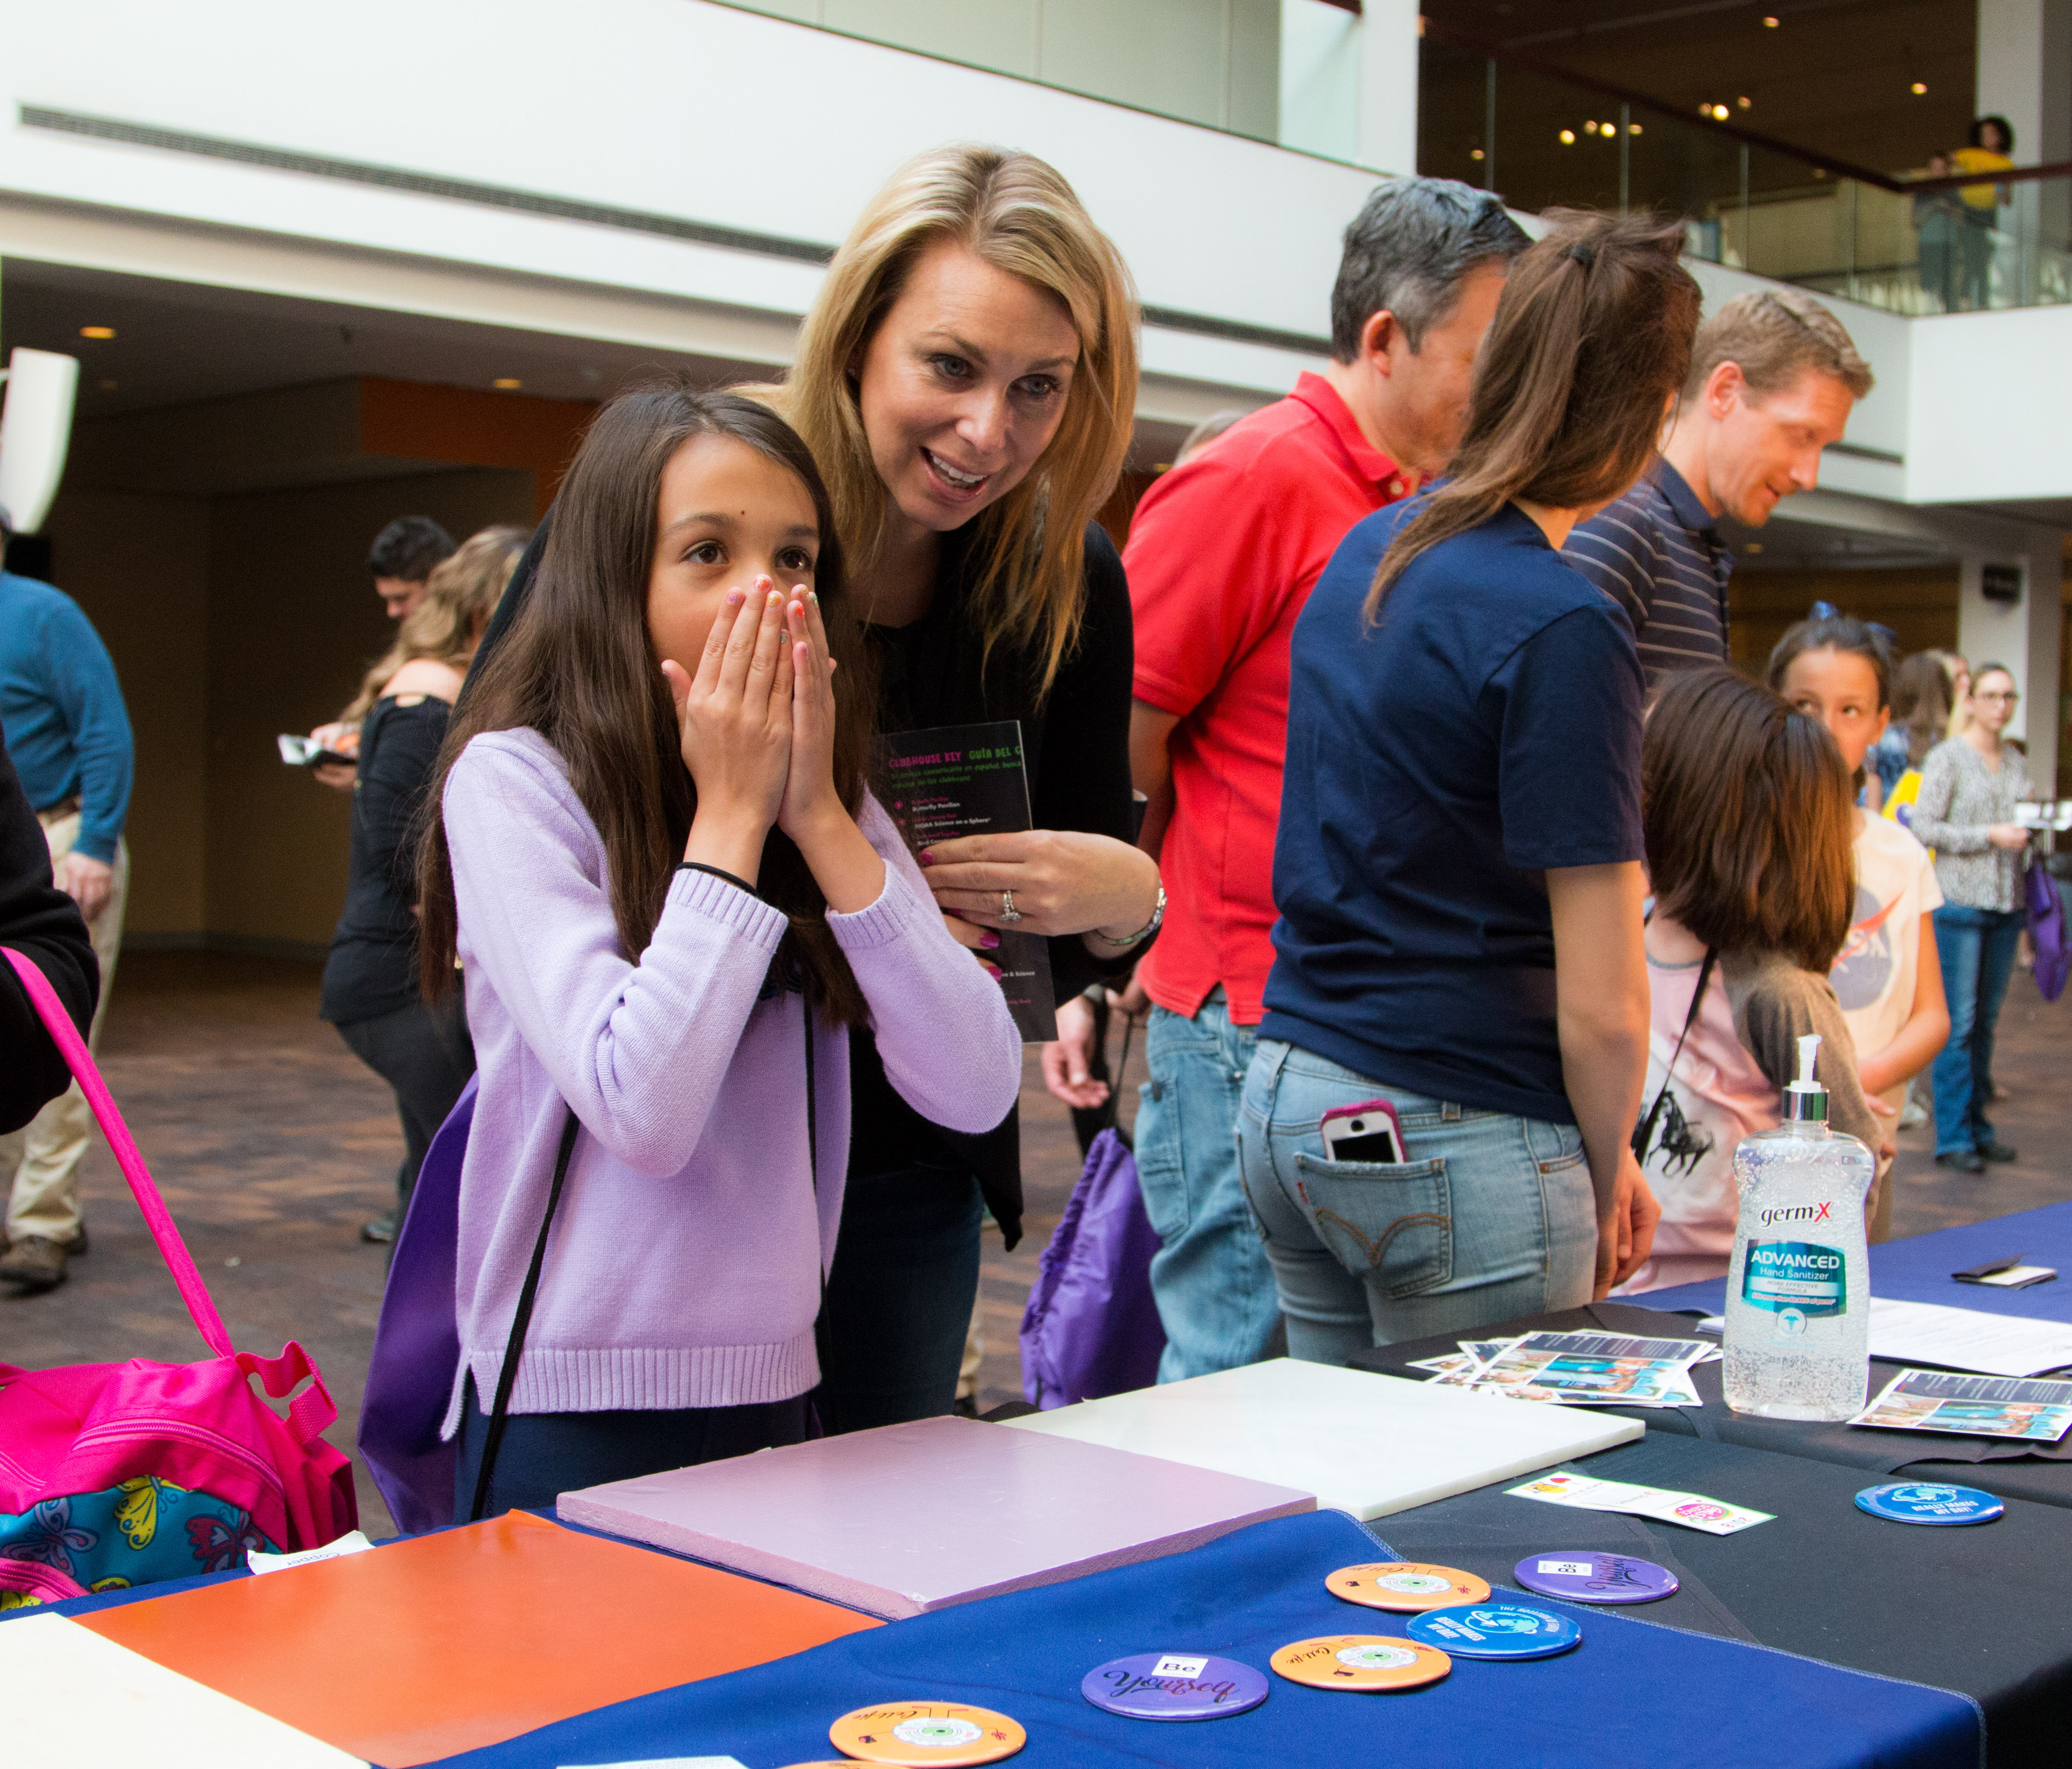
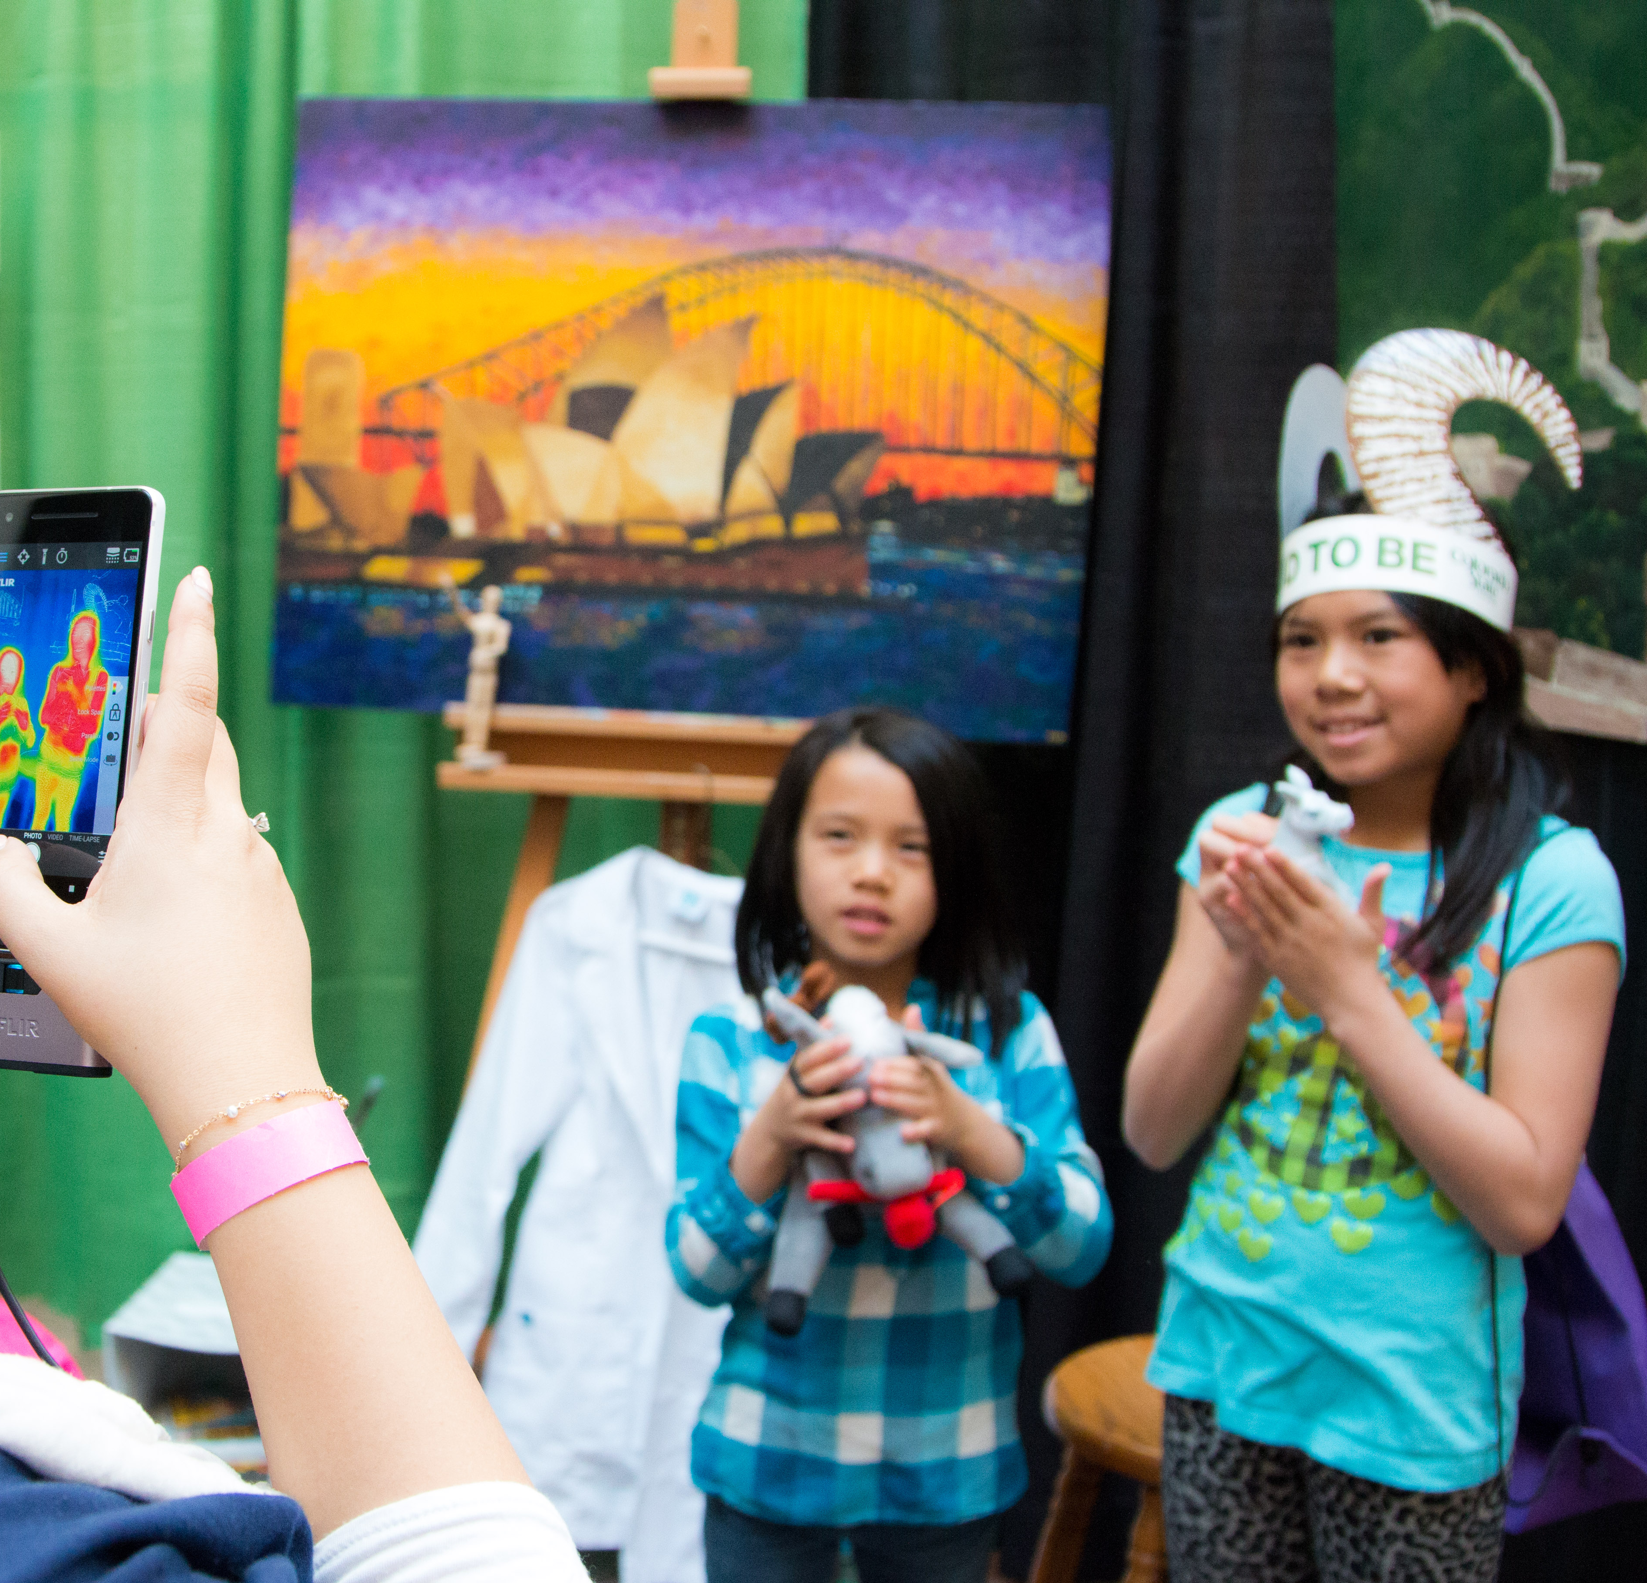
Why DI&A?
Research shows diversity in groups & organizations results in:
Richer learning experiences for students
Teams that are better at problem solving
More innovation around complex problems
Increased financial performance
Where do inclusion & access come in?
Enabling access to Mines creates diversity
A culture of inclusion sustains diversity
Phillips Scientific American (2014), Carrell et al (2010) The Quarterly Journal of Economics – TAMU ADVANCE, Mitchell (2017) The Columbia Spectator
Notes:
Mines is hard enough: a students’ background, gender, or race shouldn’t be a factor that makes success at Mines more difficult.
Note to facilitator: for URG audience, spend more time on the moral imperative, less time on this…
Why do we care about DI&A at Mines and in STEM?
Mines aspires to be a leader in student education and innovation.
Everyone who wants to be a scientist or engineer should get the same types of opportunities and not face additional barriers just because of who they are.
Research shows that having a diverse student and employee population is critical to that success.
Diversity = different lived experiences, problem solving techniques, ways of thinking/creating = more innovative
Diversity also increases financial performance of institutions.
Inclusion and access are critical to sustaining diversity.
So that everyone feels included in our culture and feels that sense of belonging
And so everyone has access to the resources and tools needed for success.

Slide 10
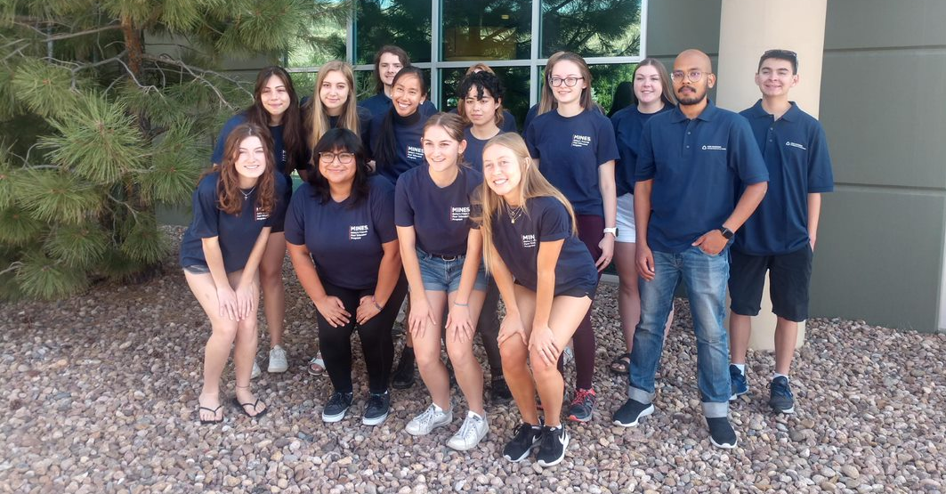
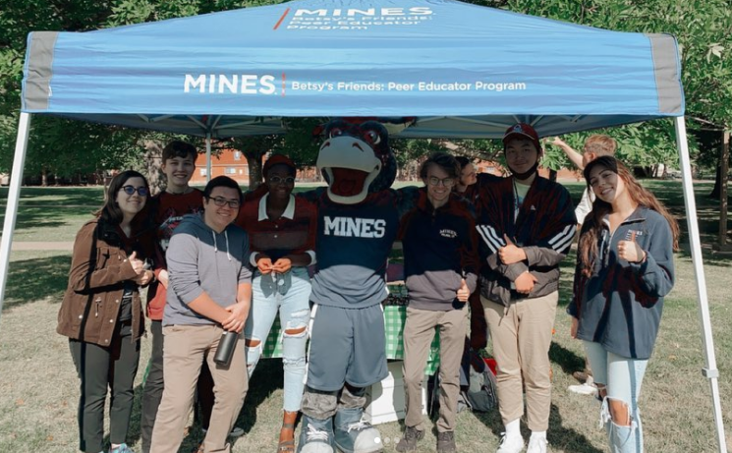
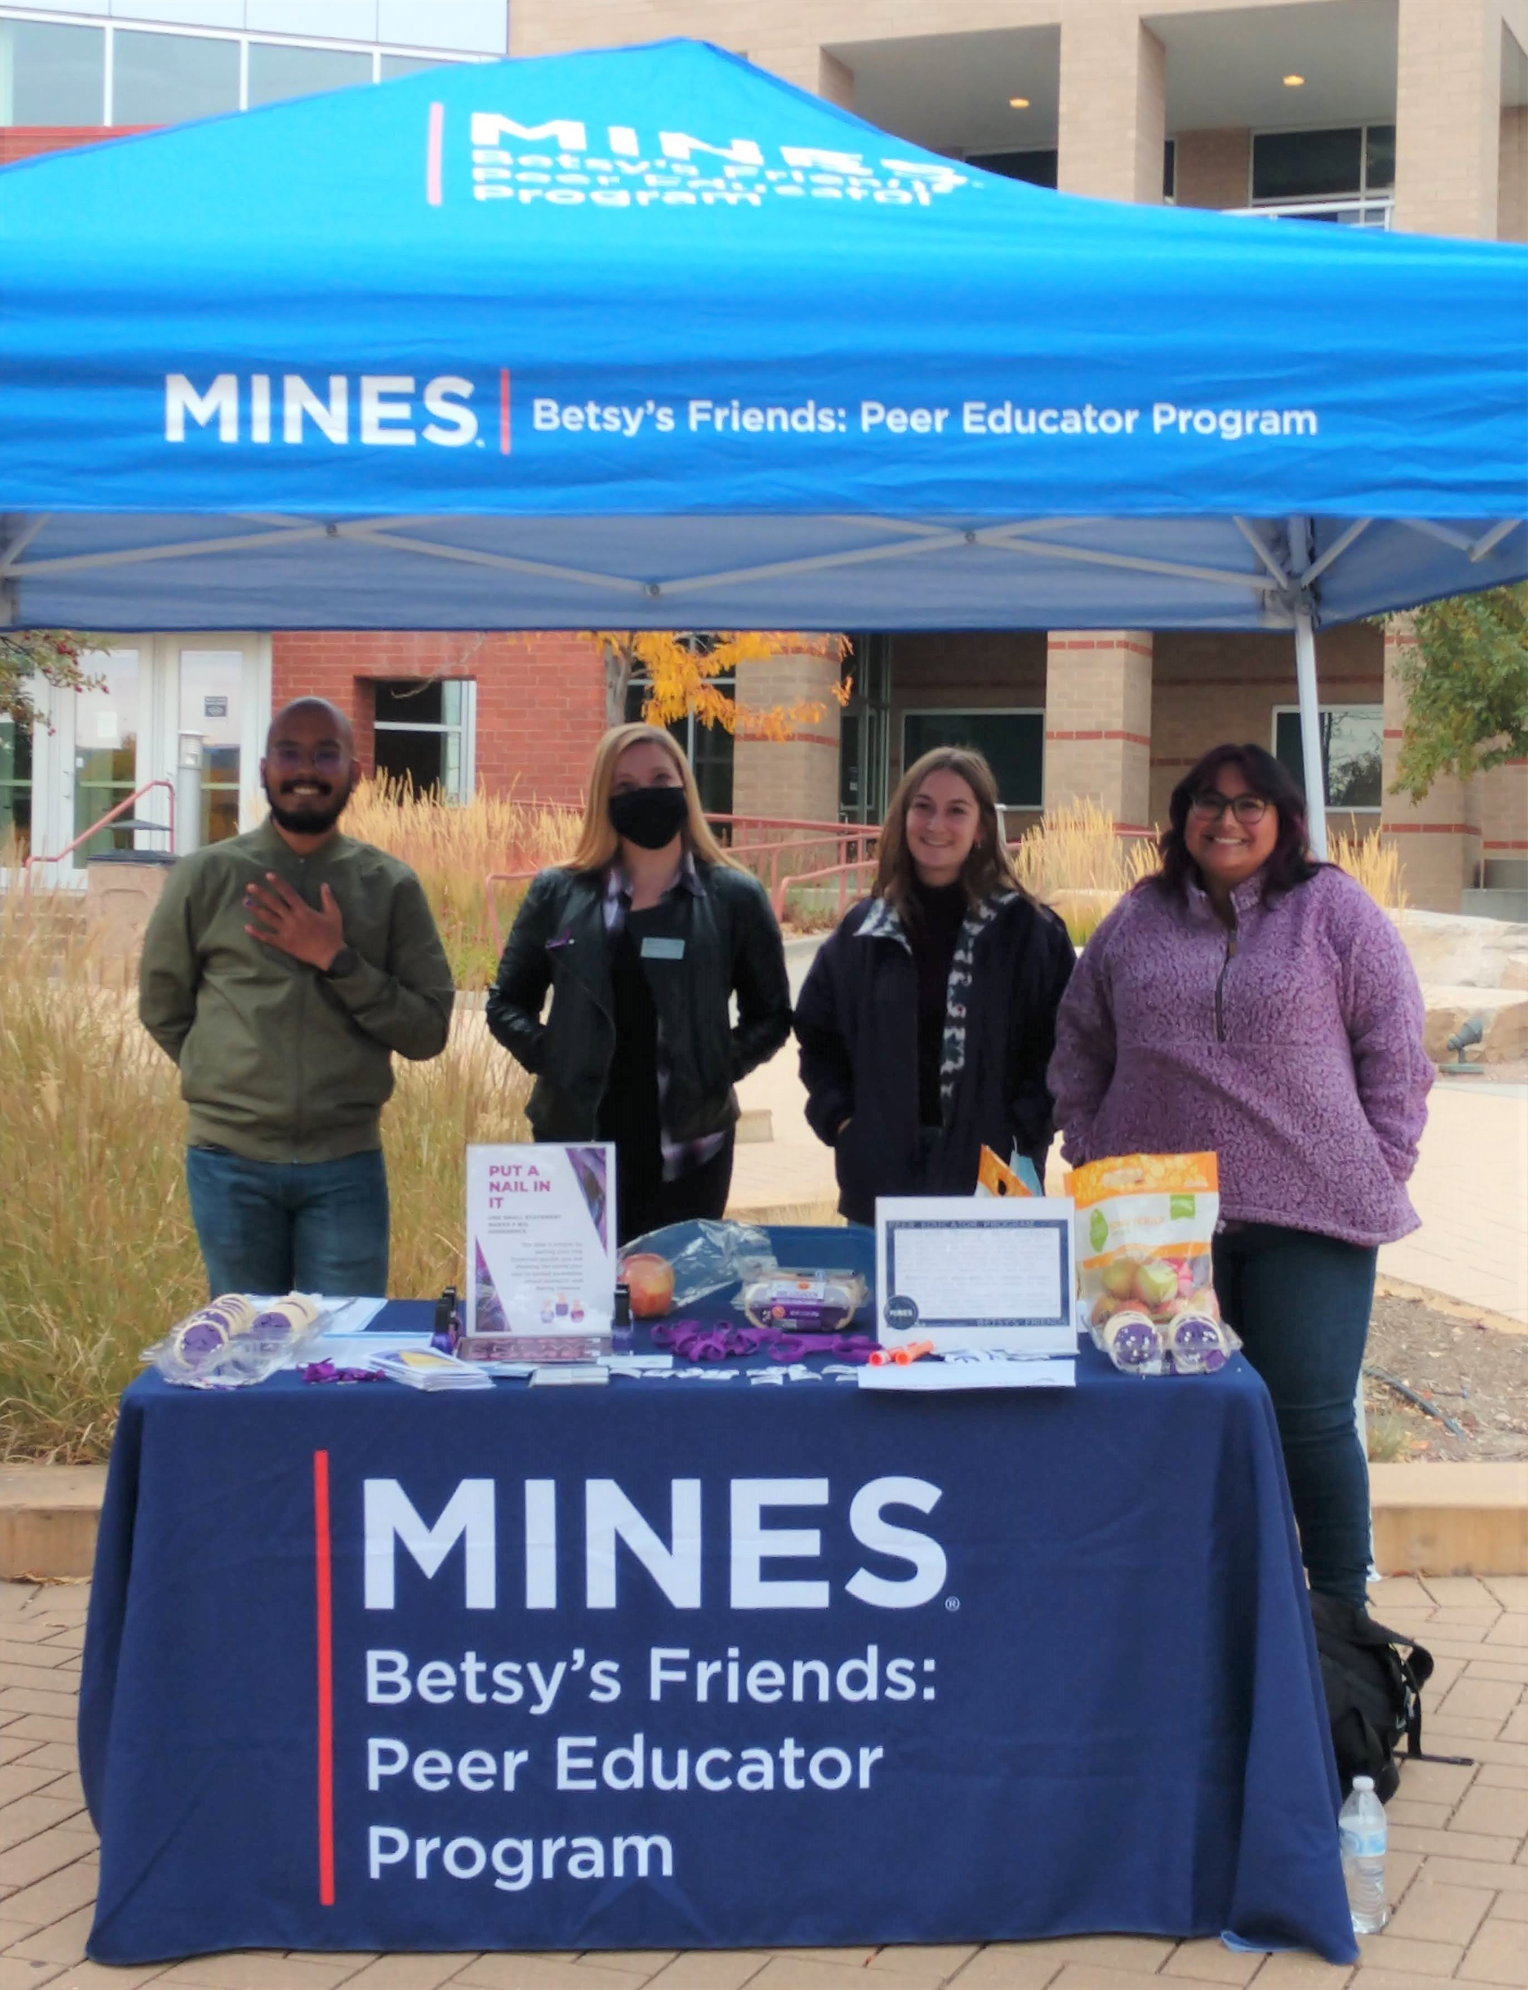
Thank you to Steve ‘63 & Carolyn McCandless for supporting our workshops!
Peer Education is a collaboration between the Student Wellness Promotion, the Title IX Office, & MinesDI&A
Notes:
This is the Mines Peer Educator team. Our mission to create an inclusive support system on campus promoting safe, healthy behaviors and relationships. We provide creative, relevant, student-centered outreach programs and workshops. The Title IX Office and Student Wellness Promotion partner to support the Peer Educator team which has three groups: one focusing on healthy relationship, one focused on mental health, and one focused on wellness.

Slide 11
24
SMART
Recommendations
Notes:
Our plan has 24 specific recommendations that fit under each of these 7 areas.
Many of the resulting programs revolve around institutional change. However, we won’t achieve true culture change at Mines unless each and every one of us finds a way to support DI&A at Mines- that’s what shared responsibility means.

Slide 12
Breakout Conversation
Talk about a time when you felt excluded and/or devalued...

Slide 13
Social Identities
Did they play a role when someone made an assumption about you based on a stereotype?
Notes:
Social Identities:
This image is a depiction of some of the different social identities that people have.
In each, there are identities that are marginalized and those that are considered the dominant/accepted/most trusted identity.
For example, when discussing sexual orientation – marginalized identities include homosexual, bisexual, or asexual, whereas the most accepted identity would be heterosexual.
There are also identities which may be more or less visible to others:
i.e. race/ethnicity perhaps versus one’s education status
This can lead us all to make assumptions, whether intentional or not.
Reflection:
Take a look at this wheel and point your cursor to the ones that you feel are a marginalized part of your identity.
Reflect on these social identities in which you feel marginalized.
Thinking back on our breakout groups:
Which social identities played a role in the time that someone made a stereotypical comment about you?
Was it a traditionally marginalized identity?
Important!!
Everyone has some sort of marginalized identity.
When someone makes assumptions based on stereotypes, it’s usually connected to one of these marginalized identities.
Imagine how you’d feel if you had a LOT of marginalized identities.
That would suck (and it does!!)
It would cause a lot of social exclusion.

Slide 14
Who do you think of first?
CEO of a company
Kindergarten teacher
Athlete
University president
Stay at home parent
Chemistry professor
Department 'secretary' or administrative assistant (what do students call the dept 'secretary')
It's possible to have an association or bias that directly opposes your beliefs!
Notes:
Play these one by one and allow participants to process through each one for about 10 seconds. Ask them to write down what image and/or emotion comes to mind
(RE last line)
Ambassadors should have a personal example of an association or bias that opposes their beliefs to show that we are also unlearning

Slide 15
Can you think of a way that someone stereotyped you in the past?
Or perhaps a time when you were excluded?
How does that relate to implicit bias?
Discussion: what is an association that you need to be more aware of, and how does that show up in your day-to-day life?
Notes:
In what scenarios do we need to be aware of and how they’re interrupting our day?
LO: Participants will Recognize IB and its validity
LO: Participants will Internally acknowledge own biases

Slide 16
Definitions
"Implicit bias refers to negative (or positive) unconscious prejudices, stereotypes, or beliefs held by a person that they may be unaware of having. Despite this unawareness, implicit biases are often expressed in real-life situations through a person's actions and attitudes and thus have real-world implications."
library.law.howard.edu/socialjustice/bias
Notes:
LO: Participants will Recognize IB and its validity
References at the end

Slide 17
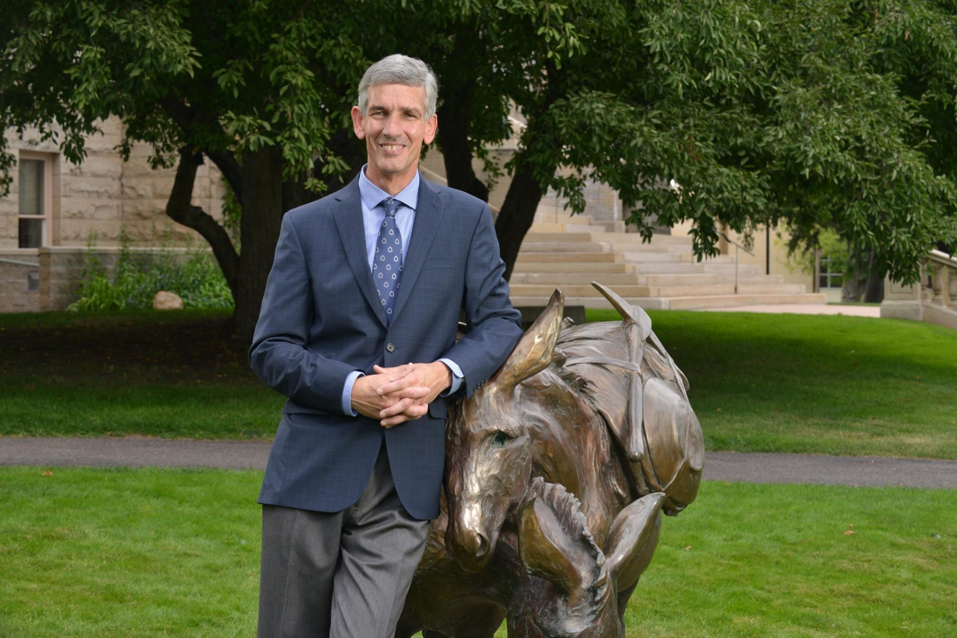
Where does IB come from?
Associated Learning: From the time we are young, our brain creates shortcuts for us to make associations and connections between two concepts
Our brain works to categorize people
We internalize these concepts at a very young age without knowing it
For example: when you think of a university
president, what image comes to mind?
Notes:
Often an experience you've had with someone can often dictate how you envision that identity or that role in the future. If President Johnson is the only university president you've ever known, there's a high likelihood you will imagine someone with similar identities
https://www.sciencedirect.com/topics/biochemistry-genetics-and-molecular-biology/associative-learning
LO: Participants will Recognize IB and its validity
LO: Participants will Internally acknowledge own biases

Slide 18
IB Research: Studies about Hiring
What happens when people review the same resume, but we change the name…
CVs for Asst Professor hire:
Men preferred 2:1 over women
4 times more reservations for women
PostDoc Fellowship Applications:
Women must publish >99 papers to be
seen as having same competence as a man with ~35
Wearing “gay & proud” apparel to apply for jobs:
Employers spent less time, used fewer works, and acted more negatively to “gay & proud” applicants
Rec Letters:
For men: have more professional statements
For women: have more personal statements
Review of resumes:
“White sounding” names receive 50%
more callbacks for interviews
Results are consistent for both male and female reviewers
Notes:
Review of Resumes Source: Kang, S. K., DeCelles, K. A., Tilcsik, A., & Jun, S. (2016). Whitened résumés. Administrative Science Quarterly, 61(3), 469–502. https://doi.org/10.1177/0001839216639577

Slide 19
IB Research: Studies about Hiring
What happens when people review the same resume, but we change the name…
CVs for Asst Professor hire:
Men preferred 2:1 over women
4 times more reservations for women
PostDoc Fellowship Applications:
Women must publish >99 papers to be
seen as having same competence as a man with ~35
Review of resumes:
“White sounding” names receive 50%
more callbacks for interviews
Wearing “gay & proud” apparel to apply for jobs:
Employers spent less time, used fewer works, and acted more negatively to “gay & proud” applicants
Results are consistent for both male and female reviewers
Notes:
NOTE TO FACILITATOR: Tell a story about this as an experience (your own, or a story you’ve read)
Review of Resumes Source: Kang, S. K., DeCelles, K. A., Tilcsik, A., & Jun, S. (2016). Whitened résumés. Administrative Science Quarterly, 61(3), 469–502. https://doi.org/10.1177/0001839216639577

Slide 20
The Picture at Mines

Slide 21
Note to facilitator:
Hide at least 2 data slides
Speak to the demographics of your audience (students, faculty, staff)

Slide 22
Bachelor’s Degrees Awarded, 2018
Notes:
In comparison to even National Statistics, Women are 50% of the population! Women are 50% of the college bound population!
Ask attendees what stands out?
We are still well below the gender distribution

Slide 23
Bachelor’s Degrees Awarded, 2018
Notes:
In comparison to even National Statistics, Hispanic people are 18,5% of the population! They are nearly 20% of the college bound population in CO!
Black 13.4% US, 4..6% CO
Native American 1.3% US, 1.6% CO
Asian 5.9% US, 3.5% CO

Slide 24
Bachelor’s Degrees Awarded, 2018

Slide 25
Doctoral Degrees Awarded NSF = 2018 Mines = 2018-2021

Slide 26
Doctoral Degrees Awarded NSF = 2018 Mines = 2018-2021
27%
of PhDs are awarded to women

Slide 27
IB Research: Retention – U.S. Data
 | Black | White | Hispanic
% Who Declare STEM Majors | 18% | 19% | 20%
% Who Earn a STEM Degree | 34% | 58% | 43%
% Women interested in STEM Degree | 23% | 16% | Data not available
% Women graduating with STEM Degree | 8% | 10% | Data not available
Notes:
Script for presenters: "Black, white and Hispanic students declare STEM majors at roughly the same rates — 18%, 19% and 20%, respectively. Students who earn a stem degree: 58% for white, 43% for Hispanic, and 34% for Black students. Black and Hispanic students tend to switch majors or leave college in higher numbers, according to the same study."* (Riegle-Crumb, King, and Irizarry, 2019). {Data in rows 1 and 2}
"Black women report interest in STEM at rates far higher than white women (23% and 16% respectively) but only 8% of Black women graduate with a STEM degree, compared to 10% of white women" (O'Brien et al., 2015). {Data in rows 3 and 4}
*https://psych.wustl.edu/news/understanding-your-biases
Link in Jeri's text above goes to: Does STEM Stand Out? Examining Racial/Ethnic Gaps in Persistence Across Postsecondary Fields - Catherine Riegle-Crumb, Barbara King, Yasmiyn Irizarry
https://journals.sagepub.com/doi/full/10.3102/0013189X19831006?journalCode=edra 2019
O'Brien, L. T., Blodorn, A., Adams, G., Garcia, D. M., & Hammer, E. (2015). Ethnic variation in gender-STEM stereotypes and STEM participation: An intersectional approach. Cultural Diversity and Ethnic Minority Psychology, 21(2), 169–180. https://doi.org/10.1037/a0037944

Slide 28
Recruitment – Yield Rates
Notes:
Jon inserted this because it counters a common assumption: that women and underrepresented students are somehow less qualified than white, male students (the default in engineering).
Corrected Script (as of Aug 17, 2022): If we look at the data on prospective students admitted compared to those enrolled, while still using our high admission standards, we find that:
1. our yield rates (the number of students enrolled divided by the number admitted) for women and students of color are 18.8% and 19.7% respectively. And
2. that these yield rates are lower than the rates for men and white students (24.1% and 23.4%, respectively).
3. This is unfortunate because the number of admitted women and admitted students of color is greater than the total number of new/incoming students who enroll at Mines – so there are TONS of qualified students out there! (To provide context, the light blue bar represents the total number of new enrolled students, including women and students of color, for 2021).
This is something Mines is working on regarding our admissions communications, climate, etc. for these marginalized groups. What's important to note is that, hypothetically if we tried to achieve gender parity (50%) and 40% students of color, we would need yield rates to be 29% for both women and students of color, which is significantly higher than the yield rates we have for men and white students (the 24% and 23%).
Another important note is oftentimes, women and students of color come in with more leadership experiences and other academic qualifications, which would actually increase the value and reputation of a Mines degree if the institution was able to increase their yield rates to match white students and/or male students.

Slide 29
Employment – Academic Leadership and Faculty 2019 by Gender

Slide 30
Employment – Academic Leadership and Faculty 2019 by Race/Ethnicity

Slide 31
Pavlovian Conditioning
Would give dogs food, which would trigger salivation
Added a bell when food was given, which increased salivation
This became a conditioned response. Any time the bell was rung, salivation would begin even without the presence of food
simplypsychology.org/Pavlov2.jpg?ezimgfmt=ng%3Awebp%2Fngcb30%2Frs%3Adevice%2Frscb30-1​
Notes:
Ivan Pavlov researched the association between dogs being fed and salivation
https://www.simplypsychology.org/pavlov.html
LO: Participants will Recognize IB and its validity
LO: Participants will Internally acknowledge own biases

Slide 32
Examples of Associations
Can you think of a way that someone stereotyped you in the past?
Or perhaps a time when you were excluded?
How does that relate to unconscious bias?
Discussion: what is an association that you need to be more aware of, and how does that show up in your day-to-day life?
CEO of a company
Kindergarten teacher
Athlete
Undergrad student president
Stay at home parent
Chemistry professor
Department 'secretary' or administrative assistant (what do students call the dept 'secretary'
It's possible to have an association or bias that directly opposes your beliefs!
Notes:
LO: Participants will Recognize IB and its validity
LO: Participants will Internally acknowledge own biases

Slide 33
Campus Climate
the current attitudes, behaviors and standards of faculty, staff, administrators and students concerning the level of respect for individual needs, abilities and potential
Notes:
Pascarella, E. T., & Terenzini, P. T. (2005). How College Affects Students: A Third Decade of Research. San Francisco: Jossey-Bass
ALSO a measure (real or perceived) of the campus environment as it relates to interpersonal, academic, and professional interactions (Hurtado, 1992);

Slide 34
Research: Climate (Students)
Students of color in STEM majors are less likely to continue if they feel excluded, isolated or have discouraging academic experiences (Miyatsu, 2019).*
The quantitative and qualitative data suggest that RMAs (racial microagressions) are not isolated incidents but are ingrained in the campus culture, including student interactions with STEM instructors and advisers and with peers (Lee et al., 2020).**
When students of color perceive a negative racial campus climate, academic persistence and retention rates fall. Conversely, a positive racial environment contributes to a strong sense of belonging and is associated with higher grades and graduation rates for students of color (Lee et al., 2020).**
In a study of implicit associations, STEM and non-STEM student groups demonstrated a significant implicit pro-male-STEM/pro-female-Arts bias. There was also evidence found of a pro-female-STEM bias, significant only among female STEM students. This suggests a shift among female STEM students but not the broader study population, the clashing of which can add to climate issues (Farrell & McHugh, 2017).
Some evidence suggests climate has disproportionate outcomes: Women of color comprise less than 5% of undergraduates in male-dominated STEM fields (Casad et al., 2020).
20-50% of women students experience sexually harassing behavior perpetrated by faculty/staff (NASEM)
Grad students are 6 times more likely to experience depression and anxiety compared to the general population. Transgender, gender-nonconforming, and women graduate students were worse than their cisgender male counterparts (>10%) (Evans 2018)
Students of color experience stereotyping and marginalization in college classes (Harwood 2015)
LGBQ students in STEM experience marginalization and devaluation and men, in particular, aren’t retained (Hughes 2018)
Female PhD applicants receive fewer email responses from profs than male (Milkman 2015)
Students who feel excluded, isolated are more likely to leave
20-50% of women students nationally experience sexually harassing behavior perpetrated by faculty/staff
Students still attribute STEM skills with men & arts with women
A positive environment results in higher grades & graduation rates
Notes:
Students of color in STEM majors are less likely to continue if they feel excluded, isolated or have discouraging academic experiences (Miyatsu, 2019).*
The quantitative and qualitative data suggest that RMAs (racial microagressions) are not isolated incidents but are ingrained in the campus culture, including student interactions with STEM instructors and advisers and with peers (Lee et al., 2020).**
When students of color perceive a negative racial campus climate, academic persistence and retention rates fall. Conversely, a positive racial environment contributes to a strong sense of belonging and is associated with higher grades and graduation rates for students of color (Lee et al., 2020).**
In a study of implicit associations, STEM and non-STEM student groups demonstrated a significant implicit pro-male-STEM/pro-female-Arts bias. There was also evidence found of a pro-female-STEM bias, significant only among female STEM students. This suggests a shift among female STEM students but not the broader study population, the clashing of which can add to climate issues (Farrell & McHugh, 2017).
Some evidence suggests climate has disproporationate outcomes: Women of color comprise less than 5% of undergraduates in male-dominated STEM fields (Casad et al., 2020).
Jeri’s stats: *(Miyatsu, 2019) https://psych.wustl.edu/news/understanding-your-biases
**(Lee et al., 2020) https://stemeducationjournal.springeropen.com/articles/10.1186/s40594-020-00241-4
Casad, B. J., Franks, J. E., Garasky, C. E., Kittleman, M. M., Roesler, A. C., Hall, D. Y., & Petzel, Z. W. (2020). Gender inequality in academia: Problems and solutions for women faculty in STEM. Journal of Neuroscience Research, 99(1), 13–23. https://doi.org/10.1002/jnr.24631
Farrell, L. & McHugh, L. (2017). Examining gender-stem bias among stem and non-STEM students using the implicit relational assessment procedure (IRAP). Journal of Contextual Behavioral Science, 6(1), 80–90. https://doi.org/10.1016/j.jcbs.2017.02.001
Sexual harassment stats: http://sites.nationalacademies.org/shstudy/index.htm
NASEM report on sexual harassment of women

Slide 35
Research: Climate (Faculty/Staff)
Men with stronger implicit stereotypes report socially including fewer women in the workplace (Cyr et al., 2021).
Three key factors are associated with gender inequalities and women’s departures from academic STEM fields: 1) numeric underrepresentation and stereotypes, 2) lack of supportive social networks, and 3) chilly academic climates (Casad et al., 2020).
40% of women of color reported feeling unsafe in the STEM workplace as a result of their sex or gender; 28% of women of color reported feeling unsafe as a result of their race (Clancy et al., 2017).
Half of female scientists leave full-time science after their first child (Cech 2019)
Women of color report overwhelming amounts of gender discrimination, isolation, marginalization and alienation resulting from microaggressions in STEM (Dortch 2017)
Women get less credit for the same contribution/effort on pubs (Macaluso 2016, Feldon 2017)
Women receive lower teaching evals despite equal teaching effectiveness (Boring 2016, MacNell 2015)
Women’s careers suffer after parental leave while men’s are enhanced by leave (Clancy 2017, Guarina 2017)
Women receive small start-ups as Asst Profs (Antecol 2016)
Papers less likely to be accepted when reviewers know the primary author is a woman (Moss-Racusin 2018)
Women receive lower grant scores (Tamblyn 2018)
Papers by women are cited less often (Lariviera 2013, Ghiasi 2015)
Women’s contributions attributed to male colleagues (Rossiter 1993)
More on women lacking representation in leadership…
More on disparity of pay for women & underrepresented groups…
Men are less likely than women to believe studies that show gender bias (Handley 2015)
Women leave STEM because
they are stereotyped
they lack support
poor climate
40% of women of color feel unsafe because of their gender
A positive climate results in better retention & success
Men who hold strong stereotypes are more likely to exclude women
Women get less credit for the same work (teaching, research)
Notes:
Men with stronger implicit stereotypes report socially including fewer women in the workplace (Cyr et al., 2021).
Three key factors are associated with gender inequalities and women’s departures from academic STEM fields: 1) numeric underrepresentation and stereotypes, 2) lack of supportive social networks, and 3) chilly academic climates (Casad et al., 2020).
40% of women of color reported feeling unsafe in the STEM workplace as a result of their sex or gender; 28% of women of color reported feeling unsafe as a result of their race (Clancy et al., 2017).
1) Cyr, E. N., Bergsieker, H. B., Dennehy, T. C., & Schmader, T. (2021). Mapping social exclusion in STEM to men’s implicit bias and women’s career costs. Proceedings of the National Academy of Sciences, 118(40). https://doi.org/10.1073/pnas.2026308118
2) Casad, B. J., Franks, J. E., Garasky, C. E., Kittleman, M. M., Roesler, A. C., Hall, D. Y., & Petzel, Z. W. (2020). Gender inequality in academia: Problems and solutions for women faculty in STEM. Journal of Neuroscience Research, 99(1), 13–23. https://doi.org/10.1002/jnr.24631
3) Clancy, K. B., Lee, K. M., Rodgers, E. M., & Richey, C. (2017). Double jeopardy in astronomy and planetary science: Women of color face greater risks of gendered and racial harassment. Journal of Geophysical Research: Planets, 122(7), 1610–1623. https://doi.org/10.1002/2017je005256

Slide 36
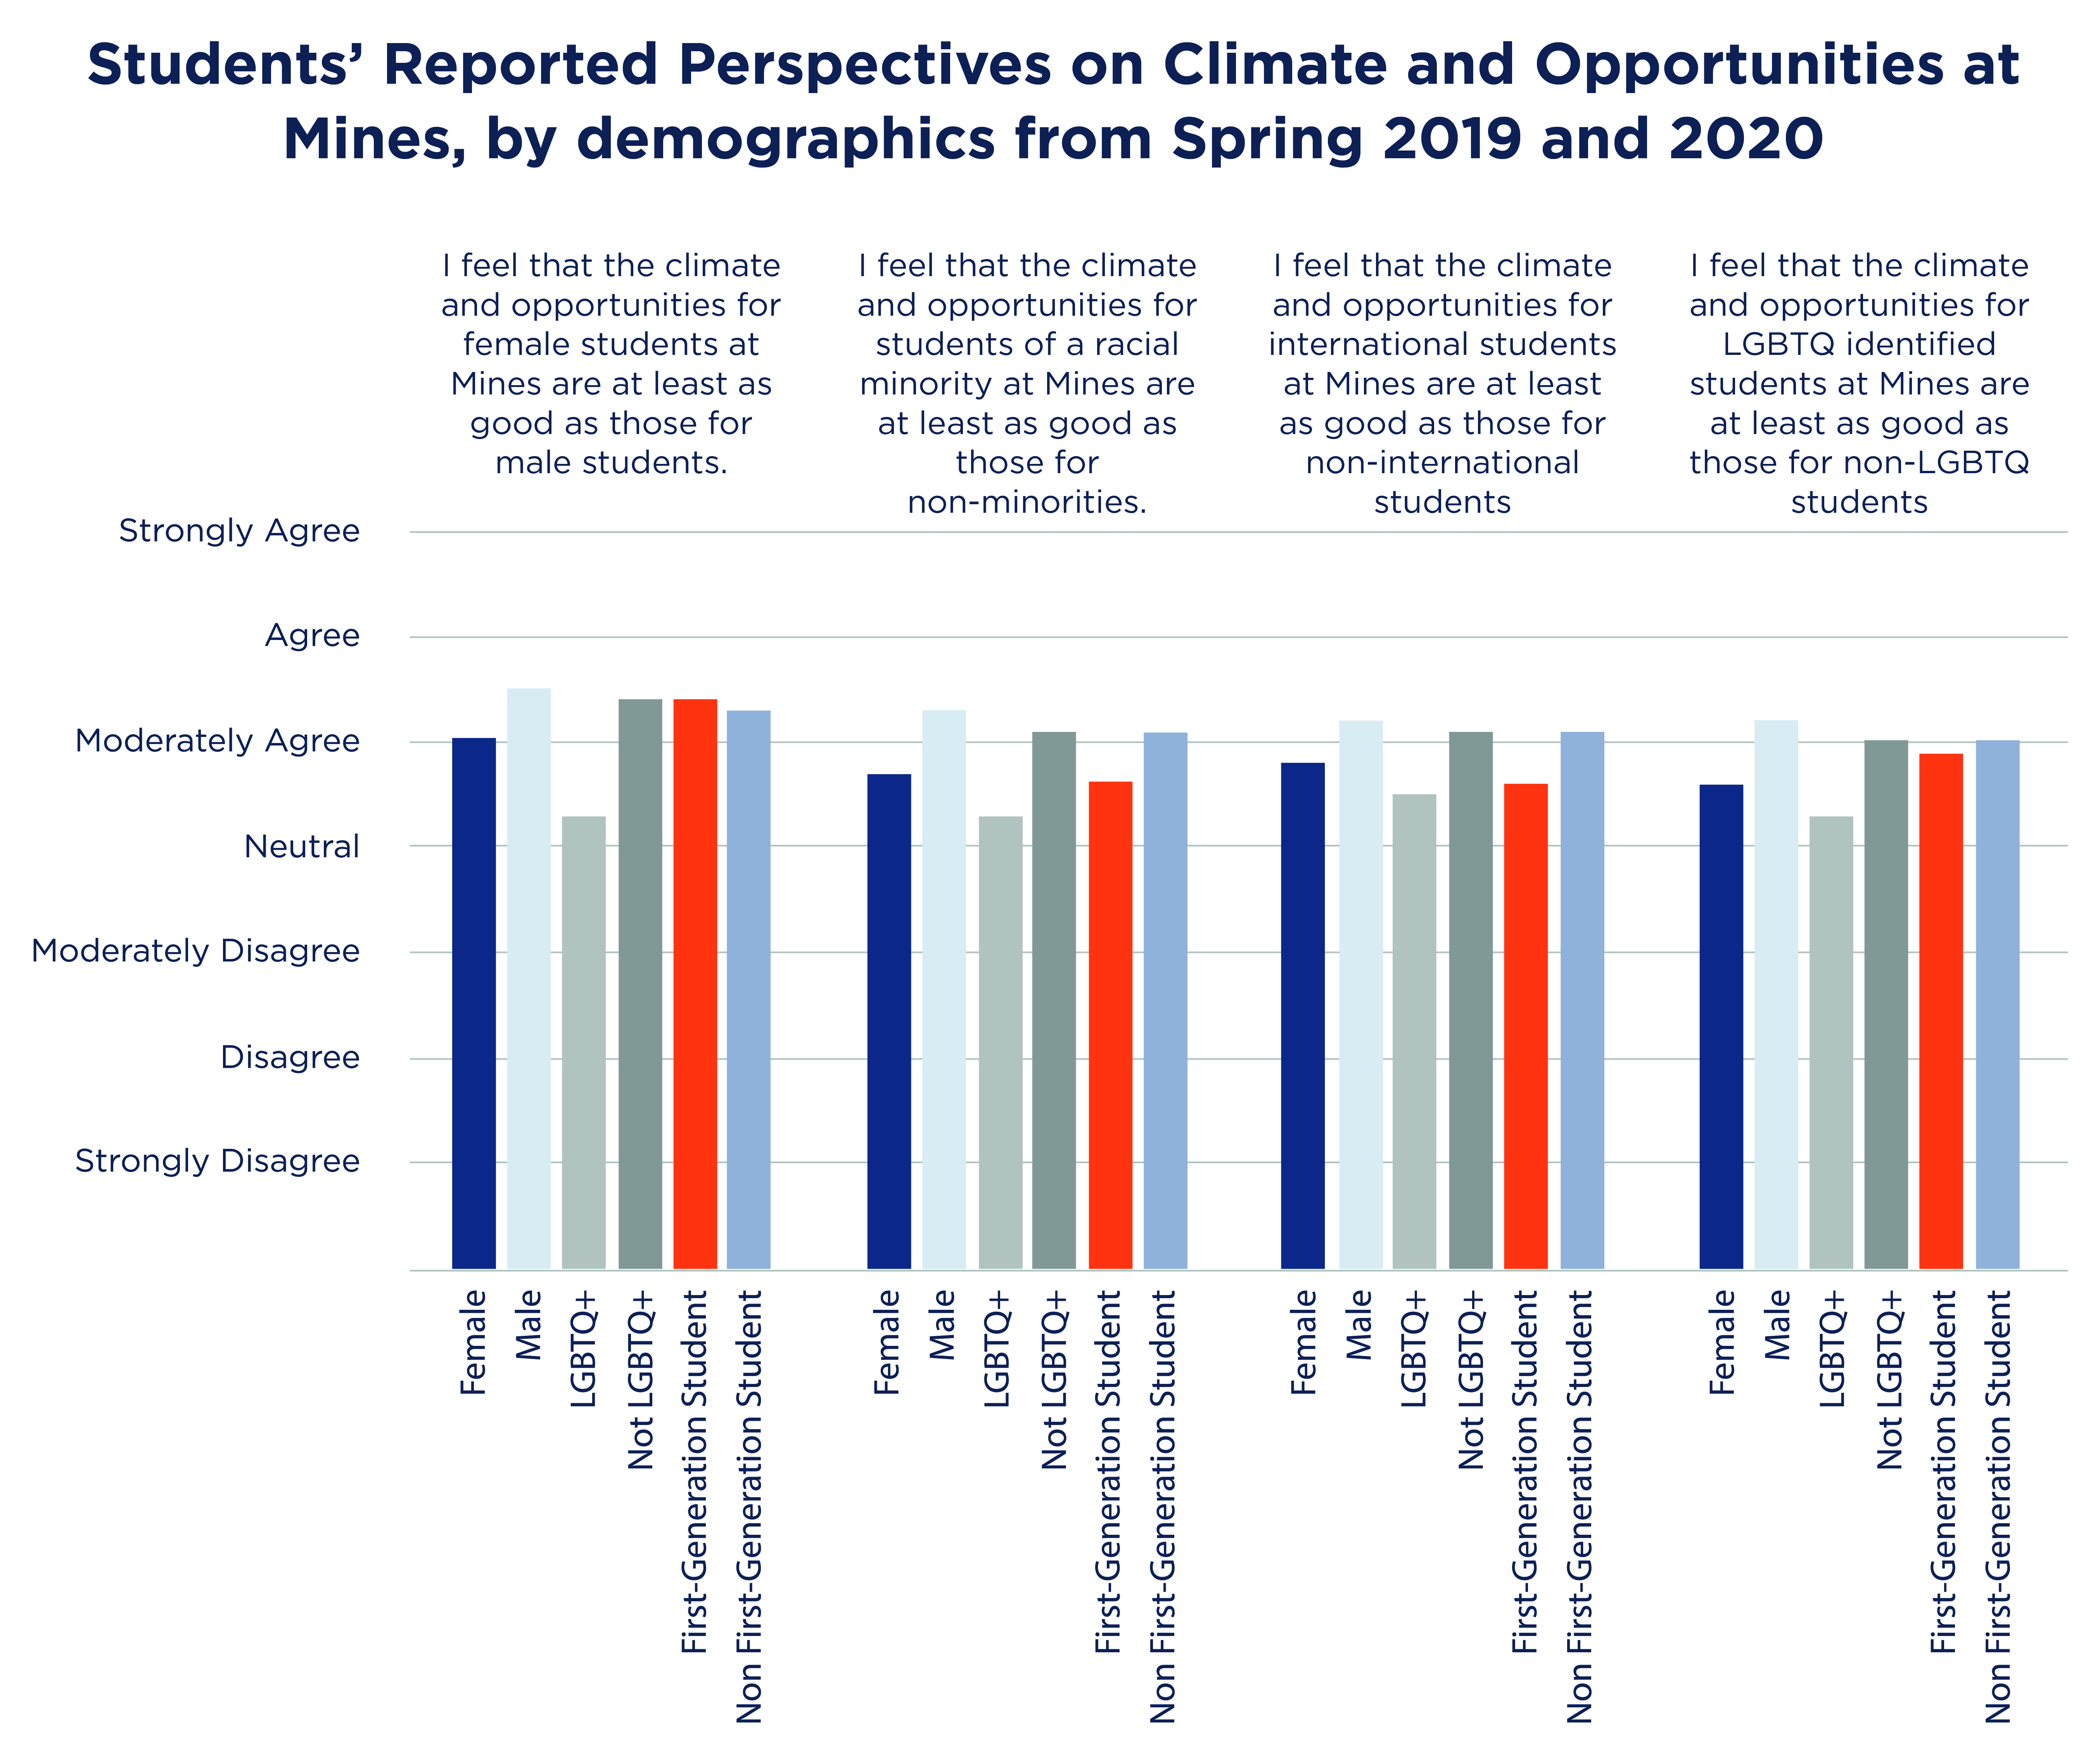
Data from Trefny Innovative Instruction Center about Campus Climate for Undergraduates
Notes:
Shown are only the identities that had notable differences between marginalized and non-marginalized groups.
Notice Students of color are not included – they didn't have a big difference in responses compared to white students.
LO: participants will have been exposed to the research on implicit bias
LO: Participants will Recognize IB and its validity

Slide 37
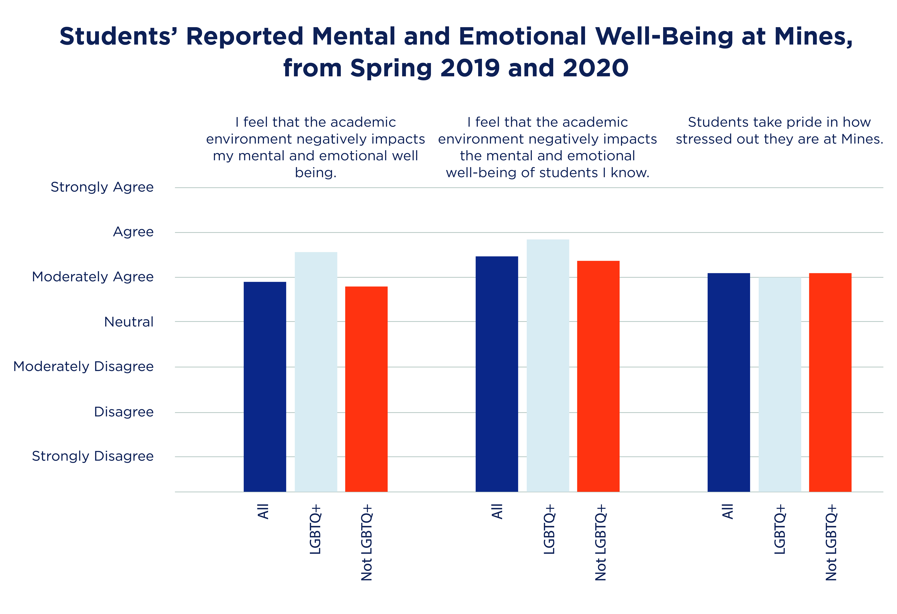
Data from Trefny Innovative Instruction Center about Campus Climate for Undergraduates
Notes:
LO: participants will have been exposed to the research on implicit bias
LO: Participants will Recognize IB and its validity

Slide 38
Research & Innovation Productivity
"When we limit diversity in our lab and networks, we end up limiting our science. Analysis of more than 2.5 million publications shows that increased ethnic diversity in the author team correlates with increased citations and impact factor of the journal” (Asplund & Welle, 2018).
When articles are reviewed anonymously (double-blind review), the number of articles published with women listed as the first author increases (Calaza et al., 2021).
Notes:
"When we limit diversity in our lab and networks, we end up limiting our science. Analysis of more than 2.5 million publications shows that increased ethnic diversity in the author team correlates with increased citations and impact factor of the journal” (Asplund & Welle, 2018).
When articles are reviewed anonymously (double-blind review), the number of articles published with women listed as the first author increases (Calaza et al., 2021).
1) Asplund, M. & Welle, C. G. (2018). Advancing science: How bias holds us back. Neuron, 99(4), 635–639. https://doi.org/10.1016/j.neuron.2018.07.045
2) Calaza, K. C., Erthal, F. C., Pereira, M. G., Macario, K. C., Daflon, V. T., David, I. P., Castro, H. C., Vargas, M. D., Martins, L. B., Stariolo, J. B., Volchan, E., &amp; de Oliveira, L. (2021). Facing racism and sexism in science by fighting against social implicit bias: A latina and black woman’s perspective. Frontiers in Psychology, 12. https://doi.org/10.3389/fpsyg.2021.671481
3)

Slide 39
Implicit Bias Continuum
People can move between phases and may progress through active practice, learning, and acknowledgement
Individuals may also regress through apathy and/or lack of awareness and practice
Individuals may exist in different phases of the continuum depending on biases they are actively engaging with
i.e., recognizing bias in action regarding race but only acknowledging the existence of bias regarding gender identity

Slide 40
Strategies to Mitigate
Recall a lived experience in which you felt devalued or excluded
Understand risk factors: where does implicit bias come into play, when is it worse?
Where you make decisions or evaluations of others
When you are rushed or under a time crunch
When you are doing things automatically
Actively Mitigate bias & seek change
Remember that lived experience in which you felt devalued or excluded
Use decision support tools (e.g. rubrics, Inter-Rater Reliability)
Take time for and review automatic, pass/fail processes
Articulate your reasoning process, get feedback from others
Check your messaging, language
Institute policies to minimize bias
Practice, Practice, Practice
Listen more, talk less
Seek out other people’s stories
Notes:
LO: and identify ways to counteract/mitigate these biases

Slide 41
IB & Your Sphere of Influence
Ways that you manifest implicit bias & how it impacts others
Major activities
Group Projects
Ways that implicit bias impacts you
Teaching classes
Others…
What strategies can you use to mitigate bias?
Notes:
Note to Facilitator: make the examples of types of activities to put in the bubble. BE SURE TO GET EXAMPLES in the chat for folks who thought this was about making breakfast ☺
Draw you!
Put some bubbles around you that reflect your major activities.
Draw arrows in describing how IB can impact you
Draw arrows out describing how your IB might manifest & impact others
ID strategies you can use to mitigate

Slide 42
Strategies to mitigate - PRACTICE
LO: and identify ways to counteract/mitigate these biases
Go through an example:
Maybe one for each type of participant
Student -
Faculty -
Employees -
Notes:
LO: and identify ways to counteract/mitigate these biases

Slide 43
Strategies to mitigate - ACTIVITY
LO: and identify ways to counteract/mitigate these biases
Go through an example:
Maybe one for each type of participant
Student -
Faculty -
Employees -

Slide 44
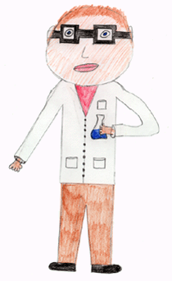
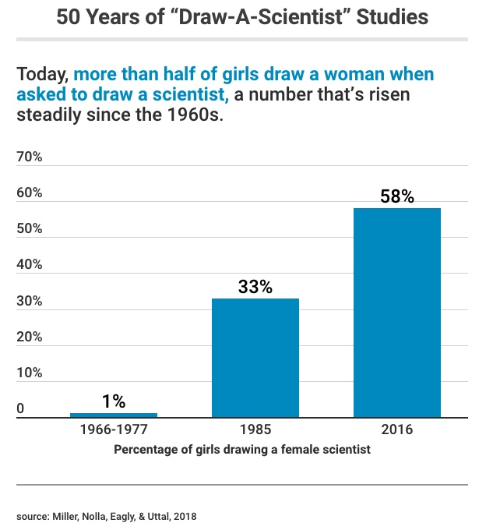
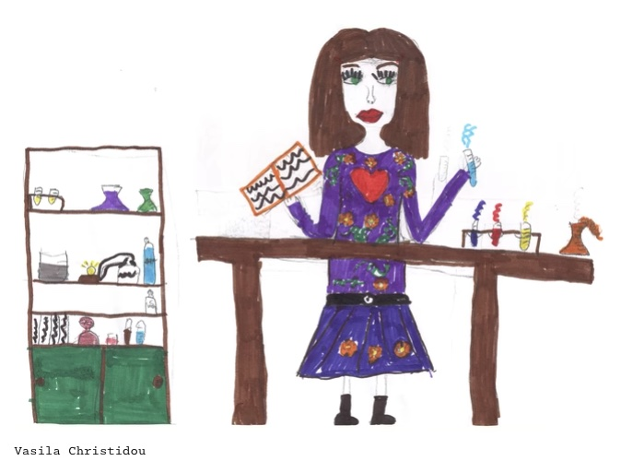
We can unlearn this!
Notes:
Notes:
Reiterate that there is hope!
It’s not your fault
It’s your responsibility to work to unlearn
Stats/research on changes (e.g. student drawings of scientists and John's lit review)
In the original 11-year study (from 1966-1977, made up of 4,807 elementary-school children, mostly from Canada and US), less than 1 percent of the drawings collected from boys and girls were of female scientists. By 1985, that rose to 33% and by 2016, 58%. However, girls are the driving shift. Boys still draw male scientists nearly 9 out of 10 times.
This aligns with the larger trends in women joining science-related occupations: In 2015, women made up 48% of biological, agricultural, and environmental life scientists (up from 34% in 1993). Women in all science and engineering occupations increased more modestly, from 22.9% in 1993 to 28.4% in 2015. = REPRESENTATION MATTERS - https://www.edutopia.org/article/50-years-children-drawing-scientists
In the event of pushback from the study: Some critics have suggested that perhaps children just draw more men regardless, but Miller says that’s not true. For example, in 2008, one team of researchers showed that elementary-school children drew 66 percent of scientists as men, compared to just 40 percent of veterinarians and 25 percent of teachers. - https://www.theatlantic.com/science/archive/2018/03/what-we-learn-from-50-years-of-asking-children-to-draw-scientists/556025/

Slide 45
Reiterate that there is hope
But we can change if we learned it we can unlearn it
Show the draw a scientist data here :)
Ambassadors share a personal example

Slide 46
Keep Learning. Keep Growing
Expect to keep messing up.
You’ll probably make mistakes for a long, long time.
Keep trying to grow.
Don’t shut down.
Keep engaging and learning.
Notes:
I may have said earlier:
This work is hard.
It takes heart and mind to make progress.
We’ve spent our lives so far learning the stereotypes, which unknowingly imprinted into our minds.
It’s going to take time to recognize these and unlearn those behaviors.
The best we can do is keep showing up.
Practice self-empathy for when we do mess up.
We all going to make mistakes, myself included, keep trying and keep learning.

Slide 47
One workshop isn’t enough…
We’ll send you one ppt slide with a new scenario to practice each month
Join our biweekly learning community to practice more scenarios with peers (you’ll automatically be added to the calendar invite)
Start your meetings with an inclusion icebreaker. Should take no more than 5 minutes
Inclusion icebreakers at: www.mines.edu/diversity/learning-resources
Notes:
If you’re interested in hosting your own mini activities:
We can send you materials!
They include:
PowerPoint slide with an example scenario to practice
Directions/notes on the slide for facilitation.
We’re here to help! Ask if you’d like DI&A or one of our Ambassadors to facilitate.
These can be TOUGH topics.

Slide 48
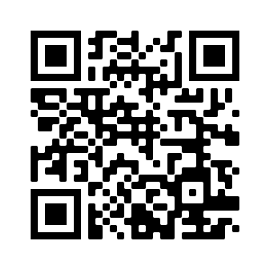
DI&A Workshops
UNDERSTANDING UNCONSCIOUS BIAS
MINIMIZING MICROAGGRESSIONS
ALLIES FOR GENDER EQUITY
BYSTANDER INTERVENTION
MINES DI&A OVERVIEW
INCLUSIVE PROGRAMMING
SAFEZONE
TREFNY INCLUSIVE CLASSROOM WORKSHOPS
MINIMIZING BIAS IN GRAD APPLICATION REVIEW
PEER EDUCATOR WORKSHOPS
LANGUAGE MATTERS
DIFFICULT CONVERSATIONS
A DI&A LENS IN APP REVIEWS
For workshop descriptions and to register, scan the QR code or visit
www.mines.edu/diversity/workshops-training
Notes:
have a lot to offer!
Request more workshops!
Request DI&A-hosted workshops: https://www.mines.edu/diversity/workshops-training/

Slide 49
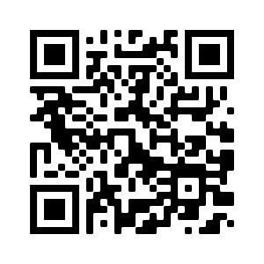
Take our survey!
https://mines.questionpro.com/t/ASiFLZukEx
Notes:
Notes:
Reiterate that there is hope!
It’s not your fault
It’s your responsibility to work to unlearn
Stats/research on changes (e.g. student drawings of scientists and John's lit review)
In the original 11-year study (from 1966-1977, made up of 4,807 elementary-school children, mostly from Canada and US), less than 1 percent of the drawings collected from boys and girls were of female scientists. By 1985, that rose to 33% and by 2016, 58%. However, girls are the driving shift. Boys still draw male scientists nearly 9 out of 10 times.
This aligns with the larger trends in women joining science-related occupations: In 2015, women made up 48% of biological, agricultural, and environmental life scientists (up from 34% in 1993). Women in all science and engineering occupations increased more modestly, from 22.9% in 1993 to 28.4% in 2015. = REPRESENTATION MATTERS - https://www.edutopia.org/article/50-years-children-drawing-scientists
In the event of pushback from the study: Some critics have suggested that perhaps children just draw more men regardless, but Miller says that’s not true. For example, in 2008, one team of researchers showed that elementary-school children drew 66 percent of scientists as men, compared to just 40 percent of veterinarians and 25 percent of teachers. - https://www.theatlantic.com/science/archive/2018/03/what-we-learn-from-50-years-of-asking-children-to-draw-scientists/556025/

Slide 50
Thank you!
diversity@mines.edu
Notes:
Amy – feel free to add your name and tell folks if they have questions they can contact me.

