Slide 1
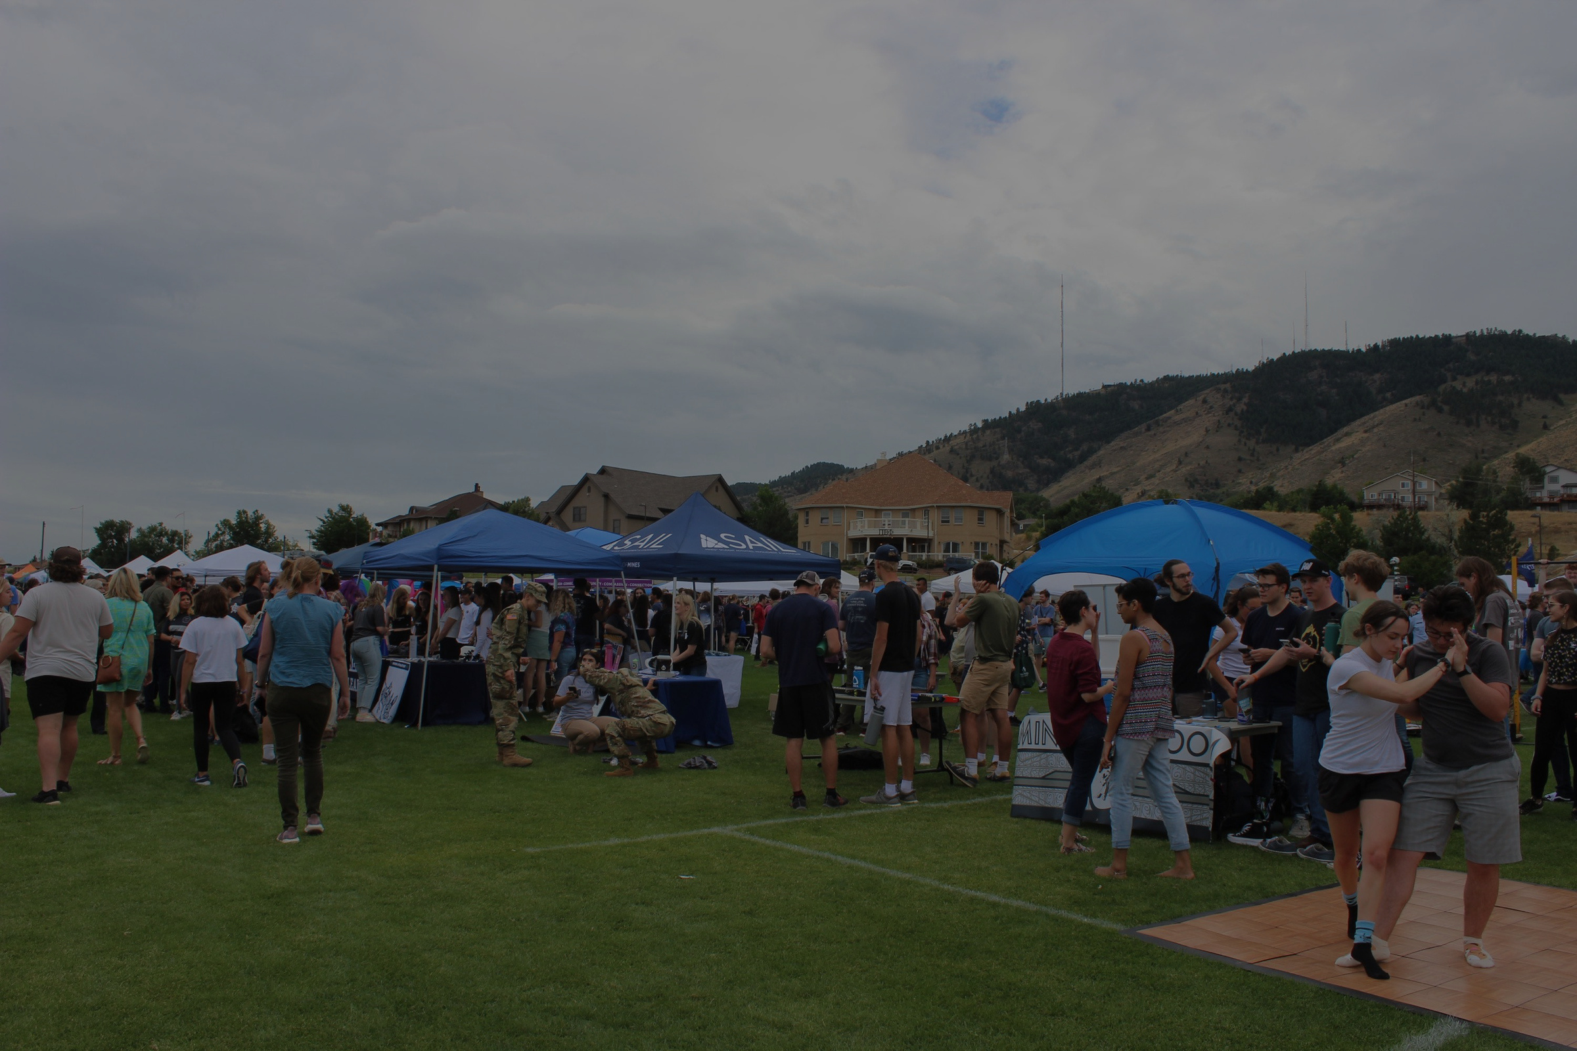

RSO Advisor Training
11 AUGUST 2023
MARILYNN GALLEGOS (SHE/HER)
STUDENT ORGS COORDINATOR

Slide 2
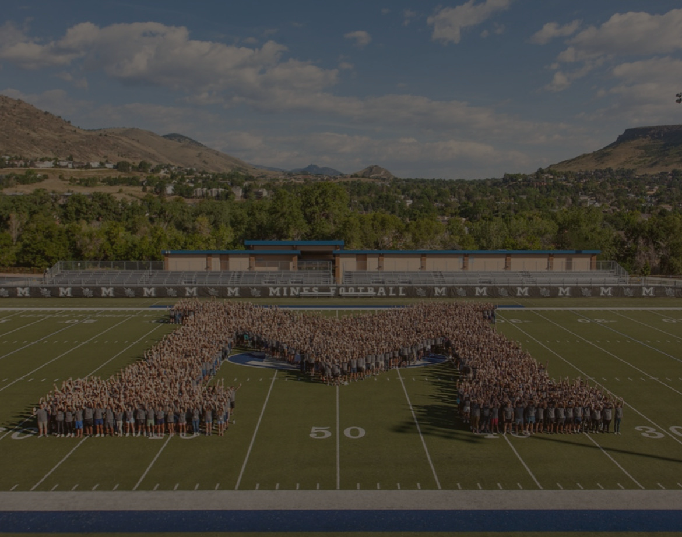
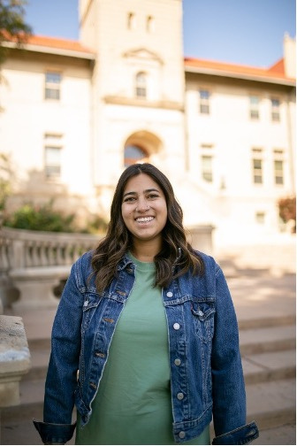
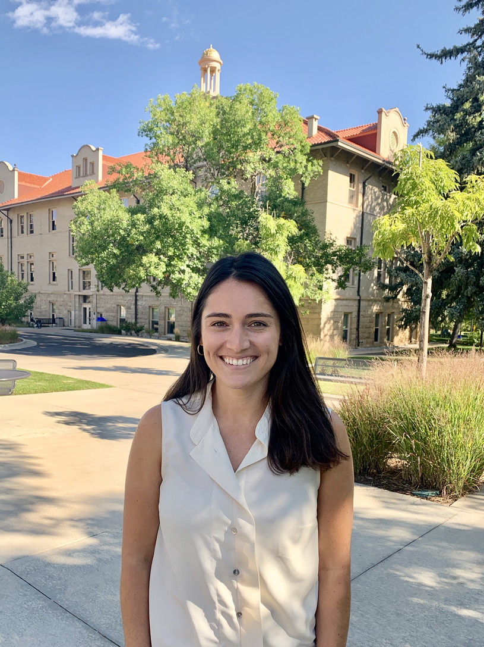
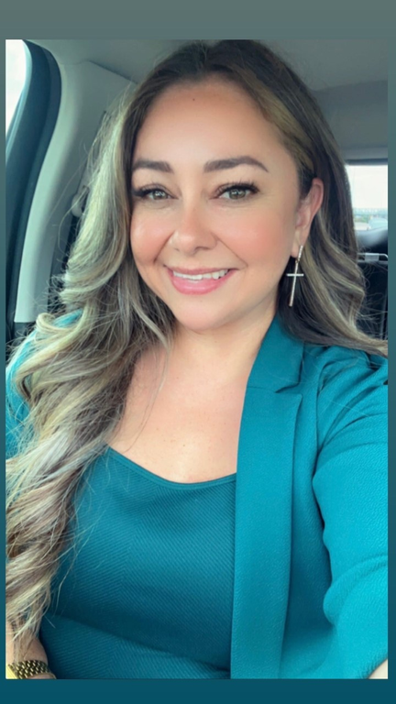
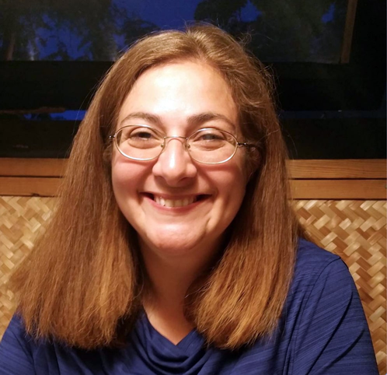
The Team
Marilynn Gallegos (she/Her)
Clubs & Orgs Coordinator
Alexandra Demopoulos (she/Her)
Asociate Director for SAIL Student Engagement
DeAnna Torrez (she/Her)
SAIL Finance Coordinator
Begoña Ruiz Pineiro (she/Her)
Associate Director for SAIL Finance and Operations

Slide 3
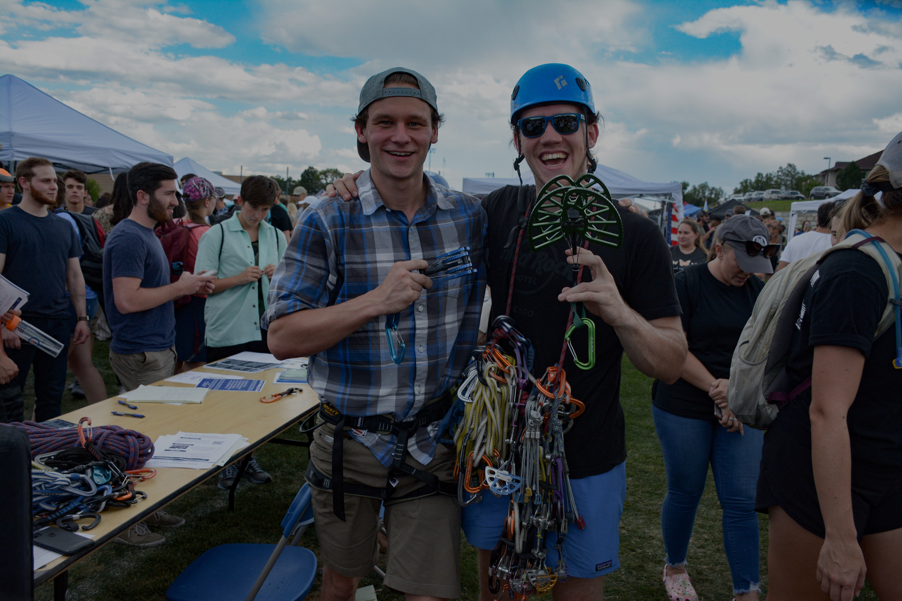
Agenda
  Advisor Responsibilities
  CSA Training
  SAIL Policies
  Financial Policies
  Advising Best Practices
  Review of RSO Website

Slide 4
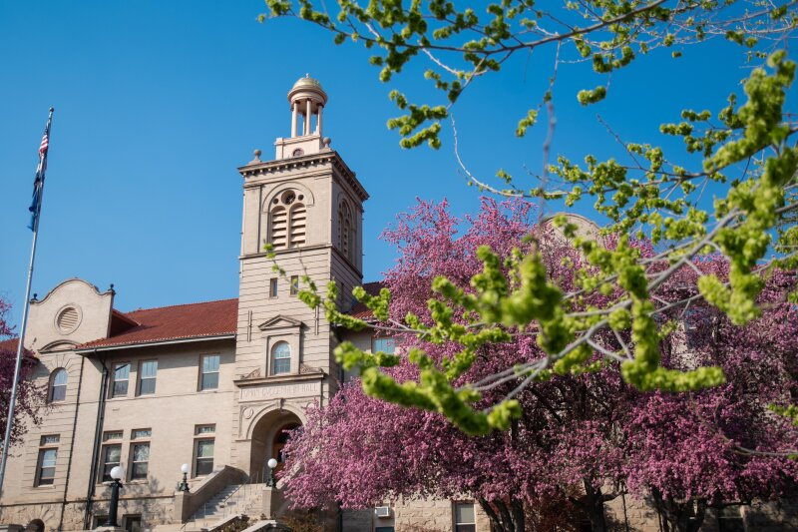
As an Advisor...
You have agreed to become a guide and a mentor for a group of passionate and organized students on our campus. Serving as an advisor is a unique opportunity for faculty and staff to work with Mines’ students outside the classroom and contribute to their holistic development. This experience provides students the opportunity to connect with faculty and staff on a more personal level.

Slide 5
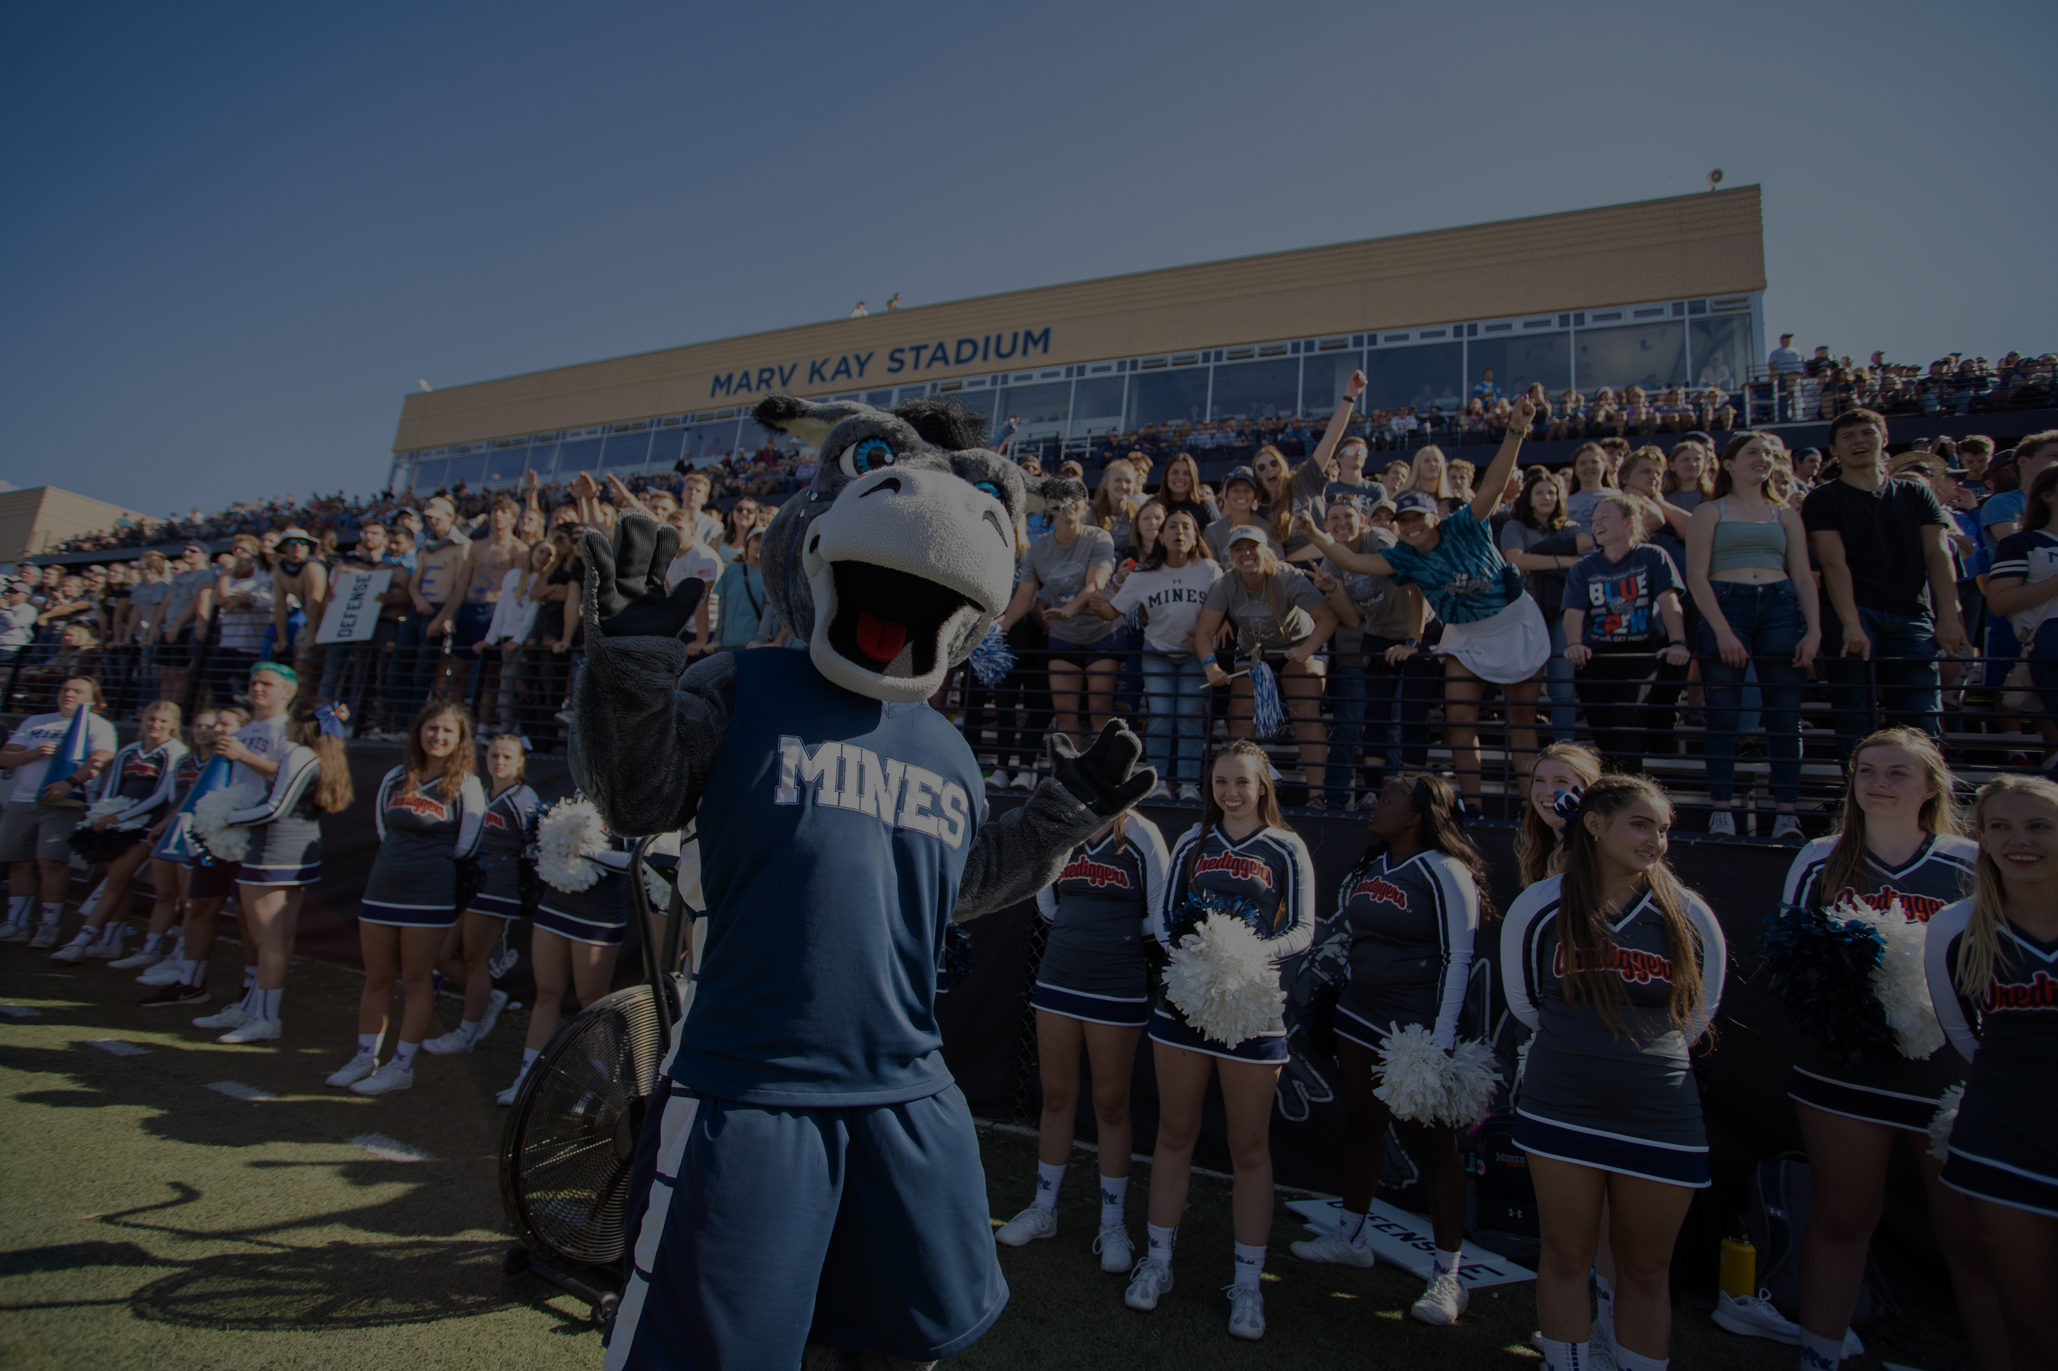
Thank you!
We couldn't do it with out you!

Slide 6
Who are RSO Advisors?
RSO Advisors are the full-time faculty or staff sponsors for a student organization. Student organizations are required to have a minimum of one full-time staff or faculty member from Mines serving as an advisor. This role is quite dynamic, where advisors assist in the general operation of the student organization but more critically help develop student leaders outside the classroom. Each organization will have different expectations of what their advisor’s specific role will look like, but in every instance, the advisor’s main responsibility will be student support.
Industry and alumni advisors as well as other advisors from National Organizations can serve along with the faculty/staff advisor and are required to abide by the same rules and standards as faculty advisors, including any mandatory trainings and reporting. These Alumni or Affiliate Advisors cannot replace a Faculty/ Staff Advisor.

Slide 7
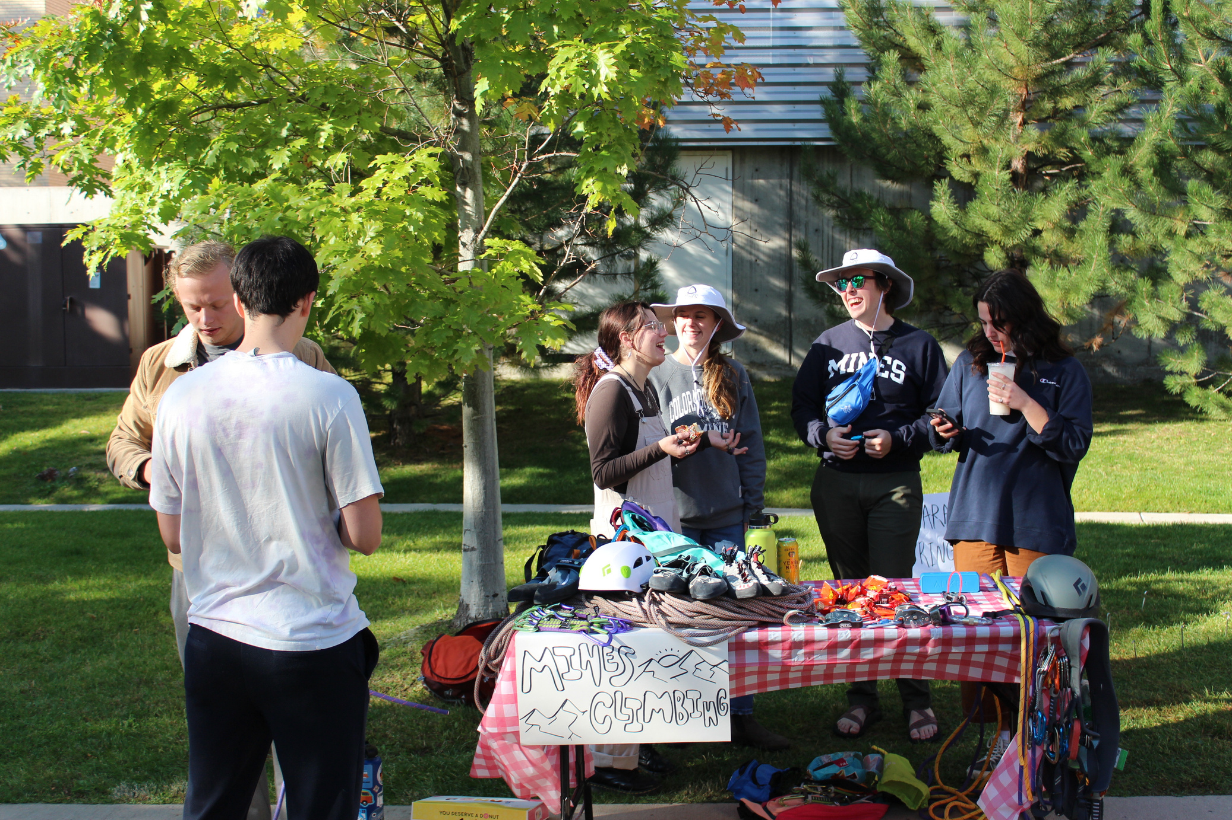
Advisors Responsibilities
  REGISTER AS AN ADVISOR FOR YOUR ORGANIZATION. MUST SUBMIT NO LATER THAN DECEMBER 31ST.
  Complete CSA training every year.
  Advocate for your student organization while also supporting institutional policies.
  Encourage leadership development through attendance of SAIL workshops and other programming.
  Assist executive board to provide a smooth transition of leadership year to year.
  Meet with the organization’s current executive board on a regular basis.
  Assist the organization in any conflict management between members, executive members, and other entities.
  Report any and all violations to the appropriate offices.
  Role model Mines values and promote the values of DEIA.
  Provide constructive feedback on organization management, event planning, and fundraising.
  Communicate with SAIL as necessary.
  Identify and mitigate organization risks.

Slide 8
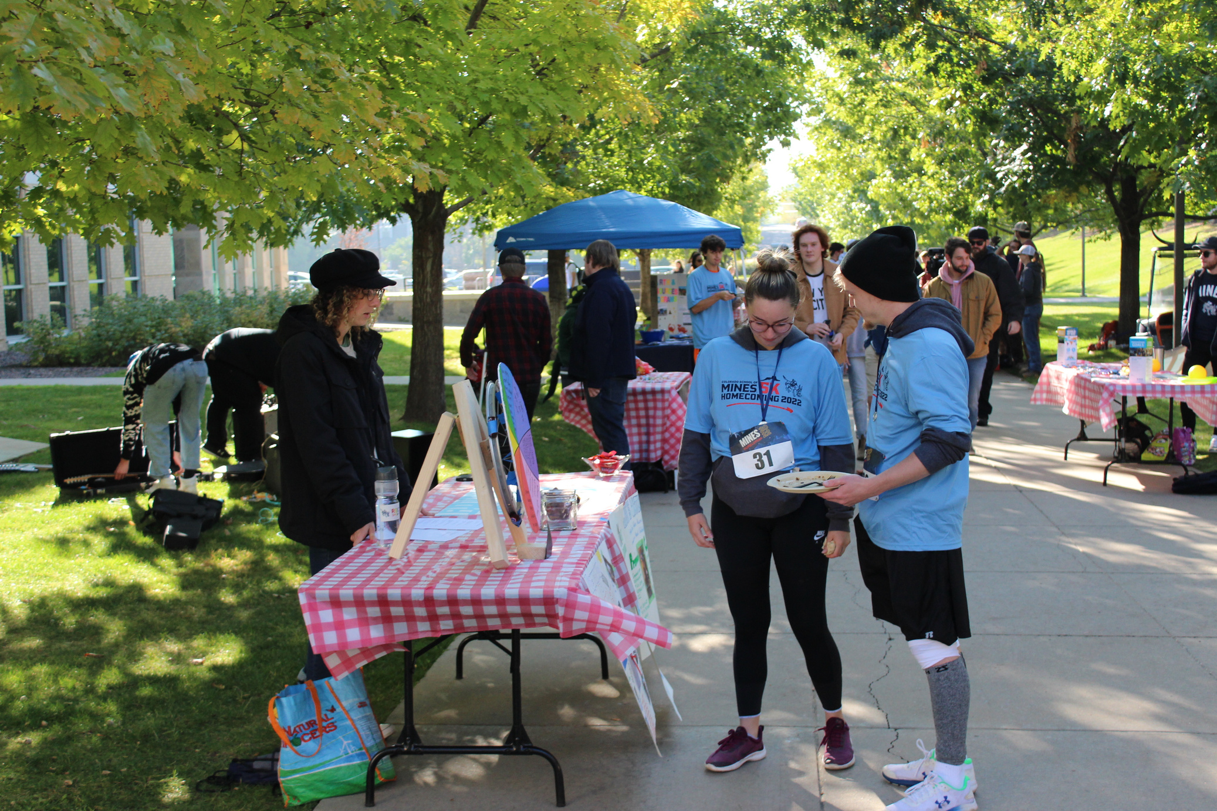
RSO Responsibilities to the Advisor
  DISCUSS THEIR EXPECTATIONS OF YOU AND HOW THEY VIEW YOUR ROLE IN THE ORGANIZATION.
  Invite you to events and weekly organization and executive board meetings.
  Regularly communicate with you and provide updates on the status of the organization, upcoming events, and any planned purchases at least monthly.
  Disclose all violations of their bylaws, University Policies, or SAIL procedures immediately upon the discovery of the violation.
  Seek your guidance in determining best practices for organization management.

Slide 9

Campus Security Authority (CSA)
  What is a CSA?
    Campus Security Authority are university employees who by their duties on campus become designated as CSA’s. Some individuals automatically qualify (ie, RA’s, police, etc) whereas other individuals may become CSA’s during an event (ie, a professor takes a class on a field trip or study abroad professors). A CSA is required to automatically report crimes within campus bounds (and campus owned property) to campus police. Mines requires all RSO advisors to be CSA trained.
    CSA training is required yearly. This training is offered through the Office of Institutional Equity/ Title IX. The link for this training can be found here: https://www.mines.edu/institutional-equity-title-ix/campus-security-authority/

Slide 10
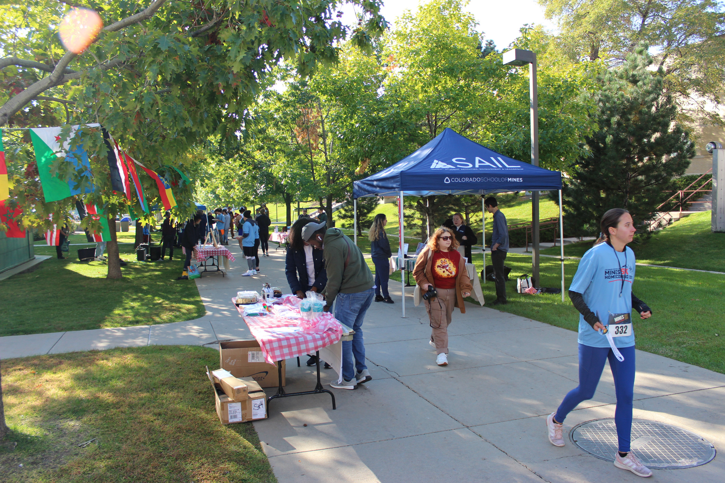
SAIL
Policies
  ORGANIZATION’S ARE REQUIRED TO UPDATE THIER INFORMATION WITH SAIL YEARLY, OR WHENEVER CHANGES IN LEADERSHIP HAPPEN (ELECTIONS OR OTHERWISE).
    CANVAS PAGES- GOVERNING BODY
    SAIL RE-REGISTRATION
    ADVISOR AGREEMENTS
    FALL SUMMIT
    YEARLY BYLAW REVIEW AND SUBMISSION
  Follow updates regularly communicated by the SAIL office through the following forms: emails, the SAIL website, and the Canvas Student Leaders page
  Hold and advertise regular open meetings with your organization and those who may be interested in joining- All events require an event approval.
    SUBMISSIONS ARE DUE 1 WEEK (7 DAYS IN ADVANCE)
    3 DAYS OF ADVERTISING IS REQUIRED
    ADVERTISMENTS/ FLYERS MUST BE APPROVED BY SAIL AND POSTED IN APPROVED PLACES ONLY.
    IF NEEDING LIABILITY FORMS OR USING AN OUTSIDE VENDOR, APPROVAL IS NEEDED 4 WEEKS IN ADVANCE OR 4 WEEKS FROM FIRST DEPOSIT WHICHEVER COMES FIRST.

Slide 11
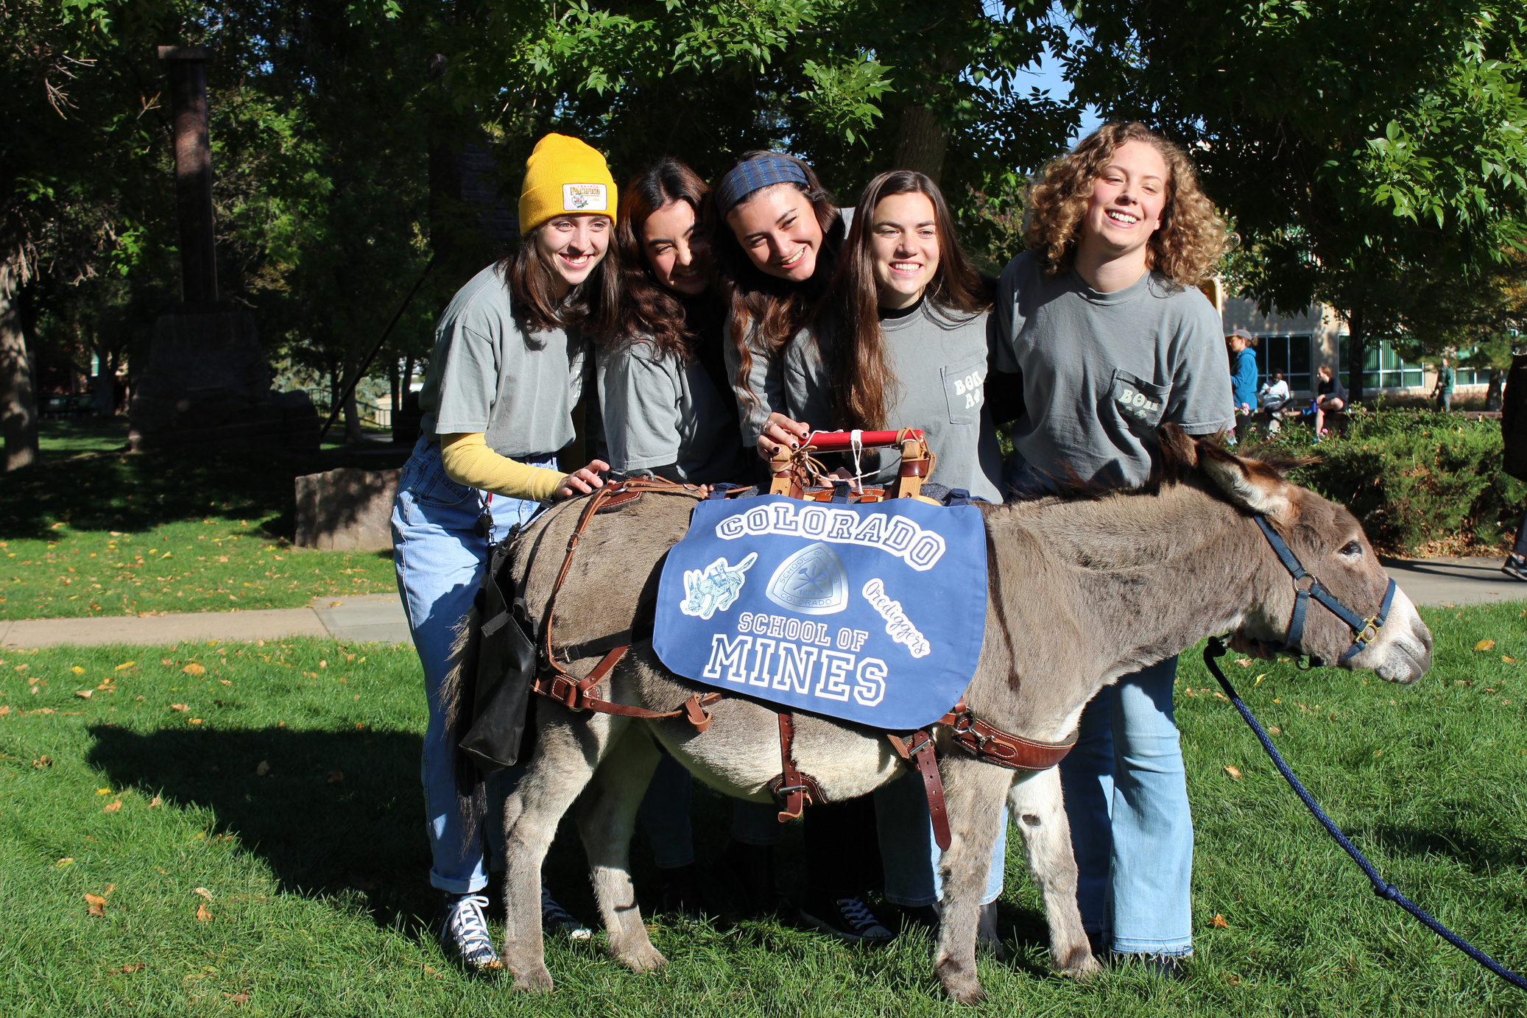
SAIL
Policies
  TRAVEL
    Domestic Travel – They must meet with DeAnna one month in advance.
    International Travel – They must meet with Begona two months in advance.
  IF AN ORGANIZATION IS PLANNING A TRIP, THAT TRIP MUST BE OPEN AND ADVERTISED TO ALL STUDENTS IN THE INSTITUTION
    EXCEPTIONS FOR COMPETITION TEAMS
    SAIL WILL DO A LOTTERY IF THERE IS ONLY A CERTAIN AMOUNT OF SPOTS OPEN
    REQUIREMENTS CAN BE INFORCED TO BE CONSIDERED
    FUNDING REQUIREMENTS CAN ALSO BE ENFORCED (IF YOUR ORGANIZATION PLANS ON FUNDING THE TRIP)
  Note: Student organizations may not purchase any travel related expenses until they have meet with the SAIL office.
  ALL PURCHASES ARE REQUIRED TO BE APPROVED BY SAIL. ENCOURAGE YOUR ORGANIZATION TO REACH OUT EARLY FOR LARGER EVENTS.

Slide 12
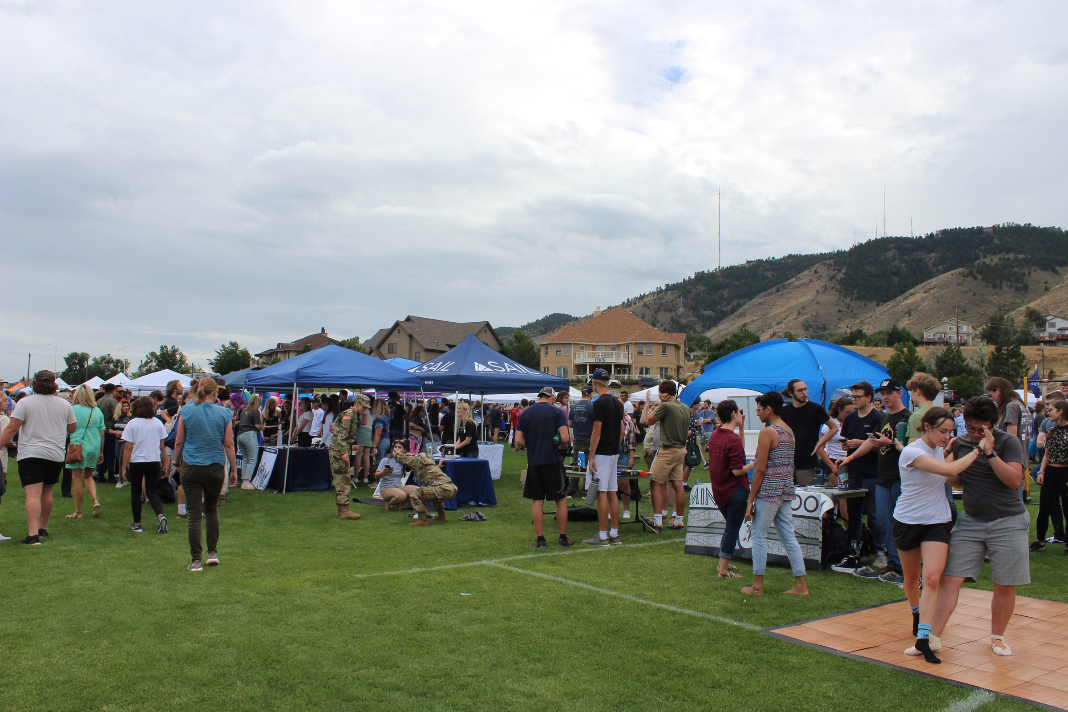
Financial
Policies for Advisors
  PCARDS
    UNLESS YOU HAVE A MULTIUSER CARD, YOU SHOULD NOT BE GIVING YOUR CARD TO STUDENTS TO MAKE PURCHASES
    YOU MAY GO WITH STUDENTS TO MAKE PURCHASES AS LONG AS THEY SHOW YOU AN APPROVED PURCHASE REQUEST FROM THE SAIL OFFICE
  WHAT HAPPEN IF STUDENTS RUN OUT OF SUPPLIES AT AN EVENT?
    YOU CAN MAKE PURCHASES FOR YOUR STUDENTS IF AN EVENT IS HAPPENING AND YOU NEED MORE FOOD/ SUPPLIES
    STUDENTS CAN ALSO SUBMIT FOR REIMBURSEMENT
  FUNDING IS DETERMINED BY THE ORGANIZATIONS GOVERNING BODY (BSO, ISC,BSM)
    GOVERNING BODIES HAVE THEIR OWN POLICIES SEPARATE FROM SAIL FOR HOW MONEY CAN BE SPENT
    STUDENT ORGS ARE TRAINED AT THAT AT FALL SUMMIT
  ALL ORG PURCHASES USING ANY ORGANIZATION'S INDEX MUST BE APPROVED PRIOR TO PURCHASE BY SAIL. SAIL CAN DENY ANY AND ALL UNAPPROVED INDEX SPENDING.

Slide 13
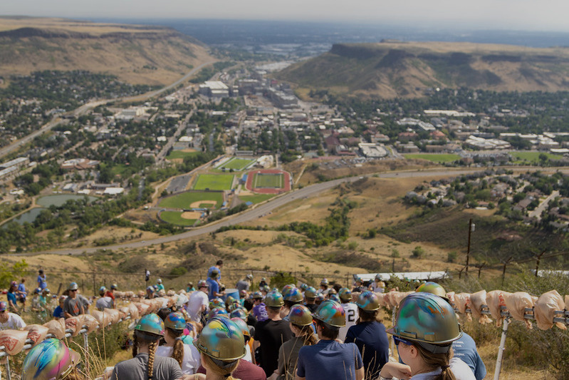
Advising best
practices
  Keep in mind that every student organization is different and will require a different combination of challenge and support by their advisor!
  Reference the organization’s bylaws, mission and vision when outlining the advisor’s role and the student leaders’ role within the organization.
  Build relationships with the organization's executive board and general members.
  Attend events and organizational meetings when possible.
  Provide guidance in understanding institutional and SAIL policies and services.
  Build trust with the organization by being open and honest with all communication.
  Allow your students to fail as long as it does not affect their long term success or that of the organization, and help them learn from that experience.

Slide 14

Advising best practices
  Encourage them to utilize their resources! We have trainings, event opportunities for involvement, and more available to your organizations.
  Have them ask questions! The SAIL office is willing to help, as am I. We are open Monday - Friday, 9am – 3:30pm, and we love it when they come by to ask questions.
  Encourage them to plan in advance. Planning ahead allows for them to prepare for their schoolwork as well as their organization responsibilities, and allows the SAIL office more time to answer questions should they have any during their planning process.
  Allow the students to do most of the work when it comes to the student organization. Their student organization involvement prepares them for life after Mines and in their professional development.

Slide 15
Advising styles & Resources
  Sanford’s Theory of Challenge and Support
  Be Effective in Navigating Power and Achieving Goals and Objectives
  Advising styles and Skills
  Tips for setting boundaries with students

Slide 16
Ways SAIL can provide support
  Workshops
    Conflict management
    Transitions
    Communication
    Relationship Building
    Many others offered by SAIL Staff
  Support with identifying reporting pathways
  Code of Conduct violations support
  Student Handbook Violations support
  Mediations
    Between students
    Between student/ staff
  Policy clarification
  Event Planning
  Recruitment efforts
  Fundraising

Slide 17

Ways to encourage and motivate your groups to share
Newsletter
Org of the Month Awards
End of Year Organization Celebration
Social Media Take Overs

Slide 18
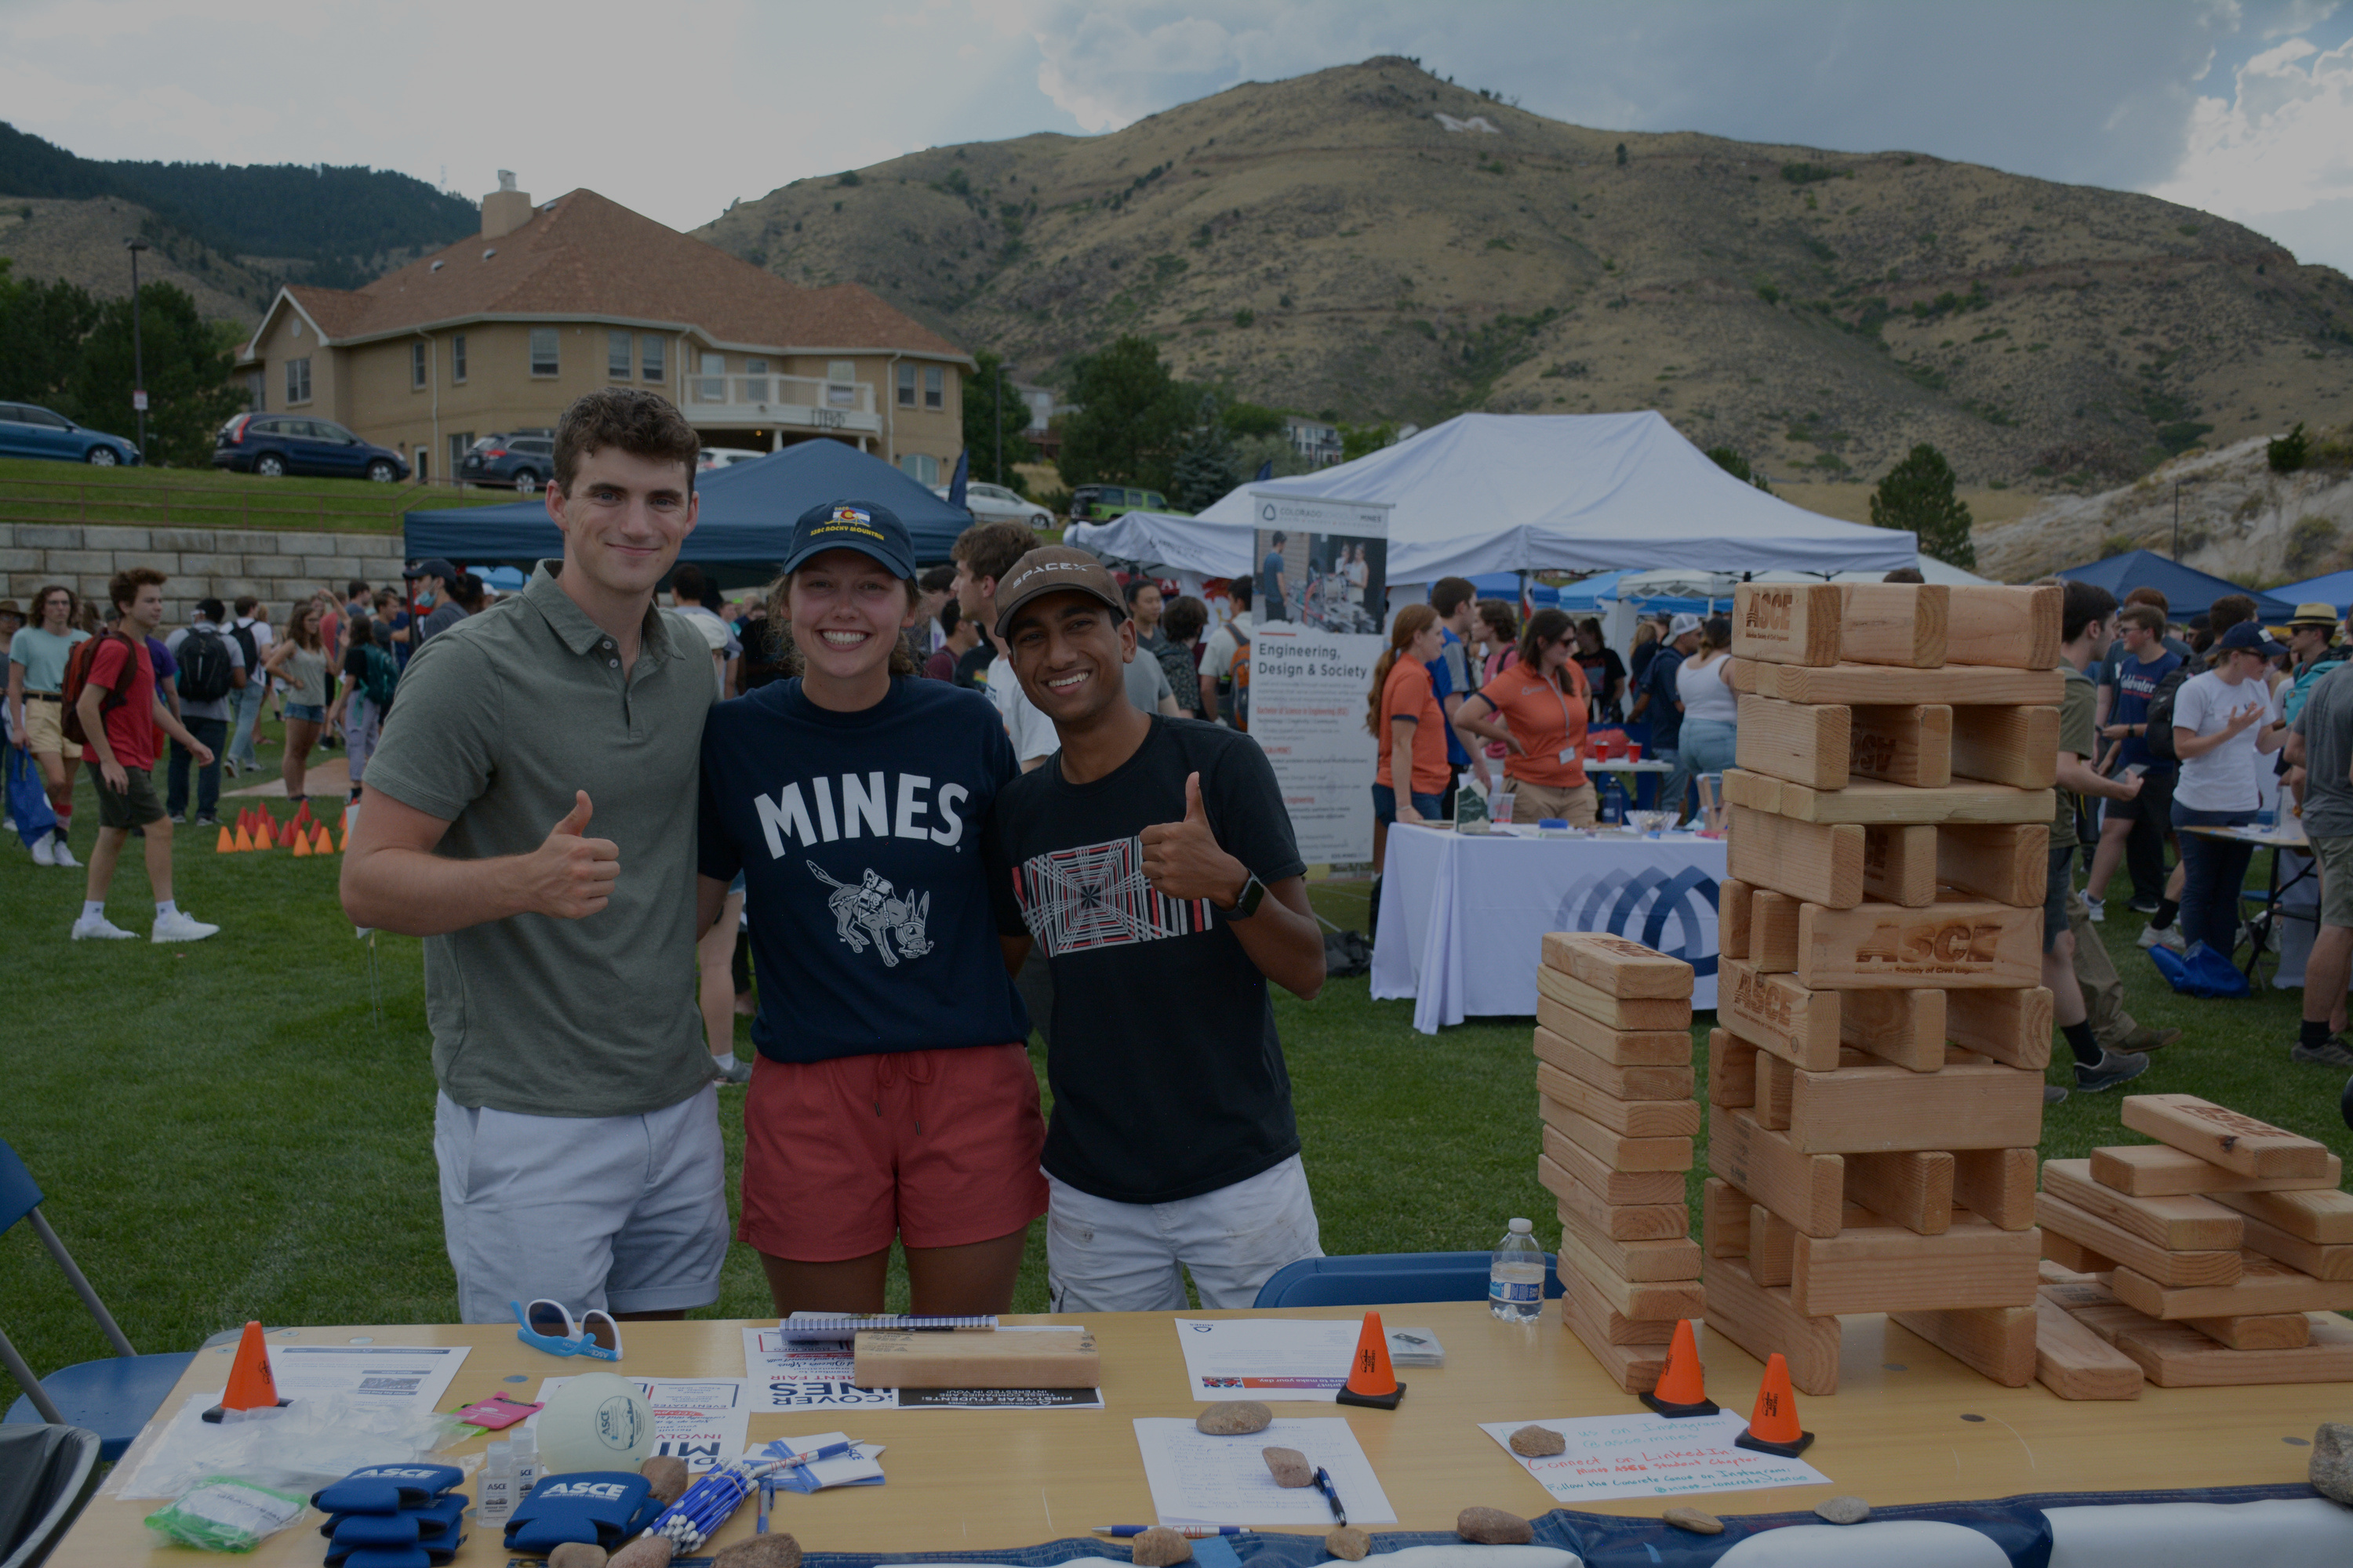

Thank you!

