Slide 1
Here's your outline to get started
Key facts about your topic
Project finance is the long-term financing of infrastructure and industrial projects based upon the projected cash flows of the project rather than the balance sheets of its sponsors. Usually, a project financing structure involves a number of equity investors, known as 'sponsors', a 'syndicate' of banks or other lending institutions that provide loans to the operation. They are most commonly non-recourse loans, which are secured by the project assets and paid entirely from project cash flow, rather than from the general assets or creditworthiness of the project sponsors, a decision in part supported by financial modeling; see Project finance model. The financing is typically secured by all of the project assets, including the revenue-producing contracts. Project lenders are given a lien on all of these assets and are able to assume control of a project if the project company has difficulties complying with the loan terms.
See more: Open the Notes below for more information.
Notes:
QuickStarter has created an outline to help you get started on your presentation. Some slides include information here in the notes to provide additional topics for you to research.

Slide 2
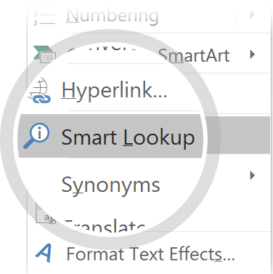
Related topics to research
Project Finance Model
Build–operate–transfer
Use Smart Lookup to learn more
1
Highlight one of the related topics
Right-click on the topic
Choose "Smart Lookup"
2
3

Slide 3
SAIL
Treasurer
Training

Slide 4
treasurer Training

Slide 5
Overview
Why Treasurer Training?
Who can spend money!
Methods of Purchasing
How to use a one card
How to submit a SAIL ticket
Reimbursements
Contracts
Gift Cards
Alcohol/Fencing
Logo Merchandise
Travel
Movies
Donations
Collecting Funds
Deposits
Fundraising
RSO Inventory
Deposits
Donations
Security
Buses

Slide 6
It’s your money All funds should be spent in a way that fulfills your mission, Mines mission, and serves the students and community at large. Resources should be used in the most appropriate manner
Programming
Resources
Know the rules

Slide 7
ISC
Helps internationally centered RSOs get money
Presents to USG for funding
Manages requirements and tier system for those organizations
Oversees allocations for international clubs
BSM
Helps student media RSOs get money
Presents to USG for funding
Manages requirements and tier system for those organizations
Oversees allocations for all student media clubs
BSO
Helps all other RSOs get money
Presents to USG for funding
Manages requirements and tier system for those organizations
Oversees allocations for all other clubs
SAIL
Helps RSOs spend money
Manages the requirements given by the State and Mines on how money can be spent
Enforces conduct system for RSOs and their ability to spend money
Notes:
Change images

Slide 8
Why Treasurer training?
RSO’s
Required to spend money
Fulfills the ‘in-person’ training requirement
Financial understanding
SAIL
Proper money management in accordance with school rules
Monitor and enforce rules
Work to maintain responsible spending
After all, it is your money, you don’t want it wasted or misused!

Slide 9
Who can spend money?
RSOs under BSO, BSM, and ISC
1 Treasurer
All purchase request must be submitted by treasurer
2 Approved Spenders
All 3 must complete in-person treasurers’ training to be able to use One Card
Treasurer’s training is available online for executive board and RSO members interested in planning events, meetings, or traveling

Slide 10
Methods of purchasing
University OneCard
For any non branded merchandise under $5,000
Purchase Order
PO (Purchase Order) for Mines branded merchandise
Contracts (if required by Mines or the vendor) Contracts are not allowed to be paid by credit card unless advised by pro-staff
ISSV (between campus entities including RSO’s)
Reimbursement forms (only for exceptional circumstances)
Can be reserved up to 3 hours
Only treasures and approved spenders can checkout the one card (bring your ID)

Slide 11
How to use the One card
BEFORE YOU USE THE ONECARD
AFTER YOU USE THE ONECARD
Submit purchase request 2-3 business days in advance
(if you want to use the card on Wednesday at noon, request must be submitted on Monday by noon)
Treasurer must submit purchase request
Under extenuating circumstances approved spenders will be allowed to submit a purchase request but must attach approval from club treasurer
Attach the AOE form to the request
Provide check-in/out availability for the One Card
Complete the form as best as possible
Make sure your purchase matches your request (amount/vendor)
Make sure your purchase is tax exempt
Make sure your receipt is itemized
Make sure your tip does not exceed 20% and that it is reflected on your receipt
Make sure the card is returned on time
Make sure to submit receipt to SAIL:
Physical copy to be turned in with One Card
Digital copy emailed to stactiv1874@gmail.com
Labeled with purchaser’s name, RSO name, and index number
If you order online, you must forward your order info to SAIL. You are not allowed to use a personal account or log-in unless approved by SAIL

Slide 12
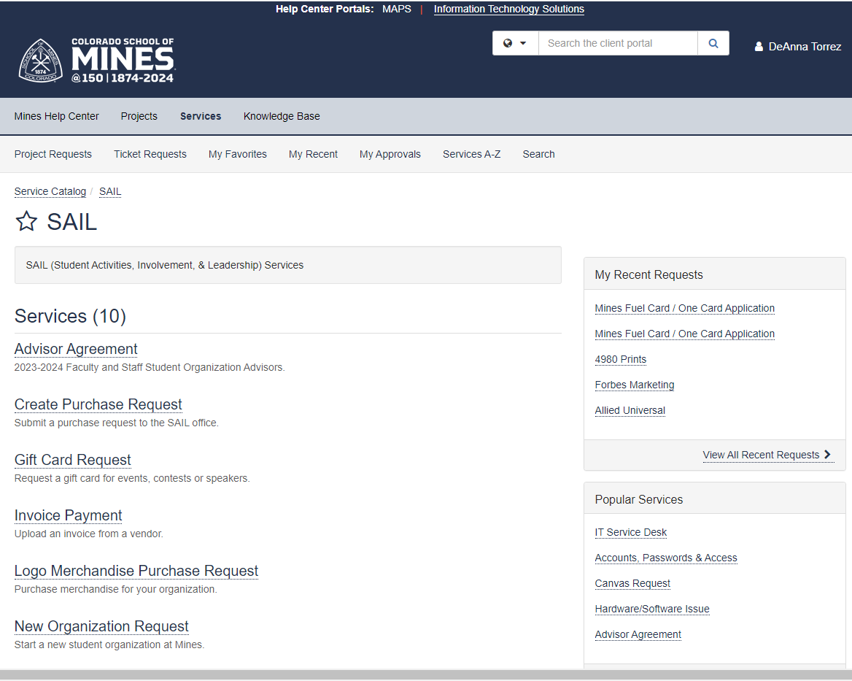
How to submit a SAIL ticket
https://www.mines.edu/student-activities/
Click ‘Organizations’
Resources
Click ‘Submit A SAIL Ticket’
Correspondence
Upload documents
Status of ticket

Slide 13
AOE is linked, download, fill out through the attachment option

Slide 14
Appropriateness of expenditures (AOE)
If your purchase is expected to be over $50, fill out the AOE form and upload it to your purchase request. The form is need for EVERY method of purchase!
If AOE is not completed, your ticket will be denied and sent back for correction.

Slide 15
Can I use my advisors one card?
Most One Cards are designated for use by the card holder only!!
For an advisor to let you use their card, they are responsible for obtaining permission from Mines to have their card be a multiuser card.
If you indicate on the Purchase Request that you will be using your advisors’ card, they should be the ones making the purchase unless they have a multiuser card.

Slide 16
Reimbursements
If you used your own money to make a purchase for your organization
You must submit a Reimbursement Request through the SAIL ticket system.
Request must be approved by treasurer
Attach an itemized receipt
A reason why the One Card was not used
One Card was declined at checkout
Attendance was higher and we needed more plates, forks, etc.
The extension cord broke, and we needed one to run the event
Once your request is received
Request will be reviewed and approved for payment
Claim your reimbursement
Check your email for notifications on how to accept or receive your reimbursement. You may receive it via direct deposit, or a check will be mailed
If you wish to pick up a check instead of having it mailed, let us know when submitting your original request
Email might come from Team Dynamix or similar

Slide 17
Contracts
All contracts must be submitted to the SAIL office 4 weeks before the event or first promised payment (deposit)
All vendors are required to submit:
W9
Contact information (name, phone number, and email)
Proof of Insurance (according to Mines specifications)
If possible, use SAIL provided contract
All food trucks require a contract
DO NOT SIGN CONTRACTS
DO NOT AGREE TO ANY TERMS AND CONDITIONS OF A CONTRACT

Slide 18
GIFT CARDS
Gift cards and tangible gifts can be purchased for events open to all campus. You must submit a Gift Card Request through the SAIL ticket system. Please DO NOT purchase gift cards.
Gift cards are typically approved for campus events or competitions for 1st, 2nd, and 3rd place. Maximum $50 per gift card
Gift to speakers- Maximum $65 (request over $65, need approval by Begoña)
Governing bodies – Please talk to Begoña if you need gift cards or gifts
No gift Cards (without SAIL approval regardless of source of funding)

Slide 19
Alcohol and Fencing
If you are planning an event with alcohol, please talk to DeAnna Torrez or Marilynn Gallegos at least 4 weeks before your event.
You will need to submit a request to serve alcohol through Student Life
You will need a non BSO index that allows for the purchase of alcohol
You will need security, bartenders, and fencing

Slide 20
LOGO merchandise
Find a vendor from the APPROVED vendor list! Attach Link
Review branding standards https://www.mines.edu/communications/branding-and-graphic-standards/
Submit: Logo Merchandise Purchase Request
Complete all fields (vendor contact information, purchase related information, index, reason for purchase, etc.)
Attach:
Artwork
Tax-exempt quote
Let us know when all goods/services are received as expected and we will submit payment
All merchandise (sticker, pen, t-shirt, etc.) must include Mines branding. Failure to do so will result in personal liability for the cost of the items and items will not be allowed to be used for your club.

Slide 21
List of approved vendors linked

Slide 22
Purchasing Restrictions
BSO
No T-Shirts or apparel
No alcohol/tobacco
Only 50% of each travel purchase
No more than 25% of total spending on food
Salaries cannot be paid to students serving their own RSO
ISC
No T-Shirts or apparel
No alcohol/tobacco
No food should be provided in RSO meetings using money received from ISC
Salaries cannot be paid to students serving their own RSO
BSM- Upcoming
MSO- Upcoming

Slide 23
Traveling: Domestic/ International
ALL travel must be approved by SAIL, even if it is funded through departments. Any overnight or out of state trips are considered travel even if nearby.
Schedule a meeting with pro-staff at SAIL 4-6 weeks prior to your trip (or at least 8 weeks prior to your trip if you are requesting a cash advance or traveling Internationally).
Do not purchase travel arrangements without approval from SAIL
To be excused from class fill out absence form 4 weeks in advance (attach names, CWIDs, and have RSO advisor sign, and submit to Student Life) https://www.mines.edu/student-life/forms/
Travel purchases of $5,000 or more will need approval from Begoña

Slide 24
Domestic Travel
Submit a travel pre-authorization request:
DeAnna will reach out to you to schedule your mandatory pre-trip meeting
Meeting:
Trip Attendees
Drawing for other (unless competition team event
Waivers
All students traveling
Drivers- sharing rides
Clery Act Form
One per trip
Allowable expenses
Registration
Lodging (per diem)
Flights
DO NOT buy trip insurance. You will not be reimbursed. The school will not cover additional flight insurance.
Meals (per diem)
Transportation
Rental cars should be reserved with our contracted agencies (which includes insurance)
Mileage
Up to 5 exec board

Slide 25
international Travel
Submit a travel pre-authorization request:
Begoña will reach out to you to schedule your mandatory pre-trip meeting
Meeting:
Trip Attendees
Drawing for other (unless competition team event
Waivers
All students traveling
Clery Act Form
One per trip
Allowable expenses
Registration
Lodging (per diem)
Flights
DO NOT buy trip insurance. You will not be reimbursed. The school will not cover additional flight insurance.
Meals (per diem)
Transportation
Rental cars should be reserved with our contracted agencies (which includes insurance)
Mileage
Up to 5 exec board
Additional approvals need to be obtained
International contracts needs to be brought to the meeting

Slide 26
Traveling: Best Practices
Organizations should try to maximize value
Students are encouraged to share accommodations but are not required to – if a student does not want to share, they DO NOT need to provide you with a reason
RSO’s can choose to provide an individual room or provide same level funding as they do for other students traveling
Students should have equitable access to resources
Consider requesting a cash advance for out-of-pocket expenses that are covered by RSO (meals, ground transportation, mileage, etc.)
Trips are like events, they are open – RSO can reserve up to 5 spots for their student leadership, all other spots must be drawn randomly
Exceptions– students presenting at a conference and competition teams representing Mines at a competition or tryout (they do not need to open the trip to anyone else)

Slide 27
MOVIES
Any movie showing by a RSO is considered a public showing
Movie rights must be purchased before showing
Contact SAIL if you wish to have a movie showing
Any movies rated above PG-13 or shows rated above TV-14 or non-rated must have security present throughout the event to check IDs of all the attendees
RSO’s are permitted to freely play the Treasurers’ Training video at events
Notes:
Consider talking about:
Engineering, procurement and construction (EPC) contract
Operation and maintenance agreement
Concession deed
Shareholders Agreement
Off-take agreement
Supply agreement
Loan agreement
Intercreditor agreement
Tripartite deed
Common Terms Agreement

Slide 28
Donations
Donations to your RSO
Any donations under $1,000 can be deposited into your school-side worktag
Any donation $1,000 and more MUST go through the Foundation
Donations from your RSO
Donations are only allowed in the form of services or tangible goods if the following criteria is met
Donations of your time are allowed
Donations of items are allowed if they are made to fully accredited charities that are not political or religious affiliated.
The total cost of the items is equal or less to the total amount of time volunteer for the event, calculated a number of hours volunteered times number people volunteering times minimum wage in Colorado
All items donated must abide by our regular purchasing rules – no alcohol, tobacco, firearms, political or religious items, etc.
The donation has been cleared by the SAIL office prior to the event
You can NEVER give any MONEY!

Slide 29
Collecting funds
If you collect funding on behalf of your organization, the funding (even in cash form) still belongs to your organization and must follow the appropriate procedures
ALL FUNDS MUST BE DEPOSITED WITHIN 2 BUSINESS DAYS INTO YOUR ACCOUNT BEFORE YOU CAN USE THEM
All deposits are completed through the SAIL office (M-F 9:00-3:30)
Failure to follow these guidelines is considered misconduct and will be subjected to disciplinary action.
Checks
Must be signed and made out to Colorado School of Mines: (RSO Name)
Do not endorse the back of the check
Credit Card
TRANSACT is the ONLY method to collect online credit card payments at Colorado School of Mines
A TRANSACT page must be created two weeks before acquiring funds through credit cards
Please submit a cash box rental/credit card terminal form for physical payments. This form requires SAIL approval and signatures. When approved you can turn into cashier’s office

Slide 30
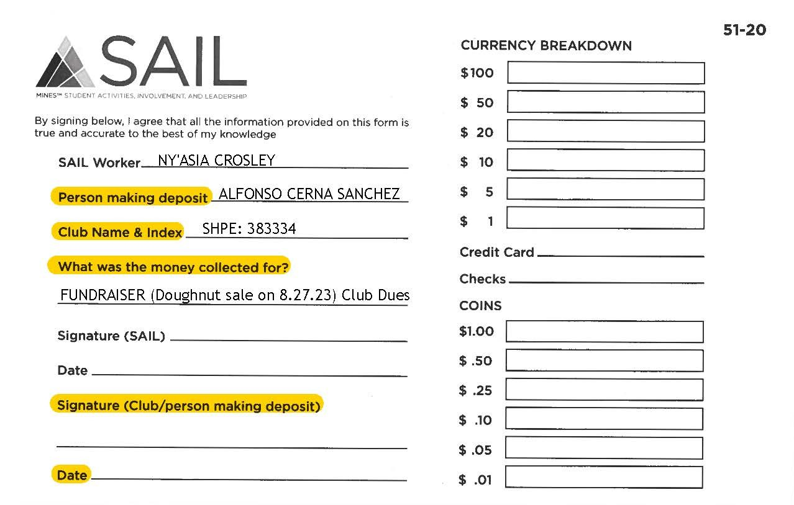
Deposits
FUNDS are required to be deposited within 2 business days of colleting money
Fill out deposit form and recount funds collected
Funds will be counted by desk staff
You will both then agree on an amount and denominations collected and sign
You will receive a copy of the deposit slip for your reference
NEVER LEAVE MONEY AT THE FRONT DESK WITHOUT FILLING OUT A DEPOSIT FORM AND RECEIVING A SIGNED RECEIPT!

Slide 31
FUNDraisers
Fundraising
If you are selling tangible goods to raise funds, you will have to pay tax and the price must meet or exceed the cost you incurred to procure those tangible items.
If you provide false advertising on where your funding is going, you will accumulate points and might incur in misconduct
Sales Tax
You MUST add that you are collecting sales tax of 7.5% on any advertisements (specify whether it is included in the price or needs to be added)
Ex.) 7.5% sales tax is included (this includes your Daily Blast Entry)
NO RAFFLES WITHOUT A GAMBLING LICENSE!

Slide 32
RSO Inventory
All items purchased by RSOs are state-owned property, they must be maintained within the club and passed down through club leadership each year.
When RSO is inactive, or item(s) are broken they must be turned into SAIL.
RSO must maintain and update an inventory list of major items (over $500) and all fabricated items that are or exceed $2,000
Inventories must be uploaded to re-registration form and passed to the incoming president after elections

Slide 33
Security
Mines has contracted with Allied Universal Event Services to provide event security services for campus. The contract is renewed through May 2024
Minimum Hours
Events hosted by RSOs shall be subject to a three (3) hour minimum charge for the services provided. If multiple events hosted by Mines employees or student groups occur on the same day consecutively, the hours of the events shall be combined to meet the minimum hour requirements
Notes:
Update with new 2024

Slide 34
Security
RSO Events:
Serving Alcohol
Showings rated above PG-13 or TV-14
To obtain security:
If the cost is less than $4,999 for the event
Submit a Purchase Request with description and details of the event.
If the cost is more than $5,000 for the event, a PO will be required.
RSO- dtorrez@mines.edu
Governing Body- bruiz@mines.edu
Submit a request to Allied Universal at auescoloradoeventrequest@aus.com (remember to submit requests with as much advanced notice as possible).
You will receive an automatic email confirmation from Allied Universal within 48 hours to discuss your event needs, including gathering any attachments (maps, additional event details, etc.) you wish to provide.
It is your responsibility to notify SAIL pro staff if you schedule security
If you receive an invoice, it is your responsibility to forward the invoice to dtorrez@mines.edu for payment

Slide 35
Security

Slide 36
BUSES
Bus vendor Information:
Contracts are valid through June 30, 2024
Ace Express
Contact Information: sales@aceexpresscoaches.com
Phone: 303-421-2780
Arrow Stage Lines
Contract Information: Sheri Kite, sheri@arrowstagelines.com
Colorado Gray Lines
Contact Information: Max Stallings, max@coloradograyline.com
Hermes Worldwide
Contact Information: groupevents@hermesworldwide.com
Ramblin Express
Contact Information: sales@ramblin.com
Phone: 303-572-8687, ext. 3
Phone: 303-577-7600, ext. 3
Phone: 303-289-2841
Phone: 303-373-9119, ext. 114

Slide 37
Buses
How to obtain bus services:
Contact one or more of the vendors above to discuss your event needs (please do so with as much advanced notice as possible).
When booking make sure you identify that you are with Colorado School of Mines and there is an existing contract between Mines and the vendor.
Purchasing recommends obtaining pricing from multiple vendors, as there are price differences among them.
Each vendor has a variety of buses in their fleet so verify they have the one that fits your needs.
Some of the vendors have a minimum number of hours.
Some of the vendors also require a deposit.
You will need to get a quote from the vendor.

Slide 38
Buses
Additional Information:
Each group is responsible for booking their own buses and paying for their own invoices under $5,000.
Equal or above $5,000 you need to have SAIL (DeAnna or Begona) do the booking for you with a purchase order.
If the cost is less than $5,000 for the event, submit a purchase request with sufficient explanation of the event.
Make sure your event is approved before submitting the request.
If the cost is equal or over $5,000 for the event, please contact:
dtorrez@mines.edu if you are a student RSO
bruiz@mines.edu if you are a student governing body
Please be sure to include the quote with your email and all pertinent information.
If the vendor sends you a contract or document with terms and conditions, send it to us, regardless of cost.
Hermes Worldwide has stricter terms on their contract, what that means for you is if passengers damage the bus, Mines will be responsible for paying the damage and then it is up to Mines to get the money from the student.

Slide 39
LOTS of rules and thing to remember…
Review this power point and the resources on our website
Ask questions
Schedule an appointment to talk with SAIL
The sooner you reach out the sooner we can help you.

