Slide 1
Mechanics Labs that can be done at Starbucks

Slide 2
Abstract
I present a sample of labs using the new IO lab device developed at University of Illinois. With some simple materials (string, paperclips, etc..., we will be able to some very formal labs in a casual location e.g. home or coffeeshop.

Slide 3
Overview.

Slide 4
Diagram
Light Sensor
Microphone and Magnetic field sensor.
Accelerometer.
Speaker
Wheel sensor Measures velocity, acceleration and position.
3.3 V power supply DC.
Differential high gain amplifier.
gyroscope
Digital and analog output.
Force Sensor

Slide 5
Software
Works on both PC and Mac.
Open source.
Able to share data via repository.
It’s FREE!!
See next slide.

Slide 6
Installing Windows.
Must Install Driver first.
https://www.youtube.com/watch?v=CYDUjHNmnWU&list=PL- 4oXKoYvmdkd5WSRifGlU30uH3eOpdlS
This installs the driver.
Now you can Install the application.
https://www.youtube.com/watch?v=ioKJJf0Uh4k&index=3&list=PL- 4oXKoYvmdkd5WSRifGlU30uH3eOpdlS
Installs the software.

Slide 7
Installing Mac
https://www.youtube.com/watch?v=_ihALKrSsBc&list=PL- 4oXKoYvmdkd5WSRifGlU30uH3eOpdlS&index=4
No need to install driver. Just install app. The rest is done for you.

Slide 8
Software 2
Measurements.
Zoom.
Stored runs.
Configuration and Calibration.
Time.
Cloud.
Available sensors.

Slide 9
Key to quantities in measurement mode.

Slide 10
Motion from a graphical perspective
One of the most effective methods of describing motion is to plot graphs of position, velocity and acceleration vs time. From such a graphical representation, it is possible to determine in what direction an object is going, how fast it is moving, how far it traveled, and whether it is speeding up or slowing down. A qualitative analysis of the graphs of the motion of a cart will help you develop an understanding of the concepts of kinematics.

Slide 11
Objectives
Analyze the motion of a cart on a flat surface.
Match the graph of position vs time and use it to predict the velocity of the cart.
Match the graph of the velocity vs. time of a cart and use it to predict the acceleration.

Slide 12
Pre activity questions.

Slide 13
Experiment 1a.
Match the graph.
Try to match the graph below by pushing the device first to the right and then to the left.
Describe the motion of the device.

Slide 14
Questions
What is the velocity of the cart when the x vs. t curve is flat?
Describe the velocity when the x vs. t curve has a positive slope? What about when the graph has a negative slope?
(Quantitative) Pick a section of x vs. t that looks linear. Using the measurement tool, what is the s value of this section of the graph and how does it compare to the 𝜇 value of the velocity?

Slide 15
Focus for today:
Your group will come up with a way to measure the coefficient of kinetic friction μ_{k}
New Skill: Constructing a Measurement
Evolving Skill: Connecting Data with Reality
Review Skills: Writing, uncertainty, etc.

Slide 16
Lab 4 Preparation
Discuss some ideas for ways you can measure the coefficient of friction μ_{k} Think back to the prelab.
(Recall that F_{friction} = μ_{k}N)

Slide 17
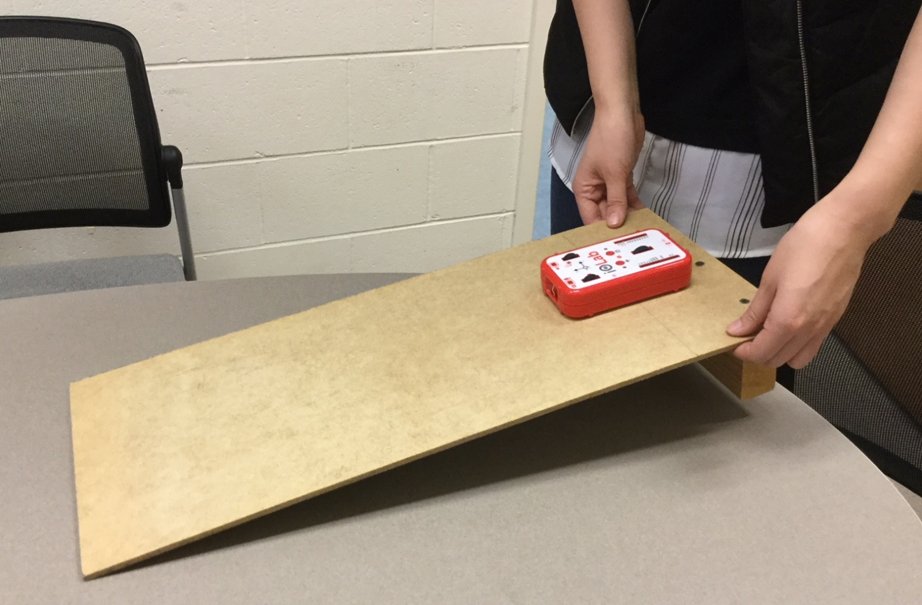
Be Creative

Slide 18
Newton's Laws
(Force sensor)
Lift device using force probe – hold still - put back down Calculate mass of device from weight
(this is basically just a check that the calibration was done
correctly and that students understand how to “zero” the force.
The answer is 2 Newtons if they do this correctly)

Slide 19
Newton's Laws
(Force & Accelerometer sensors)
Hang device from force probe & move it up & down
Observe relationship between F and a

Slide 20
Newton's Laws
(Force & Accelerometer sensors)
Hang device from force probe – moving up & down Calculate mass of device using
parametric plot of F vs a (slope = mass)

Slide 21
Newton's Laws
(Force & Wheel sensors)
Push quickly on the force sensor and plot force vs velocity Integrate Fdt during the push and show that it equals ΔP

Slide 22
Newton 3rd law
Difficult and typically abstract.
$F_{12}=−F_{21}$
Use two devices (will have to be a collaborative activity)
Graphical representation.

Slide 23
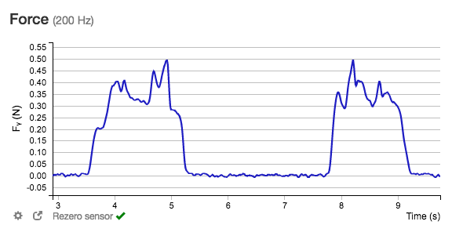
N3

Slide 24
Conclusion
Labs can be done at Starbucks, home or from where ever the student is
No specialized equipment, all you need is stuff around the house.
Can be used as either a pre-lab or as a full lab experience.

