Slide 1
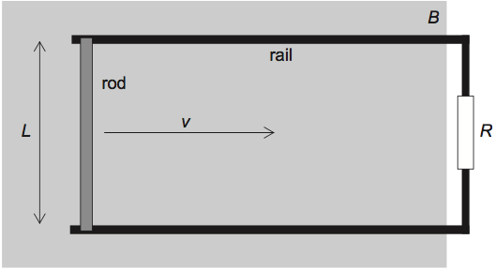
An alpha particle (He nucleus) is traveling to the left going 500,000 m/s when it enters an magnetic field with a strength of 60 mT and pointed up and to the right at an angle of 50º above the horizontal. What is the resulting force that the alpha particle experiences?
A 12.0 cm diameter loop of wire is initially oriented perpendicular to a 0.63 T magnetic field pointing up. During the course of 0.15 s, the field is changed to one of 0.25 T pointing down. What is the average emf induced in the coil?
10⁻¹⁵ N
V
The diagram shows a conducting rod of length L = 50 cm being moved in a region of uniform magnetic field B = 2.5 T. The field is directed at right angles to the plane of the paper. The rod slides on conducting rails at a constant speed v = 1.5 m/s. A resistor of resistance R = 20 Ω connects the rails. What power is required to move the rod at constant speed?
A solar farm is made up of photovoltaic cells of area 25,000 m². The average solar intensity falling on the farm is 240 Wm^{–2} and the average power output of the farm is 1.6 MW. Calculate the efficiency of the photovoltaic cells.
%
W

Slide 2
A small coastal community decides to use a wind farm consisting of five identical wind turbines to generate part of its energy. At the proposed site, the average wind speed is 8.5ms^{–1} and the density of air is 1.3kgm^{–3}. The maximum power required from the wind farm is 0.75 MW. Each turbine has an efficiency of 30%. Determine the diameter that will be required for the turbine blades to achieve the maximum power of 0.75 MW.
2 cylinders of radius r, resistivity of ρ and length L are parallel, separated a distance d apart. Both are hooked up to the same voltage source, provided a potential of V for each cylinder. Derive an equation for the force each cylinder experiences from the other and show that to Mr. Leach to earn a reward.
m
r
d
A Carbon 12 nucleus is accelerated to a speed of 750,000 m/s when it enters a magnetic field. The circular path it follows has a diameter of 13.1329 cm. What is the strength of the magnetic field in milliTeslas?
r
L

Slide 3
+15 V
5 cm
electron
-15 V
What is the necessary B field magnitude that must be placed in that same region for the electron to go straight? (first 4 sig figs)
20 V

Slide 4
positive
F
positive
negative
positive
B
v
F
F
v
F
v
B
negative
B

Slide 5
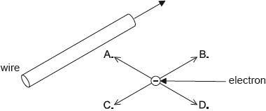
What is the correct order of energy transformations in a coal power station?
T. thermal → chemical → kinetic → electrical
R. chemical → thermal → kinetic → electrical
E. chemical → kinetic → thermal → electrical
H. kinetic → chemical → electrical → thermal
(P)
(S)
(B)
(L)
An electron is moving parallel to a straight current-carrying wire. The direction of conventional current in the wire and the direction of motion of the electron are the same. In which direction is the magnetic force on the electron?
L
Y
T
K

Slide 6


Slide 7
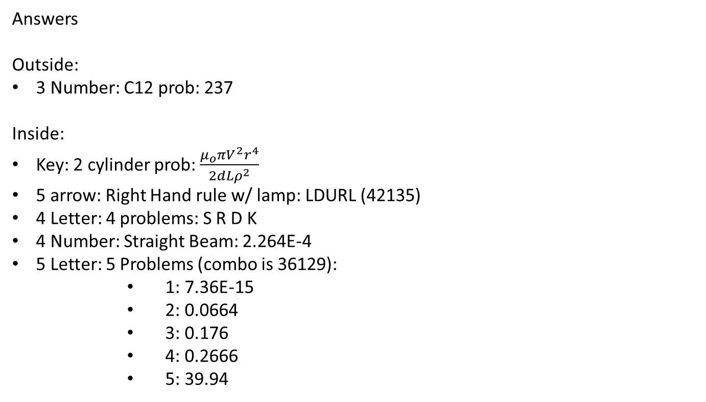
Answers
Outside:
3 Number: C12 prob: 237
Inside:
Key: 2 cylinder prob: $\frac{μ_{o}πV^{2}r^{4}}{2dLρ^{2}}$
5 arrow: Right Hand rule w/ lamp: LDURL (42135)
4 Letter: 4 problems: S R D K
4 Number: Straight Beam: 2.264E-4
5 Letter: 5 Problems (combo is 36129):
      1: 7.36E-15
      2: 0.0664
      3: 0.176
      4: 0.2666
      5: 39.94

Slide 8

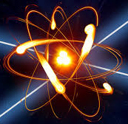
Physics Task Force

Slide 9
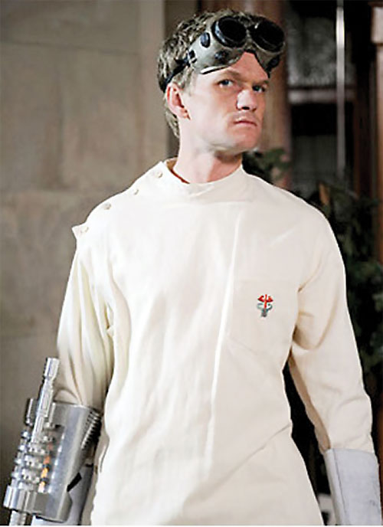
Dr. Horrible
Has a PhD in horriblism
Master of electricity and magnetism
Placed “Doomsday Device” that will activate soon!

