Slide 1
Energy Review Game
Create a fun, energy based team name & write it on the front board

Slide 3
A car covers a distance of 100 m in 5.0 s. The thrust of the engine is 1.5 kN. What is the power of the car?
A. 0.75 kW B. 3.0 kW C. 7.5 kW D. 30 kW

Slide 4
2. A block of mass 6 kg is moving at 4 m/s across a rough, horizontal surface. A constant frictional force acts on the block bringing it to rest over a distance of 2 m. What is the coefficient of friction on the block?

Slide 5
3. A horizontal spring of spring constant k and negligible mass is compressed through a distance y from its equilibrium length. An object of mass m that moves on a frictionless surface is placed at the end of the spring. The spring is released and returns to its equilibrium length.
What is the speed of the object just after it leaves the spring in terms of m, k and y?

Slide 6
4. An object, initially at rest, is accelerated by a constant force. Which graphs show the variation with time t of the kinetic energy and the variation with time t of the speed of the object?

Slide 7
5. A student of weight 600N climbs a vertical ladder 6.0m tall in a time of 8.0s. What is the power developed by the student against gravity?

Slide 8
6. A student uses a spring scale (force sensor) to exert a horizontal force on a block, pulling the block over a smooth floor. The student repeats the procedure several times, each time pulling the block from rest through a distance of 1.0 m. For which of the following graphs of force as a function of distance will the block be moving the fastest at the end of the 1.0 m?

Slide 9
7. A spring of negligible mass and length l₀ hangs downward from a fixed point. When a mass m is attached to the free end of the spring, the length of the spring increases to l. What is the value of k in terms of givens?

Slide 10
8. An object of mass 2kg is thrown vertically downwards with an initial kinetic energy of 100J. What is roughly the distance fallen by the object at the instant when its kinetic energy has doubled? (let g = 10m/s²)

Slide 11
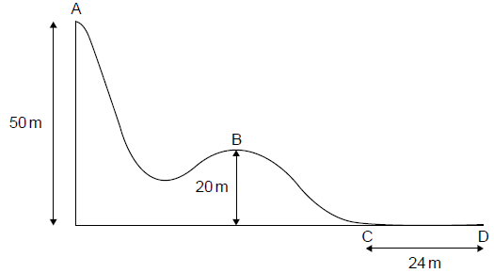
9. A skier is skiing down this hill. At what point is the skier going the fastest? DO account for friction.

Slide 12
10. A skier of mass 65 kg starts from rest at point A. From A to B, 75% of the energy converted is lost to heat. How fast is she going at point B?

Slide 13
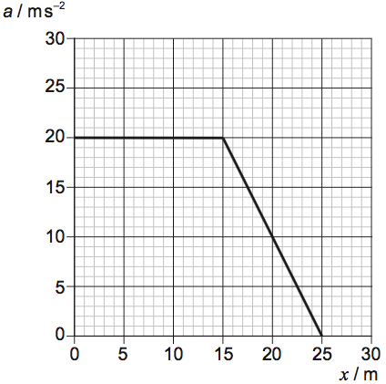
11. The graph shows how the acceleration a of an object varies with distance travelled x. The mass of the object is 3.0 kg. What is the total work done on the object?

Slide 14
12. I push an object from rest with a force of 50 N at 25º below the horizontal for a distance of 3 m. The object has a mass of 15 kg and the coefficient of friction between the object and the floor is 0.2. How fast is the object going after the 3m?

Slide 15
13. A cart is moving on a level track in the positive x-direction. A force acting parallel to the x-axis is exerted on the cart. The graph above shows the net force exerted on the cart as a function of displacement. As the cart travels from x =0m to x = 4m, what is the net change in the kinetic energy of the cart?
(A) An increase of 20 J
(B) An increase of 10 J
(C) A decrease of 20 J
(D) A decrease of 10 J

Slide 16
14. A cannon ball with mass m is fired from a cannon set at angle θ above the horizontal. The launch velocity has a magnitude of v. Derive an equation for the maximum height that the cannon ball achieves along its trajectory.

Slide 17
15. An object with mass m is suspended at rest from a spring with a spring constant of 200 N/m . The length of the spring is 5.0 cm longer than its unstretched length L, as shown above. A person then exerts a force on the object and stretches the spring an additional 5.0 cm. What is the total energy stored in the spring at the new stretched length?

Slide 18
16. I throw a ball of mass 0.75 kg from the ground straight up with a speed of 30 m/s. The entire time the ball is in the air it experiences a drag force of 5 N. How fast is the impact speed with the ground? HINT: Break this up into 2 parts, part 1 going up, part 2 going down.

Slide 19
17. A rubber ball with mass 0.2 kg is dropped vertically from a height of 1.5 m above a floor. The ball bounces off of the floor, and during the bounce 0.6 J of energy is dissipated. What is the maximum height of the ball after the bounce?

Slide 20
18. The pendulum shown in the figure above reaches a maximum height h above the equilibrium position as it oscillates. Assuming friction and air resistance are negligible, which of the following is true about the total energy of the Earth-pendulum system as the pendulum oscillates?
It is at a maximum when the pendulum is at its lowest position.
(B) It is at a maximum when the pendulum is at its maximum height h.
(C) It is constant throughout the pendulum’s motion.
(D) It is at a minimum when the pendulum is somewhere between its lowest and highest positions.

Slide 21
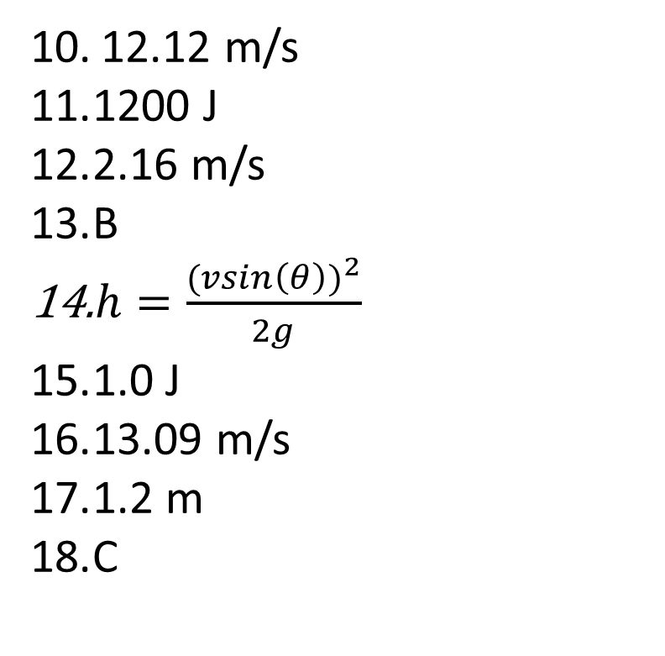
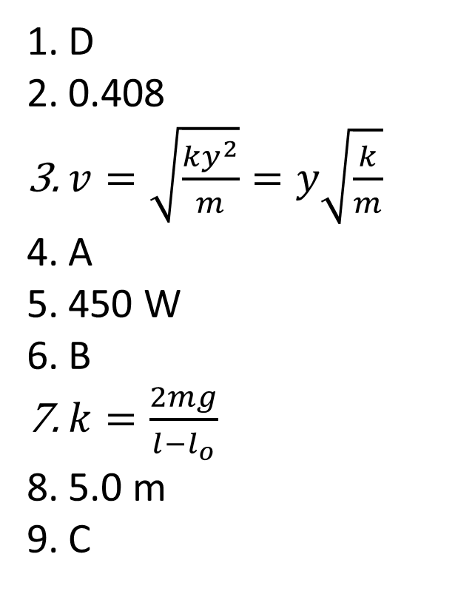
Answers
D
0.408
$v=\sqrt{\frac{ky^{2}}{m}}=y\sqrt{\frac{k}{m}}$
A
450 W
B
$k=\frac{2mg}{l−l_{o}}$
5.0 m
C
12.12 m/s
1200 J
2.16 m/s
B
$h=\frac{{(vsin\left(θ\right))}^{2}}{2g}$
1.0 J
13.09 m/s
1.2 m
C

