Slide 1
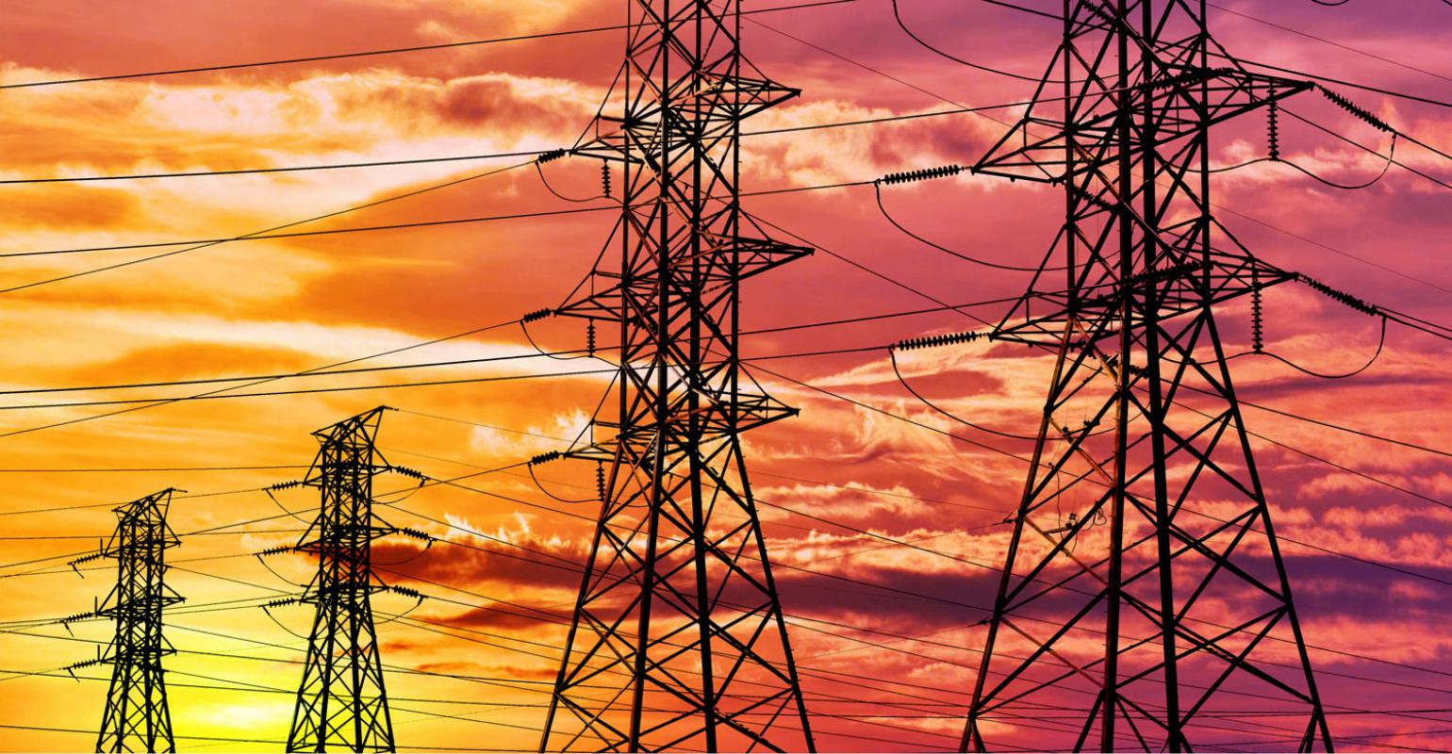
Creating an Electrical Grid

Slide 2
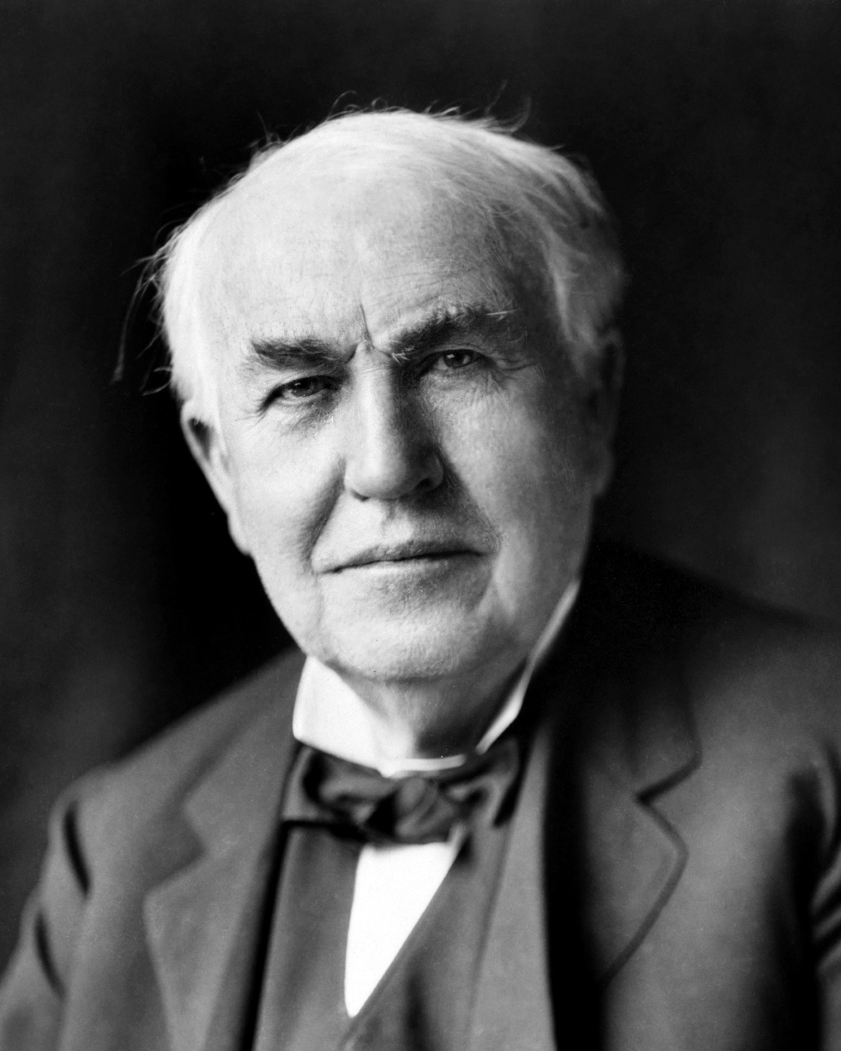
Thomas Edison
Feb 1847-Oct 1931
Made headquarters in Menlo Park, NJ
Termed “The Wizard of Menlo”
Ruthless, obsessive nature.
Edisonian approach to invention

Slide 3
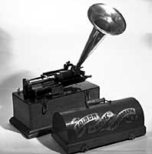
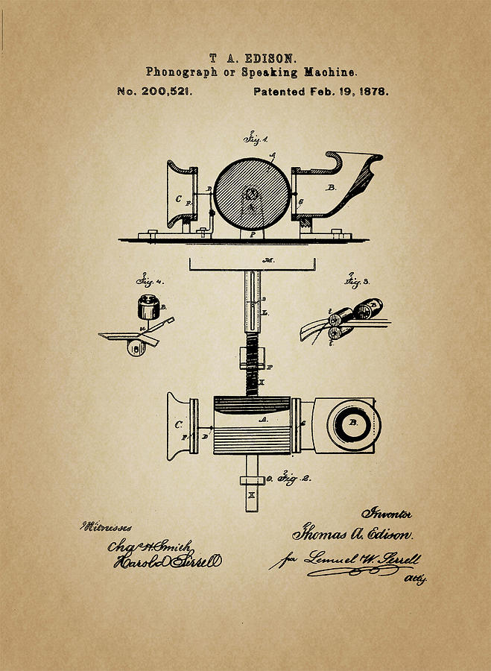
Invented in 1877

Slide 4
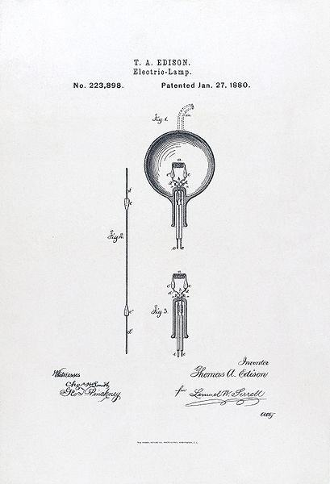
Took over 1,000 trials to produce a stable incandescent light bulb
Edison made the first public demonstration of his incandescent light bulb on December 31, 1879, in Menlo Park. It was during this time that he said: "We will make electricity so cheap that only the rich will burn candles.“
Started Con Edison (still going strong today) to promote the electrical power grid in NY and Europe

Slide 5
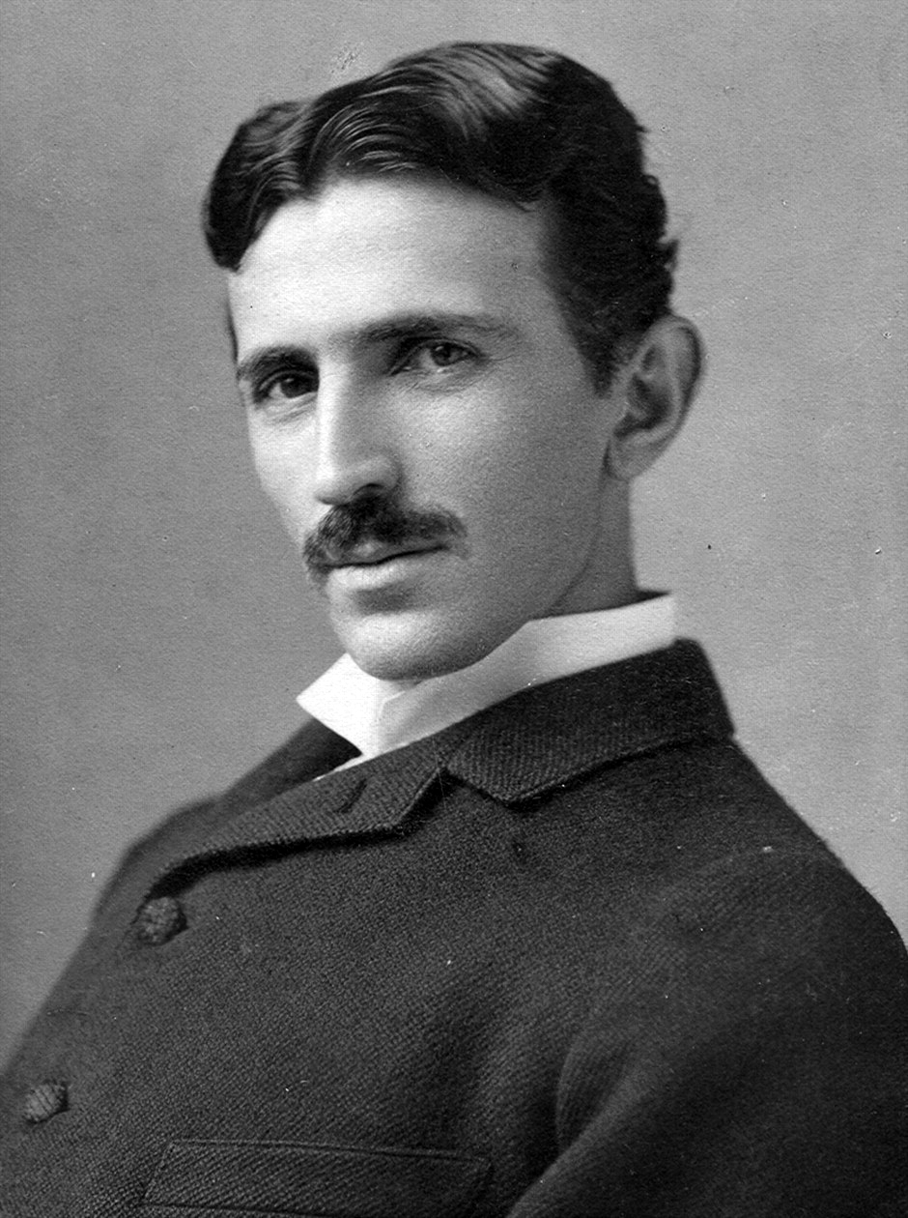
Nikola Tesla
July 1856-Jan 1943
From Austrian Empire (Modern day Croatia)
“The Serbian”
Hired by Con Edison in Paris to install lighting systems
Upgraded the Dynamos and motors of Con Edison Facilities.
Moved to USA in 1884
According to Tesla, Edison offered him a $50,000 bonus (bet) to improve 24 different types of machines for Edison Machine works. Edison denied this saying “Tesla, you don't understand our American humor”
Quit Edison Machine Works at the end of 1884

Slide 6
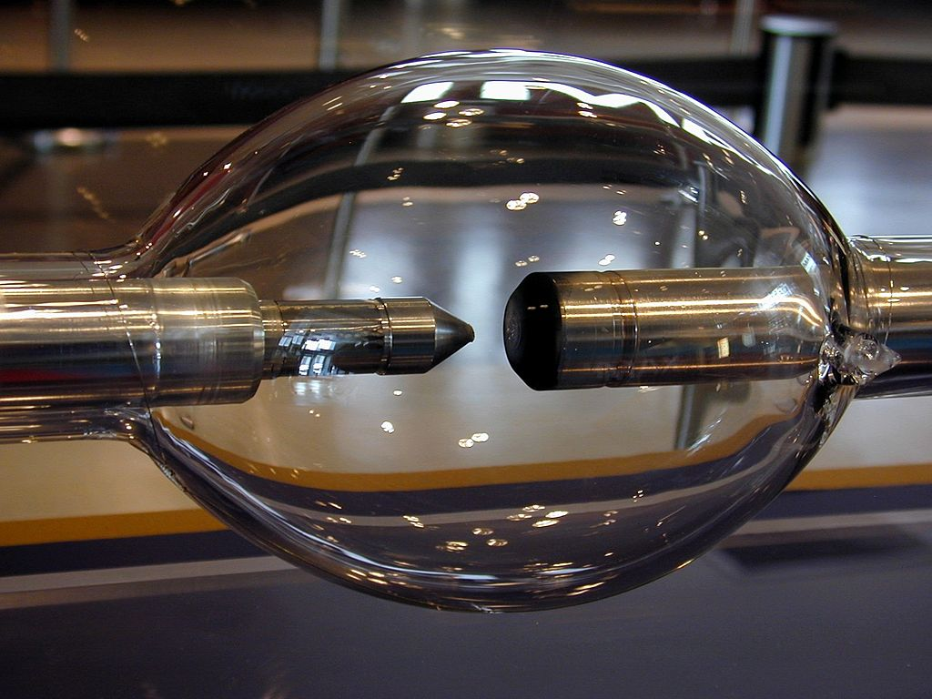

Slide 7
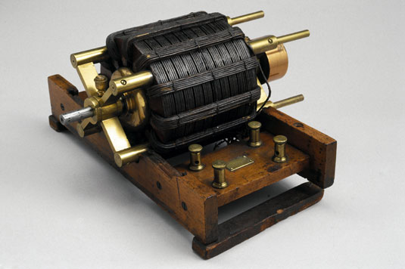

Slide 8
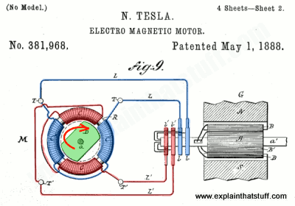

Slide 9
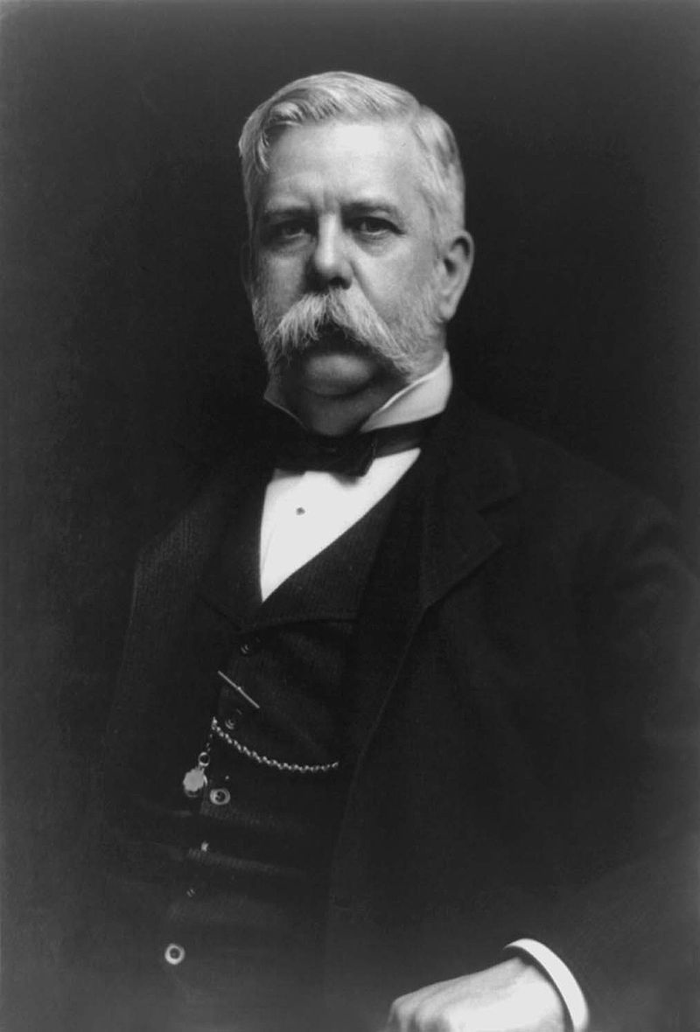
George Westinghouse
Oct 1846-March 1912
At 20 years old, witnessed a train wreck due to the engineers unable to switch on all breaks at once
At 22, invented the compressed air brake system for Trains
In 1885 started Westinghouse Electric Corporation with the focus being on AC power transmission developed from Tesla ideas.
The important piece of the puzzle was the step up and step down in Voltage from transformers

Slide 10
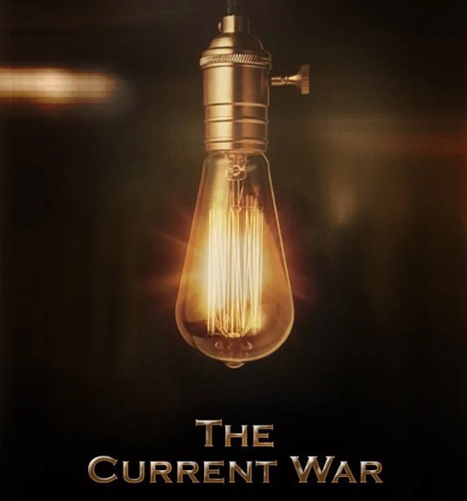

Slide 11
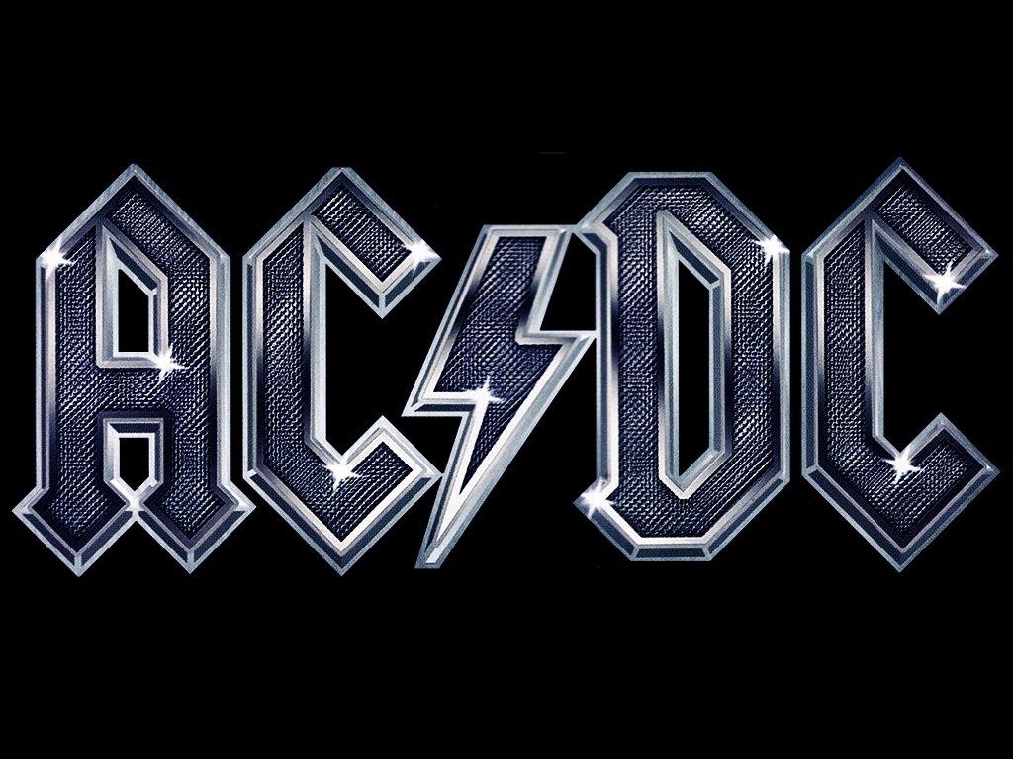

Slide 12
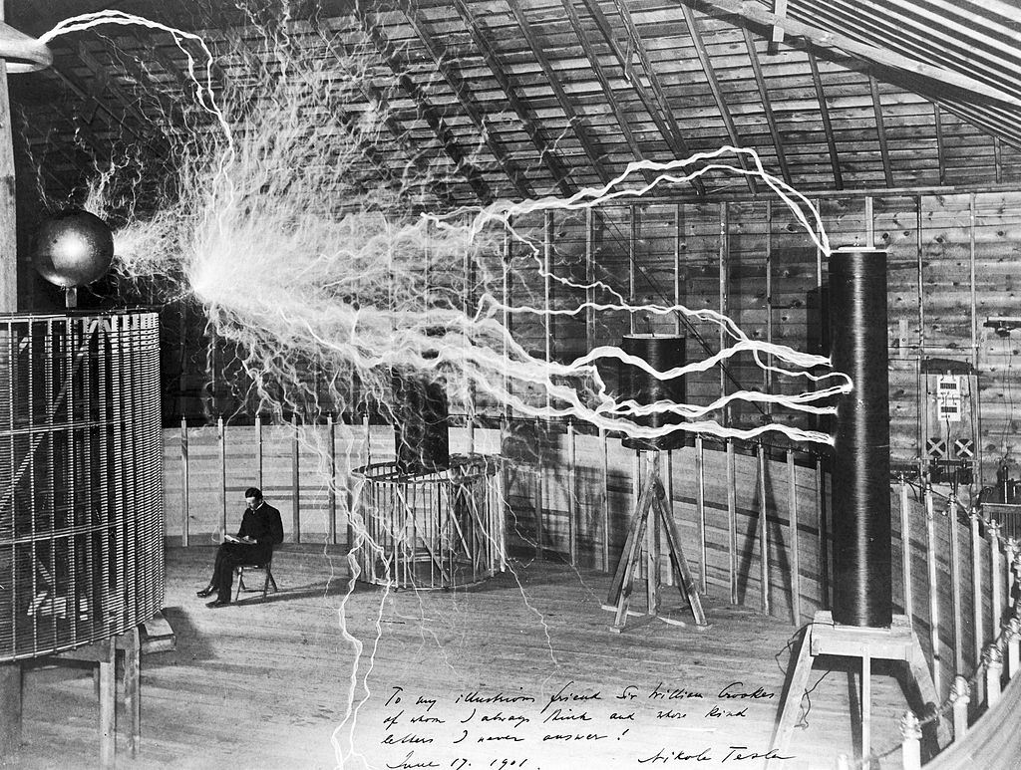

Slide 13
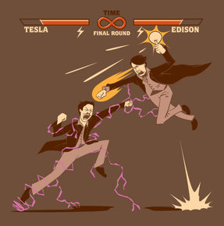

Slide 14
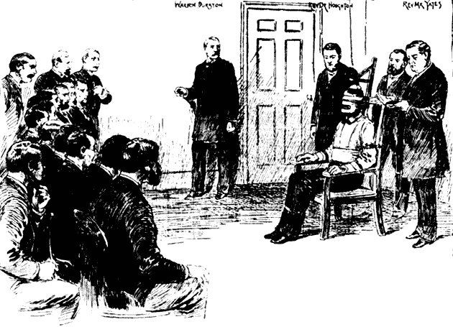
Execution of William Kemmler
First use of the Electric Chair
Idea to use the electric chair came from Edison.
Prison was powered by Westinghouse.
Westinghouse saw the possible PR problem, so hired the best lawyer to defend Kemmler

Slide 15
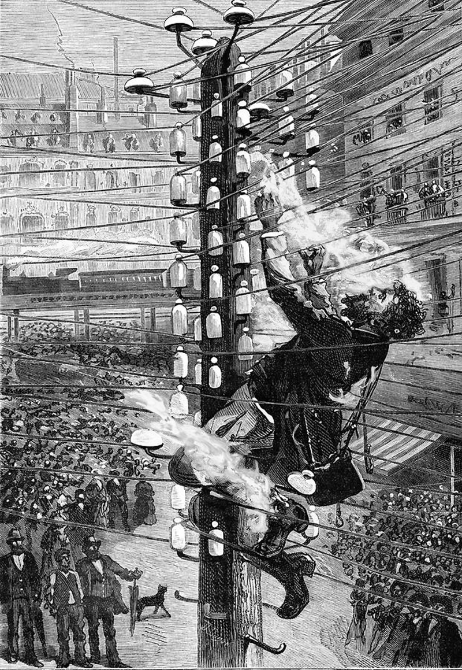

Slide 16
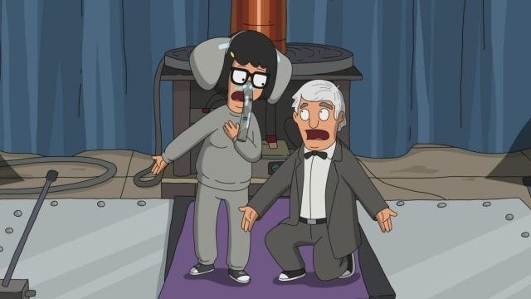

Slide 17
