Slide 2
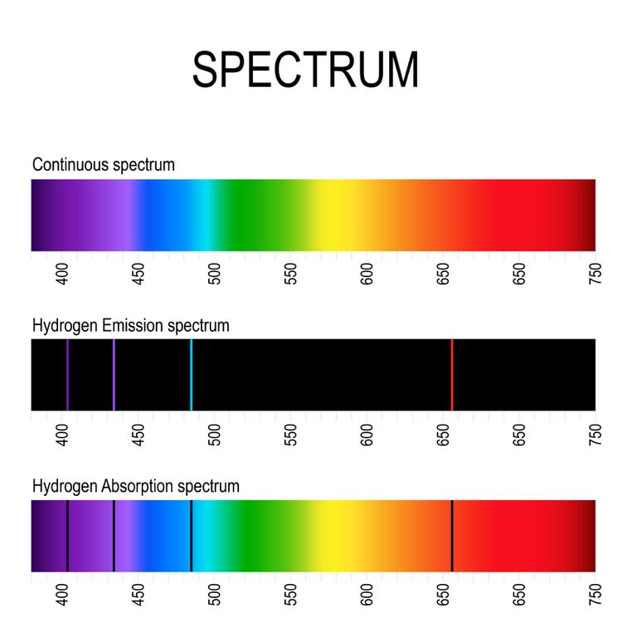

Slide 3
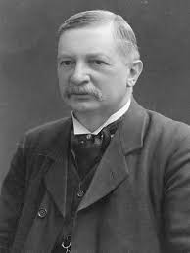
Johannes Rydberg
Experimental Physicists
In 1888, analyzed the wavelengths of spectral lines of hydrogen and “hydrogen like” atoms and determined the following equation:
Hydrogen:
$$\frac{1}{λ}=R_{H}\left(\frac{1}{m^{2}}−\frac{1}{n^{2}}\right)$$
Where n > m
Hydrogen Like:
$$\frac{1}{λ}={Z^{2}R}_{H}\left(\frac{1}{m^{2}}−\frac{1}{n^{2}}\right)$$
$$R_{H}=$$
$$1.0973732×{10}^{7}m^{−1}$$

Slide 4
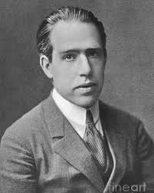
Niels Bohr
Theoretical Physicist
Took the work of Einstein, deBroglie and Coulomb, combining them together to show where the Rydberg Equation comes from.
Started with 4 assumptions:
The electron moves in circular orbits with the Coulomb Force causing the centripetal acceleration.
Only certain orbits are “stable” and do not emit energy
Electrons can “jump” between energy states and absorb or emit energy which is the difference between the energy levels
The circumference of the circular orbit of the electrons is some integral number of the deBroglie wavelength

