Slide 1
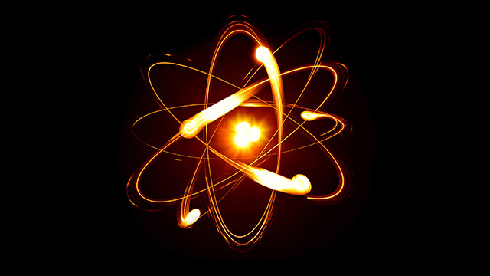
Cool Dudes of the Atom

Slide 2
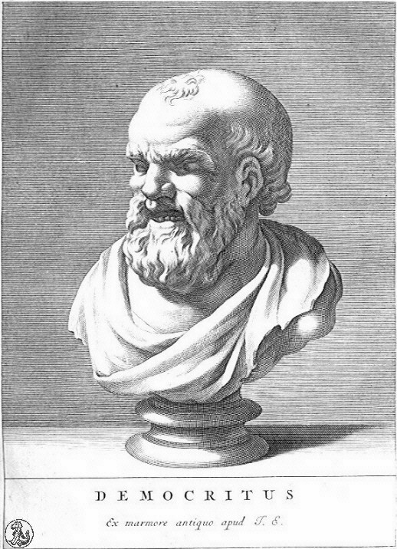
Ancient Greece: Democritus ~470 BCE
Known as the “Laughing Philosopher”
“Nothing exists except atoms and empty space; everything else is opinion.”
Created term “atomos” which literally means “not cut” or indivisible

Slide 3
John Dalton: 1766-1844
One of the founders of modern day chemistry.
Looked at Gas laws and determined that the motion of the atoms is random.
Purposed that atoms act like ball bearing or billiard balls and bounce off each other.

Slide 4
J. J. Thomson: 1856-1940
Discovered the electron, the first subatomic particle discovered.
From this discovery, hypothesized that the atom is made of smaller bits.
Purposed the “Plum Pudding” model.

Slide 5
Earnest Rutherford: 1871-1937
Conducted the Rutherford Gold Foil Experiment.
Determined that the protons must be concentrated in a small region of space, not spread out throughout the atom.
Called the center of the atom “the nucleus”

Slide 6
James Chadwick: 1891-1974
Had 1 BIG problem with Rutherford’s model.
In 1932 he took the radiation emitted by polonium (alpha particles) and sent it at beryllium. This interaction gave off a different radiation that was not deflected in a magnetic field. Sending that radiation into paraffin (which is full of hydrogen). Found that the hydrogen scattered as if hit by an equal mass.

Slide 7
Niels Bohr: 1885-1962
Analyzed the spectral lines coming off of hydrogen gas and determined that the electrons must be some distance away from the nucleus of the atom.
Purposed a Solar System model where electrons orbit the nucleus at fixed distances away that correspond to certain energy levels. (Quantized the energy states)
There is one BIG problem with this idea.
Bohr could not provide an answer to this problem.

Slide 8
Louis de Broglie: 1892-1987
Purposed that matter is not just a particle but have wave like properties as well.
Each particle has a corresponding wavelength depending on its momentum.
This solved Bohr’s problem where the energy states are the places where the wavelengths resonate at.

Slide 9
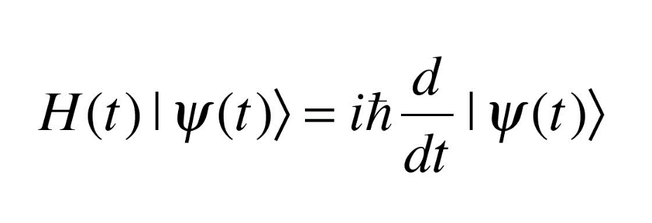
Erwin Schödinger: 1887-1961
Took de Broglie’s idea that particles have wavelike properties and determined that a particle’s location can be represented by a combination of probability waves:
From this purposed that it is impossible to know exactly where the particles are but they exist in all places in a probability field.
For electrons, this is called an electron cloud

Slide 11
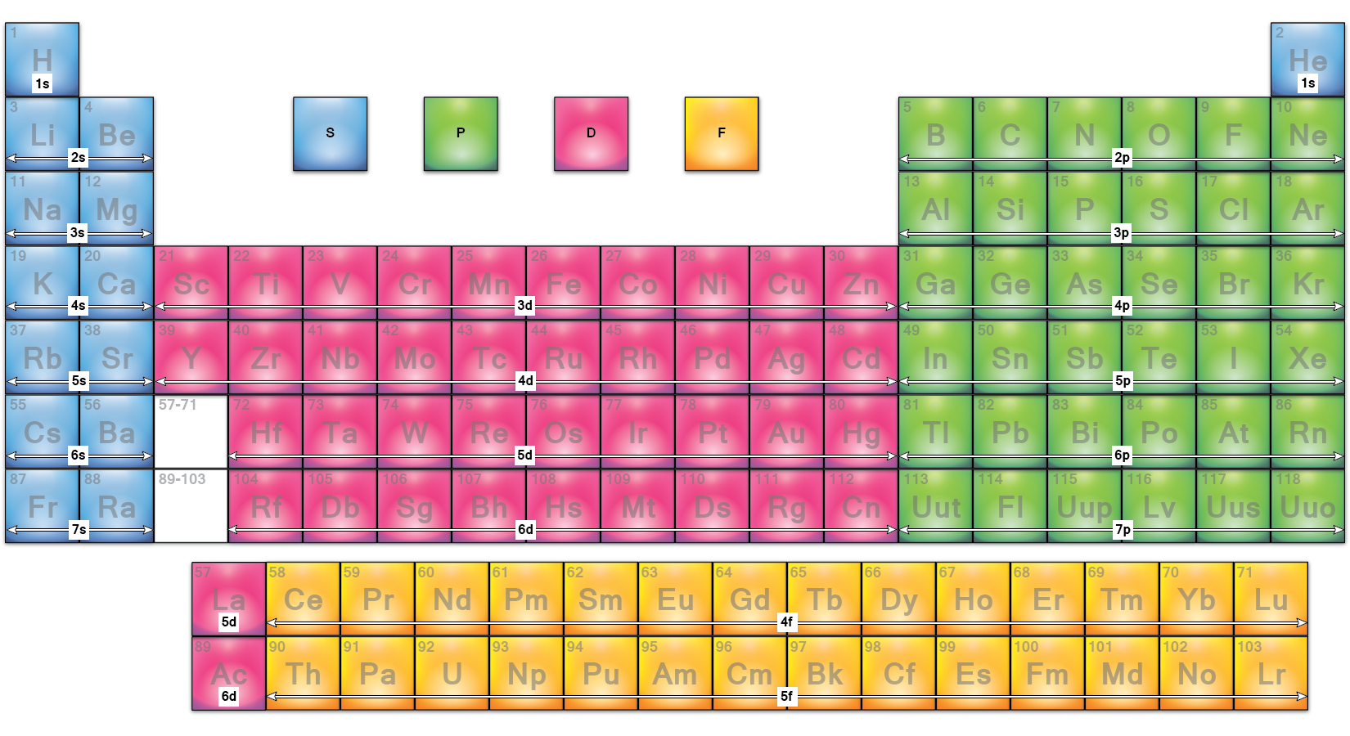

Slide 12
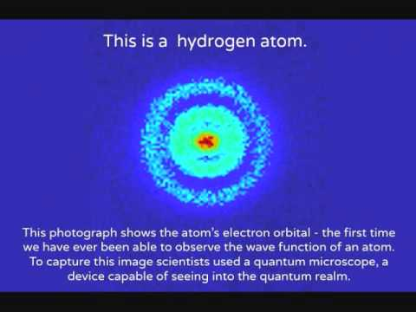

Slide 13
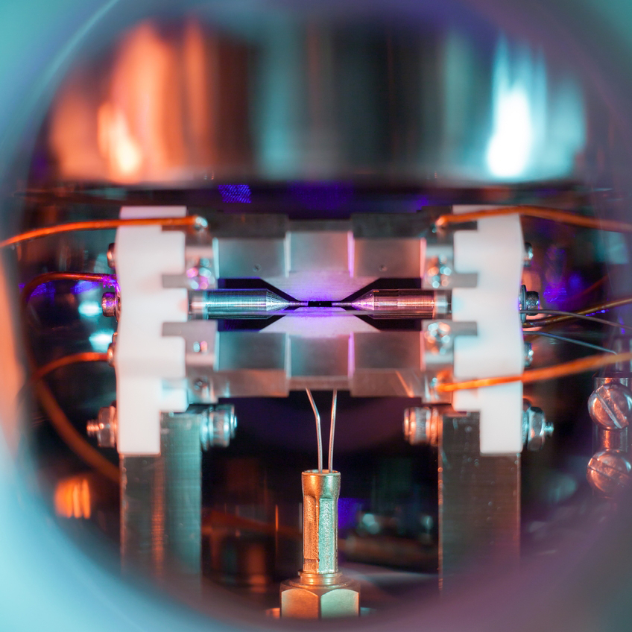
In the center of the picture, a small bright dot is visible – a single positively-charged strontium atom. It is held nearly motionless by electric fields emanating from the metal electrodes surrounding it. […] When illuminated by a laser of the right blue-violet color, the atom absorbs and re-emits light particles sufficiently quickly for an ordinary camera to capture it in a long exposure photograph.

Slide 14
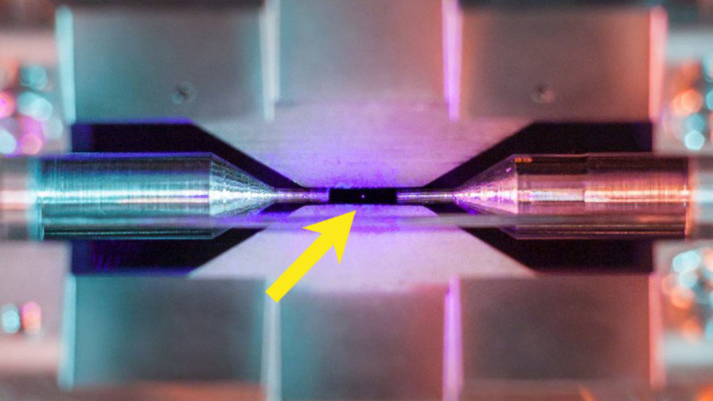

Slide 15
While Protons, Neutrons and Electrons make up most of the matter, there have been MANY more particle discovered. Some examples are:
Muon
Pion
Tau
Gluon
Higgs Boson
W boson
Z boson
Positron
Kaon
Λ⁰
Antiproton
Muon neutrino
Xi baryon
J/Ψ meson
Upsilon meson
There are many more than these and so modern particle physicists have had to create a new model explaining this organization of these particle. This model is called the “Standard Model”

