Slide 1
Feyman Diagrams

Slide 2
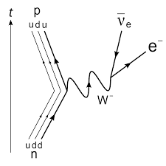
Beta Decay

Slide 3
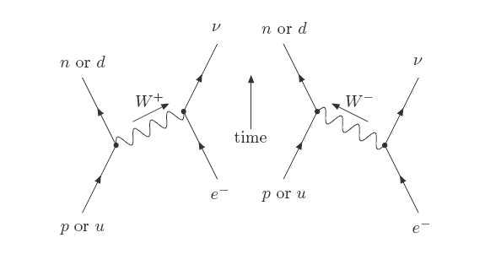
Electron Capture

Slide 4
Pair production: electron and positron created from photon

Slide 5
Annihilation: electron and positron collide and create photon

Slide 6
Emission: An electron is excited and emits a photon.

