Slide 1
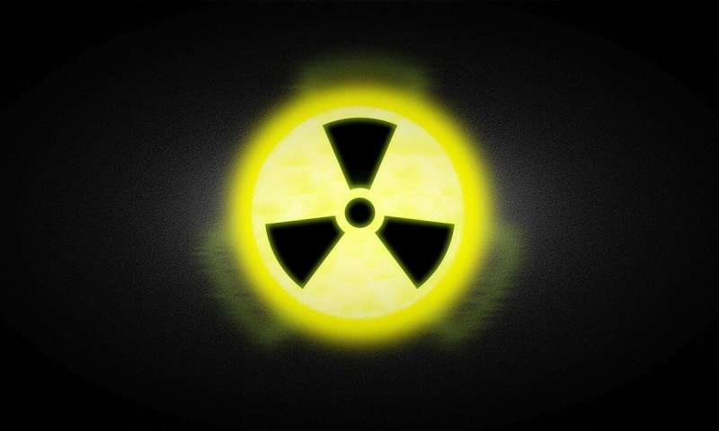
Radiation

Slide 2
There are 3 main types of nuclear radiation
Alpha
Beta
Gamma

Slide 3
Alpha: The unstable nucleus releases an alpha particle (α), which is 2 protons and 2 neutrons (⁴He nucleus)
Happens usually with very BIG nuclei
This process drops the atomic number down by 2
This process drops the atomic nucleon number (atomic mass) down by 4
$${}_{95}^{243}{Am}→{}_{93}^{239}{Np}+{}_{2}^{4}{He}$$
Parent
Isotope
Daughter Isotope
α Particle

Slide 4
2. Beta: Beta radiation involves electrons and positrons. Can be broken up into 3 types:
Beta minus (β-): Happens when there are too many neutrons in a nucleus the results in instability. A neutron converts into a proton by creating and releasing an electron.
This results in the increase of atomic number by +1
There is no change in atomic nucleon number.
$${}_{27}^{60}{Co}→{}_{28}^{60}{Ni}+{}_{−1}^{0}e$$
Parent
Isotope
Daughter Isotope
β- Particle (or just an electron)

Slide 5
Beta plus (β+): Happens when there are too many protons in the nucleus for stability. Here a proton turns into a neutron by emitting a positron (particle the size of an electron but positively charged. Also sometimes called an anti-electron because this is the antimatter pair to the electron)
This results in the decrease of atomic number by -1
There is no change in atomic nucleon number.
$${}_{19}^{40}K→{}_{18}^{40}{Ar}+{}_{+1}^{0}{\overline{e}}$$
Parent
Isotope
Daughter Isotope
β+ Particle (positron or an anti-electron)

Slide 6
Electron Capture: Similar to β+, there is an excess of protons for stability. Instead of emitting a positron, an electron from on of the lower energy states may be captured by the nucleus. This combines with a proton to become a neutron and releases energy.
Very Rare for this to happen. We see a lot more of β+ than we do EC.
This results in the decrease of atomic number by -1
There is no change in atomic nucleon number.
$${}_{4}^{7}{Be}+{}_{−1}^{0}e→{}_{3}^{7}{Li}$$
Parent
Isotope
Electron in
lower orbital
Daughter Isotope

Slide 7
3. Gamma Radiation
When an nucleus gains excess energy (usually from a collision with another particle) it becomes slightly unstable and needs to give off its extra energy. It does this by emitting a high energy photon, called a gamma ray.
This results in no change to the atomic number.
There is no change in atomic nucleon number.
$${}_{97}^{247}{{Bk}^{∗}}→{}_{97}^{247}{Bk}+{}_{0}^{0}γ$$
Parent
Isotope with energy
Daughter Isotope now stable
High energy photon

Slide 8
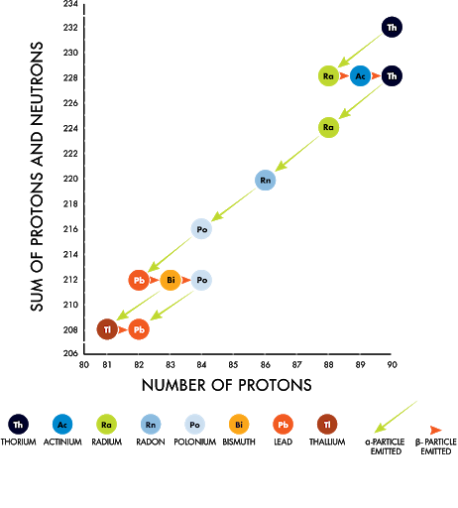
Decay Chains
After a nuclear reaction occurs, the daughter isotope might not also be stable and may go through its own decay process. A series of decays from one daughter isotope to the next is called a decay chain.

Slide 9
A closer look at the masses
Let’s analyze the alpha decay given before:
Using a table of isotope masses for a more precise look:
$${}_{95}^{243}{Am}→{}_{93}^{239}{Np}+{}_{2}^{4}{He}$$
Parent
Isotope
Daughter Isotope
α Particle
$$243.061373 u→239.052931 u+4.002603 u$$
Wait a second!!!!!
Note: For beta minus decay, we do not need to account for the mass of the electron, because that is incorporated into the mass of the daughter isotope
$$243.061373 u→243.055534 u$$

Slide 10
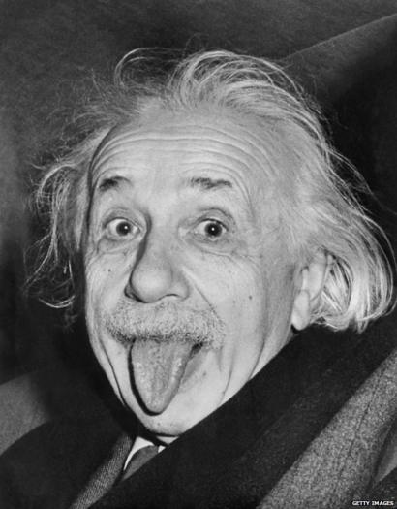
Mass Defect
There was some mass lost?! Where did it go?!
This is called the mass defect: Δm
Δm = 0.005839 u
This extra mass turns into energy:
1 u turns into 931.5 MeV
→ 5.439 MeV = 8.71E-19 J
$$E=mc^{2}$$
1 eV (electron volt) is the energy an electron gets by passing through 1 Volt:
1 eV = 1.602E-19 Joules

Slide 11
This energy from the mass defect normally goes into KE for the Daughter Isotope and the decay particle
Assuming parent isotope was motionless at first, we can find the velocity of the alpha particle using conservation of energy and momentum:

