Slide 1




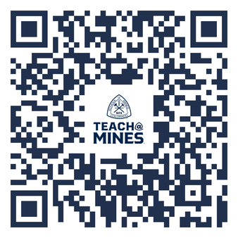





ENGINEERS MAKE BRIDGES
ARTISTS MAKE PAINTINGS
SCIENTISTS MAKE ROCKETS
TEACHERS MAKE
THEM ALL
TEACHING PATHWAYS
LEARN MORE
DIP YOUR TOE IN THE WATER
Try the K-12 Field Experience
class with just 1 credit hour!
Add SCED 262 to your schedule!
THREE WAYS TO DOUBLE YOUR CAREER OPTIONS
MINOR IN TEACHING:
Earn your teaching license alongside ANY major
CHECK OUT OUR SITE
Find everything you need to know and reach out to our program advisors!
MAJOR IN TEACHING:
BS in Design Engineering with a STEM Teaching
focus
DID YOU KNOW?
Mid-career teacher salaries typically range between $68,000 and $114,000!
ADD A MASTERS:
BS + MS in STEM Education
= BS, MS, & Licensure
Notes:
2

