Slide 1
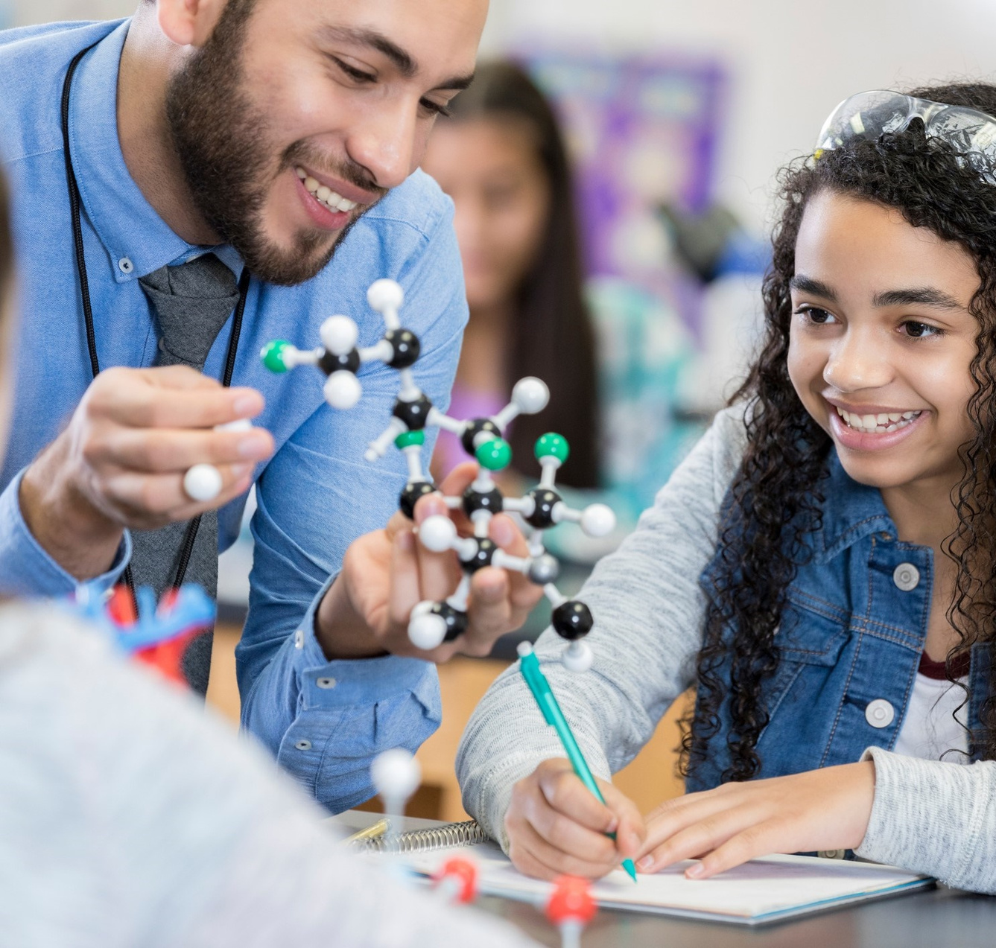



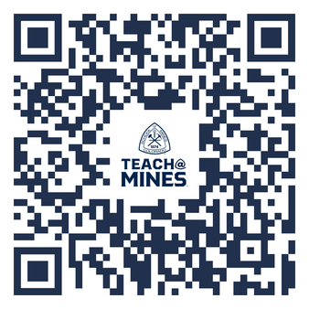





ENGINEERS MAKE BRIDGES
ARTISTS MAKE PAINTINGS
SCIENTISTS MAKE ROCKETS
TEACHERS MAKE
THEM ALL
TEACHING PATHWAYS
LEARN MORE
DIP YOUR TOE IN THE WATER
Try the K-12 Field Experience
class with just 1 credit hour!
Add SCED 262 to your schedule!
THREE WAYS TO DOUBLE YOUR CAREER OPTIONS
MINOR IN TEACHING:
Earn your teaching license alongside ANY major
CHECK OUT OUR SITE
Find everything you need to know and reach out to our program advisors!
MAJOR IN TEACHING:
BS in Design Engineering with a STEM Teaching
focus
DID YOU KNOW?
CHECK OUT OUR SITE
Find everything you need to know and reach out to our program advisors!
Behind every advance in medicine or technology is a teacher who left a lasting impression.
ADD A MASTERS:
BS + MS in STEM Education
= BS, MS, & Licensure
Notes:
2

