Slide 1
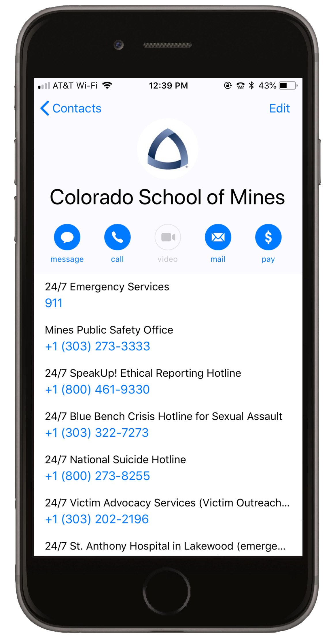
Saving emergency contacts to your smartphone

Slide 2
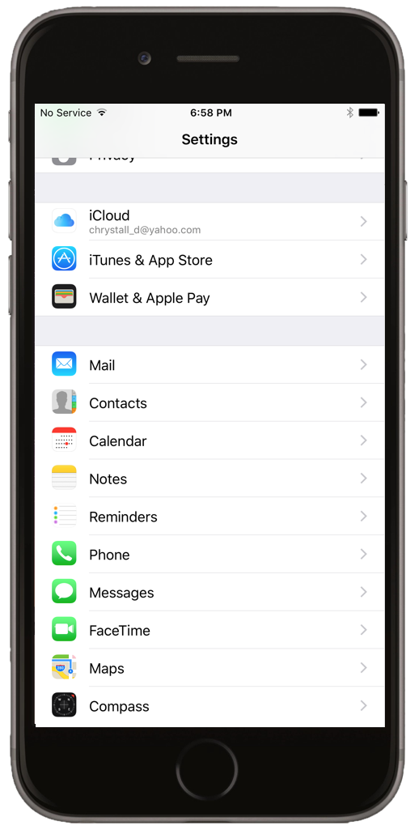
On iPhones only: make sure your default contact account is set to iCloud, not Exchange.
Go to Settings and select Contacts

Slide 3
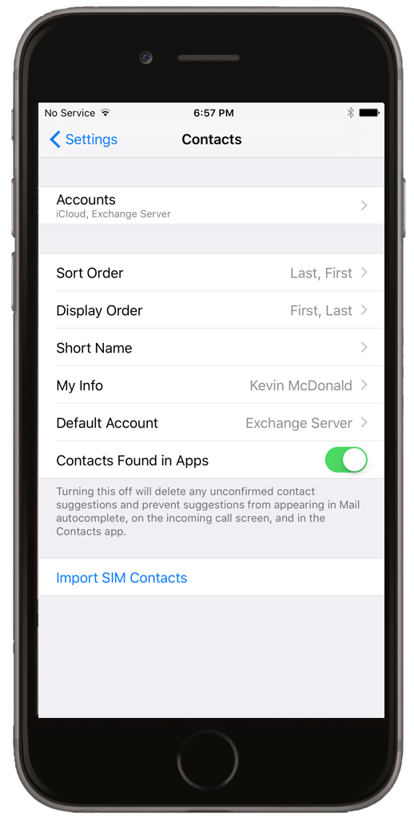
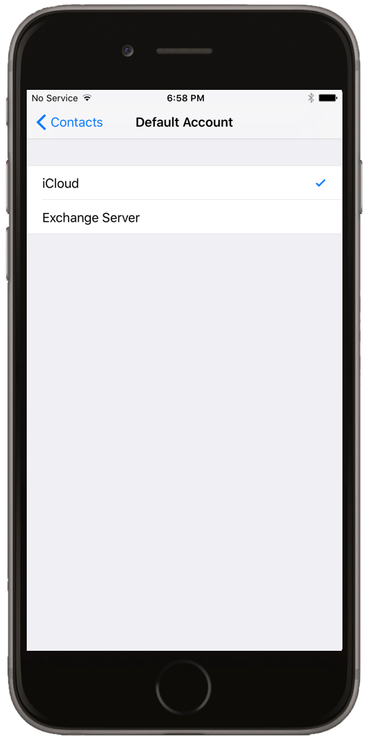
Go into Default Account
Select iCloud as your default account, NOT Exchange

Slide 4
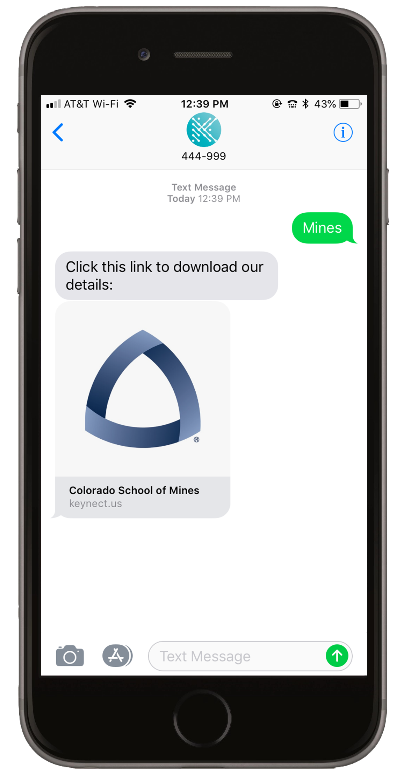
Downloading the emergency card
Start a text to phone number 444-999
For the message, type Mines
No spaces – don’t let autocorrect interfere
Tap the link that is texted to you
Fill out required info in your internet browser

Slide 5
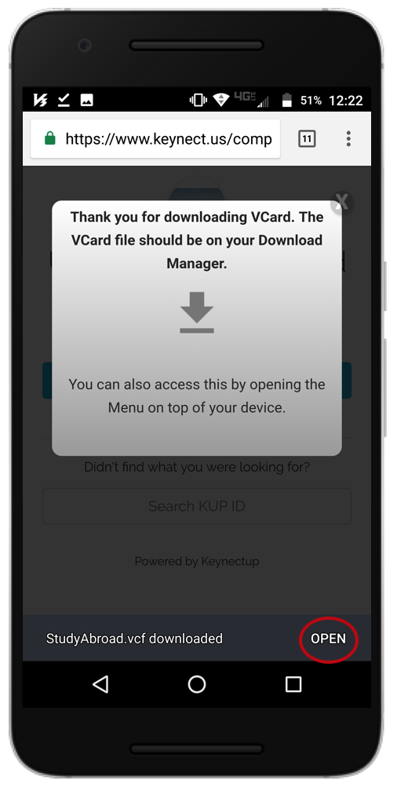
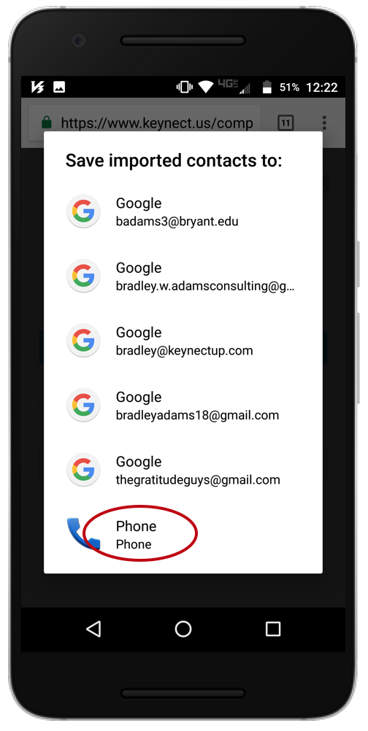
5. Click “Download card,” then “Open in Contacts” on iPhones; on Androids, download the card and press “Open” on the bottom right
6. On Androids, store the card in the “Phone” option

Slide 6
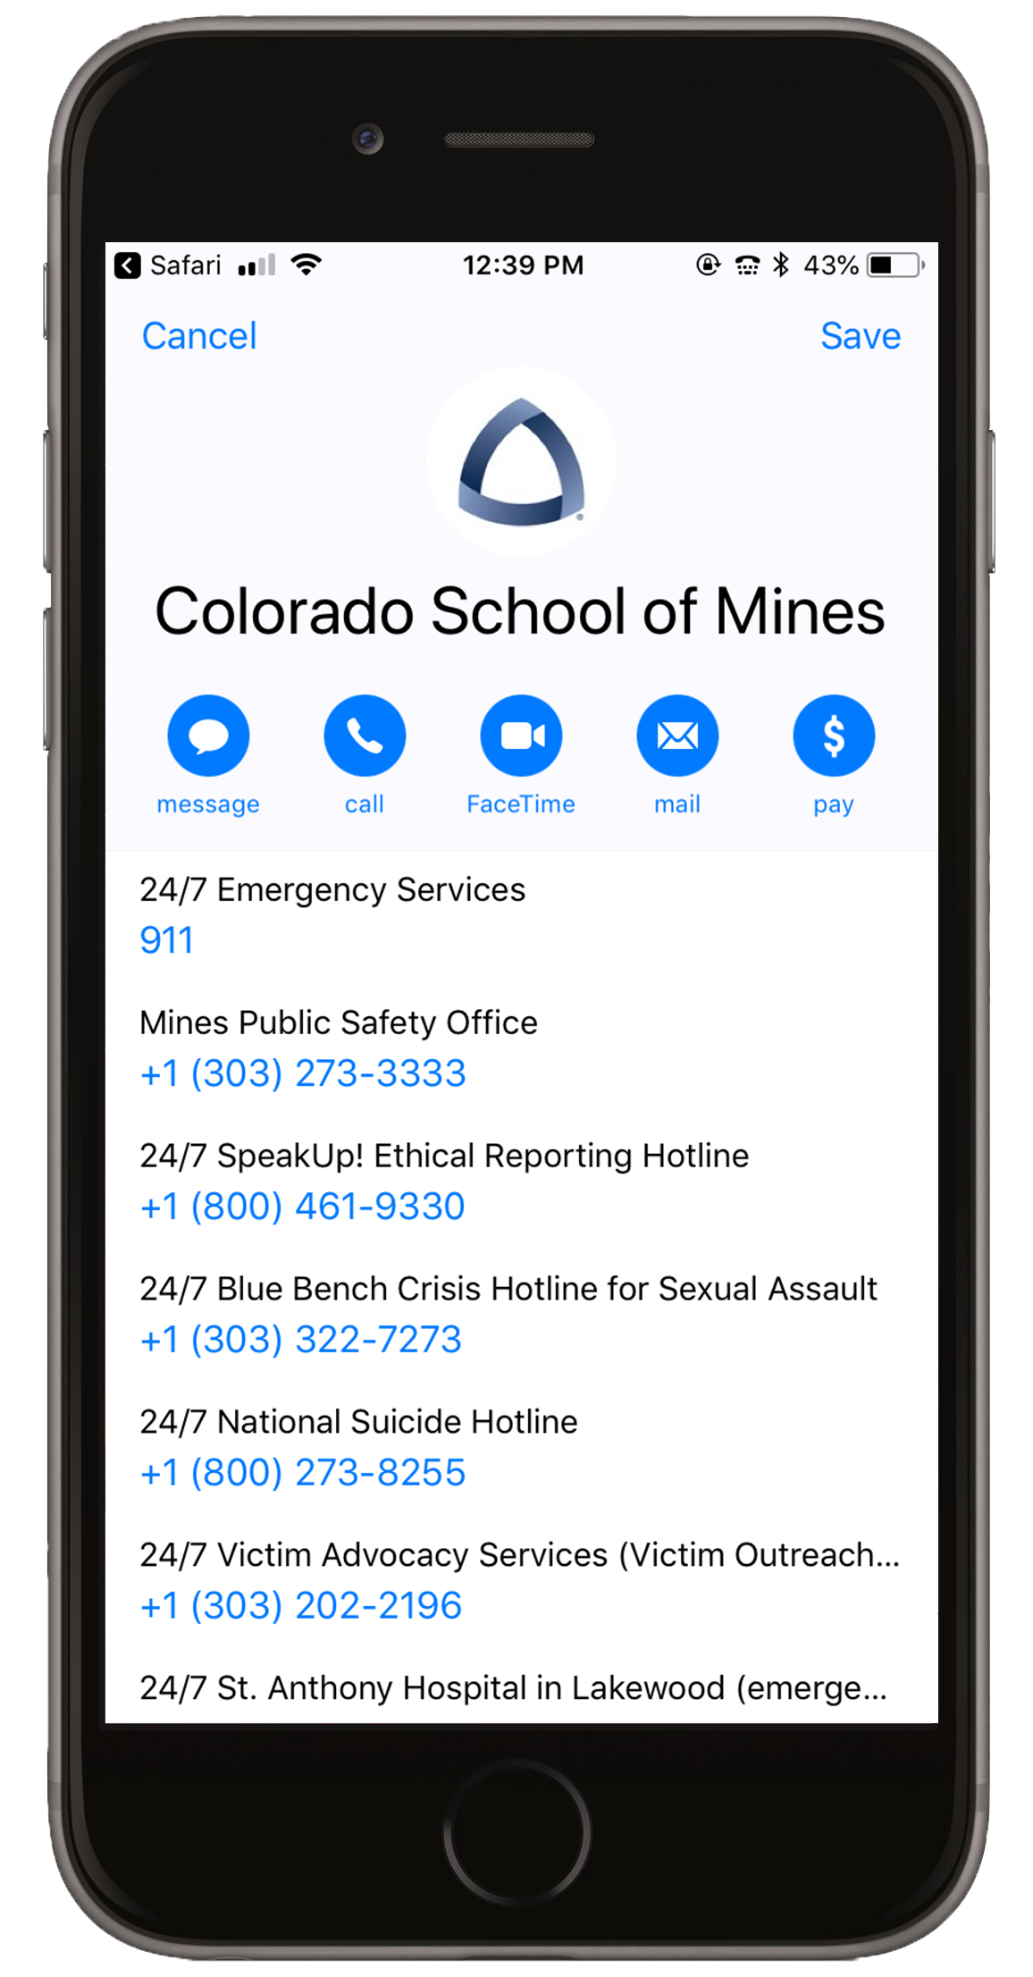
7. On iPhones, make sure you hit Save to store the contact
8. The contact should now be searchable on both types of phones

Slide 7
Now, all contacts are searchable and easy to dial.
Find the contacts now by searching on your phone “School,” “Mines,” or “Title IX”

Slide 8
Can’t download? Let’s Troubleshoot
No response from the phone number 444-999?
Instead, text our longer phone number with the same message: (505) 544-4999
Can’t “Open in ‘Contacts’”? (iPhones only)
You’ve likely deleted the iPhone’s native Contacts app. You must re-download it from the App Store to save the emergency card
Can’t locate the emergency card after saving to the contacts?
Make sure your default contacts account isn’t set to a Microsoft account
Any other issues?
Email ali@keynectup.com

